Slide 1
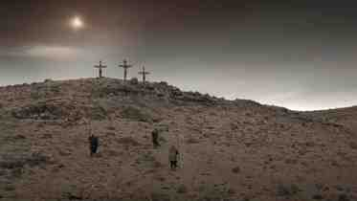
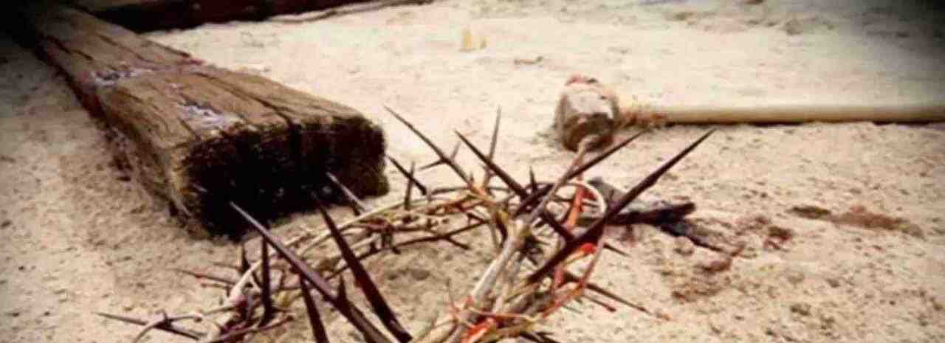
The Crucifixion
Mark 15:20-39

Slide 2
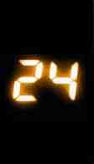
Hours…
That Changed the World
1 Cor 1:23-24 we preach Christ crucified, to the Jews a stumbling block and to the Greeks foolishness..
24 but to those who are called, both Jews and Greeks, Christ the power of God and the wisdom of God.

Slide 3
Jesus’ six trials..
Three Jewish trials…
Inquiry at Annas’ house .. John 18:13-23 2 AM
Illegal trial at Caiaphas’.. Mark 14:53-57 3 AM
Official verdict of council.. Mark 15:1 6 AM
Three Gentile trials…
Interrogation by Pilate .. Mark 15:2-5 6:30 AM
Sent to Herod Antipas .. Luke 23:8-12 7 AM
Final judgment by Pilate .. Mark 15:9-15 7:30 AM

Slide 4
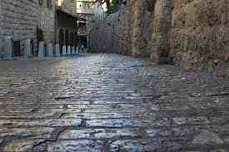
8:00 AM.. Condemned
Mark 15:15-20 Pilate… delivered Jesus, after he had scourged Him, to be crucified.
16 the soldiers led Him away.. clothed Him with purple.. twisted a crown of thorns, put it on His head began to salute Him, "Hail, King of the Jews!"
19 they struck Him on the head with a reed and spat on Him, bowing the knee, they worshiped Him… when they had mocked Him, they took the purple off Him, put His own clothes on Him, and led Him out to crucify Him.

Slide 5
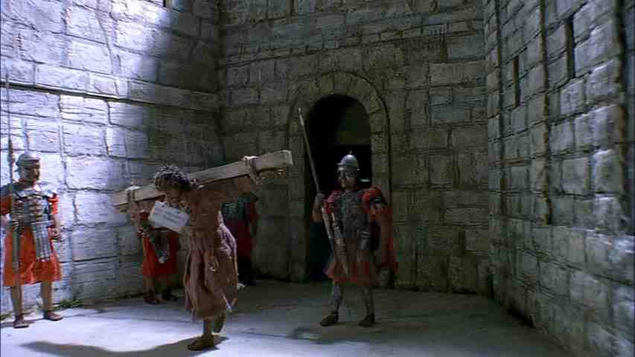
8 - 9 AM.. Bearing the cross
Mark 15:21-23 Then they compelled a certain man, Simon a Cyrenian, the father of Alexander and Rufus, as he was coming out of the country and passing by, to bear His cross. 22 And they brought Him to the place Golgotha, which is translated, Place of a Skull. 23 Then they gave Him wine mingled with myrrh to drink, but He did not take it.

Slide 6
8 - 9 AM.. Bearing the cross
Mark 15:21-23 Then they compelled a certain man, Simon a Cyrenian, the father of Alexander and Rufus, as he was coming out of the country and passing by, to bear His cross.
22 And they brought Him to the place Golgotha, which is translated, Place of a Skull. 23 Then they gave Him wine mingled with myrrh to drink, but He did not take it.

Slide 7
9 AM – 3 PM.. Torture
Mark 15:24-25 And when they crucified Him, they divided His garments, casting lots for them to determine what every man should take. 25 Now it was the third hour, and they crucified Him.

Slide 8
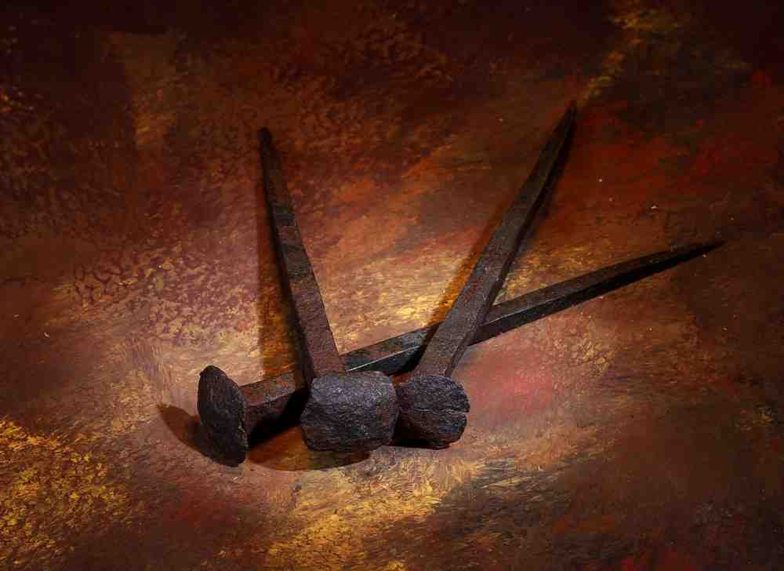
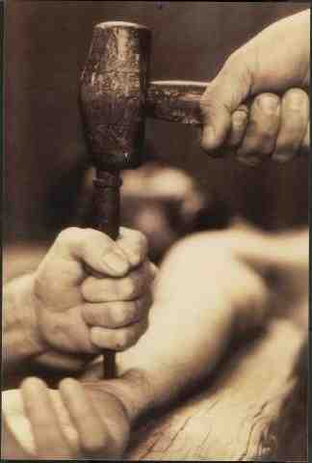
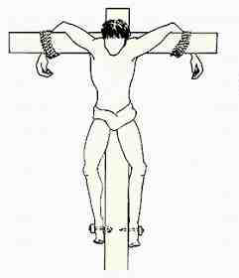
9 AM – 3 PM.. Torture
Mark 15:24-25 And when they crucified Him, they divided His garments, casting lots for them to determine what every man should take. 25 Now it was the third hour, and they crucified Him.

Slide 9
9 AM – 3 PM.. Torture
Mark 15:24-25 And when they crucified Him, they divided His garments, casting lots for them to determine what every man should take. 25 Now it was the third hour, and they crucified Him.

Slide 10
9:00–12:00.. Torture
Isaiah 50:6 I gave My back to those who struck Me, And My cheeks to those who plucked out the beard; I did not hide My face from shame and spitting.
Isaiah 52:14 Just as many were astonished at you, so His visage was marred more than any man, And His form more than the sons of men;

Slide 11
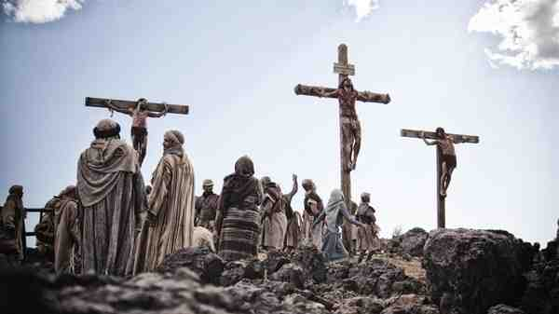
9:00–12:00.. Mockery
Mark 15:26-32 With Him they also crucified two robbers, one on His right and the other on His left. 28 So the Scripture was fulfilled which says, "And He was numbered with the transgressors." 29 And those who passed by blasphemed Him, wagging their heads and saying, "Aha! You who destroy the temple and build it in three days, 30 save Yourself, and come down from the cross!"
31 Likewise the chief priests also, mocking among themselves with the scribes, said, "He saved others; Himself He cannot save. 32 Let the Christ, the King of Israel, descend now from the cross, that we may see and believe." Even those who were crucified with Him reviled Him.

Slide 12
12 – 3 PM.. Darkness
Mark 15:33-36 Now when the sixth hour had come, there was darkness over the whole land until the ninth hour. 34 And at the ninth hour Jesus cried out with a loud voice, saying, "Eloi, Eloi, lama sabachthani?" which is translated, "My God, My God, why have You forsaken Me?"
35 Some of those who stood by, when they heard that, said, "Look, He is calling for Elijah!" 36 Then someone ran and filled a sponge full of sour wine, put it on a reed, and offered it to Him to drink, saying, "Let Him alone; let us see if Elijah will come to take Him down."

Slide 13
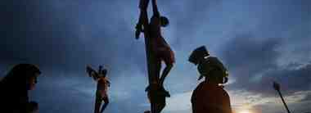
3 PM.. Victory
Mark 15:37-39 And Jesus cried out with a loud voice, and breathed His last. 38 Then the veil of the temple was torn in two from top to bottom. 39 So when the centurion, who stood opposite Him, saw that He cried out like this and breathed His last, he said, "Truly this Man was the Son of God!"

Slide 14
The Crucifixion
Mark 15:20-39

