Slide 1
G L O R Y
Ezekiel 1

Slide 2
30th birthday…

Slide 3
Ezekiel 1:1
Now it came to pass in the thirtieth year, in the fourth month, on the fifth day of the month, as I was among the captives by the River Chebar, that the heavens were opened and I saw visions of God.

Slide 4
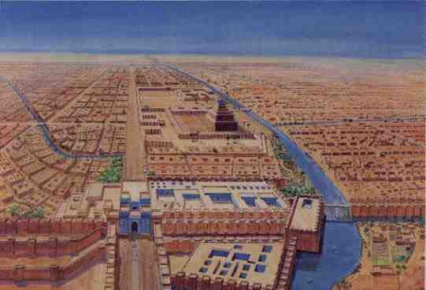
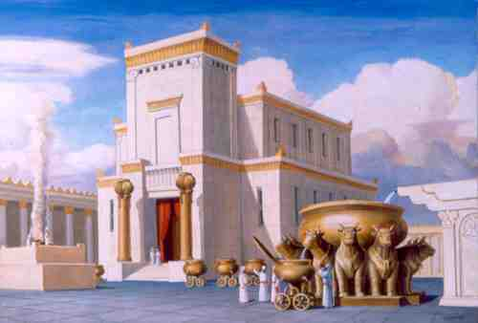
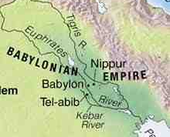
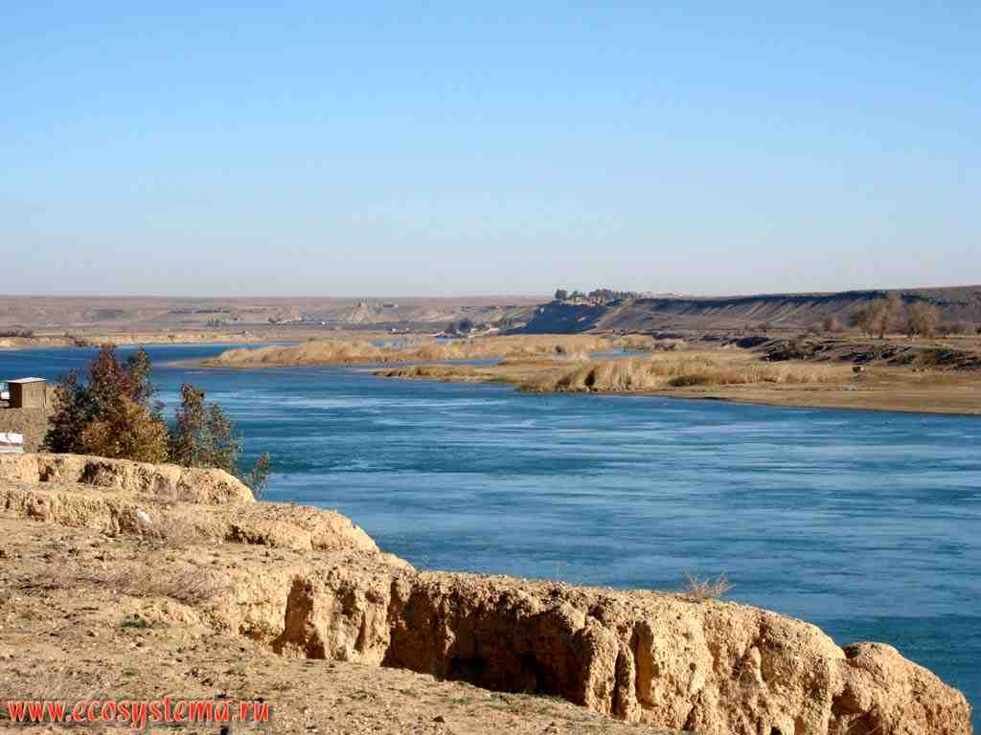
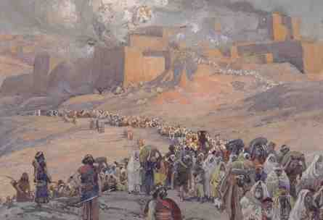
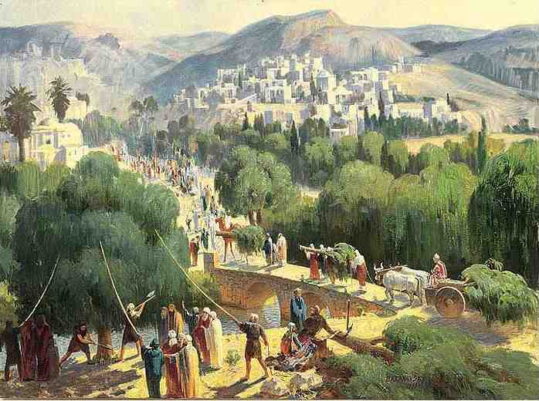
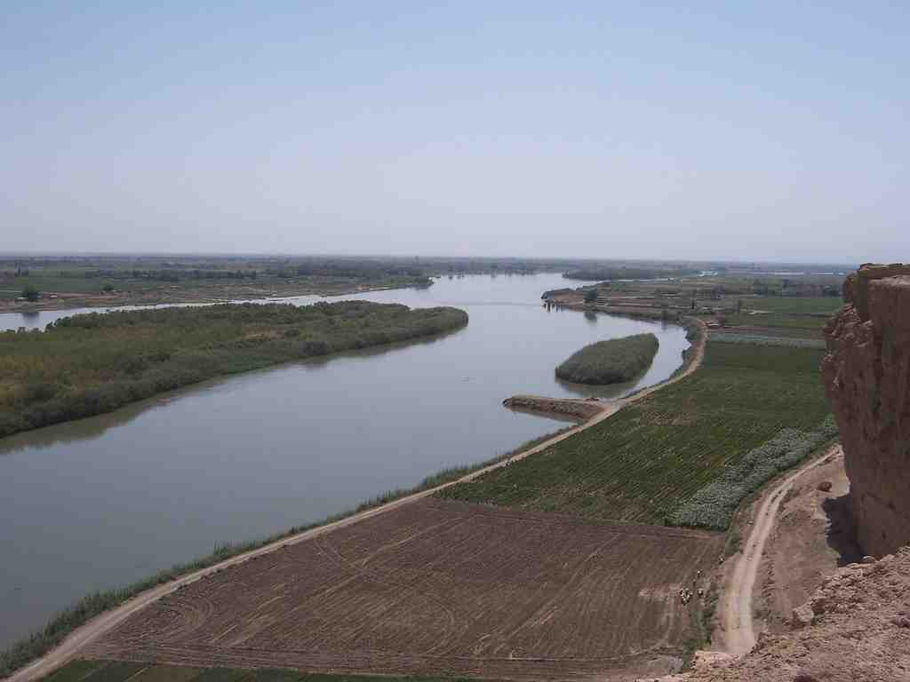
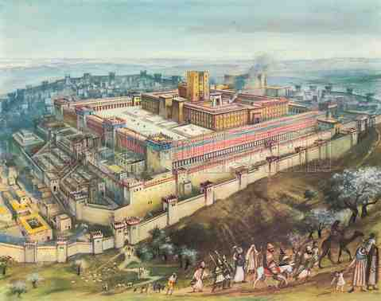
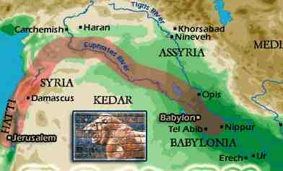
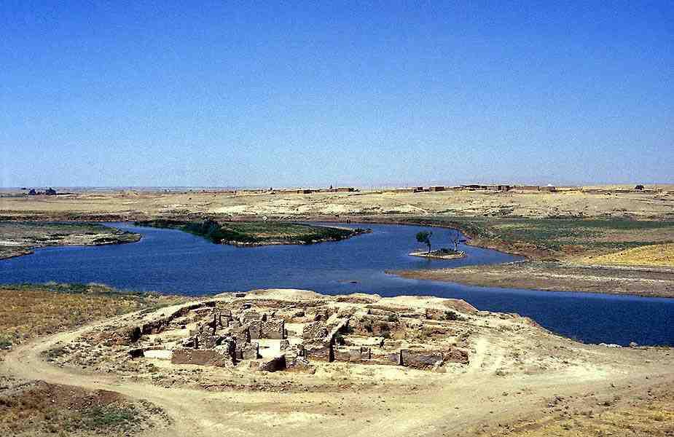
Ezekiel taken captive to Babylon at age 25..

Slide 5
Priests began their duties at age 30..

Slide 6
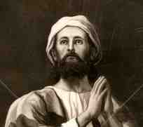
“What is God doing in my life?”

Slide 7
Ezekiel 1:4
I saw coming out of the north, an immense cloud with flashing lightning and surrounded by brilliant light.

Slide 8
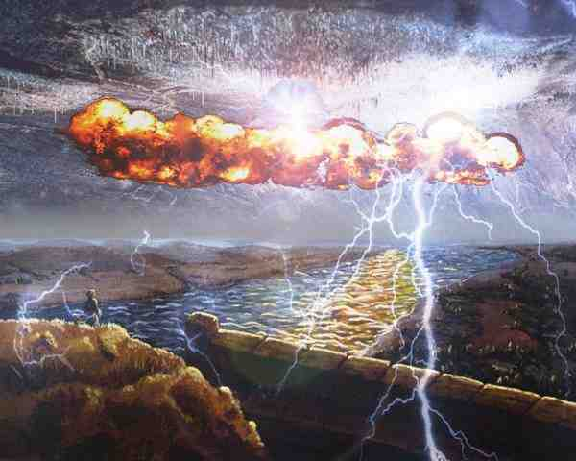
The glory appears..

Slide 9
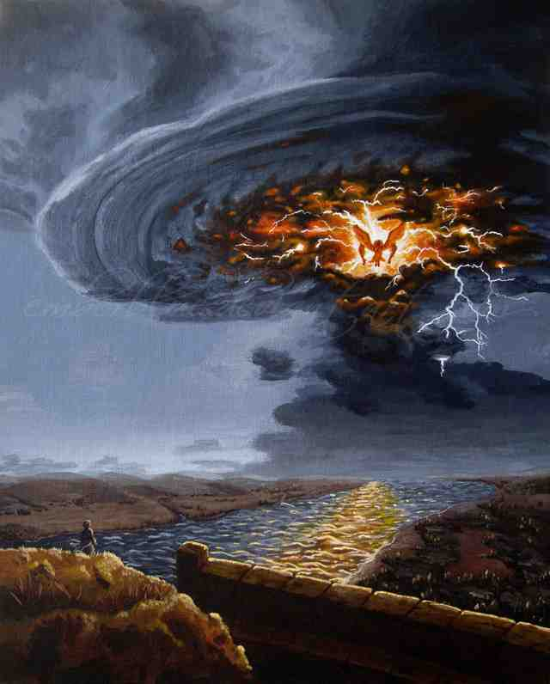
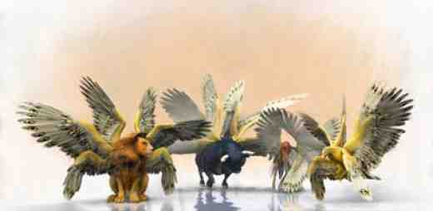
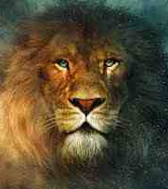
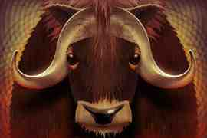
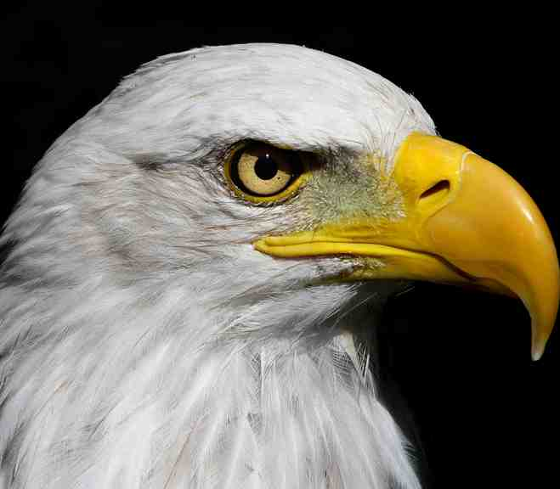
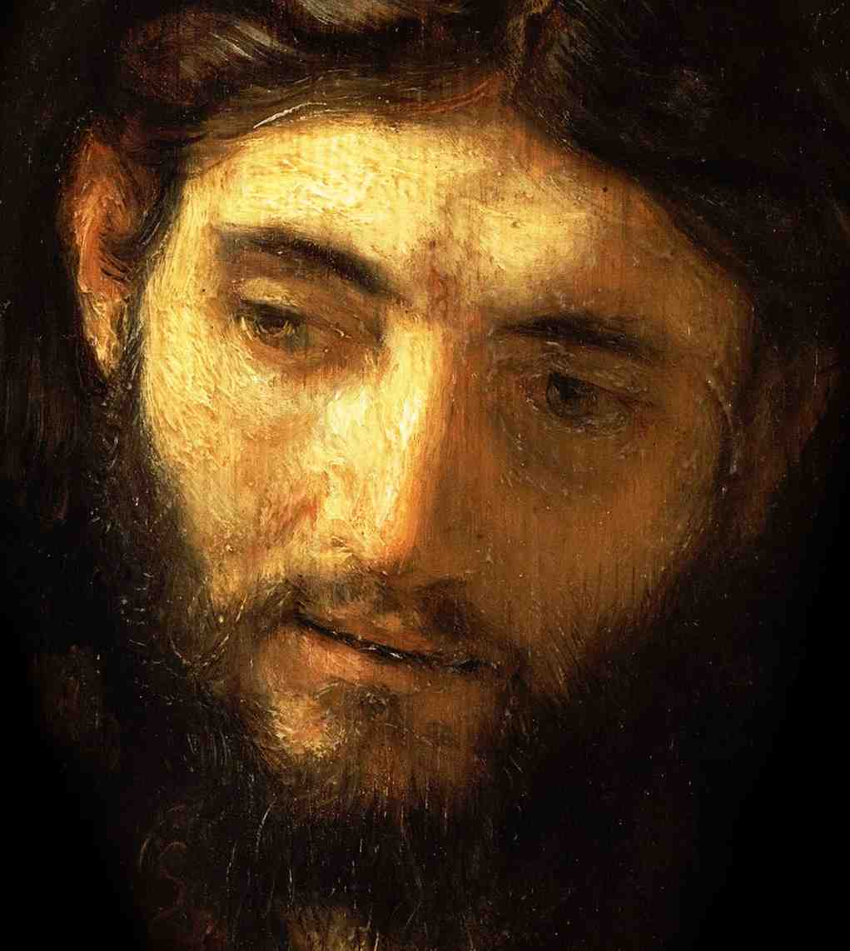

Slide 10
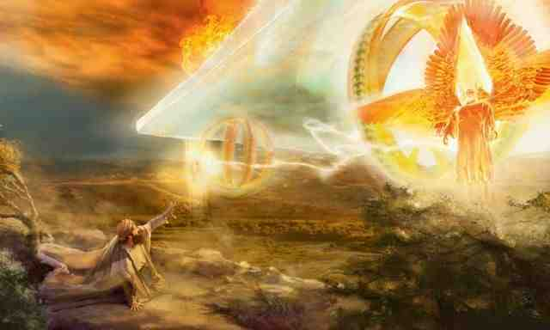
1:28 “This was the appearance of the likeness of the glory of the Lord. When I saw it, I fell facedown”..

Slide 11
Ezekiel 8:1
And it came to pass in the sixth year, in the sixth month, on the fifth day of the month, as I sat in my house with the elders of Judah sitting before me, that the hand of the Lord God fell upon me there.

Slide 12
Ezekiel 8:2-4
... and the Spirit lifted me up between earth and heaven, and brought me in visions of God to Jerusalem, to the door of the north gate of the inner court, where the seat of the image of jealousy was, which provokes to jealousy. 4 And behold, the glory of the God of Israel was there, like the vision that I saw in the plain.

Slide 13
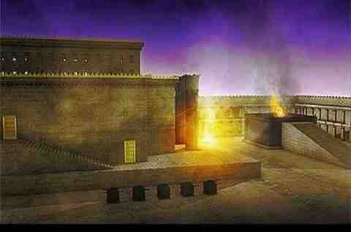
Ezekiel 10:4 Then the glory of the Lord went up from the cherub, and paused over the threshold of the temple; and the house was filled with the cloud, and the court was full of the brightness of the Lord's glory.

Slide 14
Ezekiel 10:18 Then the glory of the Lord departed from the threshold of the temple and stood over the cherubim.

Slide 15
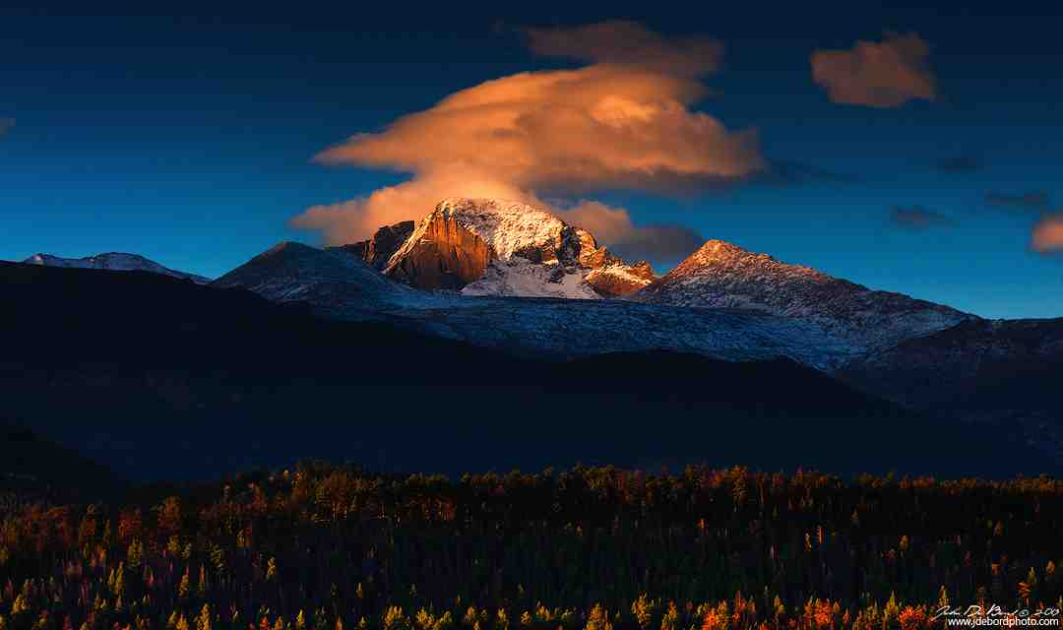
11:22-23 So the cherubim lifted up their wings, with the wheels.. 23 And the glory of the Lord went up from the midst of the city and stood on the mountain, which is on the east side of the city...

Slide 16
11:16-20 'Thus says the Lord God: "Although I have cast them far off among the Gentiles, and although I have scattered them among the countries, yet I shall be a little sanctuary for them in the countries where they have gone."'

Slide 17
19 Then I will give them one heart, and I will put a new spirit within them, and take the stony heart out of their flesh, and give them a heart of flesh, 20 that they may walk in My statutes and keep My judgments and do them; and they shall be My people, and I will be their God.

Slide 18
Ezekiel 40:1-2
In the twenty-fifth year of our captivity, at the beginning of the year, on the tenth day of the month, in the fourteenth year after the city was captured, on the very same day the hand of the Lord was upon me; and He took me there. 2 In the visions of God He took me into the land of Israel and set me on a very high mountain…

Slide 19
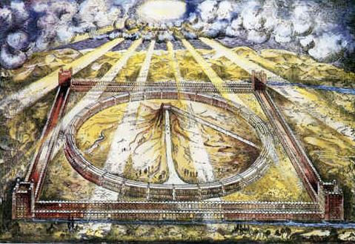
2 In the visions of God He took me into the land of Israel and set me on a very high mountain; on it toward the south was something like the structure of a city.

Slide 20
Ezekiel 43:2-5
2 the glory of the God of Israel came from the way of the east… and the earth shone with His glory. 3 It was like the appearance of the vision which I saw — like the vision which I saw when I came to destroy the city. The visions were like the vision which I saw by the River Chebar; and I fell on my face.

Slide 21
Ezekiel 43:2-5
4 And the glory of the Lord came into the temple by way of the gate which faces toward the east. 5 The Spirit lifted me up and brought me into the inner court; and behold, the glory of the Lord filled the temple.

Slide 22
“What is God doing in my life?”
There is nowhere God cannot go…
There is nothing He cannot see..
God has a work for you where you are..
God will never abandon His people..

Slide 23
God’s glory and blessing are not limited..
It is better to be in Babylon with the presence of God than Jerusalem w/o it..

Slide 24
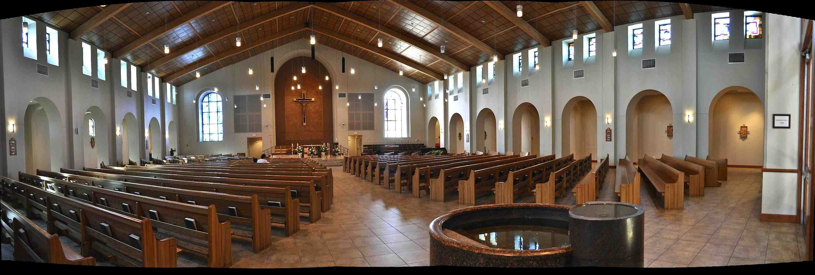
When the church becomes a corpse..
A church without Christ’s presence is like the temple without God’s glory..

Slide 25
G L O R Y
Ezekiel 1

