Slide 1
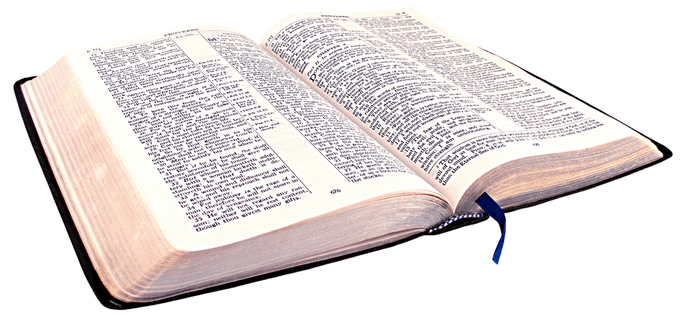
Grounded in Truth
Colossians 2:1-8

Slide 2
Many say they love God, but do they love truth? …

Slide 3
God’s Word
Eternal.. Unchanging

Slide 4
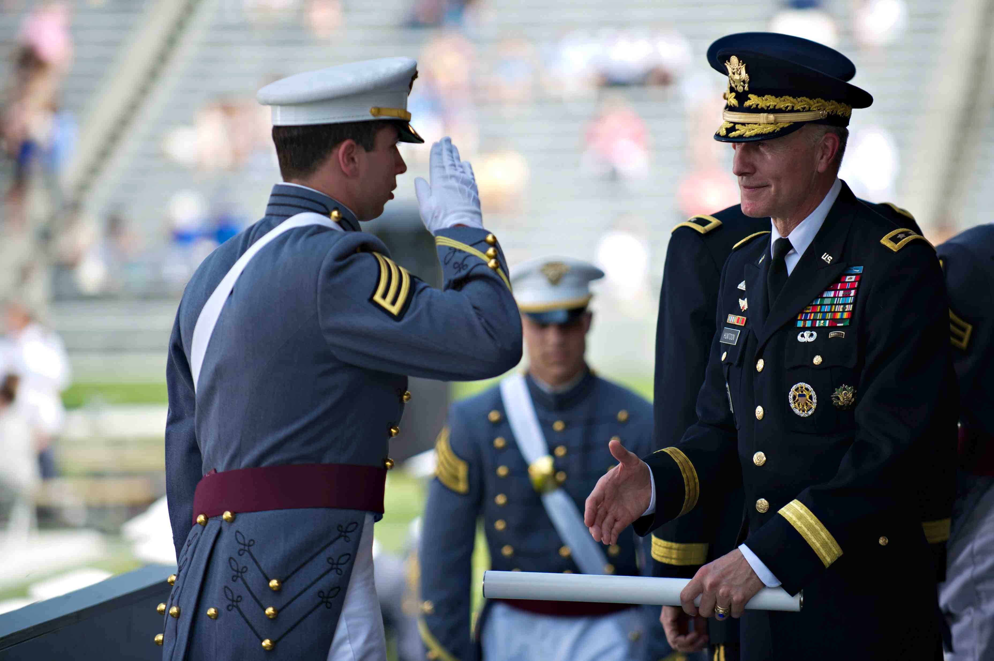
U.S. Military Academy

Slide 5
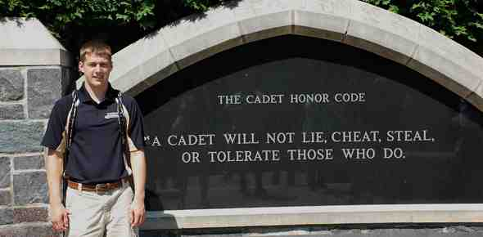
Honor Code…

Slide 6
Colossians 2:6-8
6 As you therefore have received Christ Jesus the Lord, so walk in Him, 7 rooted and built up in Him and established in the faith, as you have been taught, abounding in it with thanksgiving.
8 Beware lest anyone cheat you through philosophy and empty deceit, according to the tradition of men, according to the basic principles of the world, and not according to Christ.

Slide 7
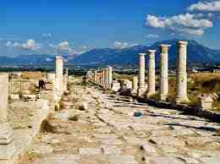
Colossae…

Slide 8
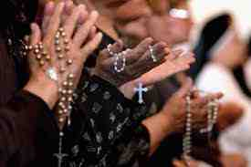
True or False?
Traditions … beliefs passed down
True traditions… 2 Thess 2:15
False traditions… Col. 2:8
Disbelief .. Rejection of truth
Misbelief .. Acceptance of error

Slide 9
Forms of error..
Another gospel Gal 1:6-9
Satan’s lies John 8:44
Half-truths.. Abraham & Sarah
False prophets Jeremiah 23:16
Lying to ourselves Jeremiah 17:9-10
Proverbs 14:12 seems right?

Slide 10
The source of truth..
Acts 17:11 These were more fair-minded than those in Thessalonica, in that they received the word with all readiness, and searched the Scriptures daily to find out whether these things were so.

Slide 11
Many are deceived..
Matthew 7:21-23 I never knew you..
John 14:6 I am the way, truth, life..
Acts 4:12 No other name of salvation
Psalm 103:15-16 Life is brief..

Slide 12
Grounded in Truth
Colossians 2:1-8

