Slide 1
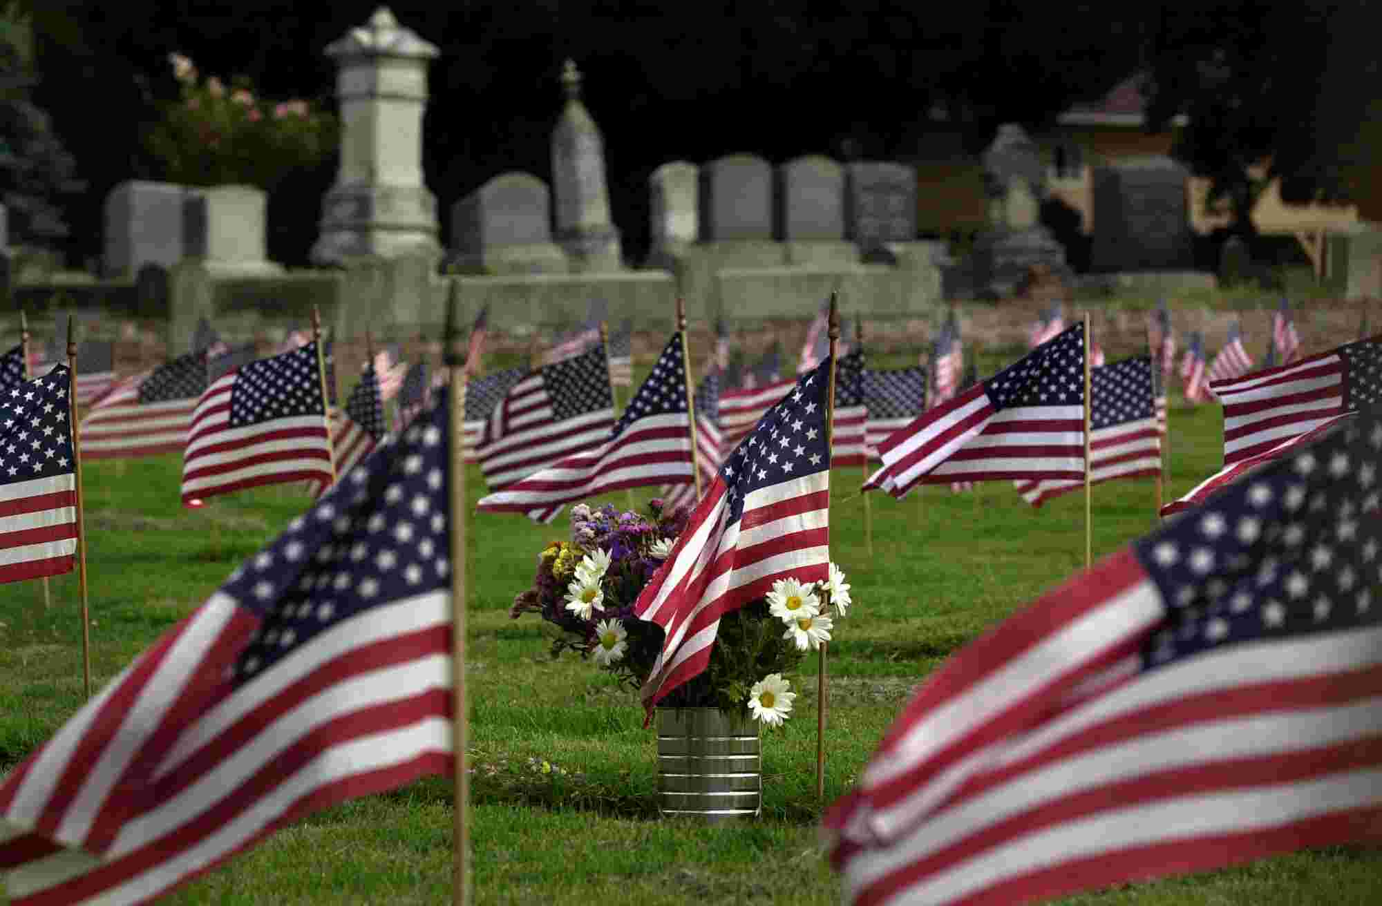
Honoring Our Heroes
Hebrews 12:1-2

Slide 2
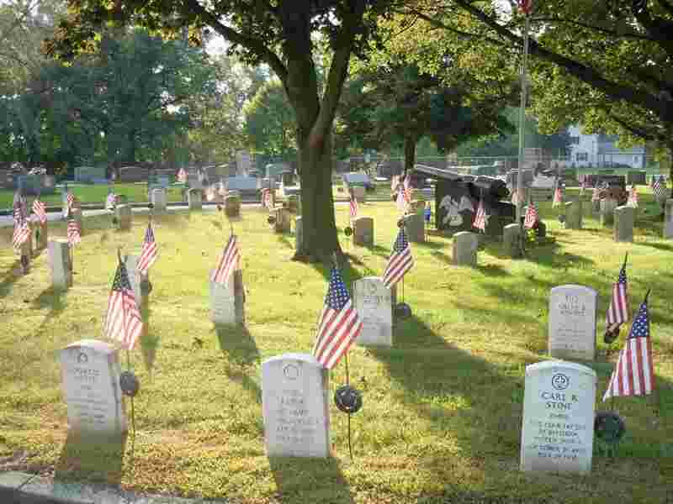
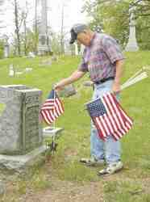
Ohio man honors veterans..
Wayne Van Doren .. Sandusky, Ohio

Slide 3
Why we show honor..
Psalms 33:12 Blessed is the nation whose God is the Lord..
Proverbs 10:7 The memory of the righteous is blessed..
Romans 13:7 Render therefore to all their due... honor to whom honor.

Slide 4
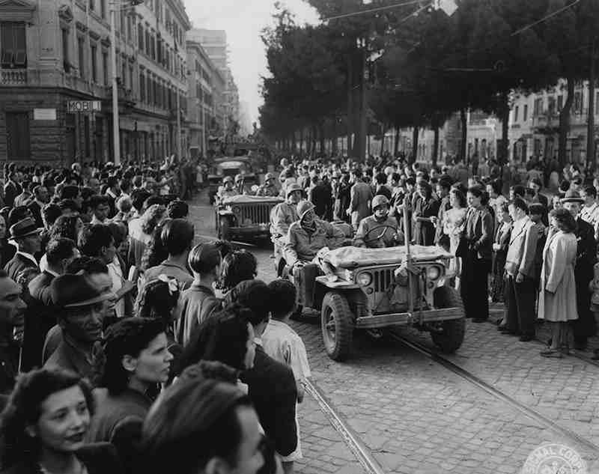
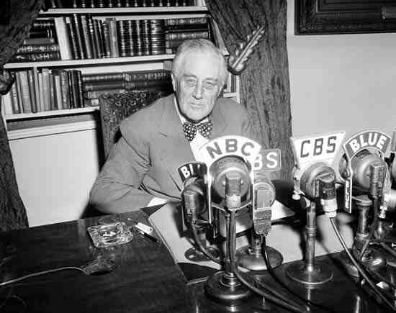
Do younger people appreciate freedom?..
June 5, 1944 Allied troops enter Rome..

Slide 5
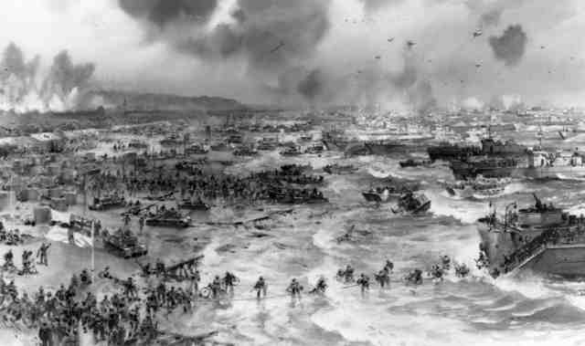
June 6, 1944..
Normandy invasion.. 125,000 Allied troops land… 2500 killed, 8,500 wounded

Slide 6
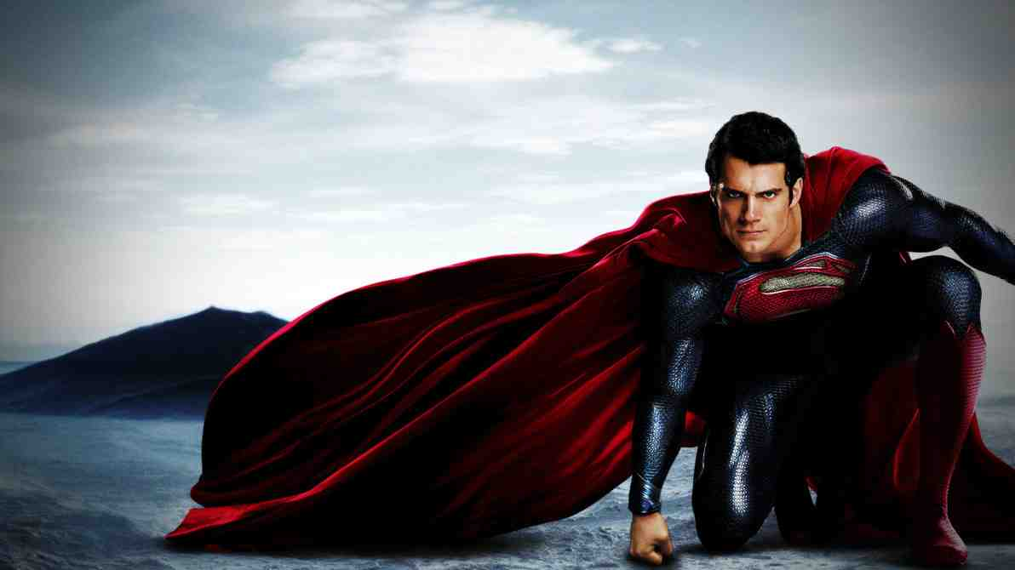
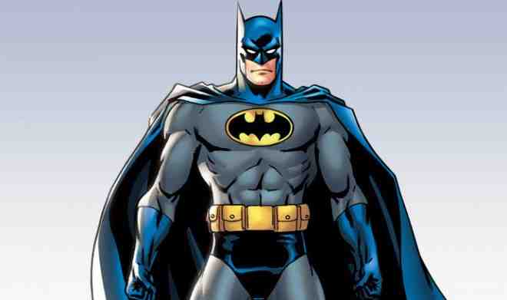
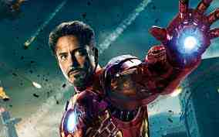
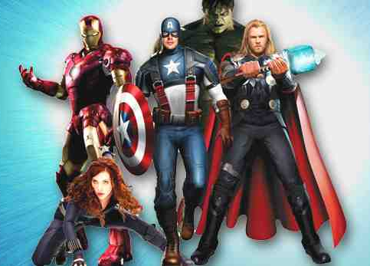
Who are our heroes?..

Slide 7
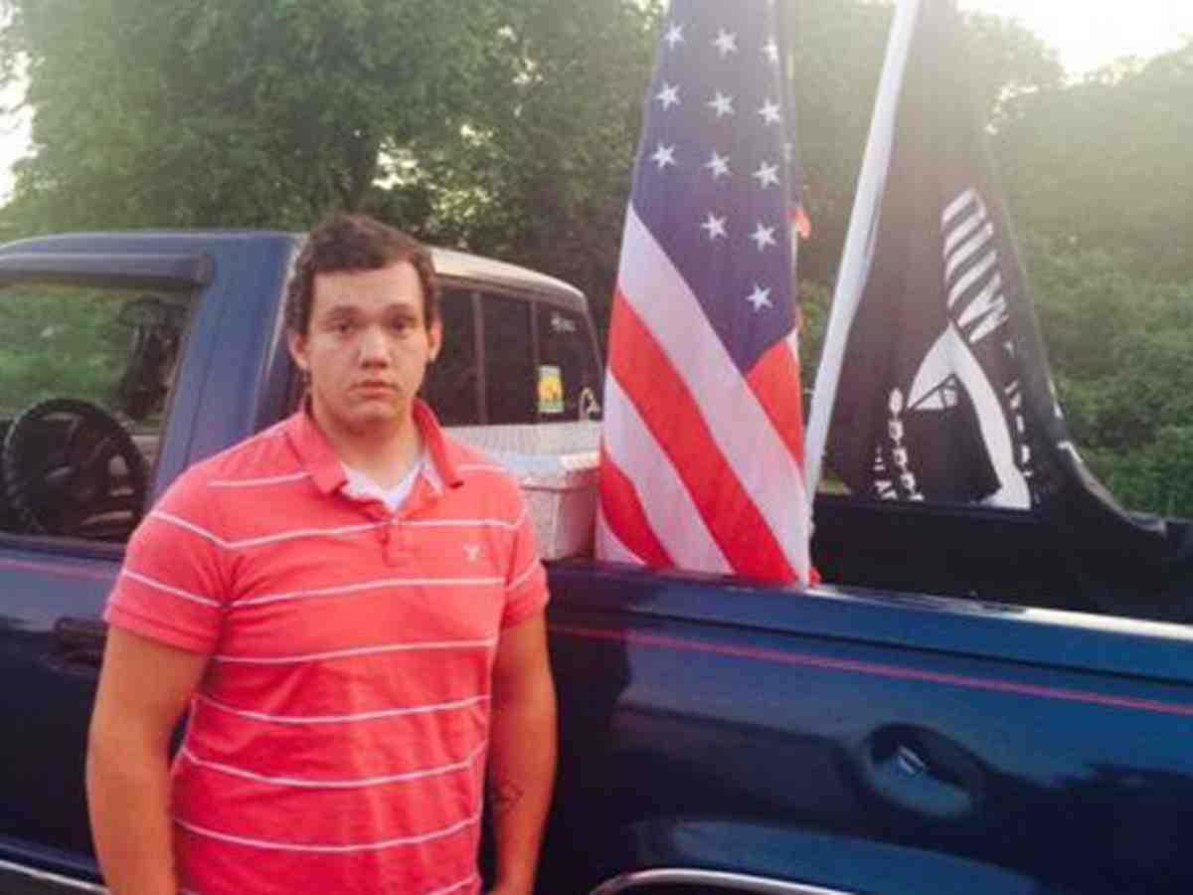
York, SC student..
Peyton Robinson with flag in truck..

Slide 8
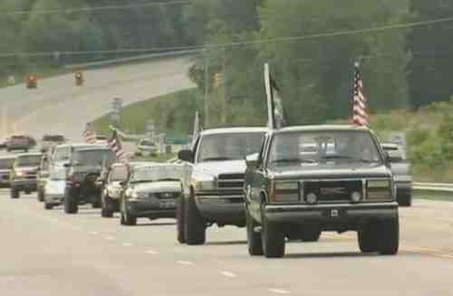
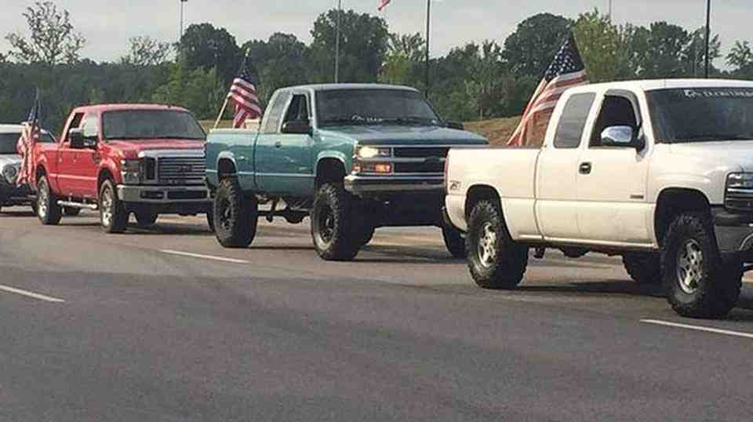
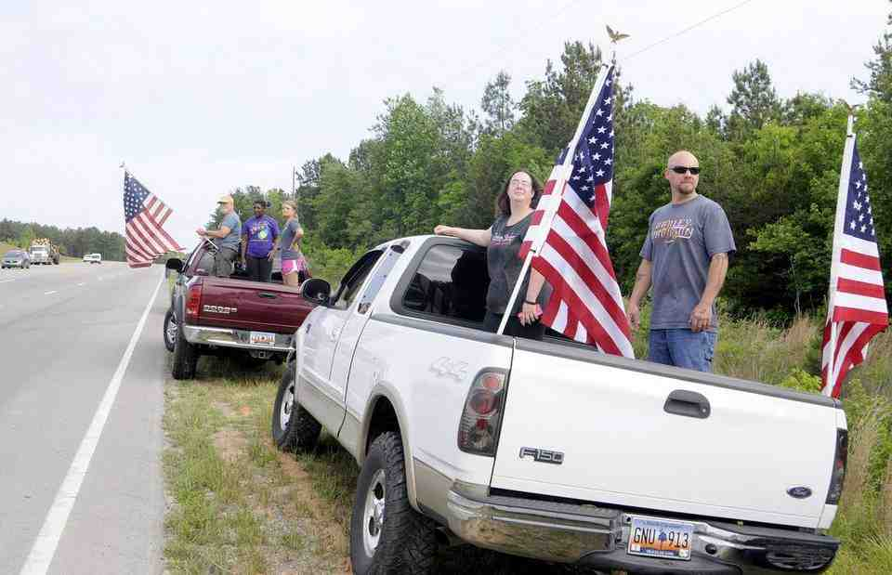
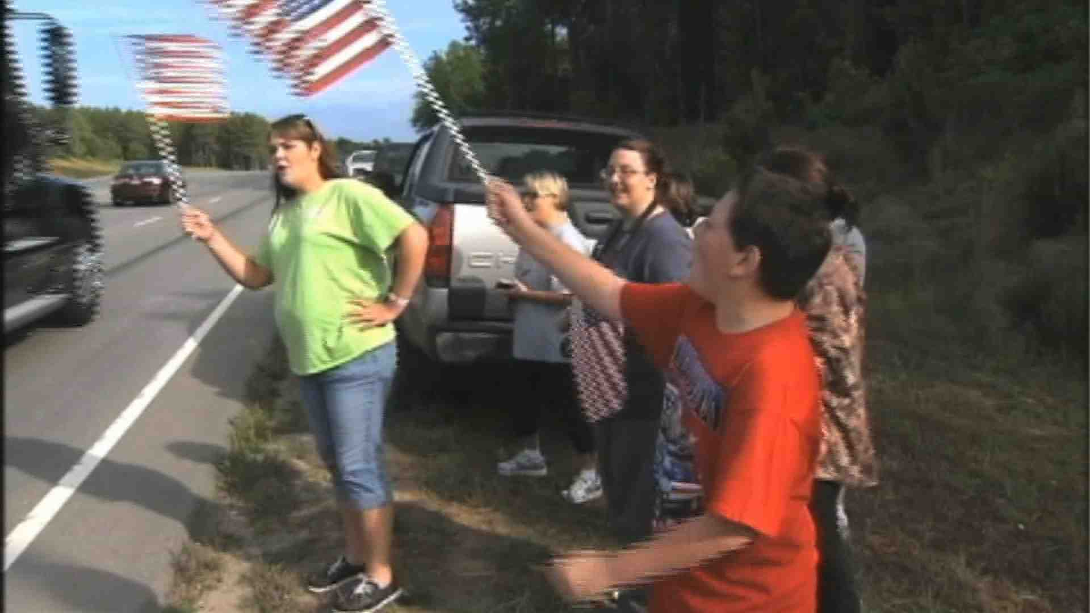
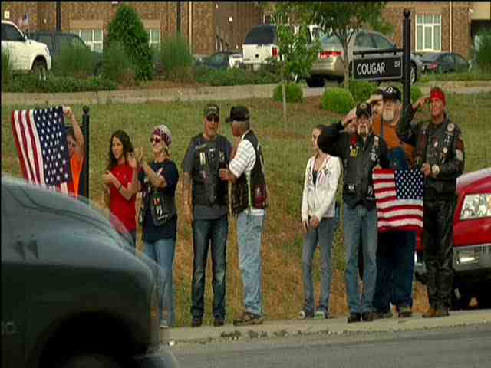
Community responds..
School officials back down…

Slide 9
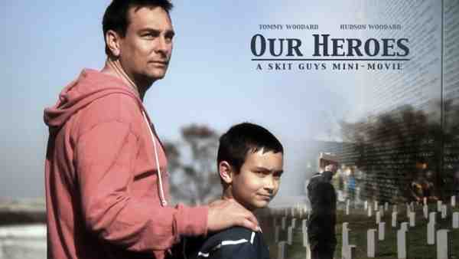
Father teaches his son true heroes…

Slide 10
Hebrews 11…
Heroes hall of faith… they each lived by faith and obeyed God…

Slide 11
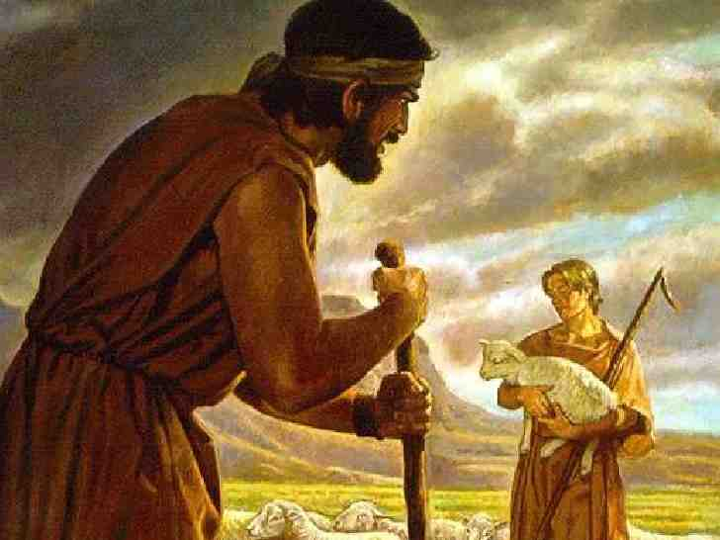
Faith of Abel..
Offered sacrifice by faith… though dead he still speaks…

Slide 12
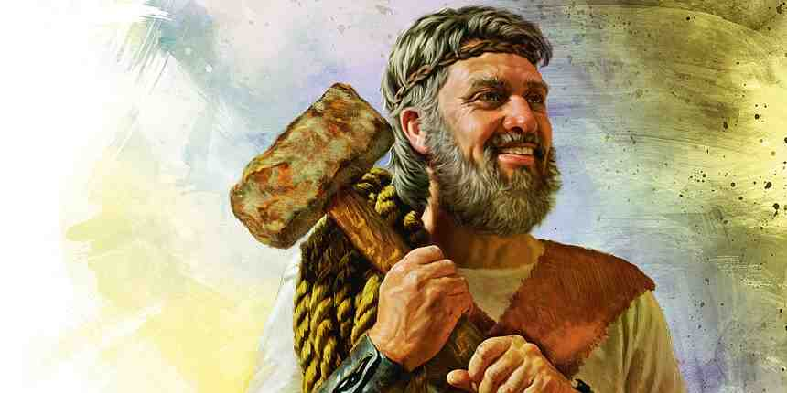
Faith of Noah..
Built ark in obedience and warned his neighbors of coming flood…

Slide 13
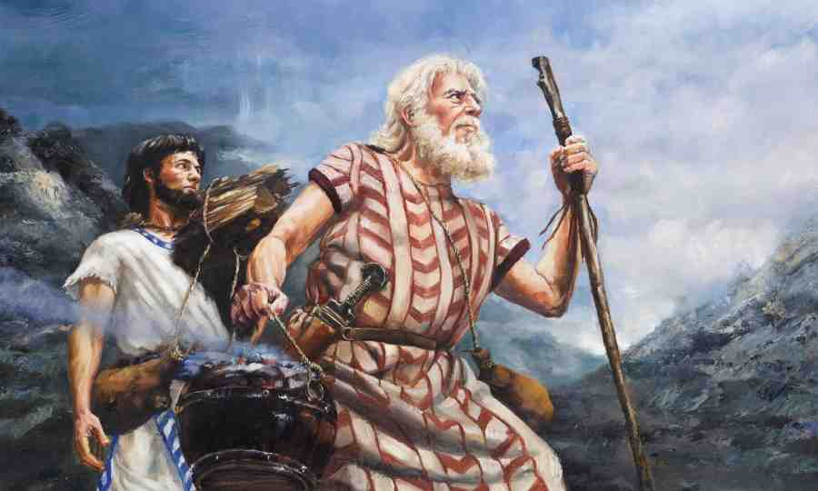
Faith of Abraham..
Trusted in God’s promises and was ready to offer his own son…

Slide 14
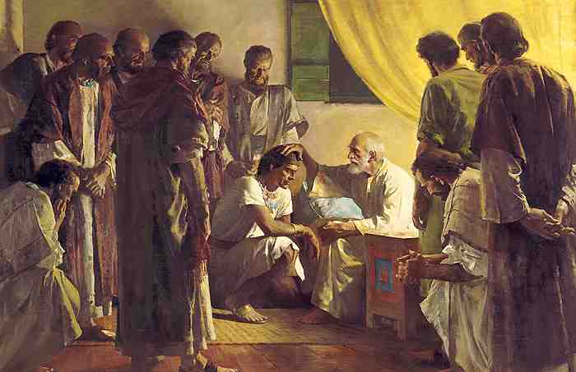
Faith of Jacob..
Made promises to his sons based on his faith in God’s purposes…

Slide 15
Faith of Jacob..
Made promises to his sons based on his faith in God’s purposes…

Slide 17
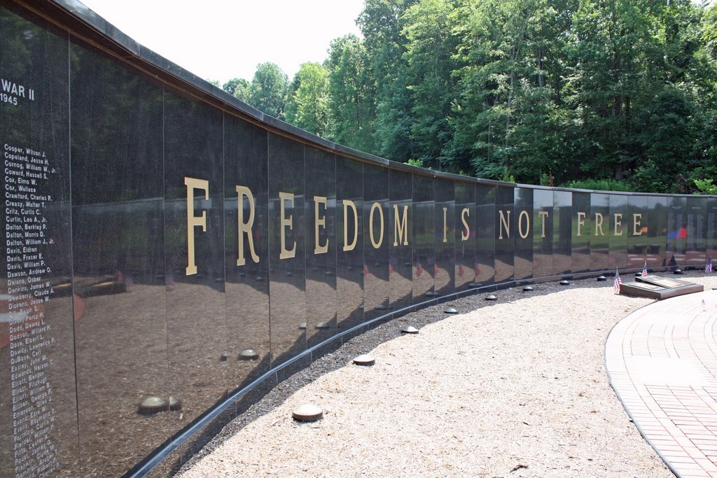

Slide 18
Honoring Our Heroes
Hebrews 12:1-2

