Slide 1
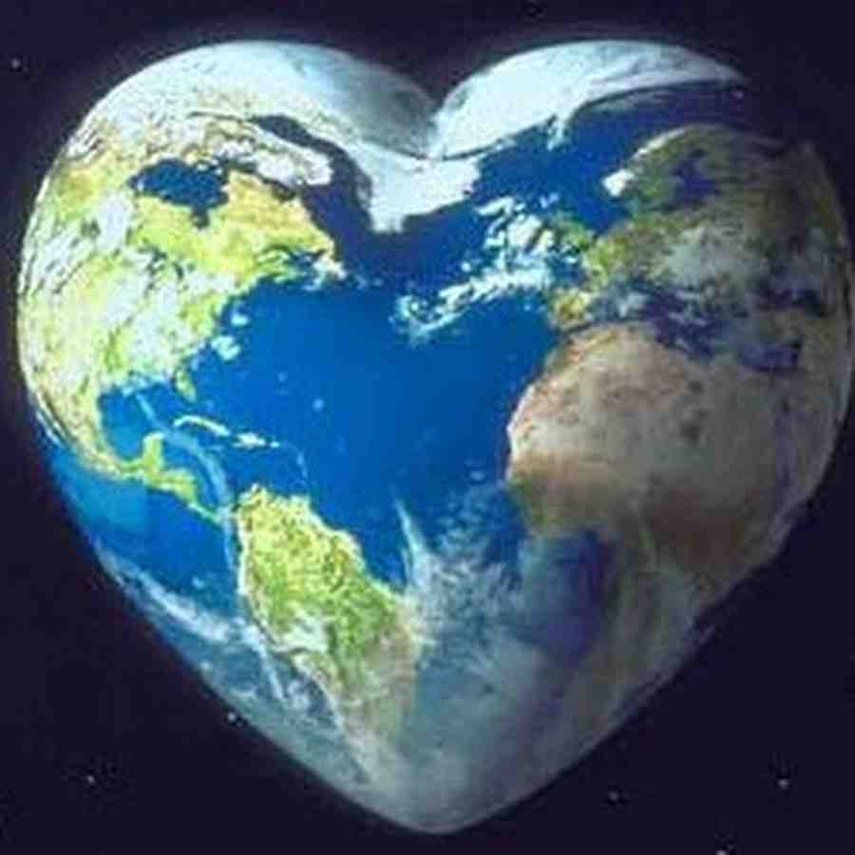
Love One Another
“By this all will know that you are My disciples..”
John 13:34-35

Slide 2
How can the world know we are God’s people?...
Matthew 28:19-20 Go therefore and make disciples of all the nations, baptizing them in the name of the Father and of the Son and of the Holy Spirit, 20 teaching them to observe all things that I have commanded you; and lo, I am with you always, even to the end of the age."

Slide 3
What did Jesus say?...
Great Commission?
Name ?
Doctrine ?
John 13:34-35 A new commandment I give to you, that you love one another; as I have loved you, that you also love one another. 35 By this all will know that you are My disciples, if you have love for one another."

Slide 4
John 13:34-35..
A new commandment..
Love As I have loved you..
By this all men will know…
If you love one another..

Slide 5
A New Commandment..
Context…
John 13:1 before the Feast of the Passover, when Jesus knew that His hour had come that He should depart from this world to the Father..
Contrast with the old law… Gal 3:22-25

Slide 6
As I have loved you..
The disciples did not understand..
Our perspective.. Eph 5:1-2, 5:25
The setting.. John 13:1-3; Phil. 2:5-8
The disciples arguing… Luke 22:24

Slide 7
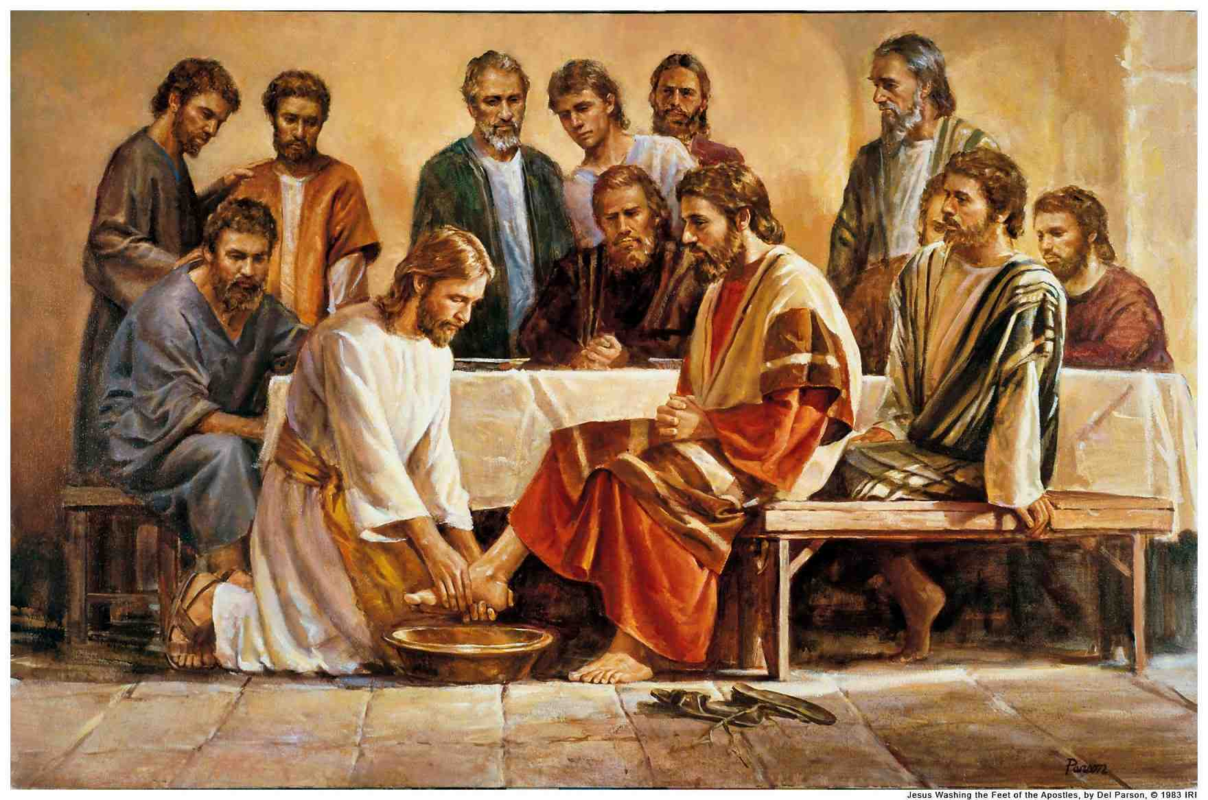
Jesus’ demonstration.
John 13:4-11.. washed their feet
John 13:12-17.. the meaning of His love
Willingness to wash one another’s feet

Slide 8
Loving as Christ loved..
Christianity crosses all cultural lines..
Slaves and masters .. Eph 6:9
Rich and poor.. James 2:1-4
Jews and Gentiles .. Gal 3:28

Slide 9
Loving as Christ loved..
Will we be called on to give our lives?
Possibly .. John 15:12-13
Family relationships.. willing to serve
With Christians.. opportunity to serve
1 John 3:18 let us not love in word but in truth
Non-Christians.. Gal 6:10

Slide 10
All will know..
You are MY disciples… Jn 15:13 1 Jn 4:12
Impossible by self.. one another
Not with unbelievers .. 2 Cor 6:14-17
Known as Christians.. Acts 11:26
Identifies us.. John 15:10; 1 Jn 4:20

Slide 11
Love One Another
“By this all will know that you are My disciples..”
John 13:34-35

