Slide 1
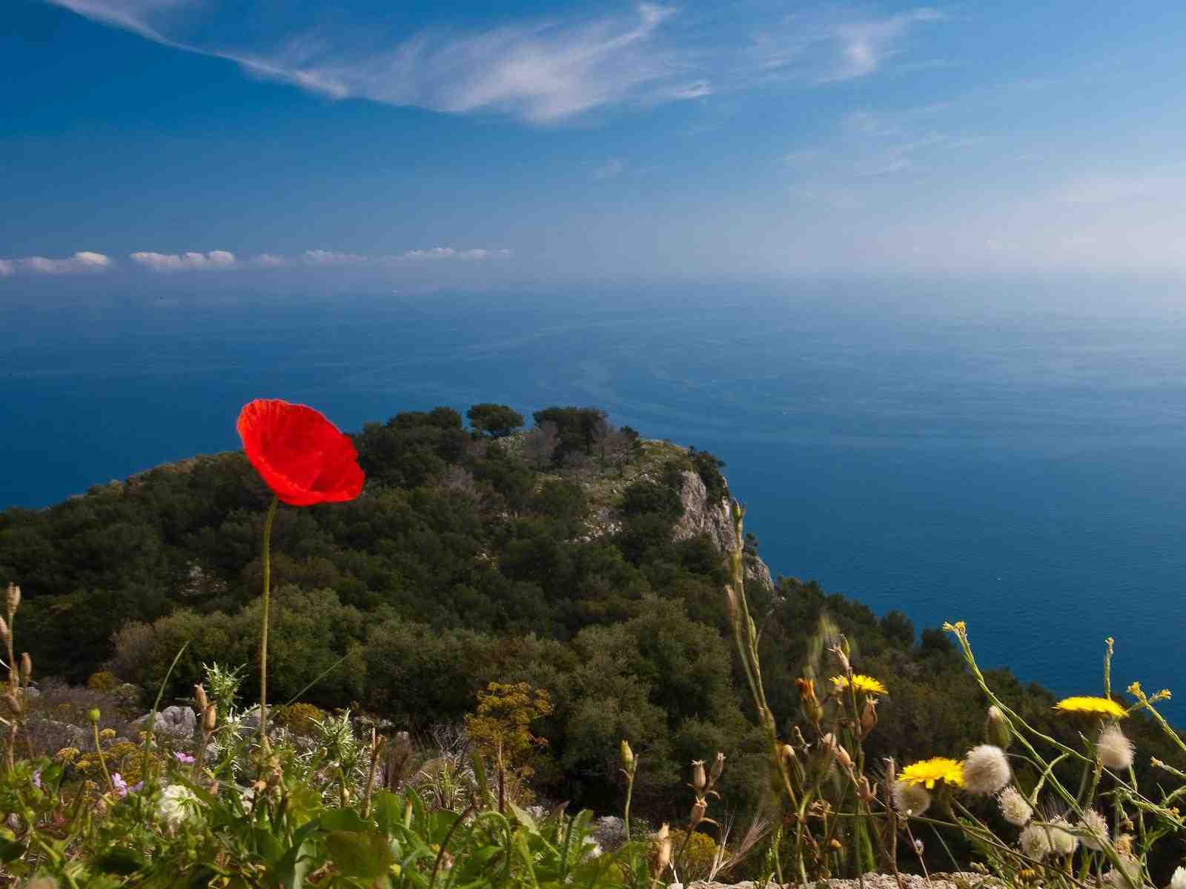
Meant for Good
Genesis 50:20-21

Slide 2
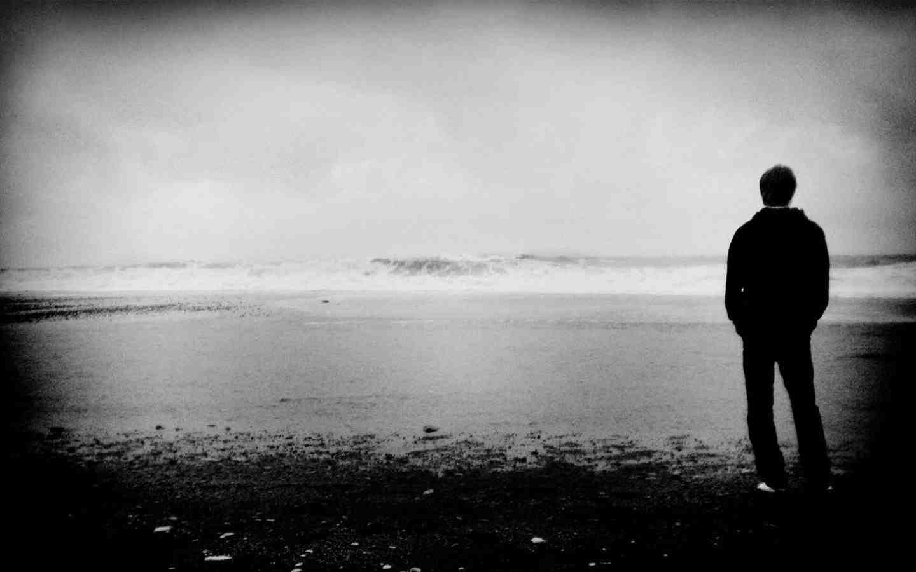
Hard to understand..
Why bad things happen to good people?

Slide 3
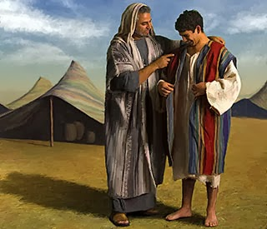
Joseph..

Slide 4
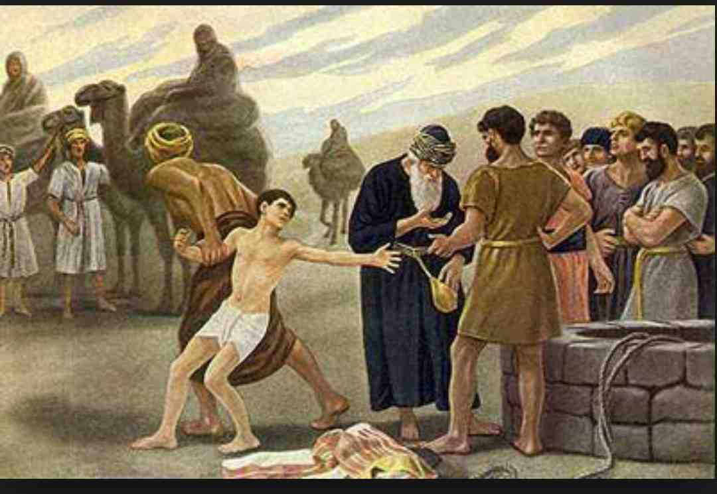
Hated by his brothers..

Slide 5
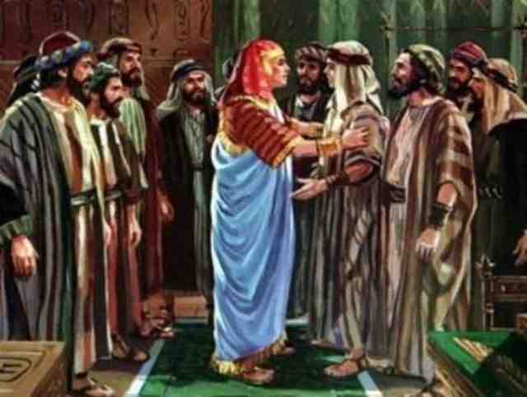
Years later..
Genesis 50:20-21 as for you, you meant evil against me; but God meant it for good, in order to bring it about as it is this day, to save many people alive.

Slide 6
God will be with us…
Psalms 23:4 Yea, though I walk through the valley of the shadow of death, I will fear no evil; For You are with me;Your rod and Your staff, they comfort me.

Slide 7
God sees what we can’t..
Deuteronomy 29:29 "The secret things belong to the Lord our God, but those things which are revealed belong to us and to our children forever, that we may do all the words of this law.

Slide 8
God’s purpose may not be seen until later..
Hebrews 12:10-11 For they (our parents) indeed for a few days chastened us as seemed best to them, but He for our profit, that we may be partakers of His holiness. 11 Now no chastening seems to be joyful for the present, but painful; nevertheless, afterward it yields the peaceable fruit of righteousness to those who have been trained by it.

Slide 9
God is working things out..
Phil 1:6 He who has begun a good work in you will complete it until the day of Jesus Christ
Philippians 2:13 for it is God who works in you both to will and to do for His good pleasure.

Slide 10
Does not separate us from God’s love..
Romans 8:28 all things work together for good to those who love God, to those who are the called according to His purpose

Slide 11
Does not separate us from God’s love..
Romans 8:35-39 Who shall separate us from the love of Christ? Shall tribulation, or distress, or persecution, or famine, or nakedness, or peril, or sword? 36 As it is written: "For Your sake we are killed all day long; We are accounted as sheep for the slaughter." 37 Yet in all these things we are more than conquerors through Him who loved us.

Slide 12
May increase our love for God..
Romans 5:3-5 And not only that, but we also glory in tribulations, knowing that tribulation produces perseverance; 4 and perseverance, character; and character, hope. 5 Now hope does not disappoint, because the love of God has been poured out in our hearts by the Holy Spirit who was given to us.

Slide 13
How we react determines the good..
James 1:2-4 My brethren, count it all joy when you fall into various trials, 3 knowing that the testing of your faith produces patience. 4 But let patience have its perfect work, that you may be perfect and complete, lacking nothing.

Slide 14
Prepares us for greater service..
2 Cor 1:3-5 Blessed be the God and Father of our Lord Jesus Christ, the Father of mercies and God of all comfort, 4 who comforts us in all our tribulation, that we may be able to comfort those who are in any trouble, with the comfort with which we ourselves are comforted by God.

Slide 15
What if suffering demonstrates love…
John 14:31 But that the world may know that I love the Father, and as the Father gave Me commandment, so I do. Arise, let us go from here.

Slide 16
Love sacrifices to benefit others…
2 Corinthians 4:8-10 We are hard-pressed on every side, yet not crushed; we are perplexed, but not in despair; 9 persecuted, but not forsaken; struck down, but not destroyed — 10 always carrying about in the body the dying of the Lord Jesus, that the life of Jesus also may be manifested in our body.

Slide 17
Cannot take away our hope of heaven…
Romans 8:18 For I consider that the sufferings of this present time are not worthy to be compared with the glory which shall be revealed in us.

Slide 18
Learning pathway..
“I walked a mile with pleasure..she chatted all the way..
But left me none the wiser.. For all she had to say..
I walked a mile with sorrow.. And ne’er a word said she.. But oh! The things I learned from her.. when sorrow walked with me!

Slide 19
Meant for Good
Genesis 50:20-21

