Slide 1
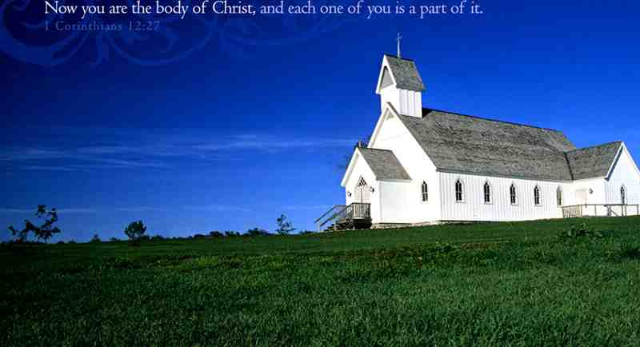
Members of One Another
Romans 12:5-8

Slide 2
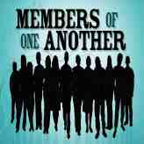
For as we have many members in one body, but all the members do not have the same function, 5 so we, being many, are one body in Christ, and individually members of one another. (Rom 12:4-5)

Slide 3
The body..
Used more than 30 times to illustrate the functioning of the church…

Slide 4
Corinthian church..
1 Cor 3:1-2 And I, brethren, could not speak to you as to spiritual people but as to carnal, as to babes in Christ. 2 I fed you with milk and not with solid food; for until now you were not able to receive it, and even now you are still not able..

Slide 5
Corinthian church..
1 Cor 12:14 For in fact the body is not one member but many. 15 If the foot should say, "Because I am not a hand, I am not of the body," is it therefore not of the body? 16 And if the ear should say, "Because I am not an eye, I am not of the body," is it therefore not of the body?

Slide 6
Corinthian church..
17 If the whole body were an eye, where would be the hearing? If the whole were hearing, where would be the smelling? 18 But now God has set the members, each one of them, in the body just as He pleased. 19 And if they were all one member, where would the body be? 20 But now indeed there are many members, yet one body.

Slide 7
Corinthian church..
21 And the eye cannot say to the hand, "I have no need of you"; nor again the head to the feet, "I have no need of you." 22 No, much rather, those members of the body which seem to be weaker are necessary. 23 And those members of the body which we think to be less honorable, on these we bestow greater honor; and our unpresentable parts have greater modesty, 24 but our presentable parts have no need.

Slide 8
Corinthian church..
But God composed the body, having given greater honor to that part which lacks it, 25 that there should be no schism in the body, but that the members should have the same care for one another. 26 And if one member suffers, all the members suffer with it; or if one member is honored, all the members rejoice with it. 27 Now you are the body of Christ, and members individually.

Slide 9
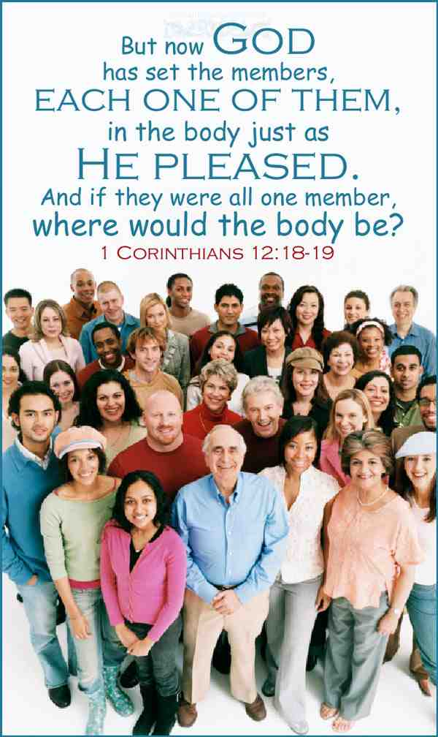
Is Paul’s main emphasis on spiritual gifts or the closeness of the body?...

Slide 10
What was Paul saying?..
1st.. No individual Christian can function effectively by himself… (vs. 18-27)

Slide 11
What was Paul saying?..
2nd .. No member of Christ’s body should feel he is more important than another..

Slide 12
What was Paul saying?..
Romans 12:3 For I say, through the grace given to me, to everyone who is among you, not to think of himself more highly than he ought to think, but to think soberly, as God has dealt to each one a measure of faith.
Romans 12:4-5 For as we have many members in one body, but all the members do not have the same function, 5 so we, being many, are one body in Christ, and individually members of one another

Slide 13
What was Paul saying?..
Ephesians 4:1-2 I, therefore, the prisoner of the Lord, beseech you to walk worthy of the calling with which you were called, 2 with all lowliness and gentleness, with longsuffering, bearing with one another in love,
Ephesians 4:4 There is one body and one Spirit, just as you were called in one hope of your calling..

Slide 14
What was Paul saying?..
3rd.. We should each work hard at creating unity in the body of Christ…

Slide 15
What was Paul saying?..
1 Corinthians 1:10 Now I plead with you, brethren, by the name of our Lord Jesus Christ, that you all speak the same thing, and that there be no divisions among you, but that you be perfectly joined together in the same mind and in the same judgment.
Ephesians 4:3 endeavoring to keep the unity of the Spirit in the bond of peace.

Slide 16
What was Paul saying?..
Not one of us can function effectively by ourselves…
Not one of us is more important than any other Christian…
All of us are to strive diligently for unity and peace…

Slide 17
No implication these Christians did not know what their gift was..
They knew what their gifts were, but were using them incorrectly..

Slide 18
The proper emphasis..
Becoming mature in Christ..
1 Corinthians 13:11 When I was a child, I spoke as a child, I understood as a child, I thought as a child; but when I became a man, I put away childish things.
Qualifications for leaders.. 1 Tim 3; Titus 1
2 Timothy 2:24-26 And a servant of the Lord must not quarrel but be gentle to all, able to teach, patient, 25 in humility correcting those who are in opposition, if God perhaps will grant them repentance, so that they may know the truth, 26 and that they may come to their senses and escape the snare of the devil, having been taken captive by him to do his will.

Slide 19
The proper emphasis..
One another.. within local church
“Suffer with one another..”
Requires maturity in understanding how the body works…
Ephesians 4:11-12 And He Himself gave some to be apostles, some prophets, some evangelists, and some pastors and teachers, 12 for the equipping of the saints for the work of ministry, for the edifying of the body of Christ..

Slide 20
Members of One Another
Romans 12:5-8

