Slide 1
Hold Marriage in Honor
Hebrews 13:1-6

Slide 2
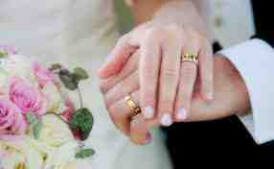
Heb 13:4-5 Let marriage be held in honor among all, and let the marriage bed be undefiled, for God will judge the sexually immoral and adulterous. (ESV)

Slide 3
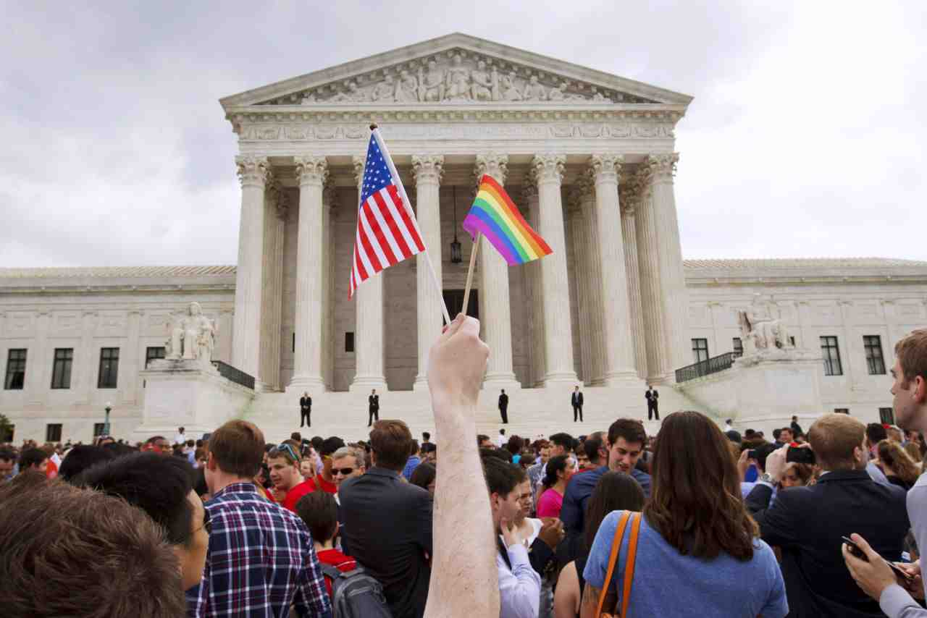
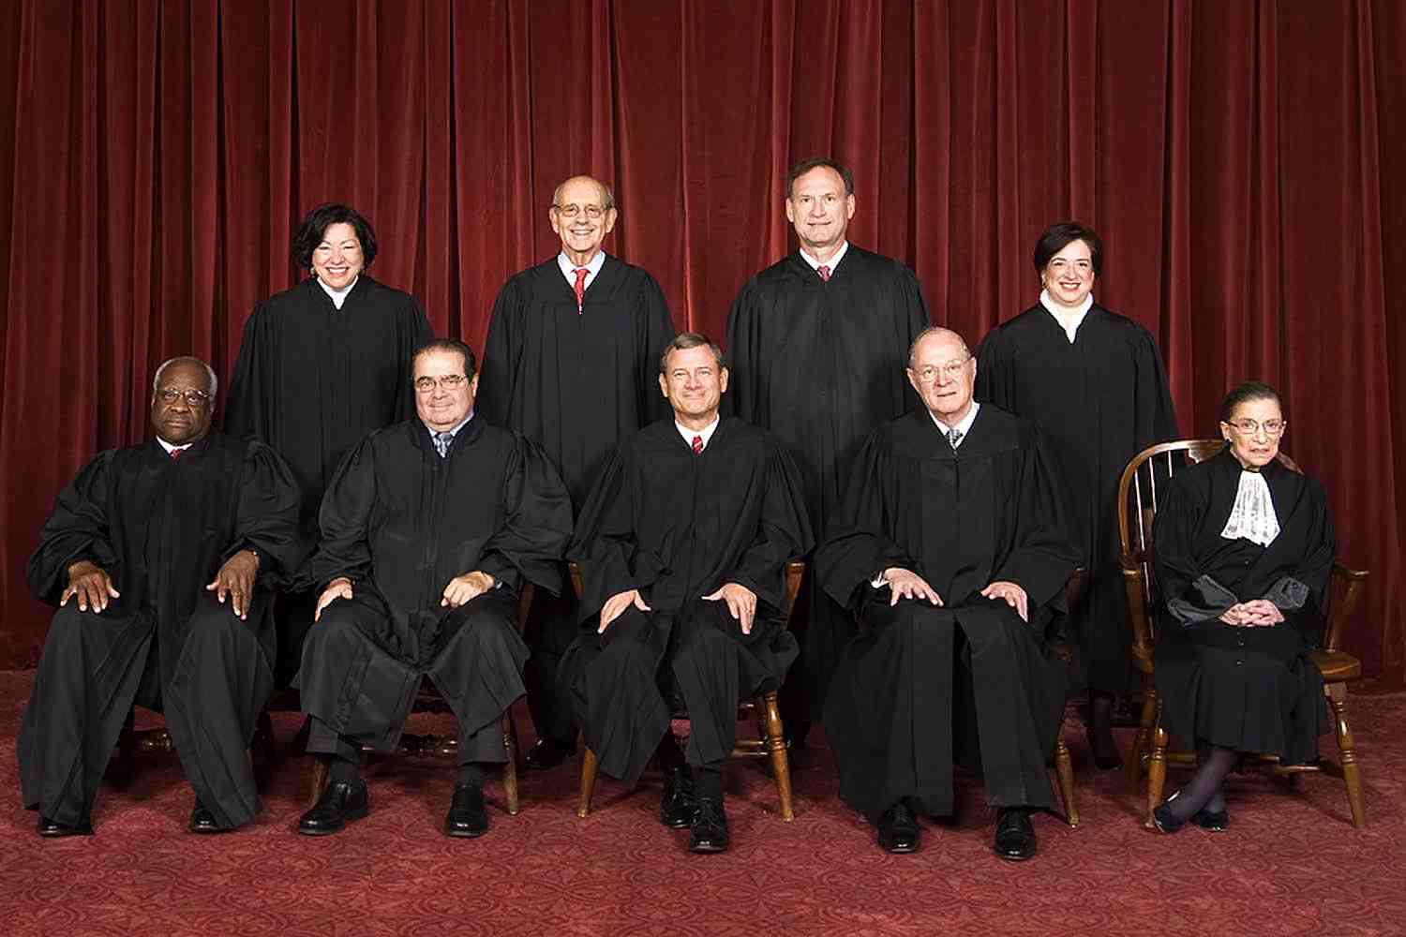
Supreme Court..
June 26th Court ruled 5-4 there is a federal constitutional right to same-sex marriage..
Legalizing at federal and state levels across the entire country.

Slide 4
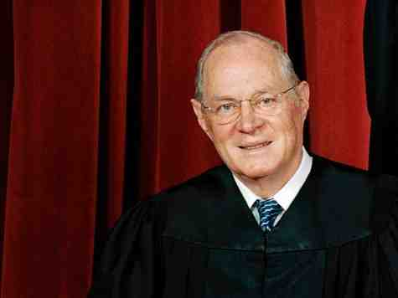
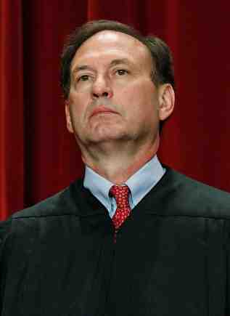
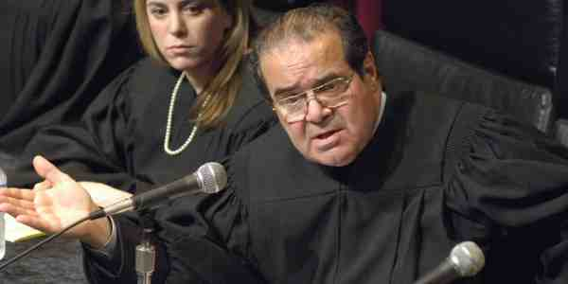
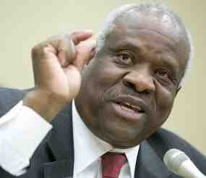
5-4 decision..
Marriage a “fundamental right” guaran-teed by the “due process” clause of the 14th and can’t be denied to same-sex couples.
“One-man one woman” marriage laws violate the equal protection clause ..

Slide 5
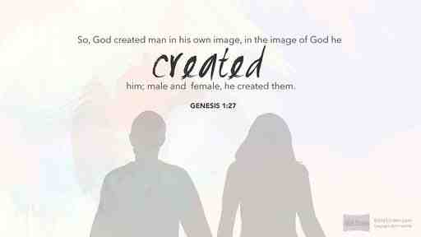
Marriage defined by God..
Genesis 1:27-28 So God created man in His own image; in the image of God He created him; male and female He created them. 28 Then God blessed them, and God said to them, "Be fruitful and multiply; fill the earth and subdue it; have dominion over the fish of the sea, over the birds of the air, and over every living thing that moves on the earth."

Slide 6
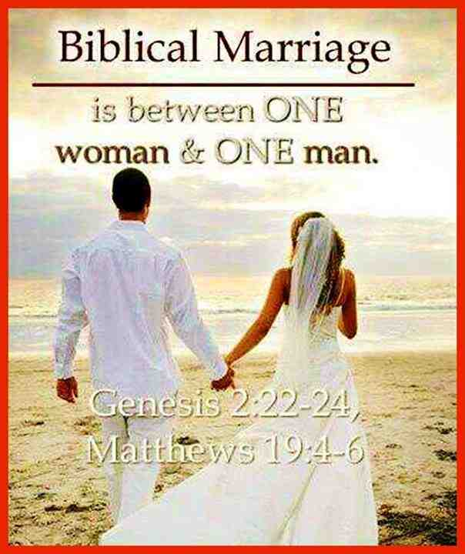
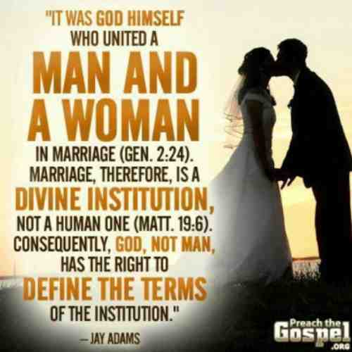
Genesis 2:23-24 Adam said: "This is now bone of my bones and flesh of my flesh; she shall be called woman, because she was taken out of Man." 24 Therefore a man shall leave his father and mother and be joined to his wife, and they shall become one flesh.

Slide 7
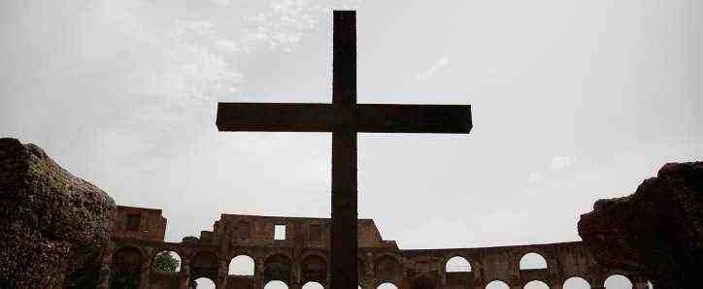
Jesus on marriage..
Mark 10:6-9 But from the beginning of the creation, God 'made them male and female.' 7 'For this reason a man shall leave his father and mother and be joined to his wife, 8 and the two shall become one flesh'; so then they are no longer two, but one flesh. 9 Therefore what God has joined together, let not man separate."

Slide 8
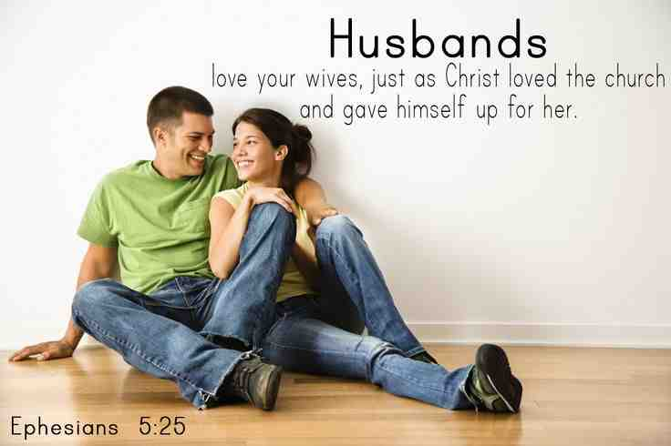
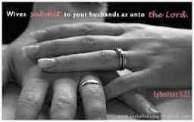
Portrayal of Christ and church..
Ephesians 5:22-25 Wives, submit to your own husbands, as to the Lord. 23 For the husband is head of the wife, as also Christ is head of the church; and He is the Savior of the body. 24 Therefore, just as the church is subject to Christ, so let the wives be to their own husbands in everything. 25 Husbands, love your wives, just as Christ also loved the church and gave Himself for her..
Ephesians 5:32-33 This is a great mystery, but I speak concerning Christ and the church. 33 Nevertheless let each one of you in particular so love his own wife as himself, and let the wife see that she respects her husband.

Slide 9
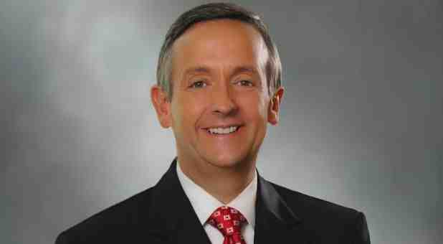
Dr. Robert Jeffress..
The Supreme Court said in essence, “We know better than God how to define marriage.” Friday’s Supreme Court decision represents a collective shaking of our fists in God’s face saying , “We don’t care what You say about life’s most important relationship. We know best.”
Regardless of what the Supreme Court justices declared Friday, the Judge of all of the universe has already issued His decision: marriage should be reserved for one man and one woman. And there is no appealing that verdict.

Slide 10
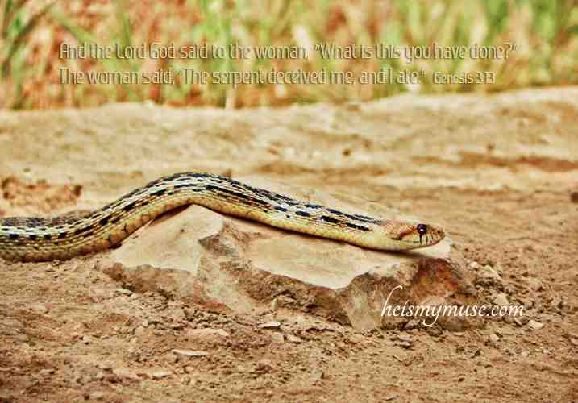
Consequences of sin..
Romans 5:12-14 Therefore, just as through one man sin entered the world, and death through sin, and thus death spread to all men, because all sinned —
Romans 8:20-21 For the creation was subjected to futility, not willingly, but because of Him who subjected it in hope; 21 because the creation itself also will be delivered from the bondage of corruption into the glorious liberty of the children of God.

Slide 11
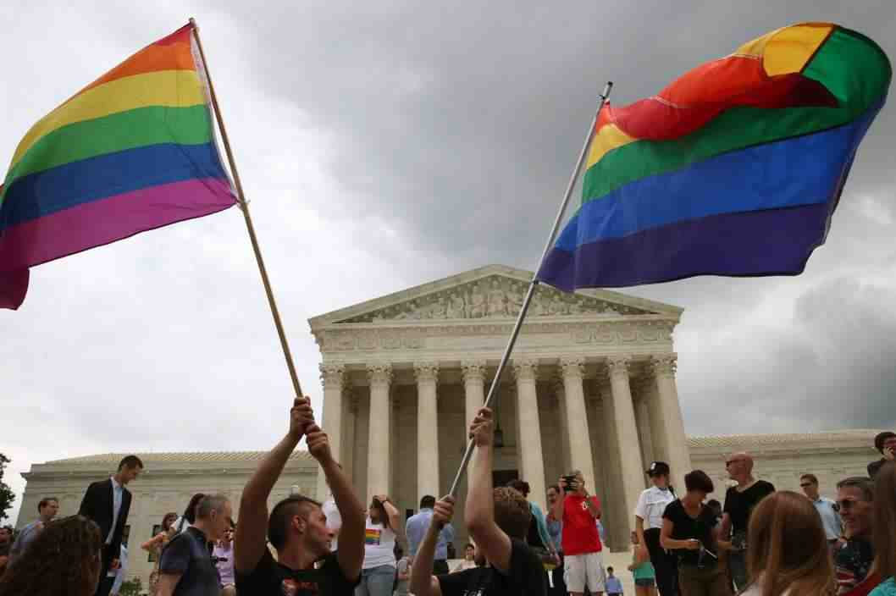
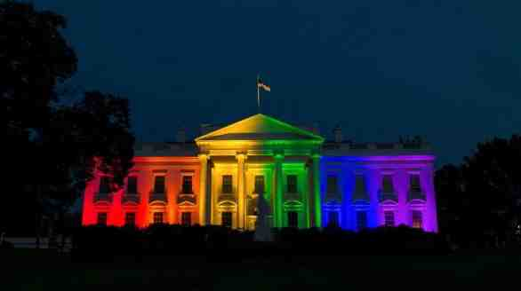
Institutionalizing Sin..
Romans 1:24-27 God gave them up to vile passions. For even their women exchanged the natural use for what is against nature. 27 Likewise also the men, leaving the natural use of the woman, burned in their lust for one another, men with men committing what is shameful, and receiving in themselves the penalty of their error which was due..32 who, knowing the righteous judgment of God, that those who practice such things are deserving of death, not only do the same but also approve of those who practice them.

Slide 12
Salvation or sin..
1 Corinthians 6:9-11 Do you not know that the unrighteous will not inherit the kingdom of God? Do not be deceived. Neither fornicators, nor idolaters, nor adulterers, nor homosexuals, nor sodomites, 10 nor thieves, nor covetous, nor drunkards, nor revilers, nor extortioners will inherit the kingdom of God. 11 And such were some of you. But you were washed, but you were sanctified, but you were justified in the name of the Lord Jesus and by the Spirit of our God.

Slide 13
Glorying in shame..
Philippians 3:18-19 For many walk, of whom I have told you often, and now tell you even weeping, that they are the enemies of the cross of Christ: 19 whose end is destruction...whose glory is in their shame —
Psalms 119:136 My eyes shed streams of tears, because people do not keep your law..

Slide 14
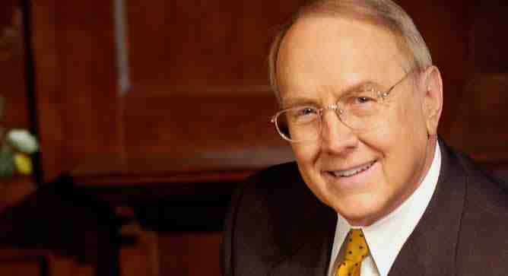
James Dobson
Even though Friday’s re-definition of marriage by the U. S. Supreme Court was anticipated, I have found myself grieving over its implications for my country and for Western civilization itself. This radical decree will have a devastating affect on every dimension of culture.
I grieve most for what it will do to our children, our grandchildren and future generations. They will be taught that right is wrong and wrong is right, and that the teachings of Scripture are unreliable and inaccurate. How outrageous it is that boys and girls barely out of babyhood are already being introduced in some schools to perverse adult behavior.

Slide 15
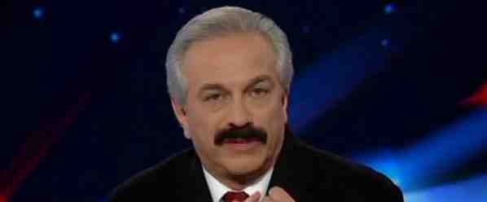
Joseph Farah
This was not a legal decision. It was a political edict by five men and women in black robes who really believe in their “supremacy.” In short, they believe they are wiser than God who created the institution of marriage and a union of a man and a woman.
There are no absolutes. Nothing is foreordained as right or wrong. It’s all just a matter of opinion – especially the opinion of unaccountable men and women in black robes.
The rule of law means what they say it means. The will of the people means nothing.

Slide 16
Joseph Farah
Make no mistake about it, folks. This decision, hardly unexpected, is a real game-changer for America.
We’ve already seen this same-sex marriage issue used, including by this same court, to portray anyone who dissents from the redefining of marriage as a bigot, a hater, a maladjusted rogue, an enemy of the people.
My prediction? It’s now open season on people of faith – Christians, Jews, anyone who holds marriage to be a sacred institution.

