Slide 1
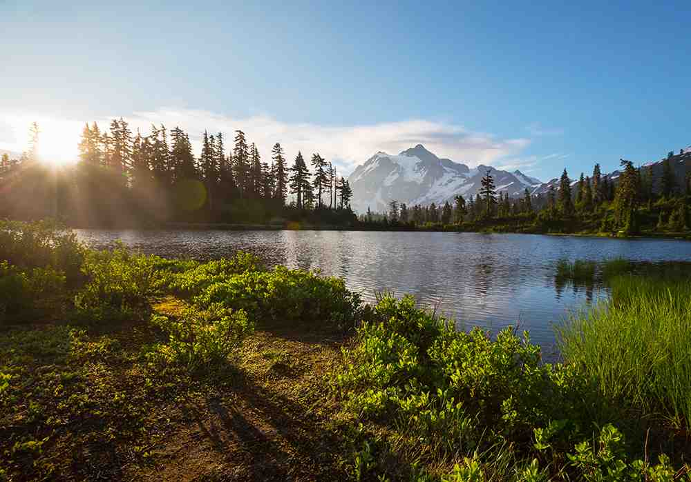
Hold to His Hand
Psalm 90:1-17

Slide 2
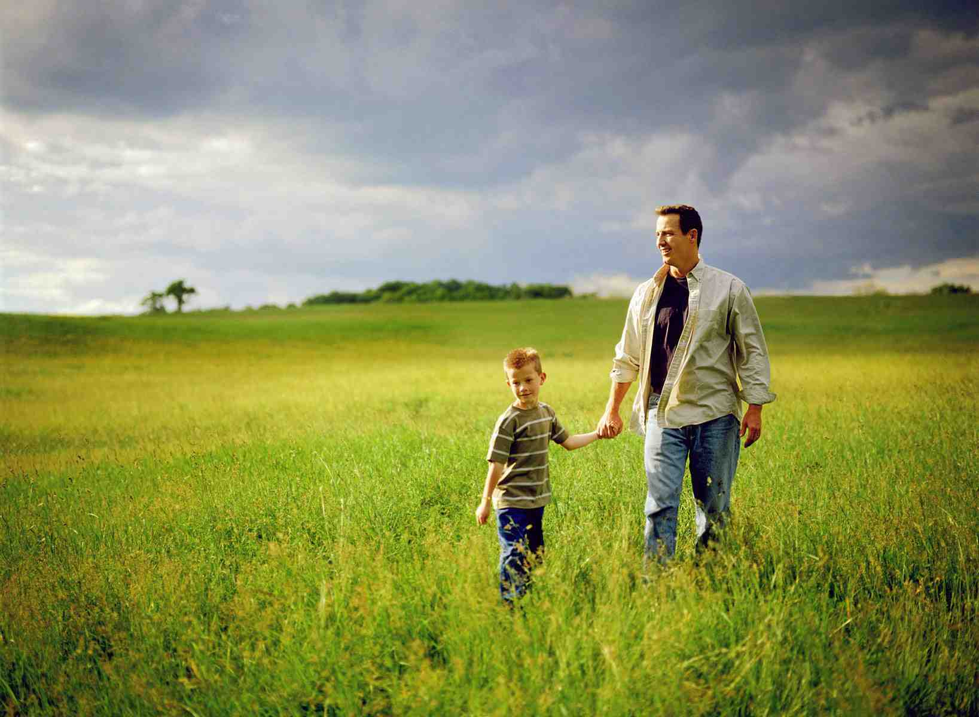
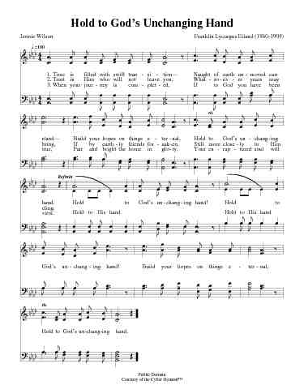
Hold my hand…
For safety, protection, reassurance..

Slide 3
Hold to God’s Unchanging Hand..
Psalm 90:1-2 Lord, You have been our dwelling place in all generations. 2 Before the mountains were brought forth, Or ever You had formed the earth and the world, Even from everlasting to everlasting, You are God.

Slide 4
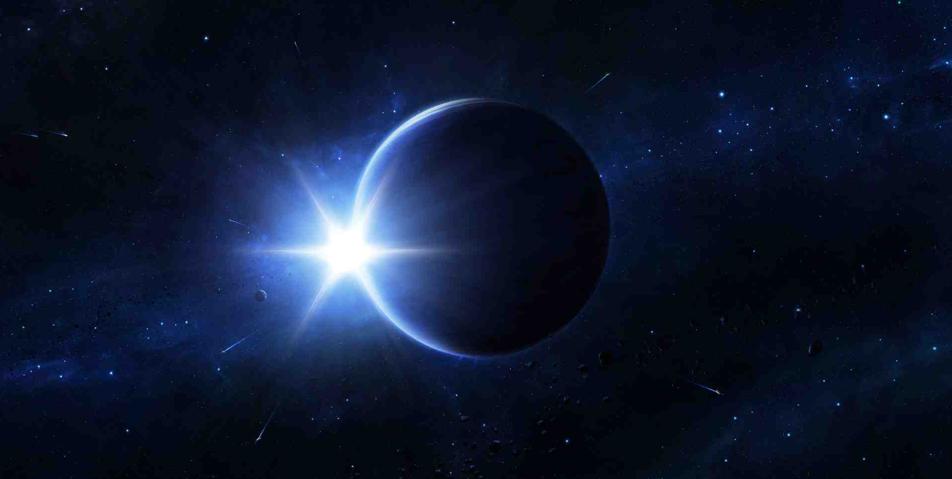
God is eternal…
There has never been a time God was not there and available to each of us..

Slide 5
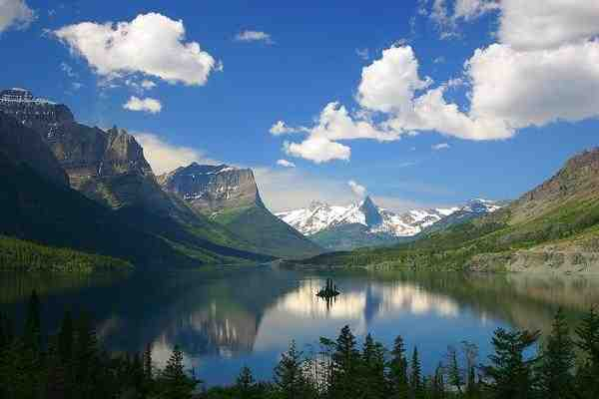
Before the mountains..
Infinite wisdom…

Slide 6
Our dwelling place in all generations..

Slide 7
Hold to God’s Unchanging Hand..
Psalm 90:1-2 Lord, You have been our dwelling place in all generations. 2 Before the mountains were brought forth, Or ever You had formed the earth and the world, Even from everlasting to everlasting, You are God.

Slide 8
Swift transition..
Time is filled with swift transition, Naught of earth unmoved can stand, Build your hopes on things eternal, Hold to God’s unchanging hand.

Slide 9
Man in contrast..
Psalm 90:3-6 You turn man to destruction, And say, "Return, O children of men." 4 For a thousand years in Your sight Are like yesterday when it is past, And like a watch in the night. 5 You carry them away like a flood; They are like a sleep. In the morning they are like grass which grows up: 6 In the morning it flourishes and grows up; In the evening it is cut down and withers.

Slide 10
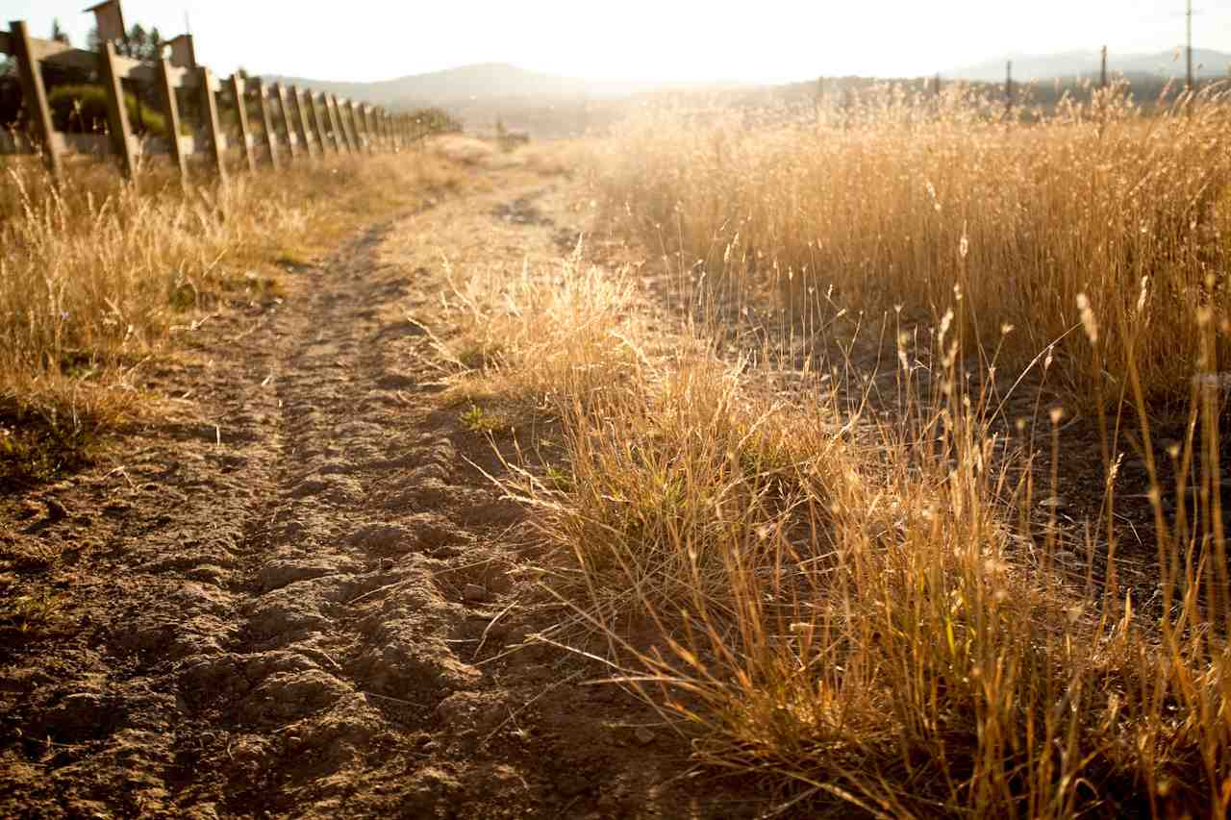
Man’s life is brief..

Slide 11
Thousand years is like one day with God..
Trust in Him who will not leave you, Whatsoever years may bring, If by earthly friends forsaken Still more closely to Him cling.

Slide 12
God knows our sins..
Psalm 90:7-8 For we have been consumed by Your anger, And by Your wrath we are terrified. 8 You have set our iniquities before You, Our secret sins in the light of Your countenance.

Slide 13
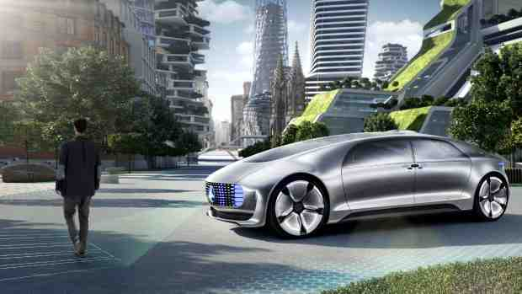
Focus on real treasure..
Covet not this world’s vain riches That so rapidly decay, Seek to gain the heav’nly treasures, They will never pass away.

Slide 14
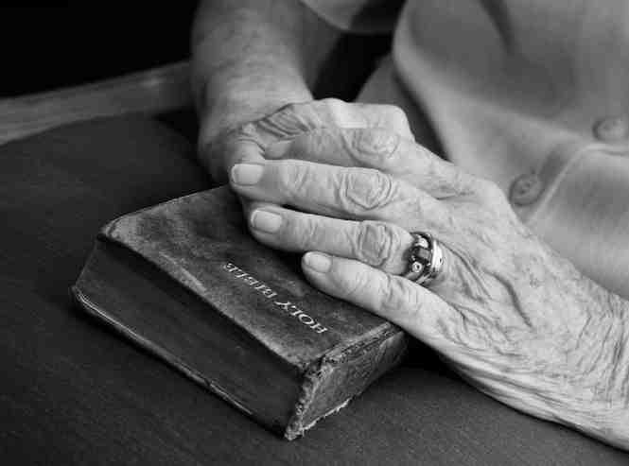
Our time on earth..
When your journey is completed, If to God you have been true, Fair and bright the home in glory Your enraptured soul will view.

Slide 15
Our time on earth..
Psa 90:9-10 For all our days have passed away in Your wrath; We finish our years like a sigh. 10 The days of our lives are seventy years; And if by reason of strength they are eighty years, Yet their boast is only labor and sorrow; For it is soon cut off, and we fly away.

Slide 16
11 Who knows the power of Your anger? For as the fear of You, so is Your wrath. 12 So teach us to number our days, That we may gain a heart of wisdom. 13 Return, O Lord! How long? And have compassion on Your servants.

Slide 17
14 Oh, satisfy us early with Your mercy, That we may rejoice and be glad all our days! 15 Make us glad according to the days in which You have afflicted us, The years in which we have seen evil. 16 Let Your work appear to Your servants, And Your glory to their children. 17 And let the beauty of the Lord our God be upon us, And establish the work of our hands for us; Yes, establish the work of our hands.

Slide 18
Hold to His Hand
Psalm 90:1-17

