Slide 1
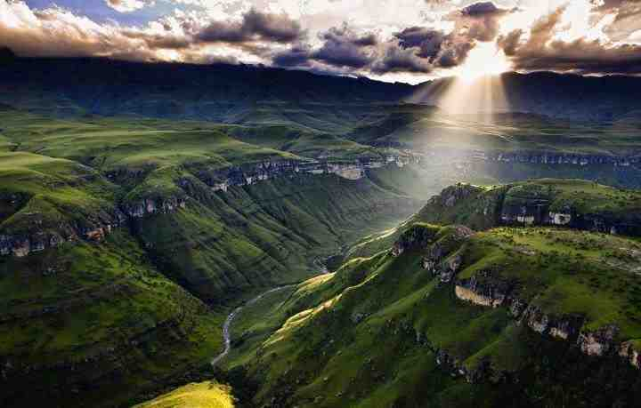
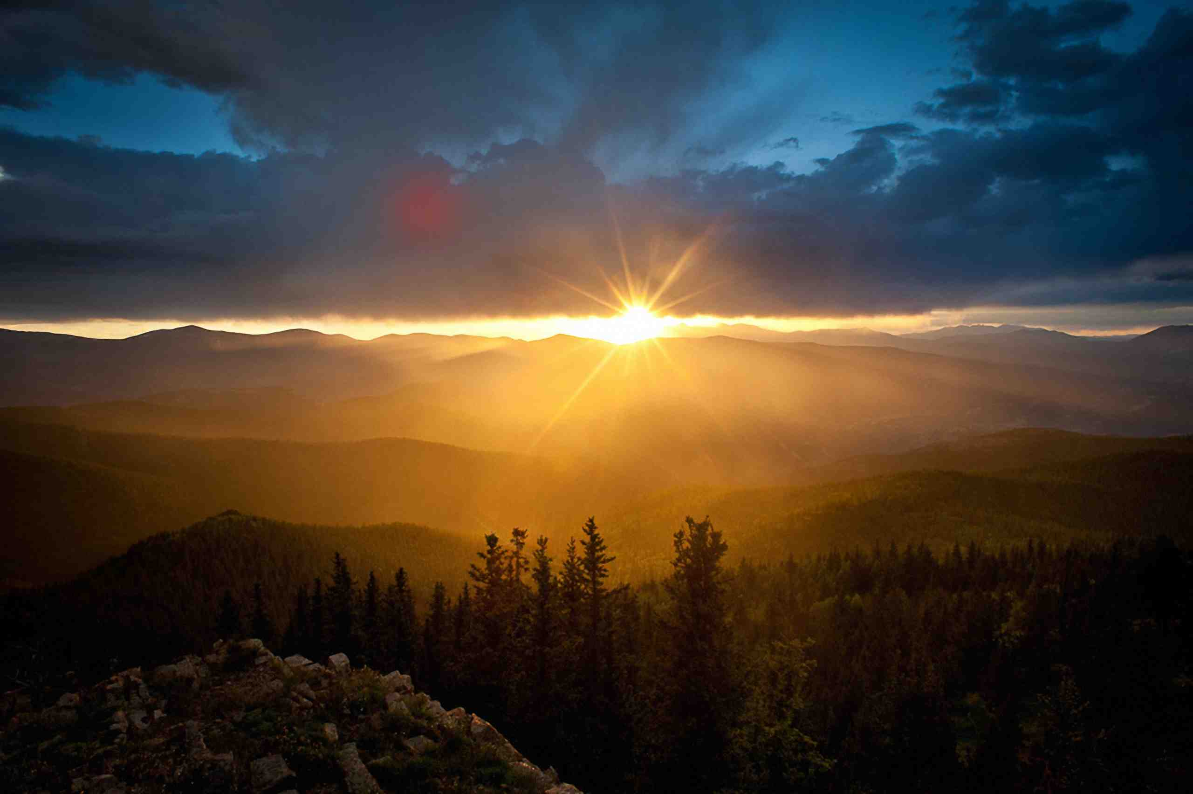
The King is Coming
Acts 1:9-11

Slide 2
Central theme…
OT
Christ is Coming
New Testament
Christ has Come
Christ is Coming Again

Slide 3
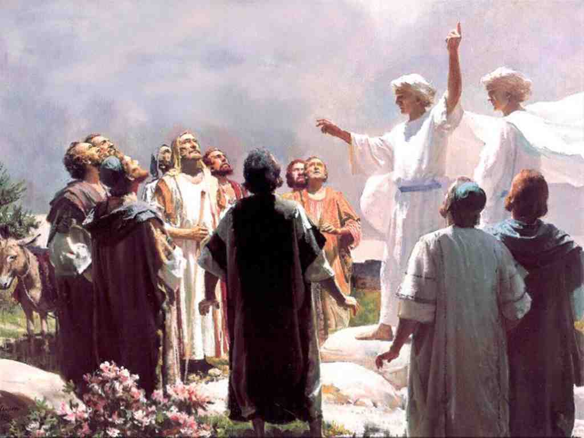
His return..
Acts 1:9-11 while they looked steadfastly toward heaven as He went up, behold, two men stood by them in white apparel, 11 who also said, "Men of Galilee, why do you stand gazing up into heaven? This same Jesus, who was taken up from you into heaven, will so come in like manner as you saw Him go into heaven."

Slide 4
His return..
Heb 9:27-28 And as it is appointed for men to die once, but after this the judgment, 28 so Christ was offered once to bear the sins of many. To those who eagerly wait for Him He will appear a second time, apart from sin, for salvation.

Slide 5
How Will Jesus Return..
Visibly.. a visible return
Acts 1:11 “This same Jesus, who was taken up from you into heaven, will so come in like manner as you saw Him go into heaven.“
1 Thessalonians 4:16 For the Lord Himself will descend from heaven..

Slide 6
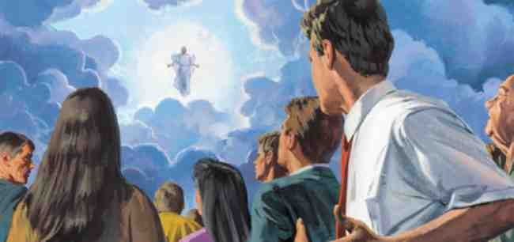
A Visible Return..
Revelation 1:7 Behold, He is coming with clouds, and every eye will see Him, even they who pierced Him. And all the tribes of the earth will mourn because of Him.

Slide 7
Terms used..
Apocalupsis (“revelation”)
Epiphanea (“manifestation”)
Parousia (“presence”)

Slide 8
How Will Jesus Return..
Visibly.. a visible return
Audibly.. audio phenomena
1 Thess 4:14-17 For the Lord Himself will descend from heaven with a shout, with the voice of an archangel, and with the trumpet of God.
1 Cor 15:51 Behold, I tell you a mystery: We shall not all sleep, but we shall all be changed — 52 in a moment, in the twinkling of an eye, at the last trumpet. For the trumpet will sound, and the dead will be raised incorruptible, and we shall be changed.

Slide 9
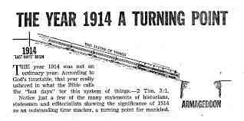
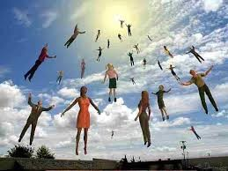
How Will Jesus Return?

Slide 10
How Will Jesus Return..
Visibly.. a visible return
Audibly.. audio phenomena
Gloriously.. With angels
Matthew 25:31-32 "When the Son of Man comes in His glory, and all the holy angels with Him, then He will sit on the throne of His glory
2 Thessalonians 1:7-8 when the Lord Jesus is revealed from heaven with His mighty angels, 8 in flaming fire taking vengeance on those who do not know God, and on those who do not obey the gospel of our Lord Jesus Christ.

Slide 11
A Glorious Return..
Jude 14-15 "Behold, the Lord comes with ten thousands of His saints, 15 to execute judgment on all, to convict all who are ungodly among them of all their ungodly deeds which they have committed in an ungodly way, and of all the harsh things which ungodly sinners have spoken against Him."
Titus 2:13 looking for the blessed hope and glorious appearing of our great God and Savior Jesus Christ…

Slide 12
Why Will He Return?
To Raise the Dead…
John 5:28-29 Do not marvel at this; for the hour is coming in which all who are in the graves will hear His voice 29 and come forth — those who have done good, to the resurrection of life, and those who have done evil, to the resurrection of condemnation.

Slide 13
Why Will He Return?
Resurrection…To Raise the Dead…
1 Thessalonians 4:13-16 But I do not want you to be ignorant, brethren, concerning those who have fallen asleep, lest you sorrow as others who have no hope. 14 For if we believe that Jesus died and rose again, even so God will bring with Him those who sleep in Jesus. 15 For this we say to you by the word of the Lord, that we who are alive and remain until the coming of the Lord will by no means precede those who are asleep. 16 For the Lord Himself will descend from heaven with a shout, with the voice of an archangel, and with the trumpet of God. And the dead in Christ will rise first.

Slide 14
Why Will He Return?
Resurrection… to raise the Dead…
Transformation.. change our bodies
1 Corinthians 15:50-53 Now this I say, brethren, that flesh and blood cannot inherit the kingdom of God; nor does corruption inherit incorruption. 51 Behold, I tell you a mystery: We shall not all sleep, but we shall all be changed — 52 in a moment, in the twinkling of an eye, at the last trumpet. For the trumpet will sound, and the dead will be raised incorruptible, and we shall be changed. 53 For this corruptible must put on incorruption, and this mortal must put on immortality.

Slide 15
Transform our bodies
Philippians 3:20-21 For our citizenship is in heaven, from which we also eagerly wait for the Savior, the Lord Jesus Christ, 21 who will transform our lowly body that it may be conformed to His glorious body, according to the working by which He is able even to subdue all things to Himself.
1 John 3:1-2 Behold what manner of love the Father has bestowed on us, that we should be called children of God! Therefore the world does not know us, because it did not know Him. 2 Beloved, now we are children of God; and it has not yet been revealed what we shall be, but we know that when He is revealed, we shall be like Him, for we shall see Him as He is.

Slide 16
Why Will He Return?
Resurrection… to raise the Dead…
Transformation.. change our bodies
Termination.. material universe
Matthew 24:35 Heaven and earth will pass away, but My words will by no means pass away.

Slide 17
The earth destroyed..
2 Peter 3:10-12 But the day of the Lord will come as a thief in the night, in which the heavens will pass away with a great noise, and the elements will melt with fervent heat; both the earth and the works that are in it will be burned up.
Revelation 14:13 Then I heard a voice from heaven saying to me, "Write: 'Blessed are the dead who die in the Lord from now on.'" "Yes," says the Spirit, "that they may rest from their labors, and their works follow them."

Slide 18
Why Will He Return?
Resurrection… to raise the Dead…
Transformation.. change our bodies
Termination.. material universe
Separation..
2 Cor 5:10 Rev 20:10ff
Matt 25:31-34 Matt 13:38-41

Slide 19
Why Will He Return?
Resurrection… to raise the Dead…
Transformation.. change our bodies
Termination.. material universe
Separation..
Vindication..
John 12:48 2 Thess 1:7-9
Jude 14-15

Slide 20
Why Will He Return?
Resurrection… to raise the Dead…
Transformation.. change our bodies
Termination.. material universe
Separation..
Vindication..
Culmination.. to deliver the kingdom
1 Cor 15:24-28

Slide 21
When Will He Return?
The Time is Unknown.. Unexpectedly
Matt 24:35-36
1 Thess 5:1-2
2 Pet 3:10-13

Slide 22
Our Attitude…
Preparation..
Matthew 24:42-44 Watch therefore, for you do not know what hour your Lord is coming. 43 But know this, that if the master of the house had known what hour the thief would come, he would have watched and not allowed his house to be broken into. 44 Therefore you also be ready, for the Son of Man is coming at an hour you do not expect.

Slide 23
Our Attitude…
Preparation..
Anticipation..
Hebrews 9:28 so Christ was offered once to bear the sins of many. To those who eagerly wait for Him He will appear a second time, apart from sin, for salvation.
2 Timothy 4:8 Finally, there is laid up for me the crown of righteousness, which the Lord, the righteous Judge, will give to me on that Day, and not to me only but also to all who have loved His appearing.

Slide 24
Desiring His Return..
2 Pet 3:10-13
Revelation 22:20 He who testifies to these things says, "Surely I am coming quickly." Amen. Even so, come, Lord Jesus!
1 Corinthians 16:22 If anyone does not love the Lord Jesus Christ, let him be accursed. O Lord, come!

Slide 25
The King is Coming
Acts 1:9-11

