Slide 1
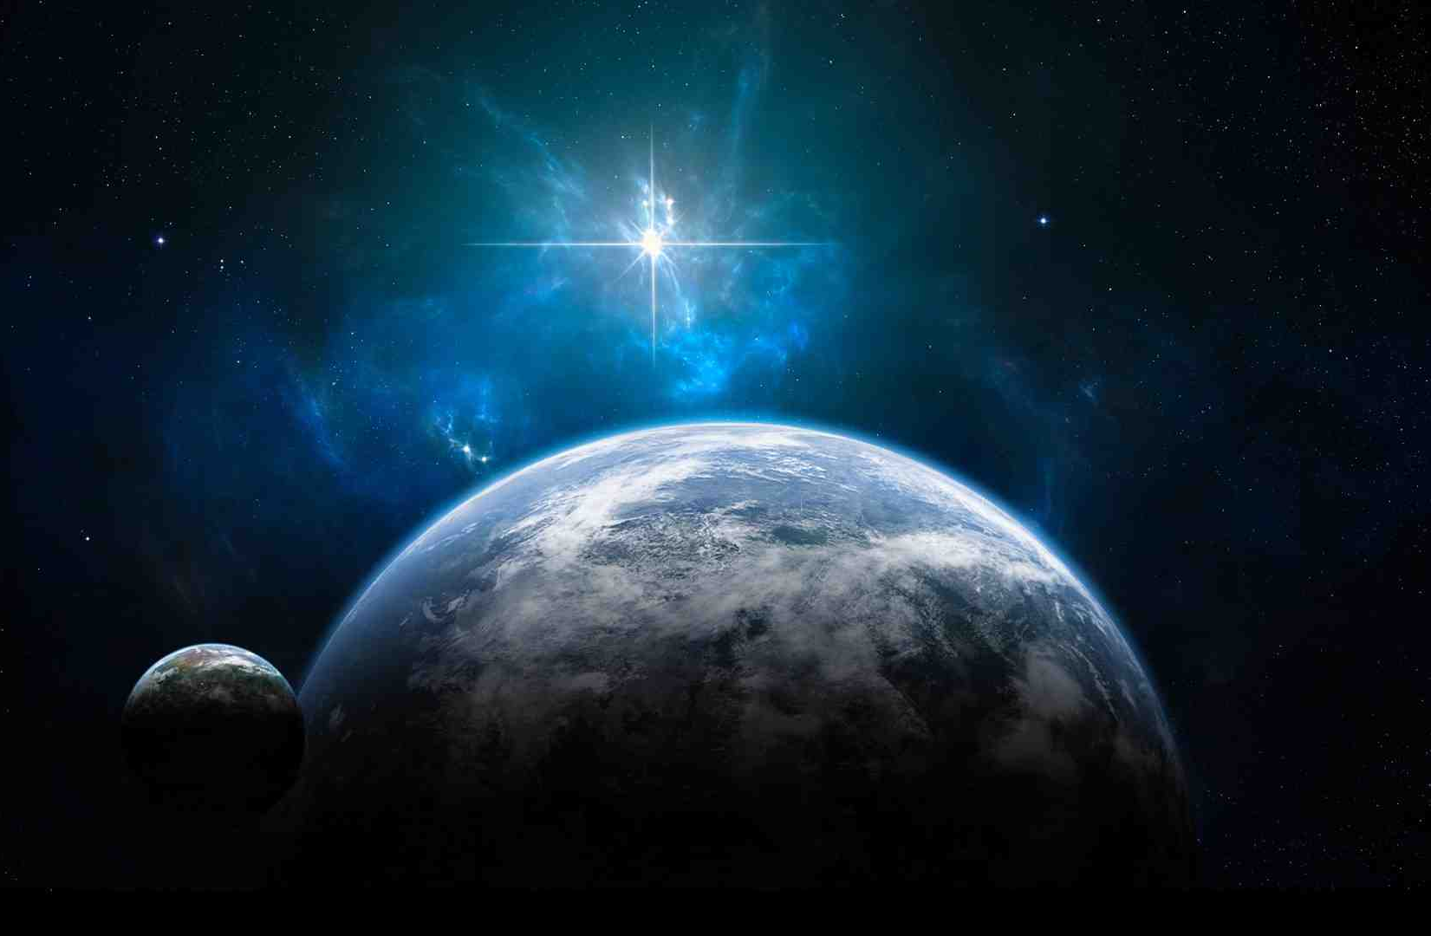
The Kingdom Has Come
Luke 1:26-33

Slide 2
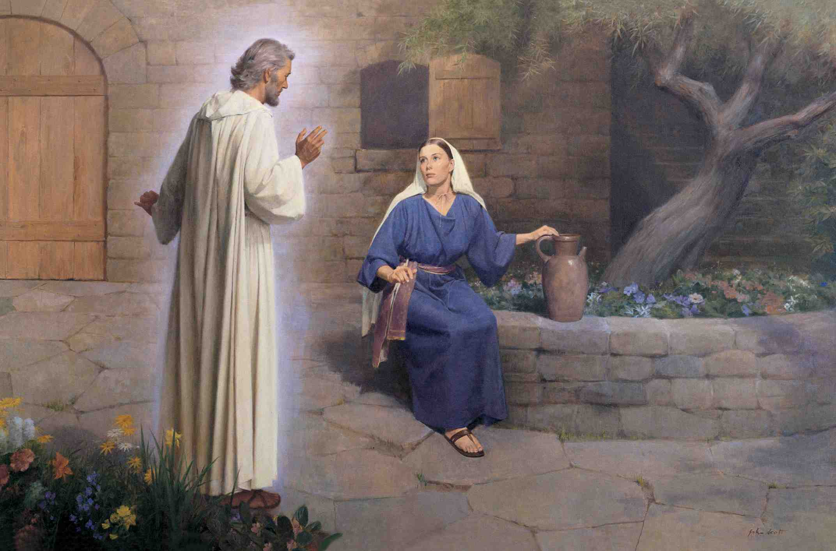
Luke 1:31-32 you will bring forth a Son, and shall call His name Jesus. 32 He will be called the Son of the Highest; and the Lord God will give Him the throne of His father David… He will reign over the house of Jacob forever, and of His kingdom there will be no end."

Slide 3
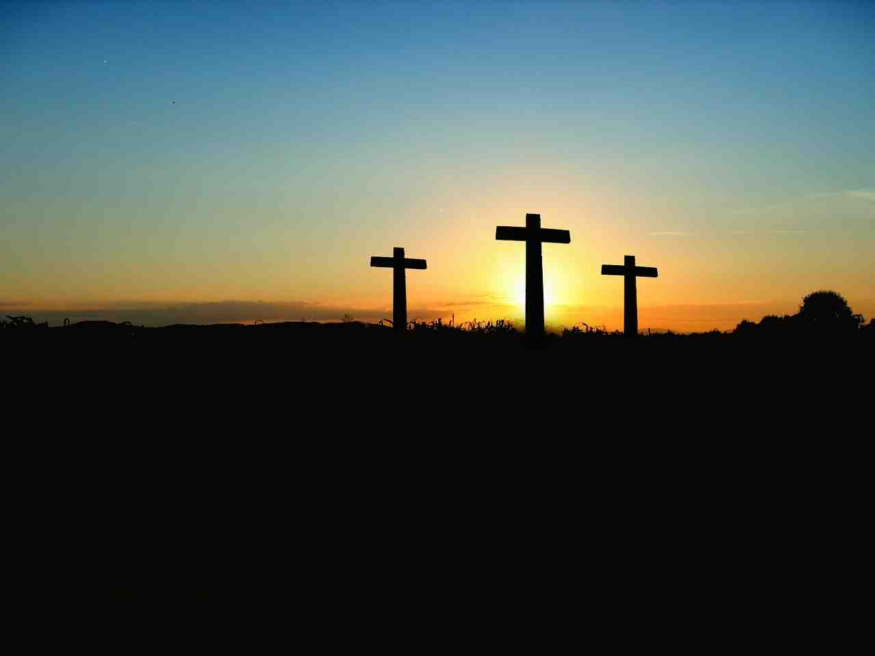
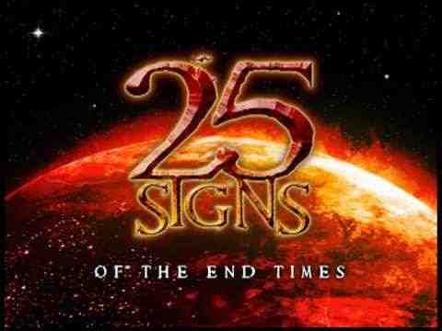
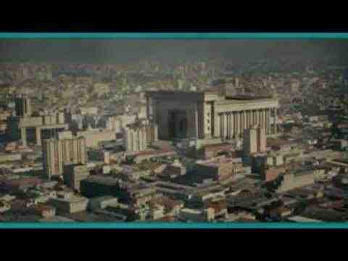
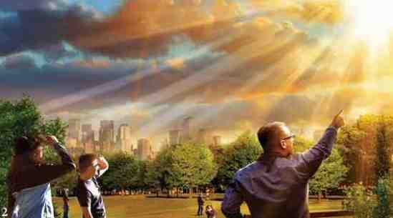
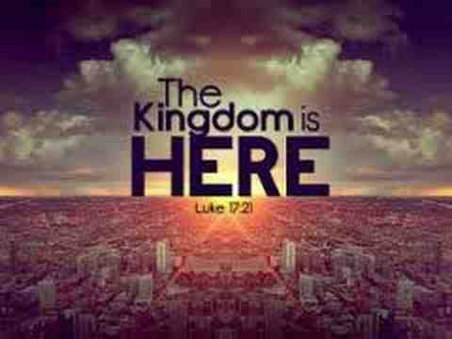
Strange irony..
“He came to His own, and His own did not receive Him..” (John 1:11)

Slide 4
Final things…

Slide 5
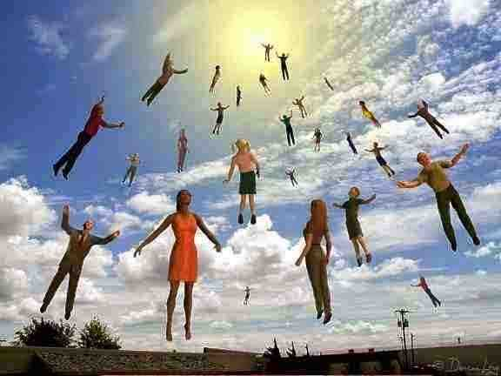
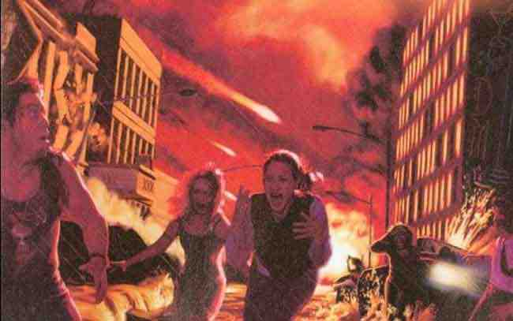

Slide 6
The Kingdom Has Come
Luke 1:26-33

Slide 7
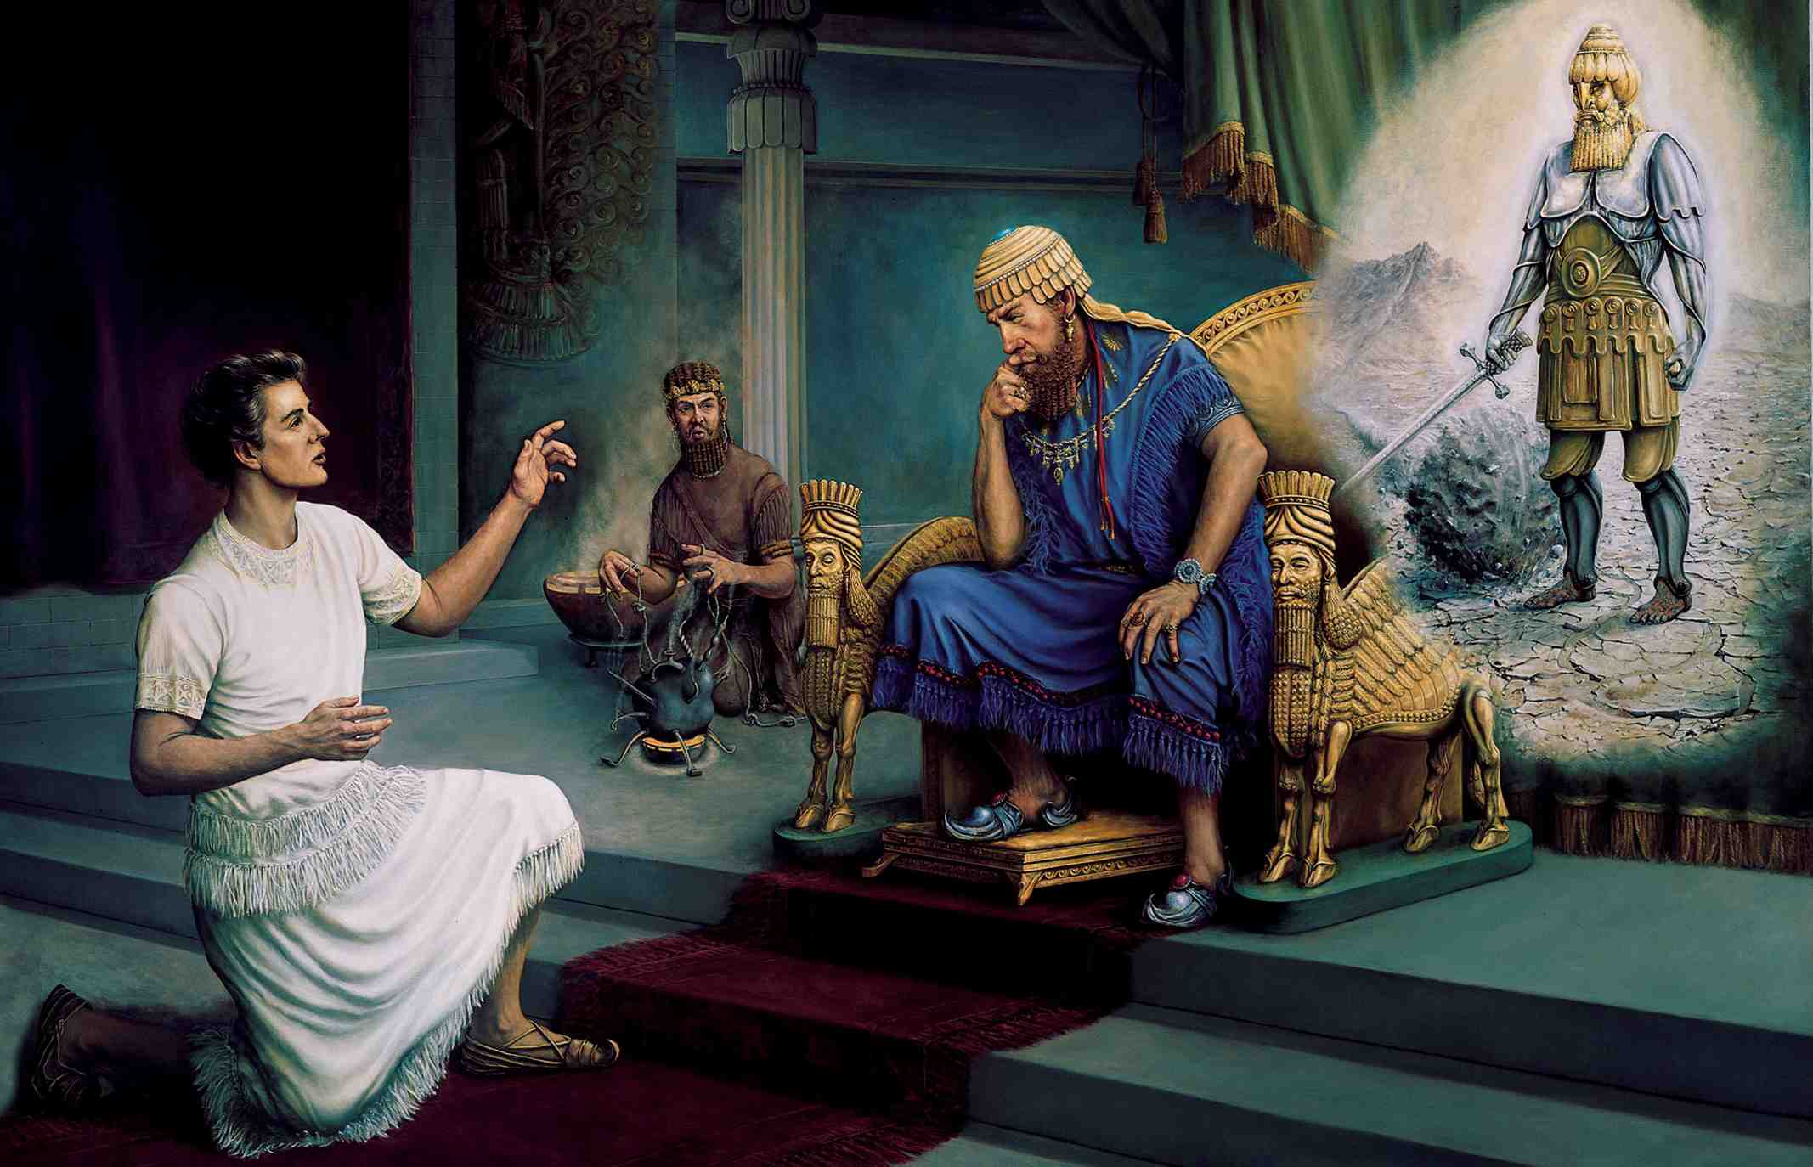
The Kingdom prophesied..
Daniel 2:44 And in the days of these kings the God of heaven will set up a kingdom which shall never be destroyed; and the kingdom shall not be left to other people; it shall break in pieces and consume all these kingdoms, and it shall stand forever.

Slide 8
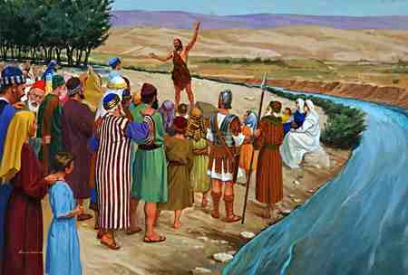
Fulfilled..
Matthew 3:1-2 In those days John the Baptist came preaching in the wilderness of Judea, 2 and saying, "Repent, for the kingdom of heaven is at hand!"
Mark 1:14-15 Jesus came to Galilee, preaching the gospel of the kingdom of God, 15 and saying, "The time is fulfilled, and the kingdom of God is at hand. Repent, and believe in the gospel."

Slide 9
The Kingdom established..
Mark 9:1 "Assuredly, I say to you that there are some standing here who will not taste death till they see the kingdom of God present with power."
Luke 24:49 Behold, I send the Promise of My Father upon you; but tarry in the city of Jerusalem until you are endued with power from on high."
Acts 1:8 But you shall receive power when the Holy Spirit has come upon you..

Slide 10
The Kingdom established..
Acts 2:1 When the Day of Pentecost had fully come, they were all with one accord in one place..
Acts 2:14 But Peter, standing up with the eleven, raised his voice and said to them, "Men of Judea and all who dwell in Jerusalem, let this be known to you, and heed my words.

Slide 11
The Kingdom established..
Acts 2:29-36 knowing that God had sworn with an oath to him that of the fruit of his body, according to the flesh, He would raise up the Christ to sit on his throne, 31 he, foreseeing this, spoke concerning the resurrection of the Christ, that His soul was not left in Hades, nor did His flesh see corruption.
32 This Jesus God has raised up, of which we are all witnesses. 33 Therefore being exalted to the right hand of God, and having received from the Father the promise of the Holy Spirit, He poured out this which you now see and hear.

Slide 12
The Kingdom a reality..
Colossians 1:13 He has delivered us from the power of darkness and conveyed us into the kingdom of the Son of His love..
Luke 22:29-30 And I bestow upon you a kingdom, just as My Father bestowed one upon Me, 30 that you may eat and drink at My table in My kingdom..
1 Corinthians 10:16 The cup of blessing which we bless, is it not the communion of the blood of Christ? The bread which we break, is it not the communion of the body of Christ? ...

Slide 13
The Kingdom a reality..
Revelation 1:5-6 Jesus Christ, the faithful witness, the firstborn from the dead, and the ruler over the kings of the earth. To Him who loved us and washed us from our sins in His own blood, 6 and has made us kings and priests to His God and Father, to Him be glory and dominion forever and ever. Amen.
Hebrews 12:28 Therefore, since we are receiving a kingdom which cannot be shaken, let us have grace, by which we may serve God acceptably with reverence and godly fear.

Slide 14
The Kingdom a reality..
1 Corinthians 15:24-28 Then comes the end, when He delivers the kingdom to God the Father, when He puts an end to all rule and all authority and power. 25 For He must reign till He has put all enemies under His feet. 26 The last enemy that will be destroyed is death. 27 For "He has put all things under His feet." But when He says "all things are put under Him," it is evident that He who put all things under Him is excepted. 28 Now when all things are made subject to Him, then the Son Himself will also be subject to Him who put all things under Him, that God may be all in all.

Slide 15
Entering the kingdom..
John 3:5 Jesus answered, "Most assuredly, I say to you, unless one is born of water and the Spirit, he cannot enter the kingdom of God.
1 Corinthians 12:13 For by one Spirit we were all baptized into one body — whether Jews or Greeks, whether slaves or free — and have all been made to drink into one Spirit.

Slide 16
Entering the kingdom..
Matthew 11:11-12 "Assuredly, I say to you, among those born of women there has not risen one greater than John the Baptist; but he who is least in the kingdom of heaven is greater than he.

Slide 17
The Kingdom Has Come
Luke 1:26-33

