Slide 1
When Jesus Comes.. Will There Be a Rapture
1 Thessalonians 4:13-18

Slide 2
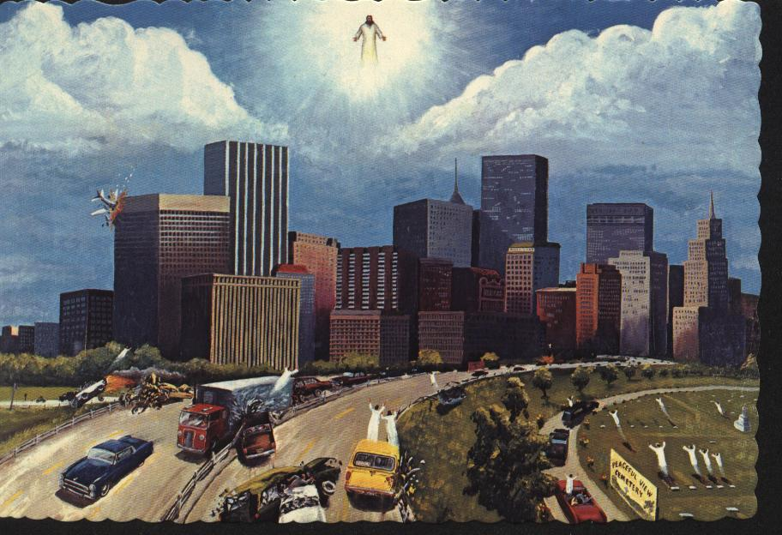

Slide 3
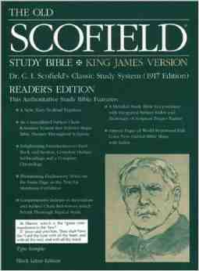
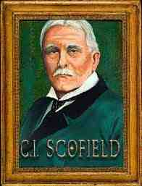
Rapture fever..
Very popular… Sensationalism sells well… over 100 million copies

Slide 4
“Rapture”not in Bible..
“rapere”.. seize, snatch out, take away
“harpadzo”.. caught up (1 Thess 4:17)
Dispensationalism: Rapture will occur before 7-yr Tribulation period, followed by Millenium (1000 yrs)

Slide 5
Dispensational scenario..

Slide 6
Key proof text..
1 Thess 4:16-17 16 For the Lord Himself will descend from heaven with a shout, with the voice of an archangel, and with the trumpet of God. And the dead in Christ will rise first. 17 Then we who are alive and remain shall be caught up together with them in the clouds to meet the Lord in the air. And thus we shall always be with the Lord.
Not a secret, silent return..
Not 7 years, but always with the Lord..
This is the general resurrection..

Slide 7
Different terms..
“Presence” (parousia) Rapture
“Appearing” (epiphaneia)
“Revelation” (apokalupsis)
Coming “with” saints
Coming “for” saints

Slide 8
Used interchangeably..
1 Thessalonians 3:13 so that He may establish your hearts blameless in holiness before our God and Father at the coming of our Lord Jesus Christ with all His saints.
2 Thessalonians 2:1 Now, brethren, concerning the coming of our Lord Jesus Christ and our gathering together to Him, we ask you..
2 Thessalonians 2:8 And then the lawless one will be revealed, whom the Lord will consume with the breath of His mouth and destroy with the brightness of His coming.

