Slide 1
God’s Measuring Line
Zechariah 2:1-5, 10-11

Slide 2
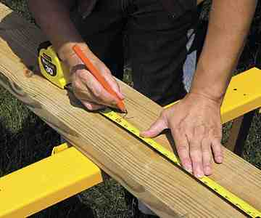
Any project that involves building
will involve measuring..

Slide 3
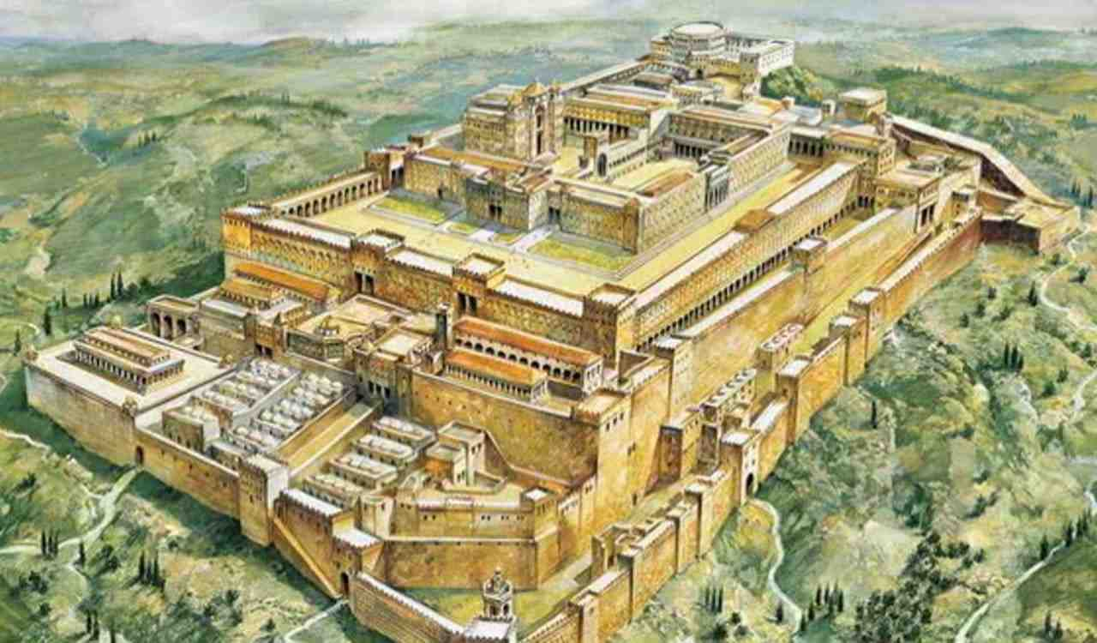
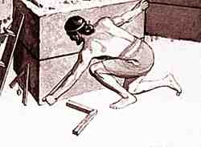
Zechariah’s vision..
Zechariah 2:1-5…
1 Then I raised my eyes and looked, and behold, a man with a measuring line in his hand. 2 So I said, "Where are you going?" And he said to me, "To measure Jerusalem, to see what is its width and what is its length."

Slide 4
Zechariah’s vision..
Zechariah 2:1-5…
3 And there was the angel who talked with me, going out; and another angel was coming out to meet him, 4 who said to him, "Run, speak to this young man, saying: 'Jerusalem shall be inhabited as towns without walls, because of the multitude of men and livestock in it. 5 For I,' says the Lord, 'will be a wall of fire all around her, and I will be the glory in her midst.'"

Slide 5
Zechariah’s vision..
Zechariah 2:1-5…
10 "Sing and rejoice, O daughter of Zion! For behold, I am coming and I will dwell in your midst," says the Lord. 11 "Many nations shall be joined to the Lord in that day, and they shall become My people. And I will dwell in your midst. Then you will know that the Lord of hosts has sent Me to you.

Slide 6
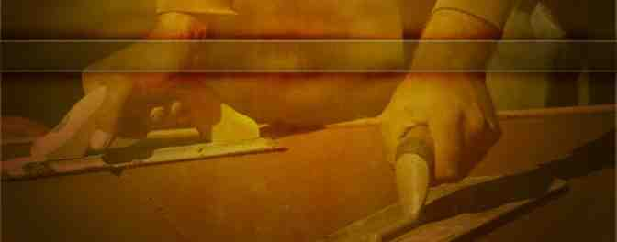
How does Jesus measure the church He is building..

Slide 7
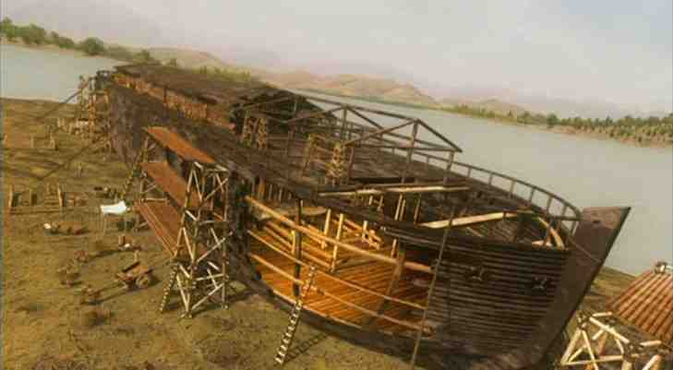
Noah building the ark..
The measurements were to be exact..

Slide 8
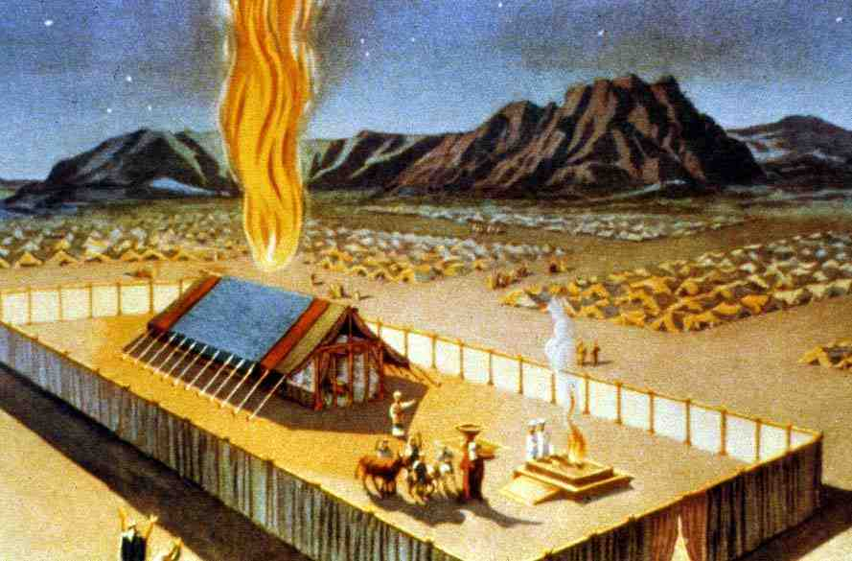
Tabernacle in wilderness..
Exodus 25:40 make them according to the pattern which was shown you on the mountain.

Slide 9
God’s only standard..
John 17:17 Sanctify them by Your truth. Your word is truth.

Slide 10
God’s only standard..
2 Timothy 3:16-17 All Scripture is given by inspiration of God, and is profitable for doctrine, for reproof, for correction, for instruction in righteousness, 17 that the man of God may be complete, thoroughly equipped for every good work.

Slide 11
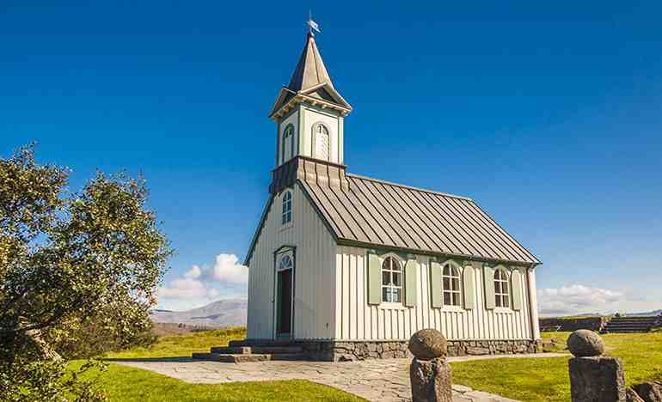
Measuring the church..
Ephesians 4:11-13 And He Himself gave some to be apostles, some prophets, some evangelists, and some pastors and teachers, 12 for the equipping of the saints for the work of ministry, for the edifying of the body of Christ, 13 till we all come to the unity of the faith and of the knowledge of the Son of God, to a perfect man, to the measure of the stature of the fullness of Christ..

Slide 12
Measuring the church..
Ephesians 4:11-13 And He Himself gave some to be apostles, some prophets, some evangelists, and some pastors and teachers, 12 for the equipping of the saints for the work of ministry, for the edifying of the body of Christ..
1 Thessalonians 1:8 For from you the word of the Lord has sounded forth, not only in Macedonia and Achaia, but also in every place. Your faith toward God has gone out, so that we do not need to say anything.

Slide 13
Measuring the church..
Ephesians 4:11-13 And He Himself gave some to be apostles, some prophets, some evangelists, and some pastors and teachers, 12 for the equipping of the saints for the work of ministry, for the edifying of the body of Christ..
1 Thessalonians 5:11 Therefore comfort each other and edify one another, just as you also are doing.

Slide 14
Measuring the church..
Romans 15:25-26 But now I am going to Jerusalem to minister to the saints. 26 For it pleased those from Macedonia and Achaia to make a certain contribution for the poor among the saints who are in Jerusalem.

Slide 15
Measuring the church..
Philippians 1:1 Paul and Timothy, bondservants of Jesus Christ, To all the saints in Christ Jesus who are in Philippi, with the bishops and deacons.. 1 Tim 3; Tit 1

Slide 16
Measuring the church..

Slide 17
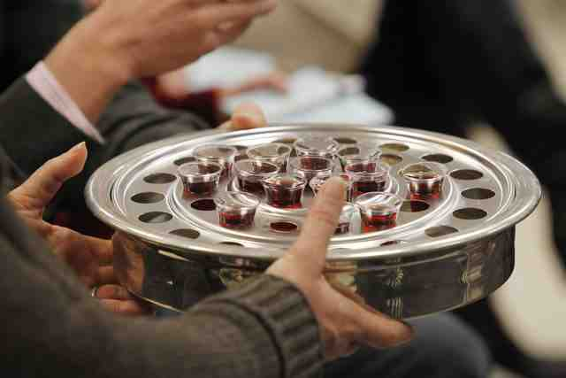
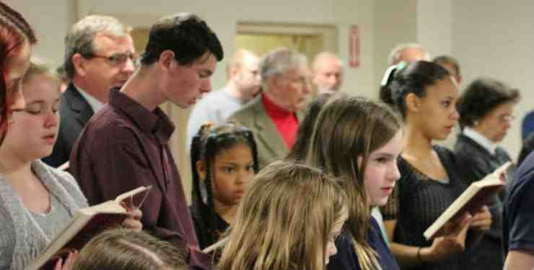
Measuring the church..

Slide 18
To the full measure of Christ..
Ephesians 4:11-13 And He Himself gave some to be apostles, some prophets, some evangelists, and some pastors and teachers, 12 for the equipping of the saints for the work of ministry, for the edifying of the body of Christ, 13 till we all come to the unity of the faith and of the knowledge of the Son of God, to a perfect man, to the measure of the stature of the fullness of Christ…

Slide 19
God’s Measuring Line
Zechariah 2:1-5, 10-11

