Slide 1
In the Blink of an Eye
Matthew 24:36-44

Slide 2
Be ready..
Matt 24:42 Watch therefore, for you do not know what hour your Lord is coming.. 44 Therefore you also be ready, for the Son of Man is coming at an hour you do not expect.

Slide 3
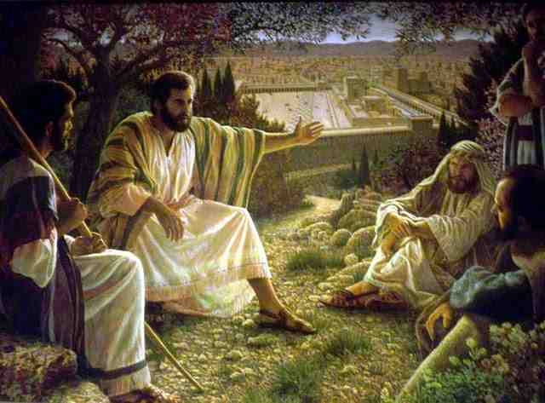
Jesus’ warnings..
Matthew 24:1-3 "Assuredly, I say to you, not one stone shall be left here upon another, that shall not be thrown down."

Slide 4
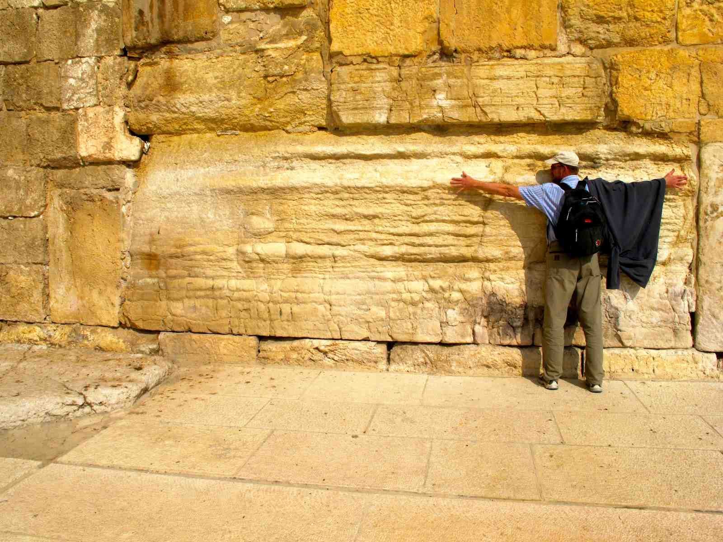
Jesus’ warnings..
Matthew 24:1-3 "Assuredly, I say to you, not one stone shall be left here upon another, that shall not be thrown down."

Slide 5
The Disciples’ question..
When will these things be?
What will be the sign of Your coming, and of the end of the age?"

Slide 6
Parallel accounts..
Mark 13:4..
When shall these things be?
What shall be the sign when these things are all about to be accomplished?
Luke 21:7..
When therefore shall these things be?
What shall be the sign when these things are about to come to pass?

Slide 7
The Disciples’ question..
When will these things be?
What will be the sign when these things are about to come pass?"

Slide 8
The Jerusalem coming..
He was coming in judgment on Jerusalem in their generation .. Vs 4-34
All these things .. Matt 23:36; 24:2, 8, 33-34
Matthew 24:33-34 So you also, when you see all these things, know that it is near — at the doors! 34 Assuredly, I say to you, this generation will by no means pass away till all these things take place.

Slide 9
Jesus gives them signs to prepare..
Early signs (not the end).. Vs 4-14
False Christs, wars, famines, earthquakes, persecution by countrymen, the gospel preached
Unmistakable signs (leave).. Vs 16-34
Abomination of desolation of Daniel (9:24-27)
Jerusalem surrounded (Luke 21:20-21)
Great tribulation (vs 21-28)
Heavenly powers brought down (vs 29-31)

Slide 10
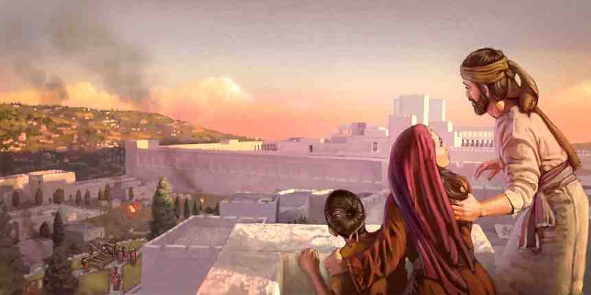
The time to flee..
When you see Jerusalem surrounded by armies… (a local event vs 15-18)
God will provide escape for his people..
For the elect’s sake those days will be shortened

Slide 11
Daniel’s 70 weeks..
Daniel 9:24-27 "Seventy weeks are determined For your people and for your holy city, To finish the transgression, To make an end of sins, To make reconciliation for iniquity, To bring in everlasting righteousness, To seal up vision and prophecy, And to anoint the Most Holy.

Slide 12
Daniel’s 70 weeks..
25 "Know therefore and understand, That from the going forth of the command To restore and build Jerusalem Until Messiah the Prince, There shall be seven weeks and sixty-two weeks; The street shall be built again, and the wall, Even in troublesome times.

Slide 13
Daniel’s 70 weeks..
26 "And after the sixty-two weeks Messiah shall be cut off, but not for Himself; And the people of the prince who is to come Shall destroy the city and the sanctuary. The end of it shall be with a flood, And till the end of the war desolations are determined.

Slide 14
Daniel’s 70 weeks..
27 Then he shall confirm a covenant with many for one week; But in the middle of the week He shall bring an end to sacrifice and offering. And on the wing of abominations shall be one who makes desolate, Even until the consummation, which is determined, Is poured out on the desolate."

Slide 15
Daniel’s 70 weeks..
70 weeks (70 sevens = 490 years)
Command to restore Jerusalem – 458 B.C.
7 weeks + 62 weeks (69 weeks) = 483 years
458 – 483 = 26 AD
70th week – covenant with many (Matt 26:28)
In middle of week.. End of sacrifice and offering
Desolations are determined until consummation

Slide 16
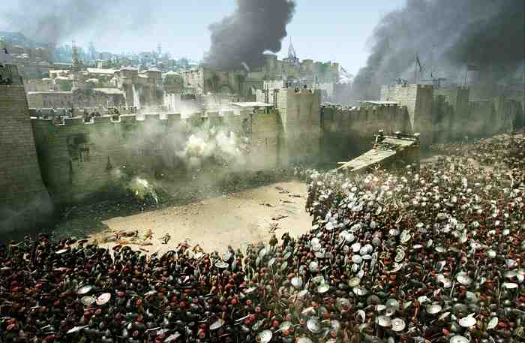
The sign of the Son of Man in heaven..
Vs 29-31 "Immediately after the tribulation of those days the sun will be darkened, and the moon will not give its light; the stars will fall from heaven, and the powers of the heavens will be shaken. 30 Then the sign of the Son of Man will appear in heaven, and then all the tribes of the earth will mourn, and they will see the Son of Man coming on the clouds of heaven with power and great glory.

Slide 17
Delivering His elect..
Vs 29-31 " 31 And He will send His angels with a great sound of a trumpet, and they will gather together His elect from the four winds, from one end of heaven to the other.

Slide 18
All these things..
Matthew 24:32-34 "Now learn this parable from the fig tree: When its branch has already become tender and puts forth leaves, you know that summer is near. 33 So you also, when you see all these things, know that it is near — at the doors! 34 Assuredly, I say to you, this generation will by no means pass away till all these things take place.

Slide 19
The Final Coming..
36 "But of that day and hour no one knows, not even the angels of heaven, but My Father only. 37 But as the days of Noah were, so also will the coming of the Son of Man be.

Slide 20
The Final Coming..
Jesus had knowledge of time of His coming upon Jerusalem.. but not this
The angels do not know..
Only the Father knew..

Slide 21
How to prepare..
Will be sudden and unexpected..
Will take people by surprise as in the Great Flood .. Vs 37-39
Some will be ready.. Close friends will not.. Vs 40-41
Thief gives no warning.. Be always on watch vs 42-45

Slide 22
How to prepare..
The wise servant is prepared for his Lord’s return at any time vs 45-51
The wise virgins were prepared for the delay of the bridegroom 25:1-13
The servants who used their talents were honored 25:14-30
The judgment will follow His coming 25:31-46

Slide 23
In the Blink of an Eye
Matthew 24:36-44

