Slide 1
Burdened by Grace
Galatians 3:1-3

Slide 2
Grace turning sour..
Galatians 3:1-3 O foolish Galatians! Who has bewitched you that you should not obey the truth?... Are you so foolish? Having begun in the Spirit, are you now being made perfect by the flesh?

Slide 3
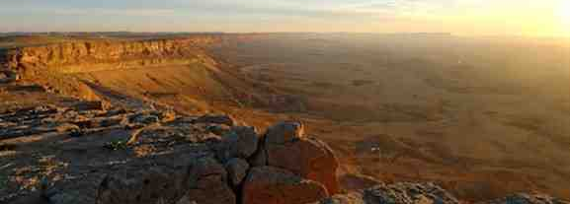
Murmuring with God..
Exodus 16:3 And the children of Israel said to them, "Oh, that we had died by the hand of the Lord in the land of Egypt… For you have brought us out into this wilderness to kill this whole assembly with hunger."

Slide 4
Disillusioned with Christ..
At first joyful to be a Christian..
Start to miss the old carefree life...
Christianity becomes an obligation..
Constant reminder of my debt to God…
“ Feeling I can never be good enough..”

Slide 5
Solving this problem..
Stop all pretense of self righteousness..
Trust His ability/desire to save you ...
Let the old self remain in the grave..
Reset your thinking with Christ …
He is ready to free you from prison!

Slide 6
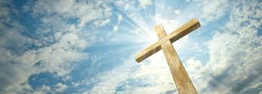
Grace is God’s gift..
It is given to us..we can’t repay it..
We overwhelm ourselves with guilt if we try to repay God for His grace…
All we can offer Him is our loyal faith..

Slide 7
God requires our faith..
Romans 1:16-17 I am not ashamed of the gospel of Christ, for it is the power of God to salvation for everyone who believes… 17 For in it the righteousness of God is revealed from faith to faith; as it is written, "The just shall live by faith."

Slide 8
Wages or Gift?..
The only wages we have truly earned…
Romans 6:23 For the wages of sin is death, but the gift of God is eternal life in Christ Jesus our Lord.
We have been deceived that sin brings gain..

Slide 9
God bestows gifts, not wages..
God is not paying us with heaven for our hard work trying to justify ourselves..
He’s giving us heaven for our genuine faith..
He has justified us by the gift of His Son!

Slide 10
The gift exceeds wages..
Romans 5:15 But the free gift is not like the offense. For if by the one man's offense many died, much more the grace of God and the gift by the grace of the one Man, Jesus Christ, abounded to many.
When we sin we earn death (Rom. 6:23)
By grace God gives us much more than life…

Slide 11
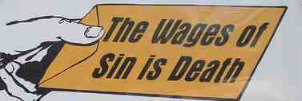
Are wages possible?..
Romans 4:4 Now to him who works, the wages are not counted as grace but as debt.
Those who lived a perfect life (have never sinned) will be rewarded with eternal life (James 2:10)
The problem: all have sinned and come short of the glory of God (Romans 3:20-23)
We can only expect the wages of eternal death!

Slide 12
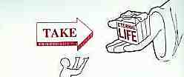
God offers a gift instead..
Rom 6:23 the wages of sin is death, but the gift of God is eternal life in Christ Jesus our Lord.
We will not receive what we have earned but what the God of grace wants to give us as a gift!
We look forward to Judgment Day as gift day like a child looks forward to Christmas…

Slide 13
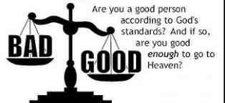
Why not a balance scale?..
Isaiah 6:3 "Holy, holy, holy is the Lord of hosts. The whole earth is full of His glory”
Galatians 3:10 "Cursed is everyone who does not continue in all things which are written in the book of the law, to do them."
Rules: “ Keep the commandments; live… Break the commandments; suffer the penalty” (Isaiah 59:2)

Slide 14
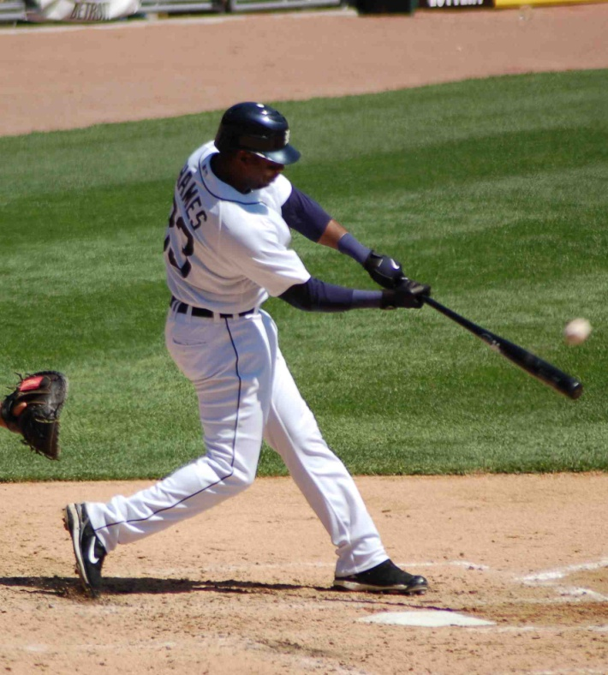
Law measures perfection..
Romans 3:10 "There is none righteous, no, not one;
Romans 3:20 Therefore by the deeds of the law no flesh will be justified in His sight, for by the law is the knowledge of sin.
Romans 3:23 for all have sinned and fall short of the glory of God,

Slide 15
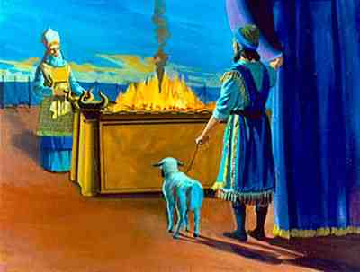
Sin required a sacrifice..
John 1:29 "Behold! The Lamb of God who takes away the sin of the world!
Romans 8:3 For what the law could not do in that it was weak through the flesh, God did by sending His own Son in the likeness of sinful flesh, on account of sin: He condemned sin in the flesh,
2 Corinthians 5:21 For He made Him who knew no sin to be sin for us, that we might become the righteousness of God in Him.

Slide 16
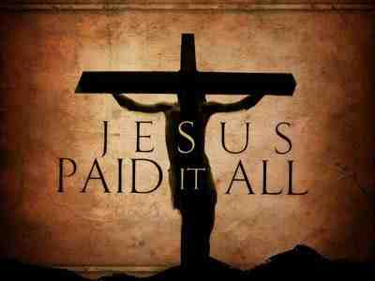
Sin required a sacrifice..
John 1:29 "Behold! The Lamb of God who takes away the sin of the world!
Romans 8:3 For what the law could not do in that it was weak through the flesh, God did by sending His own Son in the likeness of sinful flesh, on account of sin: He condemned sin in the flesh,
2 Corinthians 5:21 For He made Him who knew no sin to be sin for us, that we might become the righteousness of God in Him.

