Slide 1
Romans 15:1-7

Slide 2
Romans 15:5-7
Now may the God of patience and comfort grant you to be like-minded toward one another, according to Christ Jesus, 6 that you may with one mind and one mouth glorify the God and Father of our Lord Jesus Christ. 7 Therefore receive one another, just as Christ also received us, to the glory of God.

Slide 3
Receive, accept, welcome..
NKJ Therefore receive one another, just as Christ also received us, to the glory of God.
NIV Accept one another, then, just as Christ accepted you, in order to bring praise to God.
ESV Therefore welcome one another as Christ has welcomed you, for the glory of God.

Slide 4
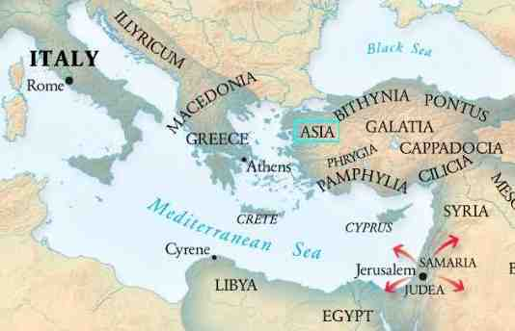
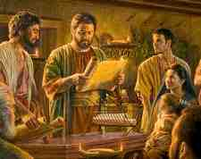
The church in Rome..
Jews and Gentiles …
1st century cultural background..
Huge divide ..
God bringing them together..
Issues of relating in the church..

Slide 5
How do I handle differences?
A Christian with different beliefs ..
What if they have different practices..
Is it possible to have fellowship..
Eating of meats..
Observing holy days..

Slide 6
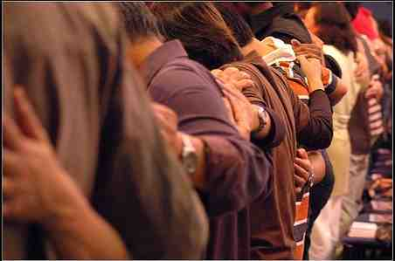
God wants us all together..
To overcome those differences…
To accept one another..
Acceptance based on His will
Built on common faith and love
Growing together to gain unity

Slide 7
Matters of indifference?
“If God hasn’t said anything about it, then He must be indifferent about it..”
But what are these differences based on?
Their understanding of God’s word..
They have different conclusions..
These are important questions..

Slide 8
How Paul handled this..
He gently lets it known where he stands..
Vs 14 there is nothing unclean of itself..
Vs 5 Let each be fully convinced in his own mind.
He doesn’t issue a simple set of answers..
He says there are going to be differences..
Here is how you treat one another..

Slide 9
A Disputable Matter..
A teaching or practice that two or more people disagree on..
Both sides support their view with scripture..
We have different convictions but we are still able to come together in fellowship..
We are accepting of one another..

Slide 10
Romans 14..
14:1-3 Receive one who is weak in the faith, but not to disputes over doubtful things. 2 For one believes he may eat all things, but he who is weak eats only vegetables. 3 Let not him who eats despise him who does not eat, and let not him who does not eat judge him who eats; for God has received him..

Slide 11
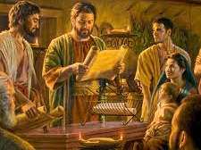
Romans 14..
14:4 Who are you to judge another's servant? To his own master he stands or falls. Indeed, he will be made to stand, for God is able to make him stand.

Slide 12
Romans 14..
14:9-10 For to this end Christ died and rose and lived again, that He might be Lord of both the dead and the living. 10 But why do you judge your brother? Or why do you show contempt for your brother? For we shall all stand before the judgment seat of Christ.

Slide 13
Romans 14..
14:11-13 For it is written:"As I live, says the Lord, Every knee shall bow to Me, And every tongue shall confess to God." 12 So then each of us shall give account of himself to God. 13 Therefore let us not judge one another anymore, but rather resolve this, not to put a stumbling block or a cause to fall in our brother's way.

Slide 14
Some matters are not disputable..
1 Corinthians 5:1-2 It is actually reported that there is sexual immorality among you, and such sexual immorality as is not even named among the Gentiles — that a man has his father's wife!
2 John 7 For many deceivers have gone out into the world who do not confess Jesus Christ as coming in the flesh. This is a deceiver and an antichrist.

Slide 15
Romans 14..
14:15-16 Yet if your brother is grieved because of your food, you are no longer walking in love. Do not destroy with your food the one for whom Christ died. 16 Therefore do not let your good be spoken of as evil..

Slide 16
Romans 15:1-7..
15:1 We then who are strong ought to bear with the scruples of the weak, and not to please ourselves.
My strength is to be used to the benefit of the weaker person..
Our goal ought to be to please our neighbor

Slide 17
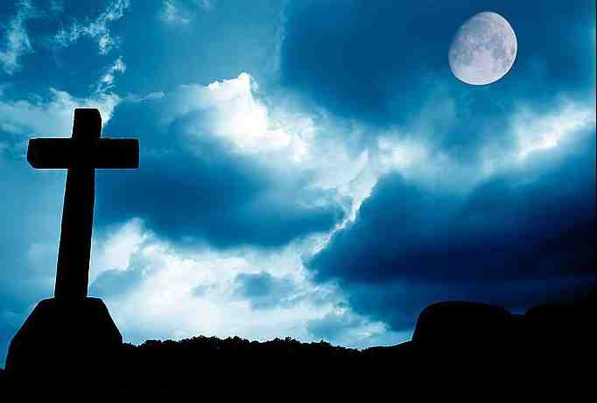
Romans 15:1-7..
15:3 For even Christ did not please Himself; but as it is written, "The reproaches of those who reproached You fell on Me."
How did Jesus conduct Himself when mistreated?
Amazing example of how deal with brothers who are not acting properly..

Slide 18
Romans 15:1-7..
15:4 For whatever things were written before were written for our learning, that we through the patience and comfort of the Scriptures might have hope.

Slide 19
Romans 15:1-7..
15:5-7 Now may the God of patience and comfort grant you to be like-minded toward one another, according to Christ Jesus, 6 that you may with one mind and one mouth glorify the God and Father of our Lord Jesus Christ.7 Therefore receive one another, just as Christ also received us, to the glory of God.

Slide 20
Romans 15:1-7

