Slide 1
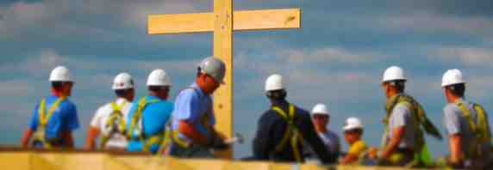
Builders for Christ
1 Corinthians 3:1-23

Slide 2
Babies and adults (3:1-4)..
3:1-4 And I, brethren, could not speak to you as to spiritual people but as to carnal, as to babes in Christ. 2 I fed you with milk and not with solid food; for until now you were not able to receive it, and even now you are still not able..

Slide 3
Babies and adults (3:1-4)..
3:3-4 for you are still carnal. For where there are envy, strife, and divisions among you, are you not carnal and behaving like mere men? 4 For when one says, "I am of Paul," and another, "I am of Apollos," are you not carnal?

Slide 4
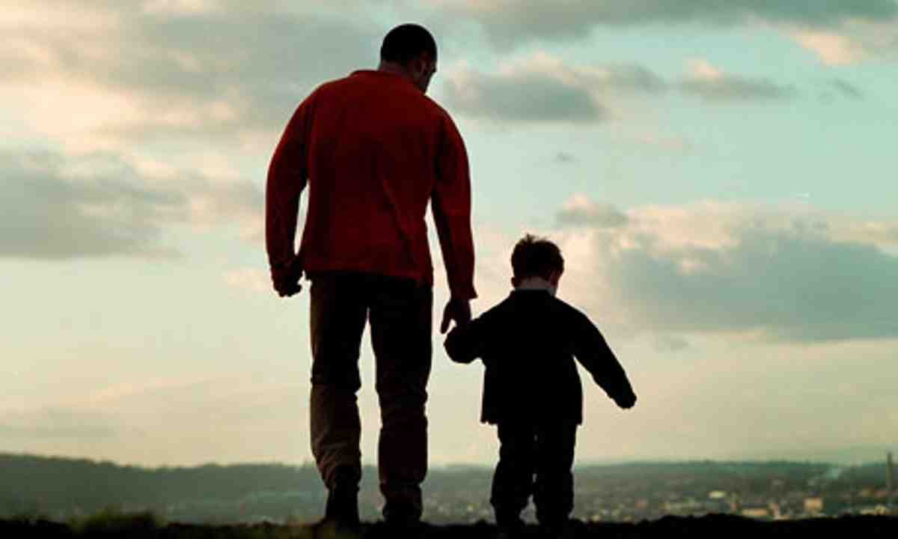
Babies and adults (3:1-4)..
Marks of immaturity…
Divisions among themselves (1:10-17)
Jealousy and Envy (3:1-4)

Slide 5
Planting and watering (3:5-8)..
3:5-8 Who then is Paul, and who is Apollos, but ministers through whom you believed, as the Lord gave to each one? 6 I planted, Apollos watered, but God gave the increase.

Slide 6
Planting and watering (3:5-8)..
7 So then neither he who plants is anything, nor he who waters, but God who gives the increase. 8 Now he who plants and he who waters are one, and each one will receive his own reward according to his own labor.

Slide 7
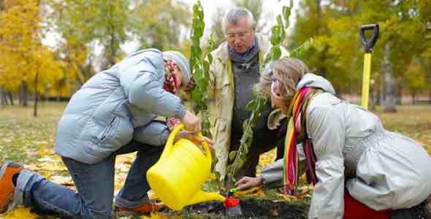
Planting and watering (3:5-8)..
Both are vital.. Equally important
God gives the growth..

Slide 8
Foundations and buildings (3:9-17)..
9 For we are God's fellow workers; you are God's field, you are God's building. 10 According to the grace of God which was given to me, as a wise master builder I have laid the foundation, and another builds on it. But let each one take heed how he builds on it. 11 For no other foundation can anyone lay than that which is laid, which is Jesus Christ.

Slide 9
Foundations and buildings (3:9-17)..
12 Now if anyone builds on this foundation with gold, silver, precious stones, wood, hay, straw, 13 each one's work will become clear; for the Day will declare it, because it will be revealed by fire; and the fire will test each one's work, of what sort it is. 14 If anyone's work which he has built on it endures, he will receive a reward. 15 If anyone's work is burned, he will suffer loss; but he himself will be saved, yet so as through fire.

Slide 10
Foundations and buildings (3:9-17)..
16 Do you not know that you are the temple of God and that the Spirit of God dwells in you? 17 If anyone defiles the temple of God, God will destroy him. For the temple of God is holy, which temple you are.

Slide 11
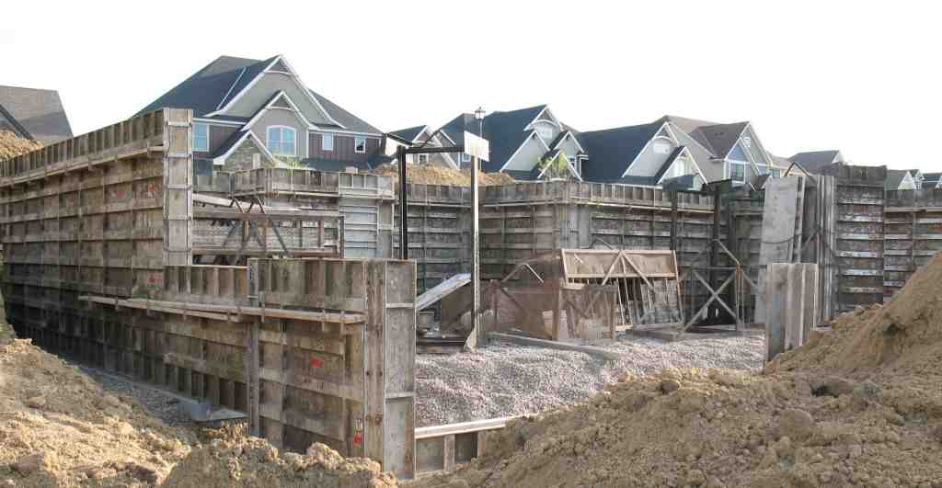
Foundations and buildings (3:9-17)..
We are fellow workers with God..
The quality of our work will be tested..
God’s temple is holy

Slide 12
Worldly wisdom (3:18-23)..
18 Let no one deceive himself. If anyone among you seems to be wise in this age, let him become a fool that he may become wise. 19 For the wisdom of this world is foolishness with God. For it is written, "He catches the wise in their own craftiness"; 20 and again, "The Lord knows the thoughts of the wise, that they are futile."

Slide 13
Worldly wisdom (3:18-23)..
21 Therefore let no one boast in men. For all things are yours: 22 whether Paul or Apollos or Cephas, or the world or life or death, or things present or things to come — all are yours. 23 And you are Christ's, and Christ is God's.

Slide 14
Builders for Christ
1 Corinthians 3:1-23

