Slide 1
Saved by Grace
Romans 6:8-14

Slide 2
Grace is about Giving
Romans 6:23 For the wages of sin is death, but the gift of God is eternal life in Christ Jesus our Lord.
Lostness – earned (deserved)
Salvation – a gift

Slide 3
Grace an attitude of God
Job 34:10-12
Nahum 1:2
Hebrews 12:29
Psalm 77:9
Micah 7:18-19
1 John 4:8

Slide 4
Window of Justice
Window of Grace
Wrath (fair)
Wages due
Gift – eternal life
Opposite of deserved

Slide 5
God’s tears..
Matthew 23:37 "O Jerusalem, Jerusalem, the one who kills the prophets and stones those who are sent to her! How often I wanted to gather your children together, as a hen gathers her chicks under her wings, but you were not willing!

Slide 6
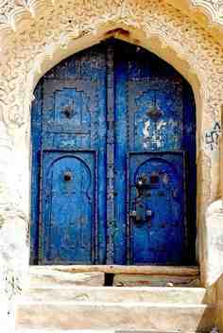
Grace is a way of Salvation
John 1:17
Galatians 5:4
Romans 6:14
Law
Grace
Gal 3:14 James 2:10
2 Cor 5:21
Keep the commandments
Escape the penalty
Break the commandments
Suffer the penalty
Keep the commandments
Suffer the penalty
Break the commandments
Escape the penalty

Slide 7
Saved by Grace
Romans 6:8-14

