Slide 1
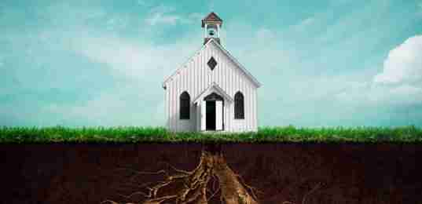
Strengthening the Church
“So the churches were strengthened in the faith,
and increased in number daily. ..”
Acts 16:1-5

Slide 2
2 Timothy 2:15 Be diligent to present yourself approved to God, a worker who does not need to be ashamed, rightly dividing the word of truth.

Slide 3
Location, Location, Location!

Slide 4
Essentials for Strengthening the Church..
Authority, Authority, Authority!
Attitude, Attitude, Attitude!
Action, Action, Action!

Slide 5
Authority of God’s Word..
Begins with Christ (Matt 28:18)..
"All authority has been given to Me in heaven and on earth..”
Delegated to Apostles (Matt 28:19; Acts 2:42)
Jude 17 But you, beloved, remember the words which were spoken before by the apostles of our Lord Jesus Christ..
Based on Will of God (Matt 7:21-23)
Matthew 7:21 "Not everyone who says to Me, 'Lord, Lord,' shall enter the kingdom of heaven, but he who does the will of My Father in heaven.

Slide 6
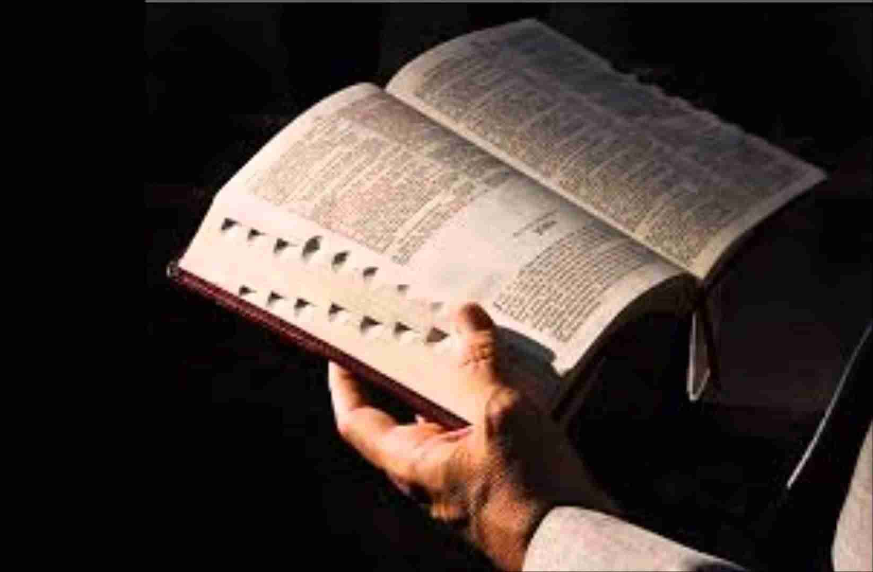
Attitude toward God..
Humble submission to God (James 4:6-10)
Humble yourselves in the sight of the Lord, and He will lift you up.
Loving obedience (John 14:15; 1 John 5:3)
"If you love Me, keep My commandments”..
Respect or reverence (John 4:24; Heb 12:28)
Hebrews 12:28 Therefore, since we are receiving a kingdom which cannot be shaken, let us have grace, by which we may serve God acceptably with reverence and godly fear.

Slide 7
Respond with Action..
Doing what God says (Rom 10:17)
Luke 11:28 But He said, "More than that, blessed are those who hear the word of God and keep it!“
Attitude of obedience (James 1:22-25)
James 1:22 But be doers of the word, and not hearers only, deceiving yourselves.
Calling Him “Lord” (Luke 6:46)
Luke 6:46 "But why do you call Me 'Lord, Lord,' and not do the things which I say?

Slide 8
Strengthening the Church
“So the churches were strengthened in the faith,
and increased in number daily. ..”
Acts 16:1-5

