Slide 1
The Foolishness of God
1 Corinthians 1:18-31

Slide 2
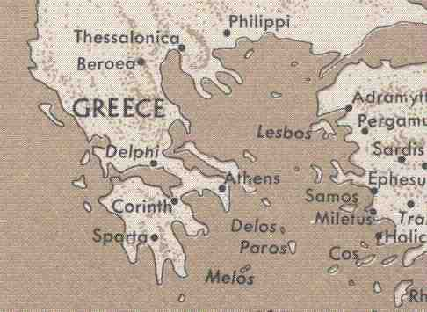

Slide 3
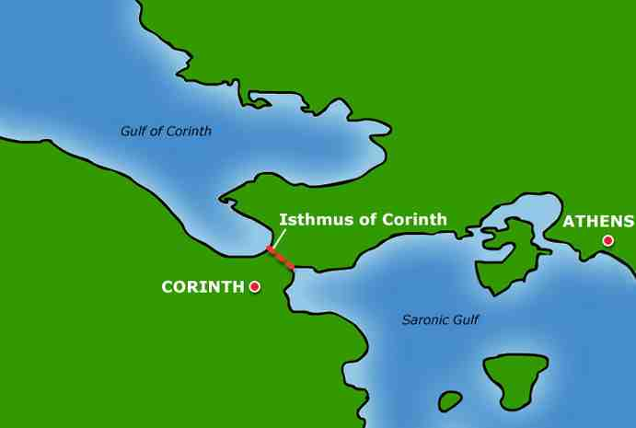

Slide 4
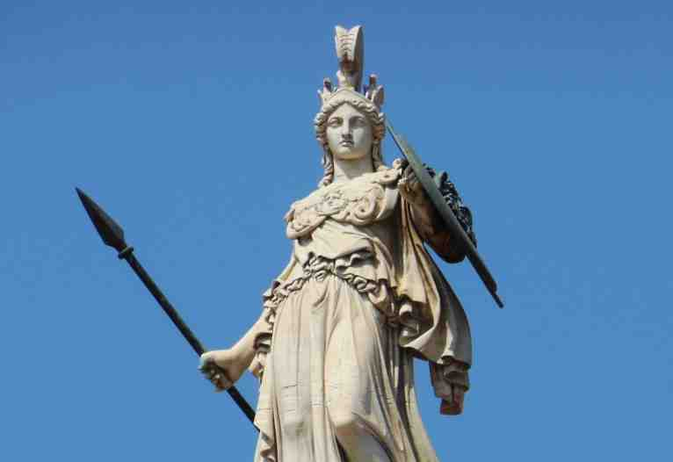
Athena (goddess of wisdom)

Slide 5
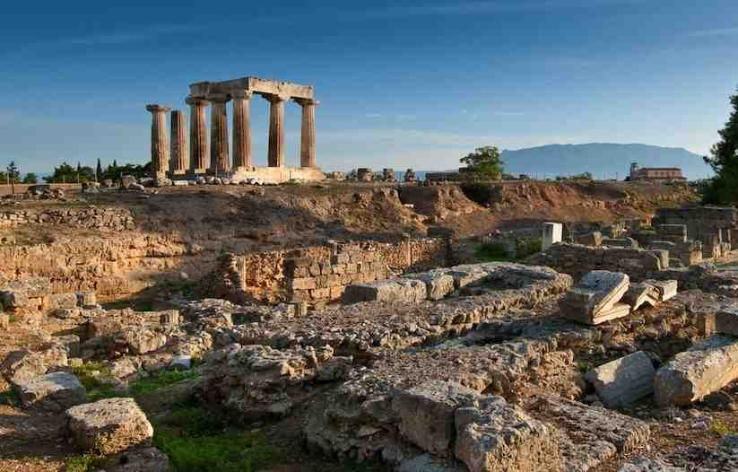
Problems in the church..
1 Corinthians 1:10 Now I plead with you, brethren, by the name of our Lord Jesus Christ, that you all speak the same thing, and that there be no divisions among you, but that you be perfectly joined together in the same mind and in the same judgment.

Slide 6
Adopting human wisdom..
1 Corinthians 1:17 For Christ did not send me to baptize, but to preach the gospel, not with wisdom of words, lest the cross of Christ should be made of no effect.
Produces division..
Makes void the cross of Christ..

Slide 7
The Cross is foolish to man..
A Crucified Messiah and a Crucified Self…

Slide 9
The Message (18-25)…
18 For the message of the cross is foolishness to those who are perishing, but to us who are being saved it is the power of God. 19 For it is written:"I will destroy the wisdom of the wise, And bring to nothing the understand-ing of the prudent." 20 Where is the wise? Where is the scribe? Where is the disputer of this age? Has not God made foolish the wisdom of this world?

Slide 10
The Message…
21 For since, in the wisdom of God, the world through wisdom did not know God, it pleased God through the foolishness of the message preached to save those who believe. 22 For Jews request a sign, and Greeks seek after wisdom; 23 but we preach Christ crucified, to the Jews a stumbling block and to the Greeks foolishness, 24 but to those who are called, both Jews and Greeks, Christ the power of God and the wisdom of God. 25 Because the foolishness of God is wiser than men, and the weakness of God is stronger than men.

Slide 11
The Messengers (26-29)…
26 For you see your calling, brethren, that not many wise according to the flesh, not many mighty, not many noble, are called. 27 But God has chosen the foolish things of the world to put to shame the wise, and God has chosen the weak things of the world to put to shame the things which are mighty; 28 and the base things of the world and the things which are despised God has chosen, and the things which are not, to bring to nothing the things that are, 29 that no flesh should glory in His presence.

Slide 12
The Method (30-31)…
30 But of Him you are in Christ Jesus, who became for us wisdom from God — and righteousness and sanctification and redemption — 31 that, as it is written, "He who glories, let him glory in the Lord."

Slide 14
The Foolishness of God
1 Corinthians 1:18-31

