Slide 1
The True Grace of God
1 Peter 5:5-12

Slide 2
.. may the God of all grace, who called us to His eternal glory by Christ Jesus, after you have suffered a while, perfect, establish, strengthen, and settle you… I have written to you briefly, exhorting and testifying that this is the true grace of God in which you stand.
1 Peter 5:10-12

Slide 3
CHARIS = GRACE
(Greek) (English)
CHARA = Beautiful, Lovely, Delightful
N.T. = Joy/Rejoicing
LATIN = Gratitude

Slide 4
God’s attitude &
Actions towards Mankind
GRACE

Slide 5
God’s options…
To destroy man ..
Take away man’s free will ..
Offer man salvation in Christ ..

Slide 6
John 1:17
For the Law was given through Moses…
Grace and truth came through
Jesus Christ.

Slide 7
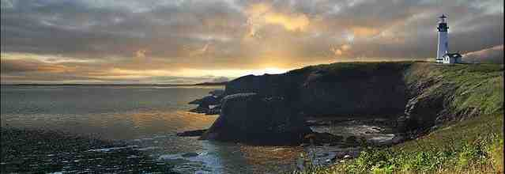
NT Emphasis ..
Salvation is result of God’s grace..
All have sinned/cannot save ourselves..
We are justified by grace through faith..
Salvation is a gift/we cannot boast..

Slide 8
For the Law was given through Moses; grace and truth were realized through Jesus Christ.
John 1:17

Slide 9
Paul in Romans..
Therefore by the deeds of the law no flesh will be justified in His sight, for by the law is the knowledge of sin.
Romans 3:20-21

Slide 10
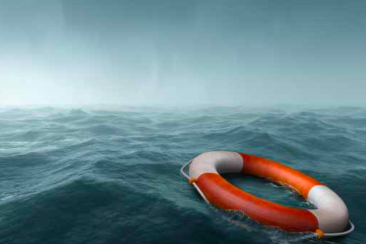
Paul in Romans..
For all have sinned and fall short of the glory of God, 24 being justified freely by His grace through the redemption that is in Christ Jesus..
Romans 3:23-24

Slide 11
Paul in Romans..
Therefore we conclude that a man is justified by faith apart from the deeds of the law. .. Do we then make void the law through faith? Certainly not! On the contrary, we establish the law.
Romans 3:28,31

Slide 12
Abraham justified by faith..
What then shall we say that Abraham our father has found according to the flesh? 2 For if Abraham was justified by works, he has something to boast about, but not before God. 3 For what does the Scripture say? "Abraham believed God, and it was accounted to him for righteousness."
Romans 4:1-3

Slide 13
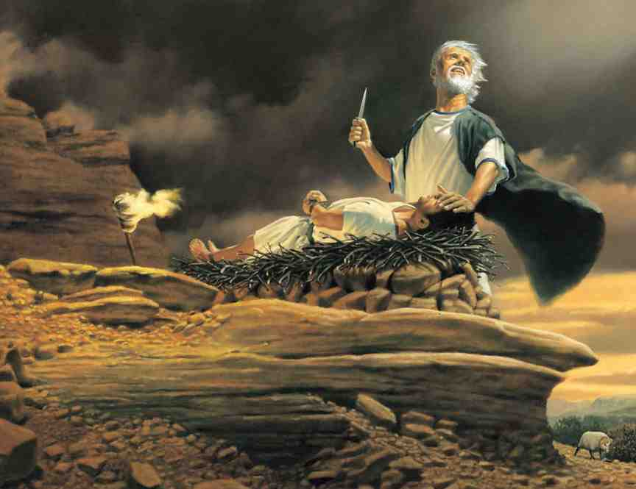
James 2:21-24..
Was not Abraham our father justified by works when he offered Isaac his son on the altar? 22 Do you see that faith was working together with his works, and by works faith was made perfect? .. 24 You see then that a man is justified by works, and not by faith only.

Slide 14
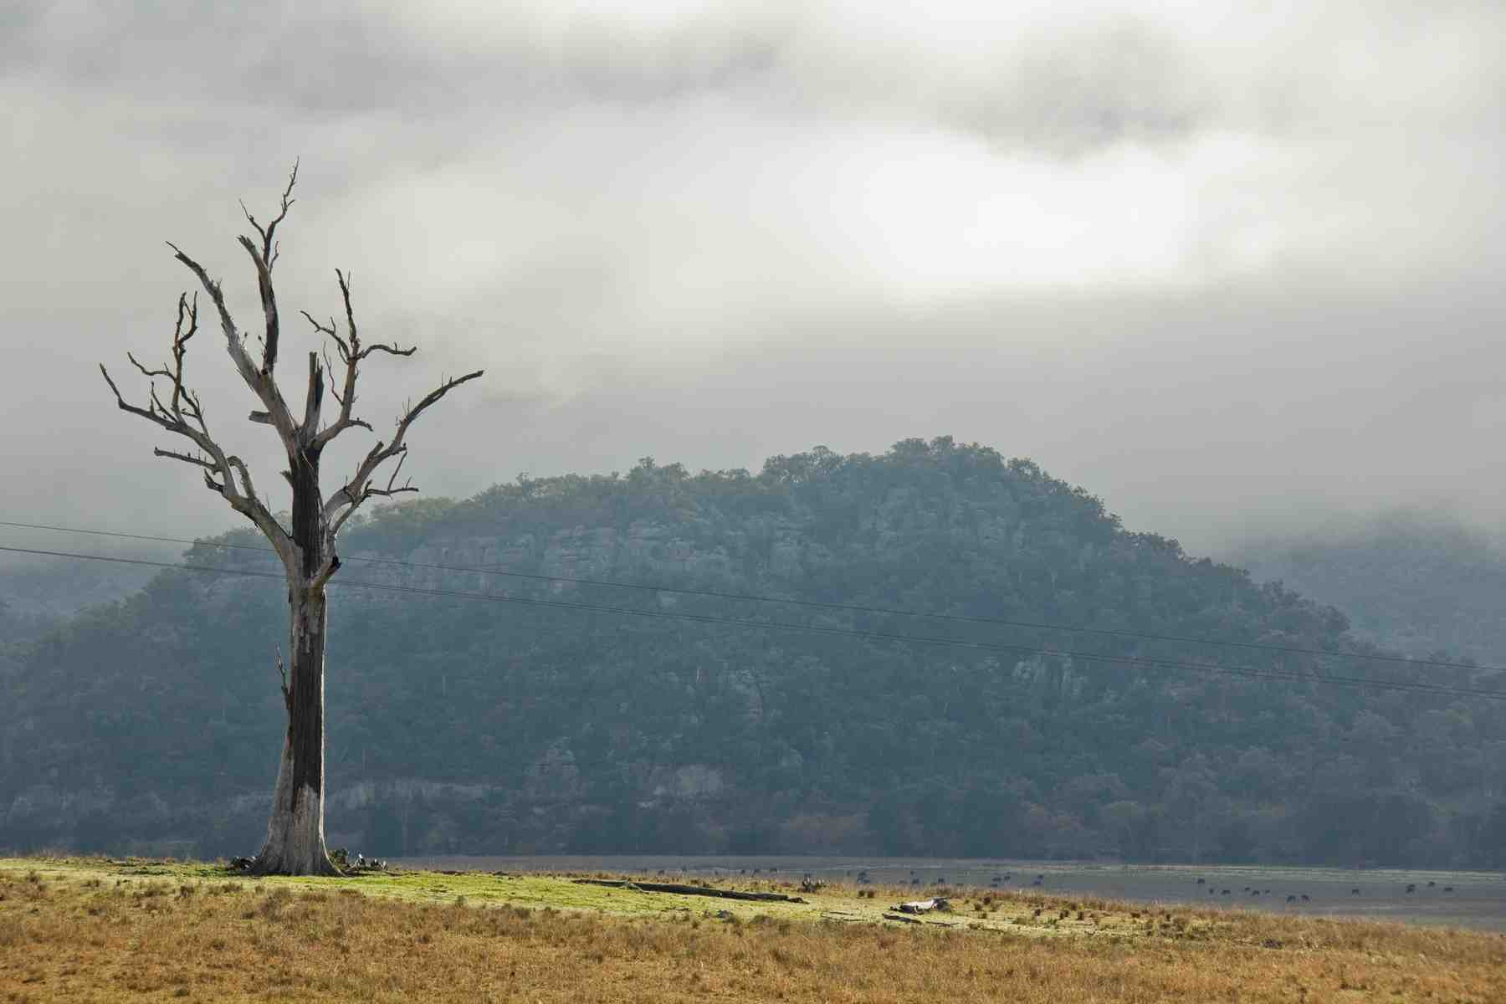
Why James emphasizes works..
14 What does it profit, my brethren, if someone says he has faith but does not have works? Can faith save him?
15 If a brother or sister is naked and destitute of daily food, 16 and one of you says to them, "Depart in peace, be warmed and filled," but you do not give them the things which are needed for the body, what does it profit?
17 Thus also faith by itself, if it does not have works, is dead.
James 2:14-17

Slide 15
Different contexts..
Paul is dealing with justification..
Not through merit but through grace
Both Jew and Gentile have sinned
Both must be saved by faith in Christ
James exhorts us to faith that works..
What good is it to “say” we believe in God
We must show our faith by doing His will

Slide 16
Paul and James agree..
What shall we say then? Shall we continue in sin that grace may abound? 2 Certainly not! How shall we who died to sin live any longer in it? 3 Or do you not know that as many of us as were baptized into Christ Jesus were baptized into His death?
Romans 6:1-3

Slide 17
Paul and James agree..
Shall we sin because we are not under law but under grace? Certainly not! 16 Do you not know that to whom you present yourselves slaves to obey, you are that one's slaves whom you obey, whether of sin leading to death, or of obedience leading to righteousness? 17 But God be thanked that though you were slaves of sin, yet you obeyed from the heart that form of doctrine to which you were delivered. 18 And having been set free from sin, you became slaves of righteousness.
Romans 6:14-18

Slide 18
Paul and James agree..
But be doers of the word, and not hearers only, deceiving yourselves. 23 For if anyone is a hearer of the word and not a doer, he is like a man observing his natural face in a mirror; 24 for he observes himself, goes away, and immediately forgets what kind of man he was. 25 But he who looks into the perfect law of liberty and continues in it, and is not a forgetful hearer but a doer of the work, this one will be blessed in what he does.
James 1:22-25

Slide 19
Paul and James agree..
For whoever shall keep the whole law, and yet stumble in one point, he is guilty of all. 11 For He who said, "Do not commit adultery," also said, "Do not murder." Now if you do not commit adultery, but you do murder, you have become a transgressor of the law. 12 So speak and so do as those who will be judged by the law of liberty.
James 2:10-12

Slide 20
The True Grace of God
1 Peter 5:5-12

