Slide 1
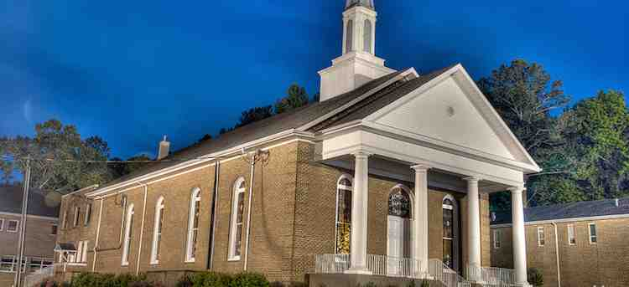
Immorality in the Church
1 Corinthians 5:1-13

Slide 2
A different problem..
Ch 1-4 Problem of Division
Report from Chloe’s household
Contentions over different teachers
Wisdom of God foolishness to world
(PHILOSOPHICAL SINS)
Ch 5 Problem of Immorality
(FLESHLY PHYSICAL SINS)

Slide 3
1-2 A Shocking Sin..
5:1 a man living with his father’s wife
The sin was well known
Still going on at present
A sin not acceptable to pagans

Slide 4
1-2 A Strange Response..
5:2 the church not disturbed
Puffed up (arrogant)
No sense of shame or guilt
Need for recognizing and confronting

Slide 5
3-5 Tough Love..
5:3 Paul’s attitude
Absent but Judged the man guilty
Not same as critical judgmental spirit
5:4 Action for the church
Gather together to deal with
With power of Christ
Deliver to Satan (remove from church)

Slide 6
3-5 Tough Love..
5:5 Hopeful goal of repentance
Destruction of flesh (painful)
Spirit may be saved in day of Lord
Numbered with saints when Jesus returns

Slide 7
6-8 Why Sin Can’t be Ignored..
5:6 Spread of leaven..
Sin unchecked will permeate church
Christ our Lamb offered Himself
Keep feast with purity and sincerity

Slide 8
9-13 An Important Clarification..
5:9 How to apply our relationships
Previous letter as to sexually immoral
Does not refer to those immoral in world
Separate from Christian disciplined by church
Leave those outside for God to judge

Slide 9
Important principles..
Never judge non-Christians by Christian standards
Infiltrate the world – not isolate from it
Church discipline applies to church – not your family
The purpose is restoration, not punishment

Slide 10
Immorality in the Church
1 Corinthians 5:1-13

