Slide 1
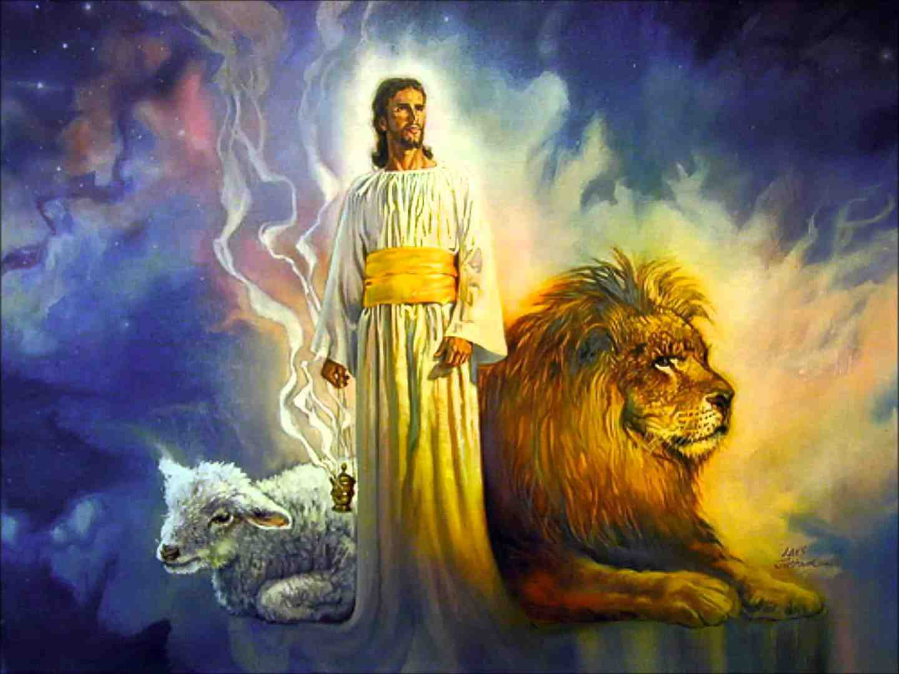
The Lamb of God
Slain from the Foundation of the World
Revelation 13:8

Slide 2
Revelation 13:8 All who dwell on the earth will worship him, whose names have not been written in the Book of Life of the Lamb slain from the foundation of the world.

Slide 3
An Eternal Plan
God is not subject to time..
Psalms 90:2 from everlasting
2 Peter 3:8 one day as a thousand years
Creation.. Gen 1:1
The beginning of time
God’s plan was from eternity

Slide 4
Things kept secret..
Matthew 13:34-35 "I will open My mouth in parables; I will utter things kept secret from the foundation of the world.“
1 Corinthians 2:9-10 But as it is written: "Eye has not seen, nor ear heard, Nor have entered into the heart of man The things which God has prepared for those who love Him.“
Matthew 7:28-29 And so it was, when Jesus had ended these sayings, that the people were astonished at His teaching, 29 for He taught them as one having authority, and not as the scribes.

Slide 5
A Kingdom prepared from foundation of the world..
Matthew 25:34 Then the King will say to those on His right hand, 'Come, you blessed of My Father, inherit the kingdom prepared for you from the foundation of the world:
Yet prepared finally by Jesus .. John 14:1-4
Hebrews 4:3 For we who have believed do enter that rest, as He has said:"So I swore in My wrath, 'They shall not enter My rest,'" although the works were finished from the foundation of the world.

Slide 6
The Father’s love for the Son
John 17:24 "Father, I desire that they also whom You gave Me may be with Me where I am, that they may behold My glory which You have given Me; for You loved Me before the foundation of the world.
John 17:9-10 "I pray for them. I do not pray for the world but for those whom You have given Me, for they are Yours. 10 And all Mine are Yours, and Yours are Mine, and I am glorified in them.

Slide 7
The saved in Christ chosen before foundation of world..
Ephesians 1:4-5 just as He chose us in Him before the foundation of the world, that we should be holy and without blame before Him in love..
God chose to save the world in His Son
John 14:6; Acts 4:12; John 15:4-5
We can only be saved “in Him” – in Christ
The revealed terms of salvation – Acts 2:37-41,47

Slide 8
Christ the Lamb foreordained before foundation of world..
1 Peter 1:18-20 knowing that you were not redeemed with corruptible things..19 but with the precious blood of Christ, as of a lamb without blemish and without spot. 20 He indeed was foreordained before the foundation of the world, but was manifest in these last times for you
Hebrews 9:25-26 not that He should offer Himself often, as the high priest enters the Most Holy Place every year with blood of another — 26 He then would have had to suffer often since the foundation of the world; but now, once at the end of the ages, He has appeared to put away sin by the sacrifice of Himself.

Slide 9
The Slain Lamb is Alive..
Revelation 5:6 And I looked, and behold, in the midst of the throne and of the four living creatures, and in the midst of the elders, stood a Lamb as though it had been slain, having seven horns and seven eyes, which are the seven Spirits of God sent out into all the earth.

Slide 10
The Lamb of God
Slain from the Foundation of the World
Revelation 13:8

