Slide 1
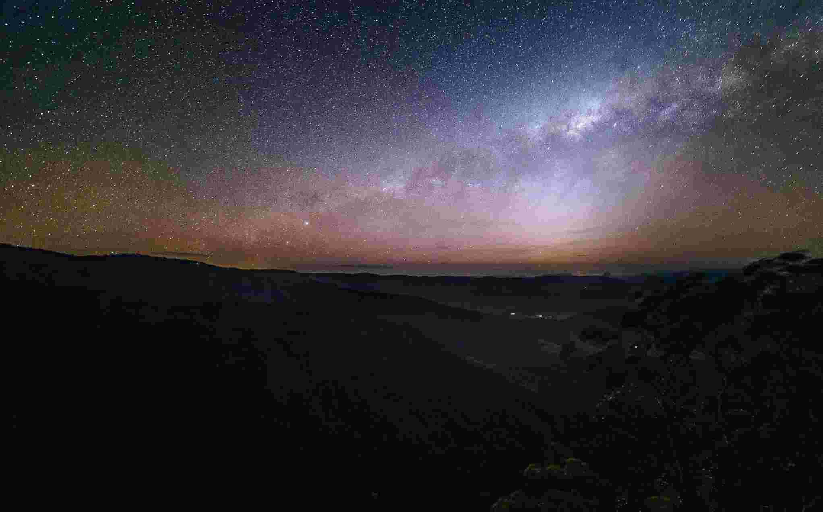
Adonai Owner and Ruler
Genesis 15:1-8

Slide 2
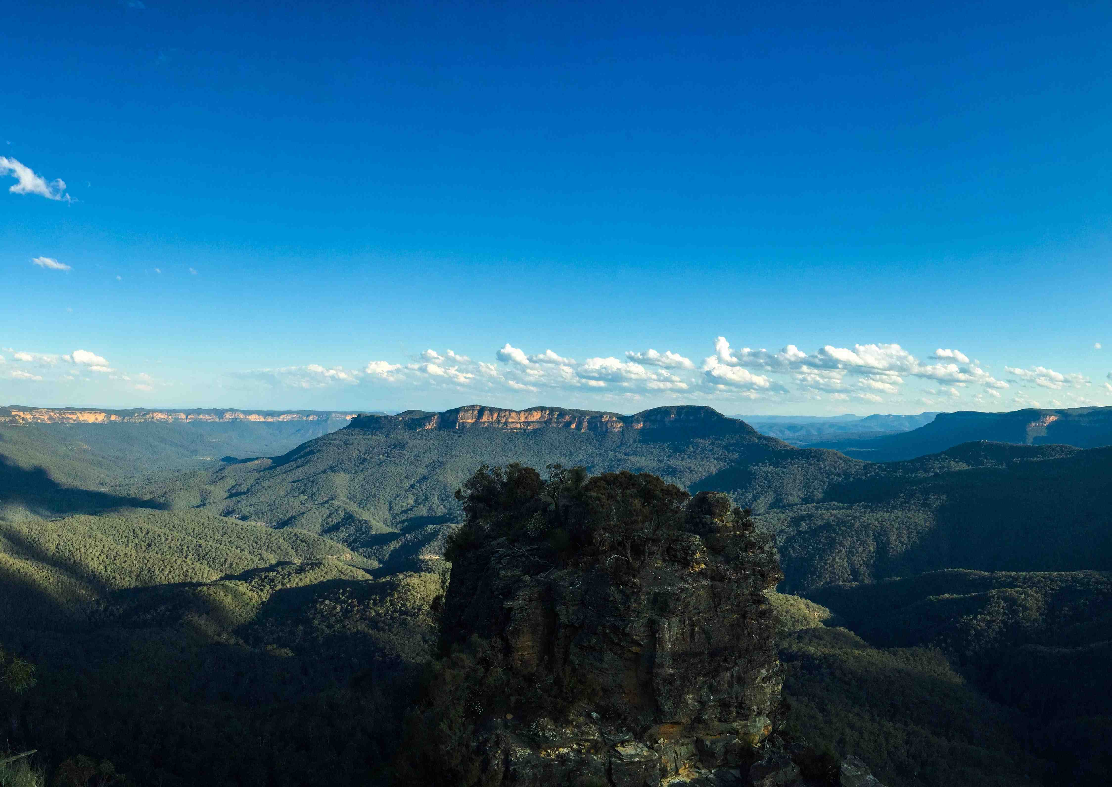
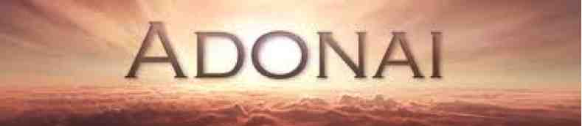
Psalms 97:5 The mountains melt like wax at the presence of the Lord..
the Lord (Adonai) of the whole earth.

Slide 3
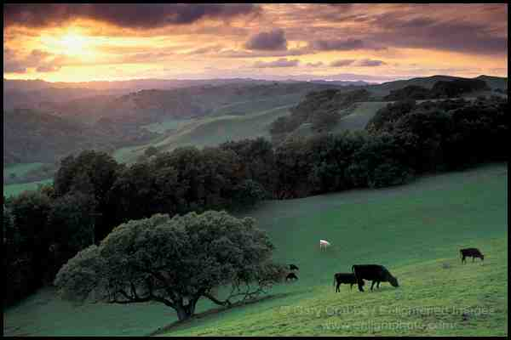
Psalms 50:10 For every beast of the forest is Mine, and the cattle on a thousand hills

Slide 4
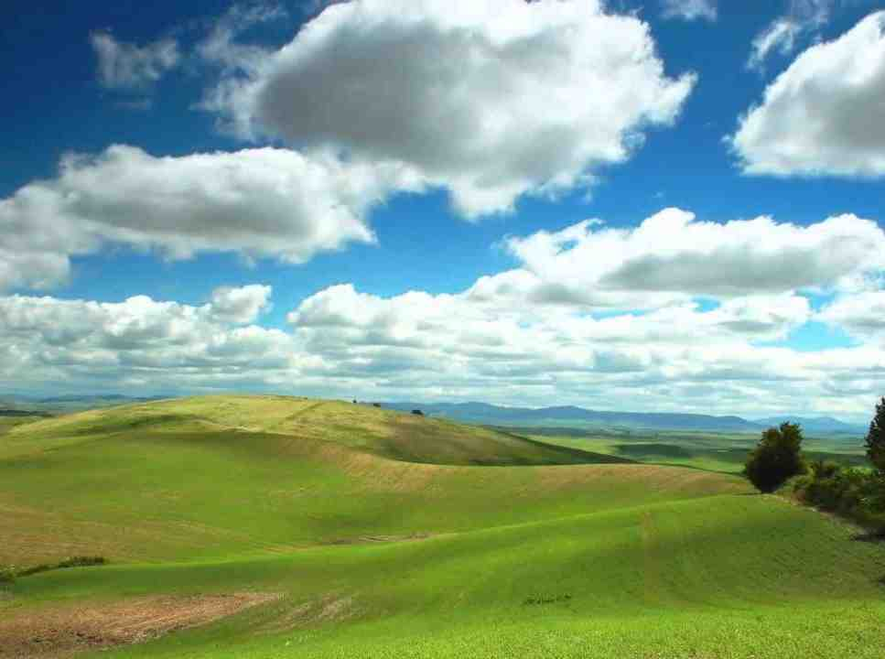
Malachi 1:6 "If I am the Father, where is My honor? And if I am a Master. where is My reverence?
Malachi 1:14 "I am a great King" says the Lord of hosts, "and My name is to be feared among the nations."

Slide 5
Accepting God’s ownership..
Genesis 12:1-2 Now the LORD (Yahweh) had said to Abram..I will make you a great nation; I will bless you And make your name great; And you shall be a blessing...
10 years later..

Slide 6
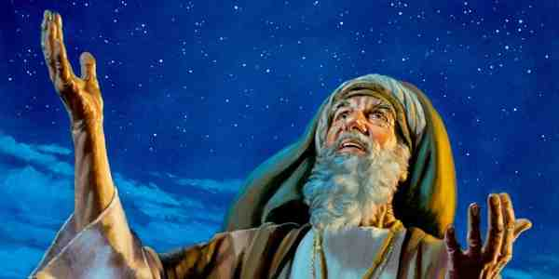
Accepting God’s ownership..
Genesis 15:1-2 After these things the word of the LORD came to Abram in a vision, saying, "Do not be afraid, Abram. I am your shield, your exceedingly great reward." 2 But Abram said, "Lord God, what will You give me, seeing I go childless, and the heir of my house is Eliezer of Damascus?" Then Abram said, "Look, You have given me no offspring; indeed one born in my house is my heir!"

Slide 7
Accepting God’s ownership..
Genesis 15:4-5 And behold, the word of the Lord came to him, saying, "This one shall not be your heir, but one who will come from your own body shall be your heir." 5 Then He brought him outside and said, "Look now toward heaven, and count the stars if you are able to number them." And He said to him, "So shall your descendants be."

Slide 8
Accepting God’s ownership..
6 And he believed in the Lord, and He accounted it to him for righteousness. Then He said to him, "I am the Lord, who brought you out of Ur of the Chaldeans, to give you this land to inherit it." 8 And he said, "Lord God, how shall I know that I will inherit it?"

Slide 9
Accepting God’s ownership..
Genesis 15:18 On the same day the Lord made a covenant with Abram, saying:"To your descendants I have given this land, from the river of Egypt to the great river, the River Euphrates —

Slide 10
Lord and Master..
Surrender and submission..
Acknowledge God’s ownership
Requires our submission
We are merely stewards..
All we have belongs to Him
We are allowed to use it

Slide 11
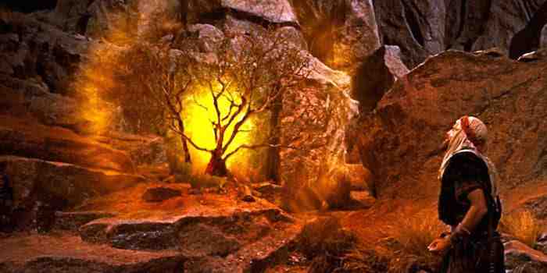
Helps us overcome doubts
Exodus 4:10-12 Then Moses said to the LORD (Yahweh), "O my Lord (Adonai), I am not eloquent, neither before nor since You have spoken to Your servant; but I am slow of speech and slow of tongue."

Slide 12
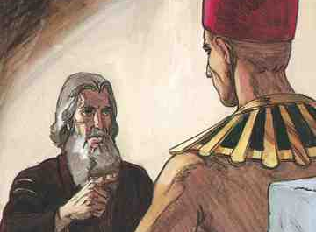
Helps us overcome doubts
Exodus 4:10-12 11 So the Lord said to him, "Who has made man's mouth? Or who makes the mute, the deaf, the seeing, or the blind? Have not I, the Lord? 12 Now therefore, go, and I will be with your mouth and teach you what you shall say."

Slide 13
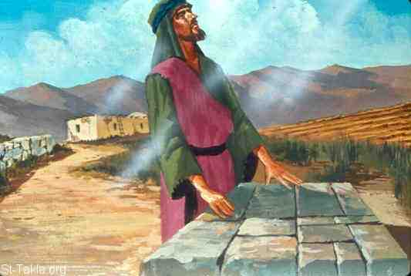
Helps us overcome doubts
Judges 6:12-15 And the Angel of the Lord appeared to him, and said to him, "The Lord is with you, you mighty man of valor!" 13 Gideon said to Him, "O my lord, if the Lord is with us, why then has all this happened to us? And where are all His miracles which our fathers told us about, saying, 'Did not the Lord bring us up from Egypt?' But now the Lord has forsaken us and delivered us into the hands of the Midianites."

Slide 14
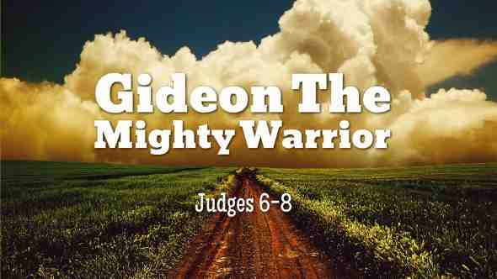
Helps us overcome doubts
Judges 6:12-15 14 Then the Lord turned to him and said, "Go in this might of yours, and you shall save Israel from the hand of the Midianites. Have I not sent you?" 15 So he said to Him, "O my Lord (Adonai), how can I save Israel? Indeed my clan is the weakest in Manasseh, and I am the least in my father's house. 16 And the Lord said to him, "Surely I will be with you, and you shall defeat the Midianites as one man." ...

Slide 15
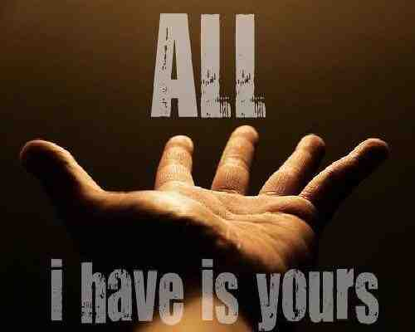
Acknowledgment vs Surrender..
1 Timothy 6:6-8 Now godliness with contentment is great gain. 7 For we brought nothing into this world, and it is certain we can carry nothing out. 8 And having food and clothing, with these we shall be content.

Slide 16
Acknowledgment vs Surrender..
Acts 2:36 "Therefore let all the house of Israel know assuredly that God has made this Jesus, whom you crucified, both Lord and Christ."
Romans 10:9-10 that if you confess with your mouth the Lord Jesus and believe in your heart that God has raised Him from the dead, you will be saved. 10 For with the heart one believes unto righteousness, and with the mouth confession is made unto salvation...

Slide 17
Acknowledgment vs Surrender..
1 Timothy 1:12-15 And I thank Christ Jesus our Lord who has enabled me, because He counted me faithful, putting me into the ministry, 13 although I was formerly a blasphemer, a persecutor, and an insolent man; but I obtained mercy because I did it ignorantly in unbelief. 14 And the grace of our Lord was exceedingly abundant, with faith and love which are in Christ Jesus. 15 This is a faithful saying and worthy of all acceptance, that Christ Jesus came into the world to save sinners, of whom I am chief.

Slide 18
Knowing God as Adonai..
They are servants (God as owner)
He can supply all their needs
Can do whatever He calls them to do
Daniel 11:32b but the people who know their God shall be strong, and carry out great exploits.

Slide 19
Adonai Owner and Ruler
Genesis 15:1-8

