Slide 1
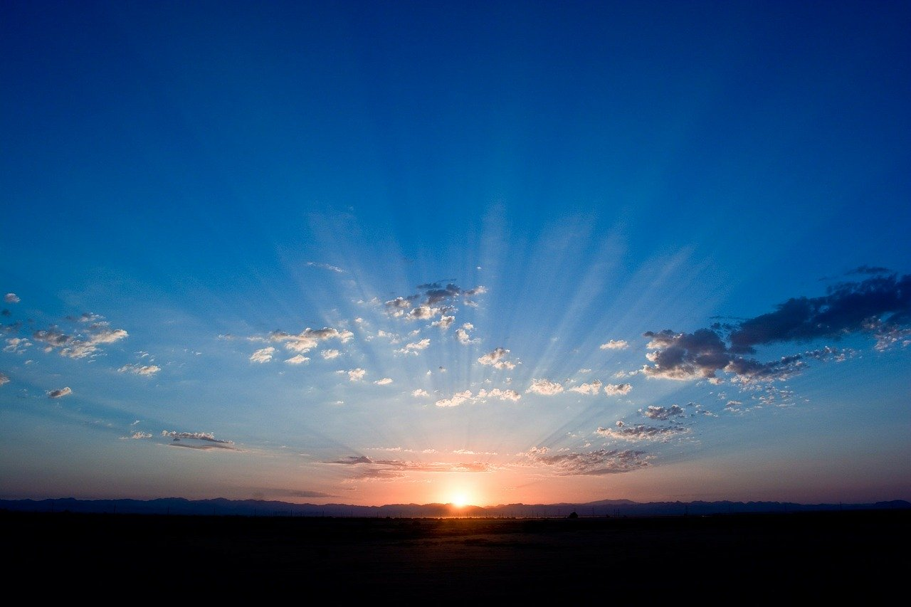
How Majestic is Your Name
Psalm 8:1-9

Slide 2
Our names are important..

Slide 3
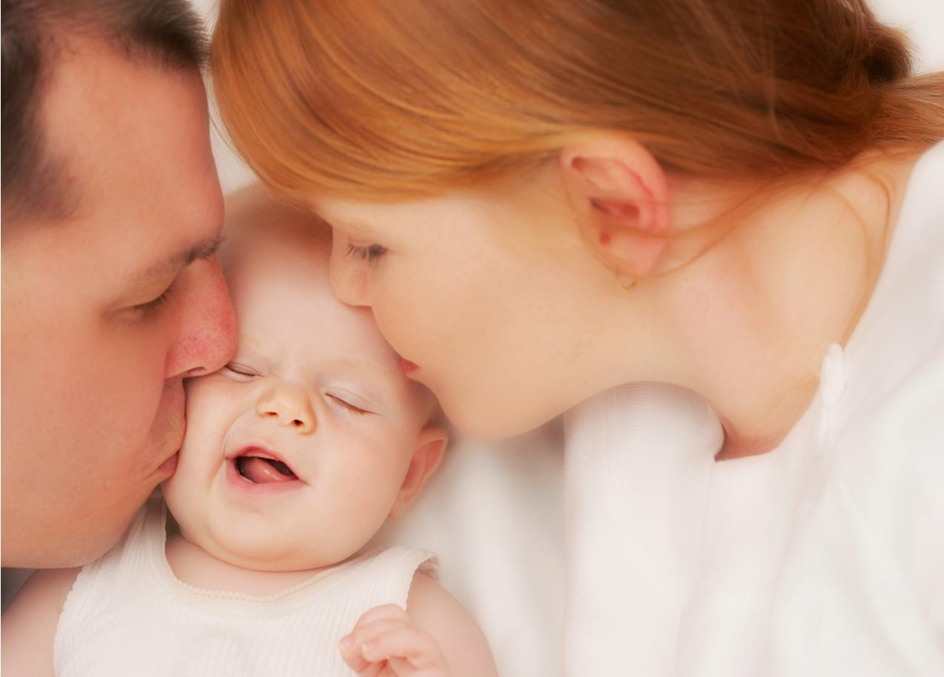
Naming our children..

Slide 4
Our names identify us..

Slide 5
Meeting someone new..

Slide 6
Changing your name..

Slide 7
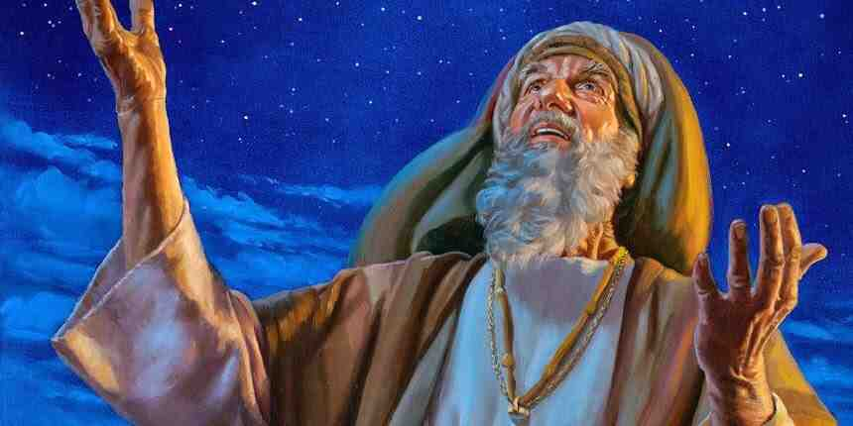

Slide 8
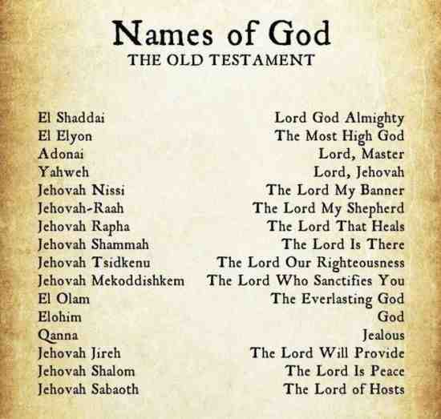

Slide 9
God’s name is critical to our understanding of His nature..

Slide 10
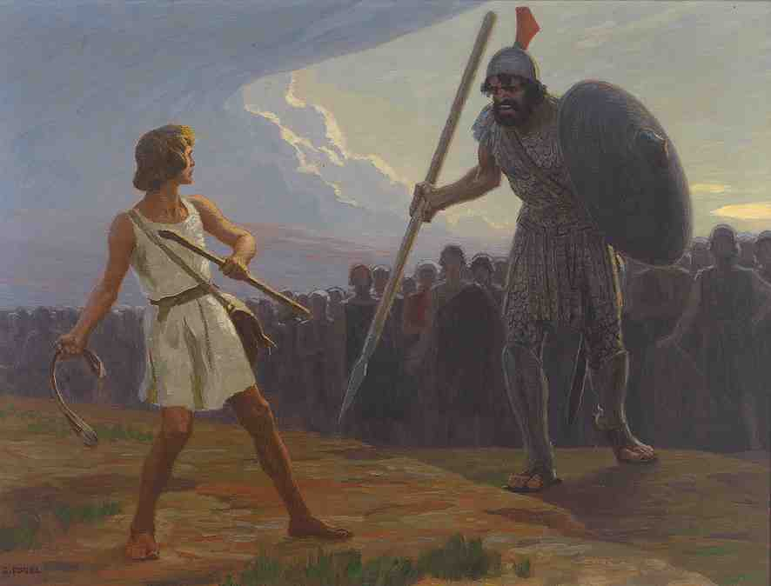
David in an overwhelming situation knew His God..

Slide 11
God’s name provides refuge..

Slide 12
How Majestic is Your Name
Psalm 8:1-9

Slide 13
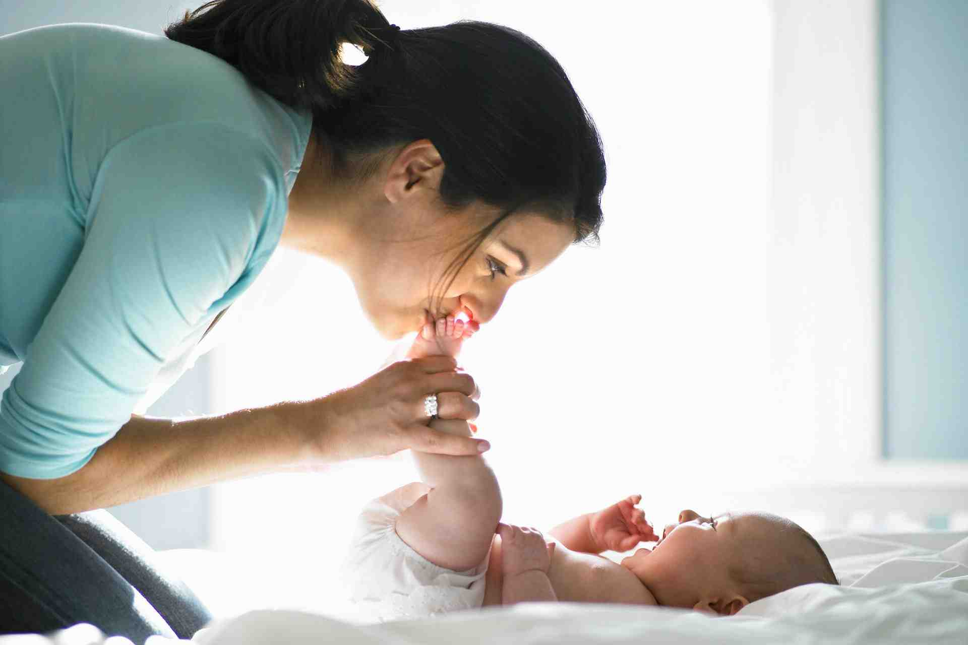
Dependence on God..
Matt 11:27 I thank You, Father, Lord of heaven and earth, that You have hidden these things from the wise and prudent and have revealed them to babes. 26 Even so, Father, for so it seemed good in Your sight.
God ordains His strength to infants..

Slide 16
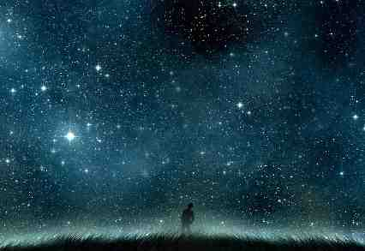
The work of your fingers..

Slide 17
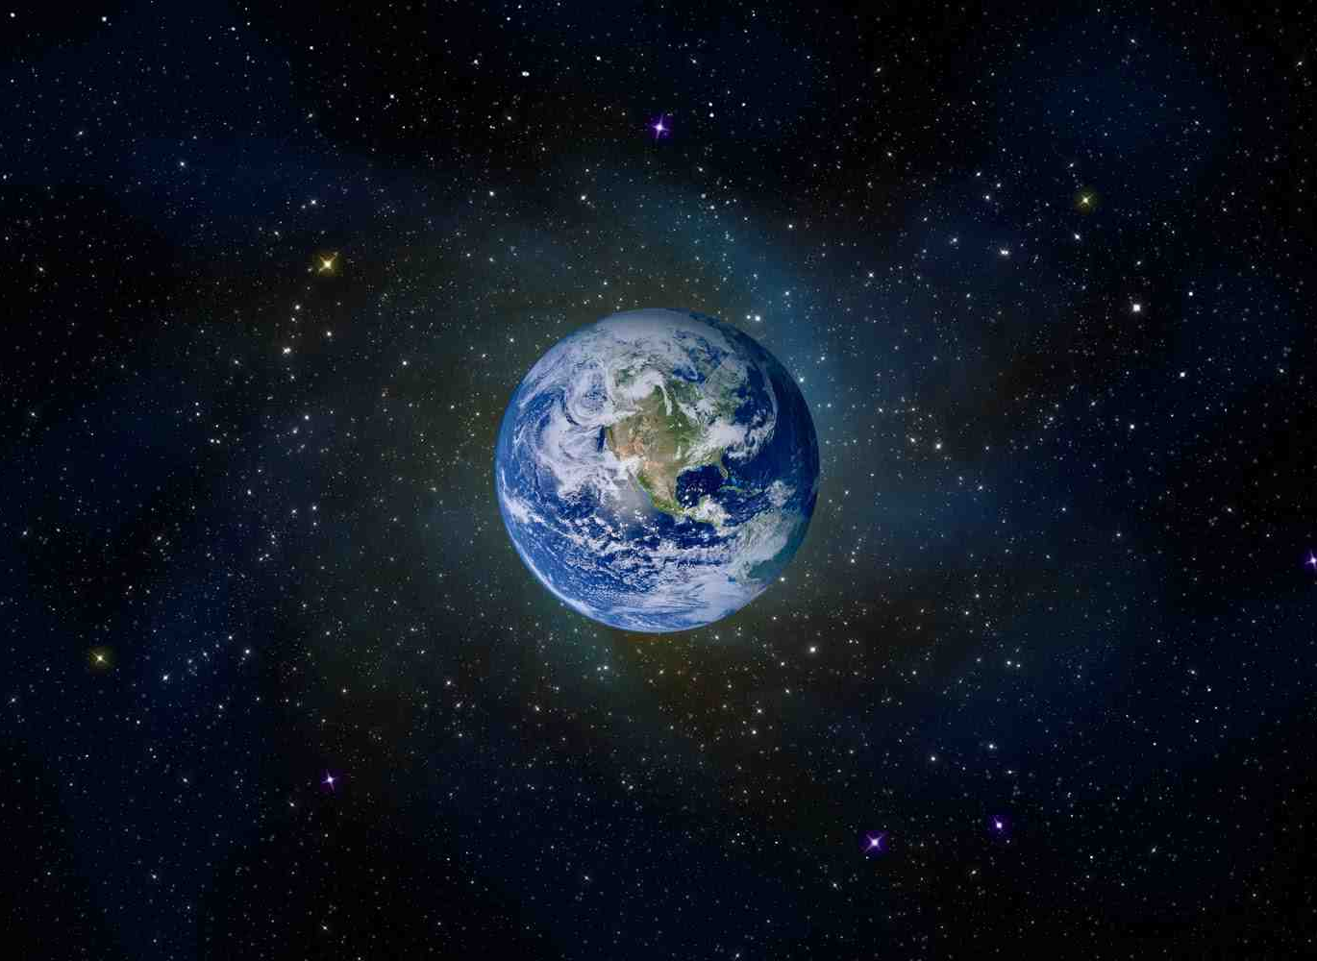
What is man that You take thought of him?..

Slide 18
1 O Lord, our Lord, How majestic is Your name in all the earth..
9 O Lord, our Lord, How majestic is Your name in all the earth!

Slide 19
Psalm 34:1-3

Slide 20
How Majestic is Your Name
Psalm 8:1-9

