Slide 1
Yahweh Unchanging Personal God
Exodus 3:1-15

Slide 2
Our God is multi-faceted

Slide 4
Yahweh
Isaiah 42:8
I am the Lord (Yahweh), that is My name; And My glory I will not give to another..

Slide 5
God’s personal name..
Isaiah 42:8..
I am the Lord (Yahweh), that is My name; And My glory I will not give to another..
Yahweh (Jehovah)..
Most used name .. 6,823 times
LORD (Yahweh)… Lord (Adonai)

Slide 6
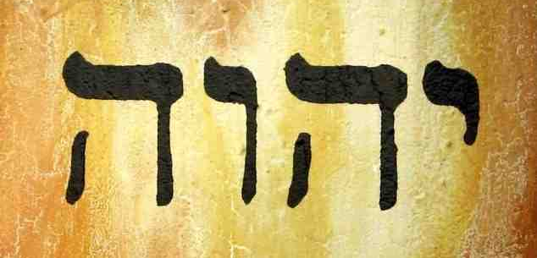
YHWH (four consonants)
The “Tetragrammaton”

Slide 7
Yahweh Elohim ..
Genesis 2:4 This is the history of the heavens and the earth when they were created, in the day that the Lord God made the earth and the heavens...
Genesis 28:13 And behold, the Lord stood above it and said: "I am the Lord God of Abraham your father and the God of Isaac; the land on which you lie I will give to you and your descendants.

Slide 8
God reveals His name.. (Exodus 3)
3:1-6 Moses sees burning bush ..
God of Abraham, Isaac, Jacob
The same God ..
3:7-11 God’s announcement..
Deliver My people in Egypt
I will send you to Pharaoh

Slide 9
God reveals His name.. (Exodus 3)
3:13-16 Then Moses said to God, "Indeed, when I come to the children of Israel and say to them, 'The God of your fathers has sent me to you,' and they say to me, 'What is His name?' what shall I say to them?"
14 And God said to Moses, "I AM WHO I AM." And He said, "Thus you shall say to the children of Israel, 'I AM has sent me to you.'"
15 Moreover God said to Moses, "Thus you shall say to the children of Israel: 'The Lord God of your fathers, the God of Abraham, the God of Isaac, and the God of Jacob, has sent me to you. This is My name forever, and this is My memorial to all generations.'

Slide 10
I AM WHO I AM (YAHWEH)..
Self-Existing, Unchanging..
Exists in Himself
Unchanging
Malachi 3:6 For I, the LORD (Yahweh), do not change..

Slide 11
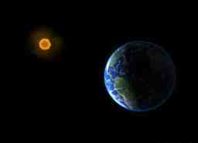

Slide 12
I AM WHO I AM (YAHWEH)..
God of revelation..
Genesis 2:4 This is the history of the heavens and the earth when they were created, in the day that the Lord God made the earth and the heavens...
“Thus saith the LORD (Yahweh)”..

Slide 13
I AM WHO I AM (YAHWEH)..
God of holiness..
Gen 2:4-25 Yahweh Elohim
Genesis 3:1-5.. Elohim only
Genesis 3:8-23 .. Yahweh Elohim
Psalms 11:7 For the Lord is righteous, He loves righteousness; His countenance beholds the upright.
Leviticus 19:2 'You shall be holy, for I the Lord your God am holy.

Slide 14
I AM WHO I AM (YAHWEH)..
God of relationship (covenant)
Exodus 33:18 Show me your glory
Ex 33:19-23 Yahweh passes by Moses
Ex 34:6-7"The Lord, the Lord God, merciful and gracious, longsuffering, and abounding in goodness and truth, 7 keeping mercy for thousands, forgiving iniquity and transgression and sin, by no means clearing the guilty, visiting the iniquity of the fathers upon the children and the children's children to the third and the fourth generation."

Slide 15
Yahweh Unchanging Personal God
Exodus 3:1-15

