Slide 1
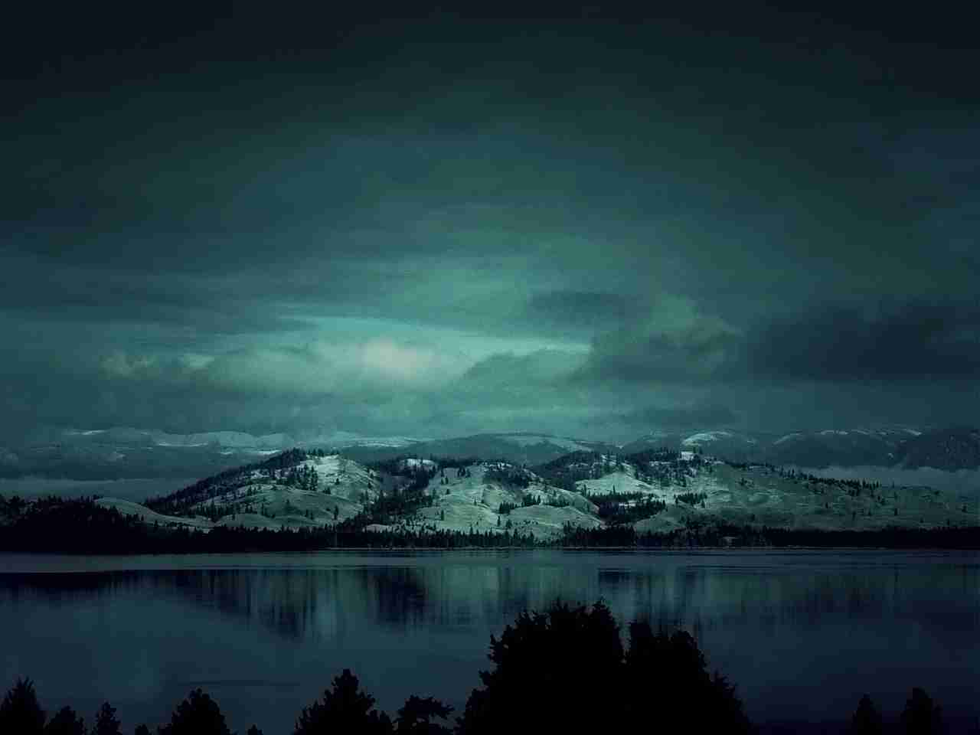
El Shaddai Lord God Almighty
Genesis 17:1-8

Slide 2
Happiness?..

Slide 3
Genesis 17:1 When Abram was ninety-nine years old, the Lord appeared to Abram and said to him, "I am Almighty God; walk before Me and be blameless.

Slide 7
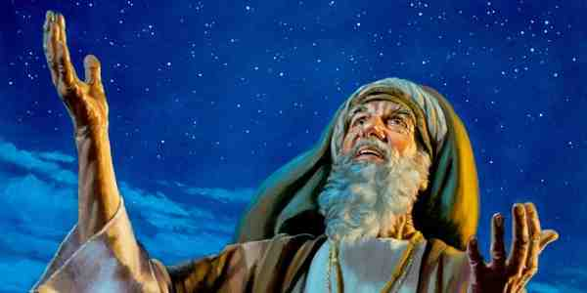
Genesis 15:1-2 the word of the Lord came to Abram in a vision, saying, "Do not be afraid, Abram. I am your shield, your exceedingly great reward."

Slide 8
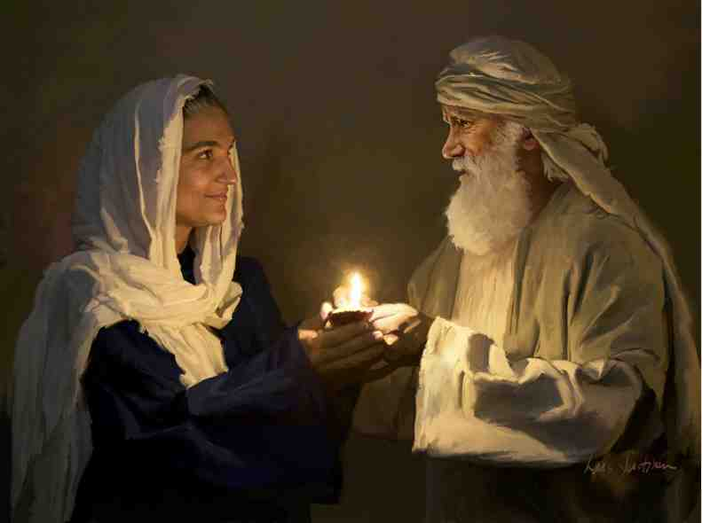
Gen 16:1-2Now Sarai, Abram's wife, had borne him no children. And she had an Egyptian maidservant whose name was Hagar. 2 So Sarai said to Abram, "See now, the Lord has restrained me from bearing children. Please, go in to my maid; perhaps I shall obtain children by her." And Abram heeded the voice of Sarai.

Slide 9
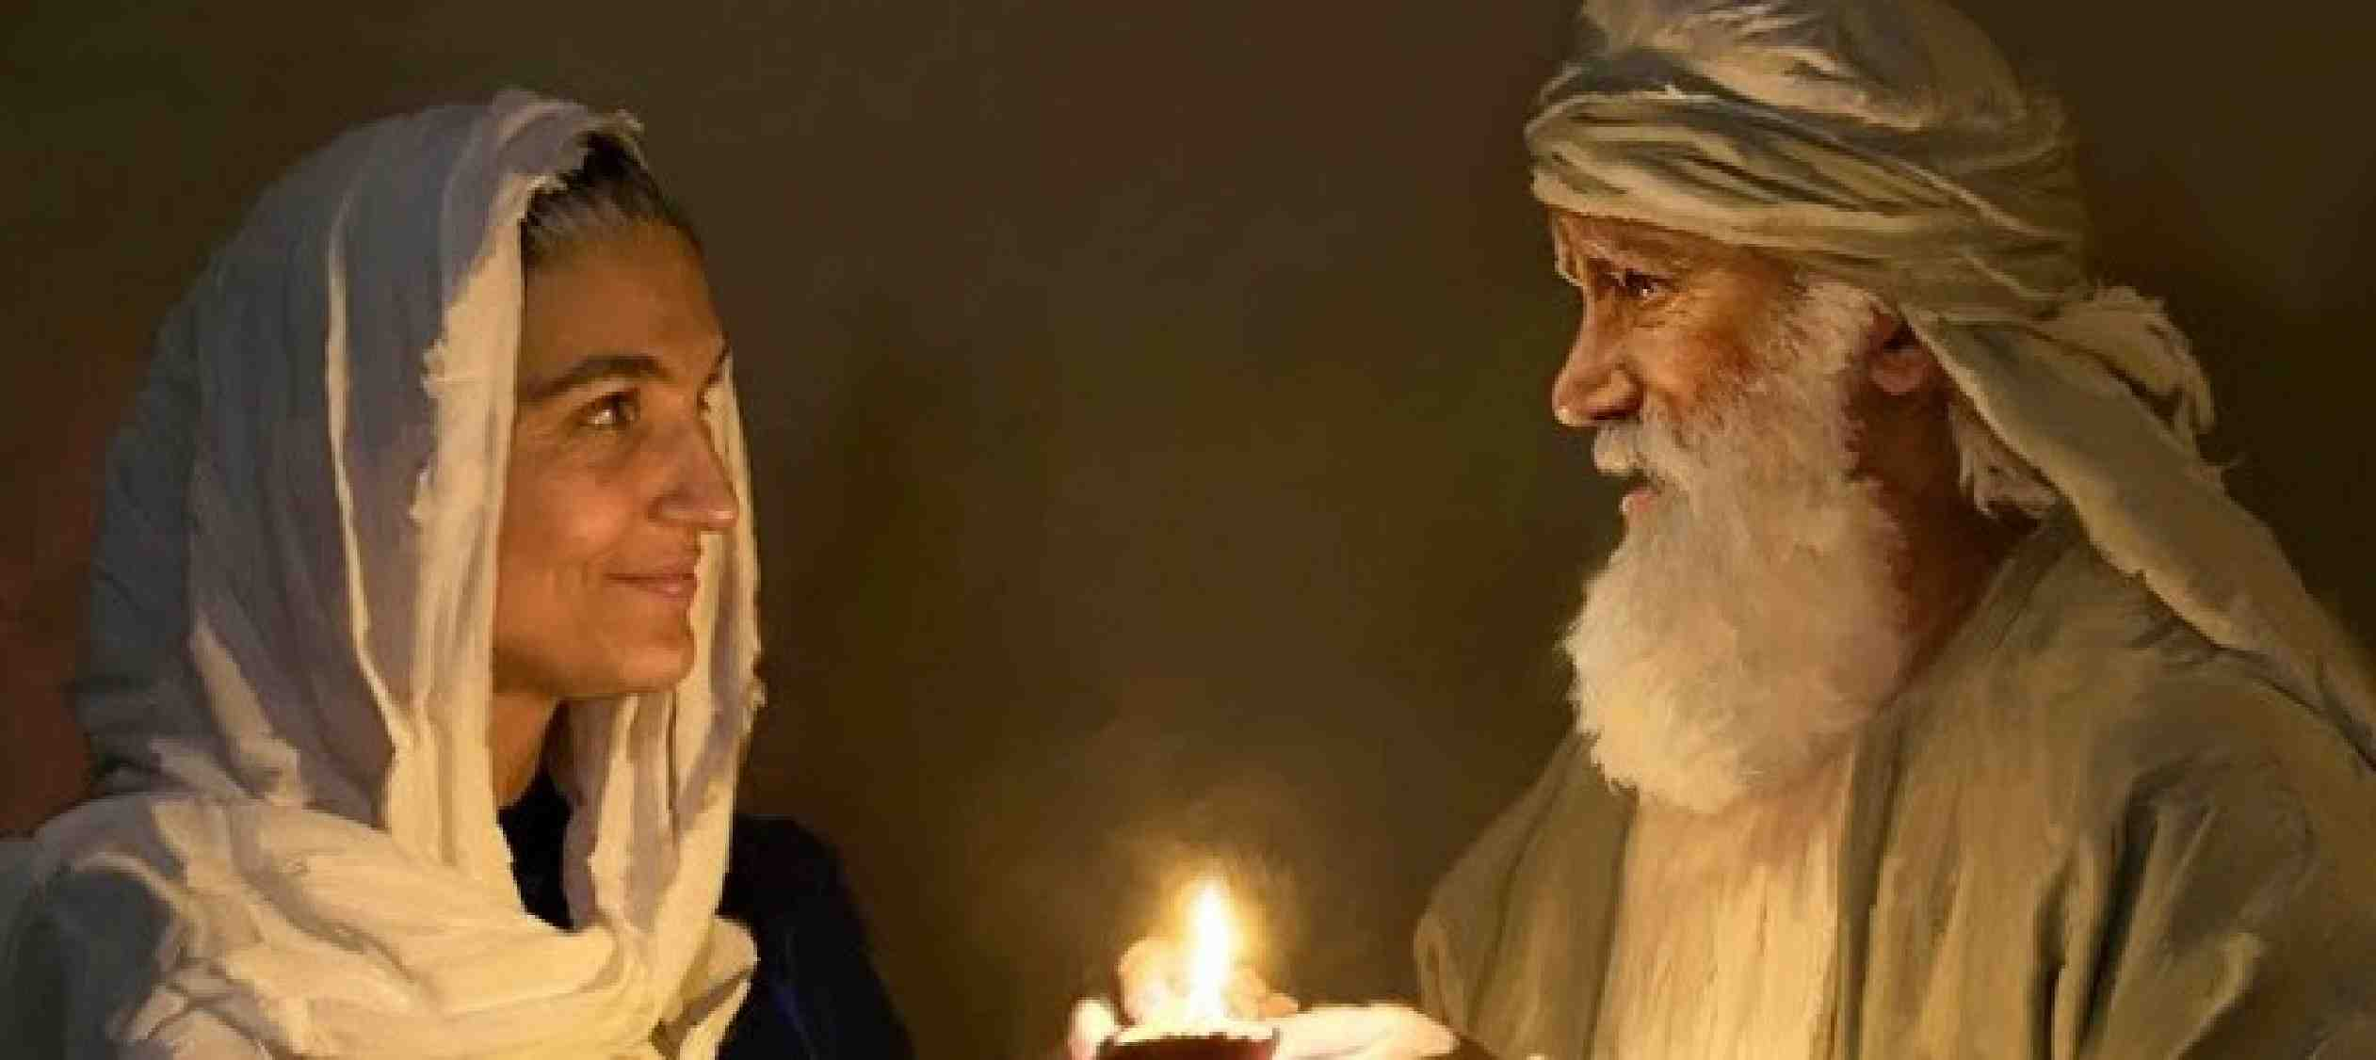
Sarai /Sarah
(Princess)
Abram /Abraham
(Father of a Multitude)
Gen 17:1-2 When Abram was ninety-nine years old, the Lord appeared to Abram and said to him, "I am Almighty God; walk before Me and be blameless. 2 And I will make My covenant between Me and you, and will multiply you exceedingly."

Slide 10
El Shaddai
El (God) + Shaddai (Almighty, Sufficient)
“God Almighty”/“Almighty God” (7 times)
“Almighty” (Shaddai alone) (41 times)
“Shad” - image of a nursing mother

Slide 11
God’s requirement..
"I am Almighty God; walk before Me and be blameless.”
Walk in My Presence..
Dwell in Me..

Slide 12
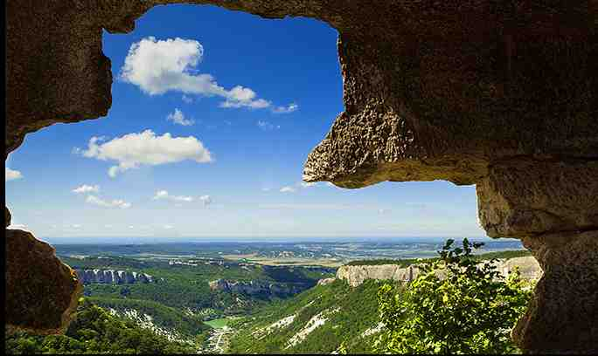
Sheltered by El Shaddai
Psalms 91:1-2 He who dwells in the secret place of the Most High Shall abide under the shadow of the Almighty. 2 I will say of the Lord, "He is my refuge and my fortress; My God, in Him I will trust."

Slide 13
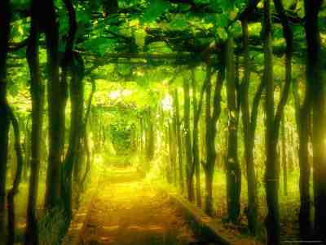
Abiding in Him..
John 15:5-7 "I am the vine and you are the branches.. he who abides in Me and I in Him, he bears much fruit, for apart from Me you can do nothing...

Slide 14
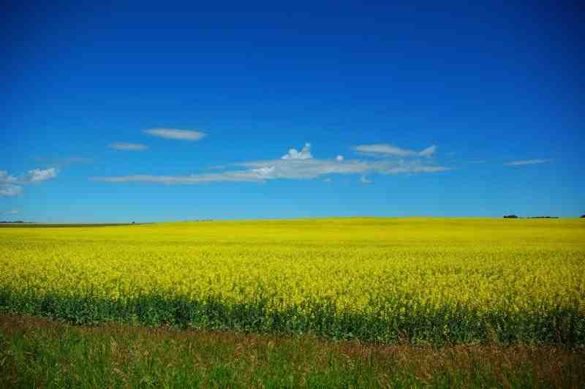
The All Sufficient God..
Ephesians 3:20-21 Now to Him who is able to do exceedingly abundantly above all that we ask or think, according to the power that works in us, 21 to Him be glory in the church by Christ Jesus to all generations, forever and ever. Amen.

Slide 15
El Shaddai Lord God Almighty
Genesis 17:1-8

