Slide 1
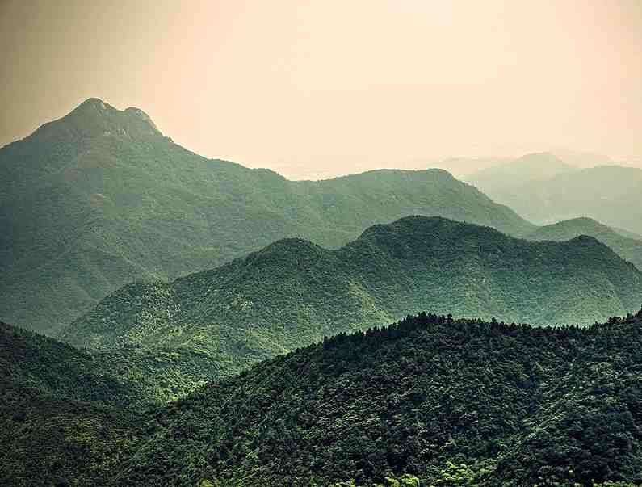
Jehovah Jireh The Lord Will Provide
Genesis 22:1-14

Slide 2
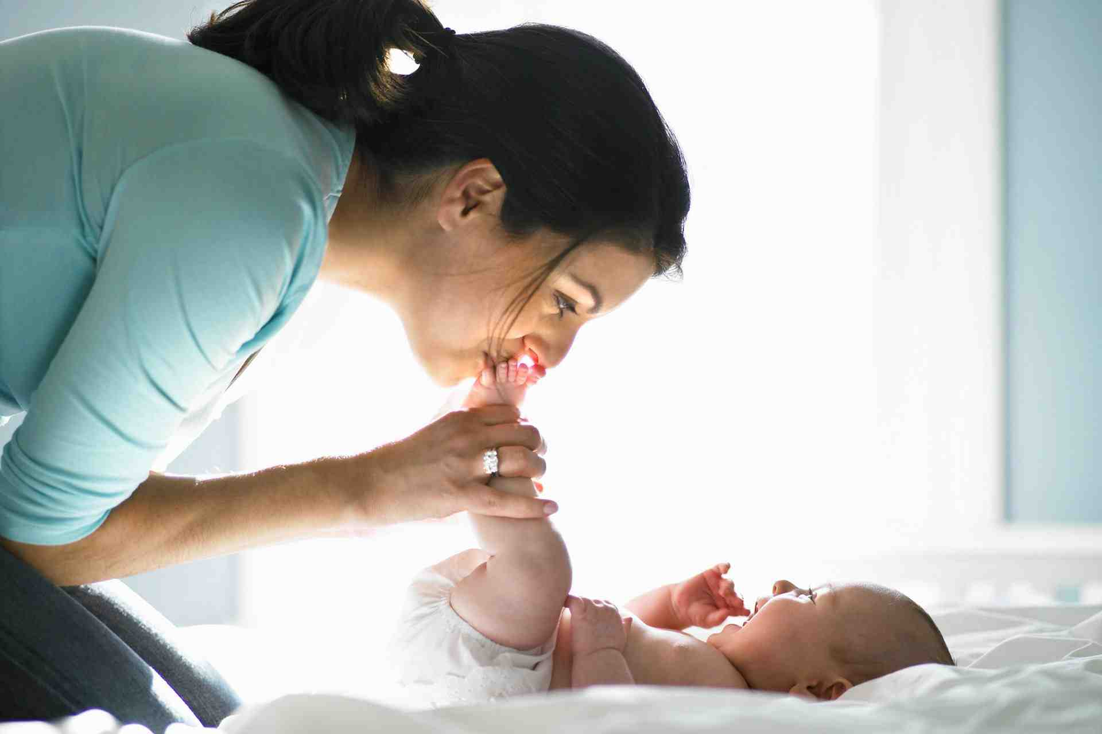
Names matter..

Slide 4
Knowing God by His names..
Single Names
Elohim (Powerful Creator)
Yahweh (Unchanging Personal God)
Adonai (Owner and Ruler)
Combined Names
El (God) + Shaddai (Almighty)

Slide 5
Jehovah Jireh
Jehovah (Yahweh) + Jireh (to Provide)
“ The LORD ---- Will Provide ”

Slide 6
God tests Abraham..
Genesis 22:1-2 Now it came to pass after these things that God tested Abraham, and said to him, "Abraham!"And he said, "Here I am."
2 Then He said, "Take now your son, your only son Isaac, whom you love, and go to the land of Moriah, and offer him there as a burnt offering on one of the mountains of which I shall tell you."

Slide 8
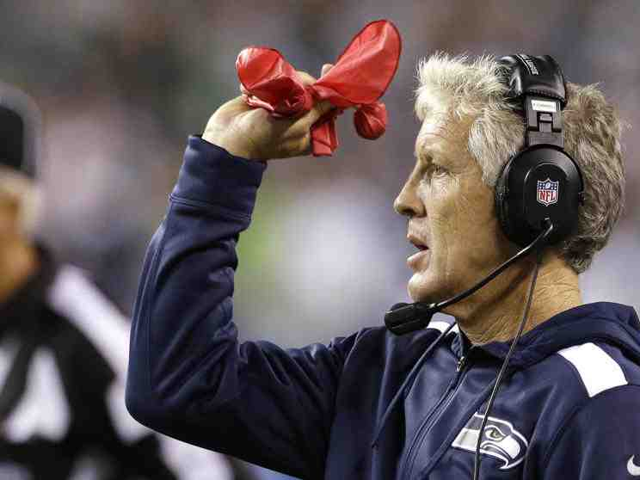
Review ruling..

Slide 9
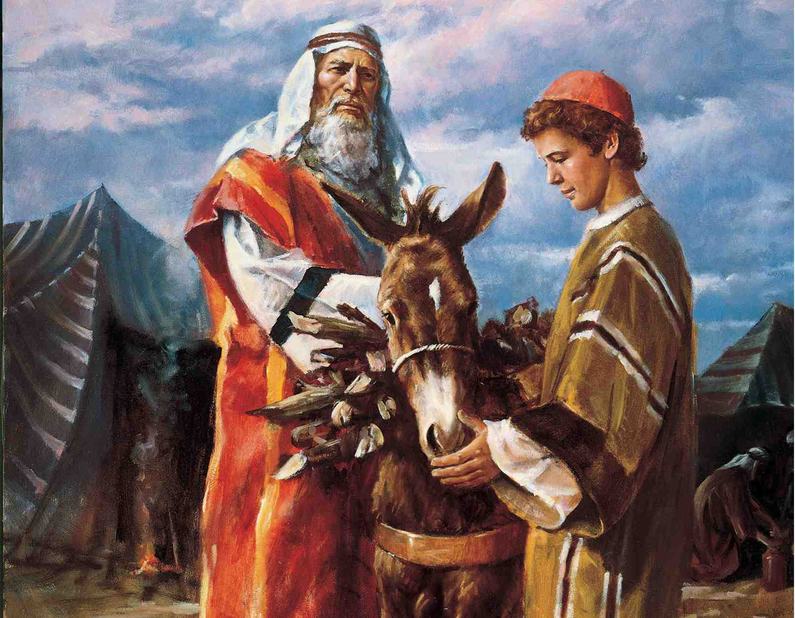
Choosing the blessing or the Blesser..

Slide 10
Abraham’s Choice..
Genesis 22:3-4 So Abraham rose early in the morning and saddled his donkey, and took two of his young men with him, and Isaac his son; and he split the wood for the burnt offering, and arose and went to the place of which God had told him. 4 Then on the third day Abraham lifted his eyes and saw the place afar off.

Slide 11
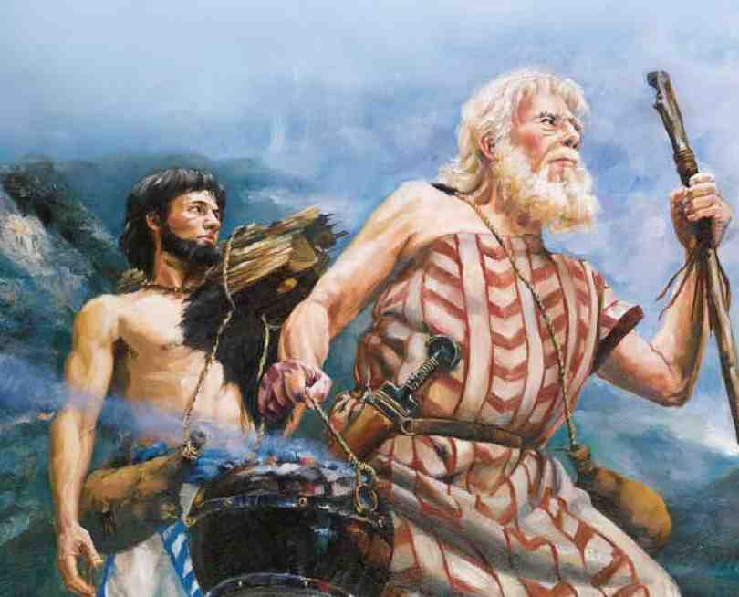
Abraham’s faith..
Genesis 22:5 And Abraham said to his young men, "Stay here with the donkey; the lad and I will go yonder and worship, and we will come back to you."

Slide 12
Abraham’s faith..
Hebrews 11:17-19 By faith Abraham, when he was tested, offered up Isaac, and he who had received the promises offered up his only begotten son, 18 of whom it was said, "In Isaac your seed shall be called," 19 concluding that God was able to raise him up, even from the dead, from which he also received him in a figurative sense.

Slide 13
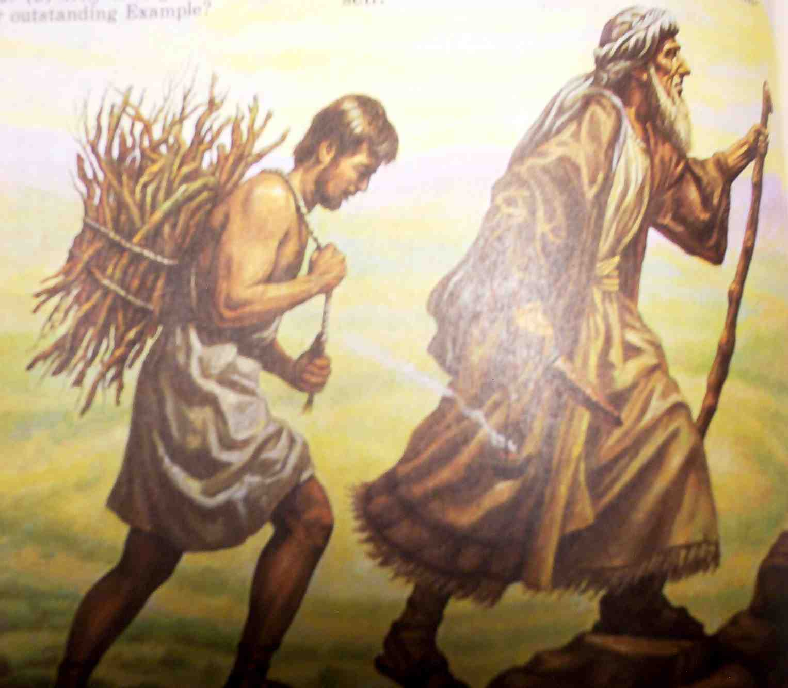
Where is the lamb..
Genesis 22:7-8 But Isaac spoke to Abraham his father and said, "My father!"And he said, "Here I am, my son."Then he said, "Look, the fire and the wood, but where is the lamb for a burnt offering?"
8 And Abraham said, "My son, God will provide for Himself the lamb for a burnt offering." So the two of them went together.

Slide 14
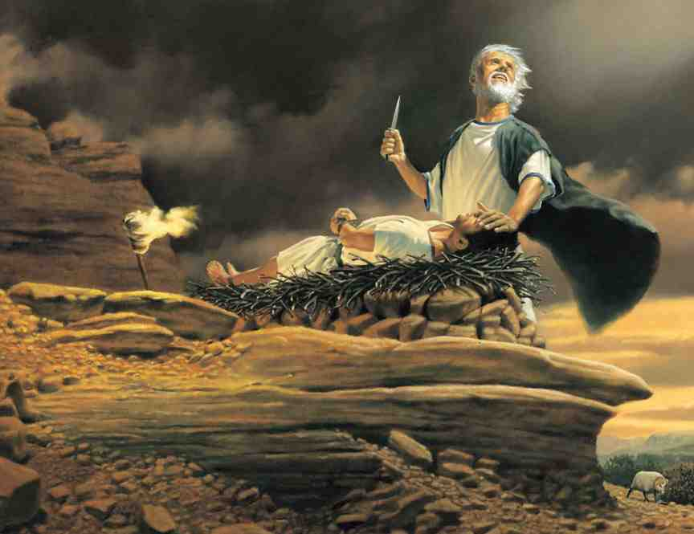
Isaac on the altar..
Genesis 22:9-12 Then they came to the place of which God had told him. And Abraham built an altar there and placed the wood in order; and he bound Isaac his son and laid him on the altar, upon the wood. 10 And Abraham stretched out his hand and took the knife to slay his son.

Slide 15
Isaac on the altar..
11 But the Angel of the Lord called to him from heaven and said, "Abraham, Abraham!"So he said, "Here I am." 12 And He said, "Do not lay your hand on the lad, or do anything to him; for now I know that you fear God, since you have not withheld your son, your only son, from Me."

Slide 16
God’s experiential knowledge..
Psalms 139:1-4 O Lord, You have searched me and known me. 2 You know my sitting down and my rising up; You understand my thought afar off. 3 You comprehend my path and my lying down, And are acquainted with all my ways. 4 For there is not a word on my tongue, But behold, O Lord, You know it altogether.

Slide 17
God’s experiential knowledge..
Psalms 139:1-4 O Lord, You have searched me and known me. 2 You know my sitting down and my rising up; You understand my thought afar off. 3 You comprehend my path and my lying down, And are acquainted with all my ways. 4 For there is not a word on my tongue, But behold, O Lord, You know it altogether.

Slide 18
The Lord will provide..
Genesis 22:13-14 Then Abraham lifted his eyes and looked, and there behind him was a ram caught in a thicket by its horns. So Abraham went and took the ram, and offered it up for a burnt offering instead of his son. 14 And Abraham called the name of the place, The-Lord-Will-Provide; as it is said to this day, "In the Mount of the Lord it shall be provided."

Slide 19
Jireh = “to provide”
Pro + vision (to see before)
What must God see so He may provide?
The same things He saw in Abraham..
“Rose – Saddled – Took – Split – Arose – Went”
He did what God asked Him to do even though he didn’t know God would work it out

Slide 20
Greater blessings given back..
Genesis 22:15-18 Then the Angel of the Lord called to Abraham a second time out of heaven, 16 and said: "By Myself I have sworn, says the Lord, because you have done this thing, and have not withheld your son, your only son — 17 blessing I will bless you, and multiplying I will multiply your descendants as the stars of the heaven and as the sand which is on the seashore; and your descendants shall possess the gate of their enemies. 18 In your seed all the nations of the earth shall be blessed, because you have obeyed My voice."

Slide 21
Jehovah Jireh The Lord Will Provide
Genesis 22:1-14

