Slide 1
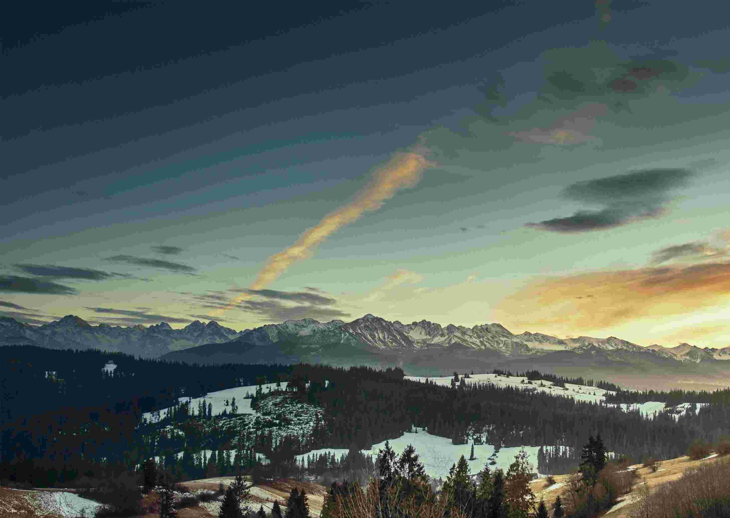
Jehovah Nissi The Lord is My Banner
Exodus 17:8-16

Slide 2
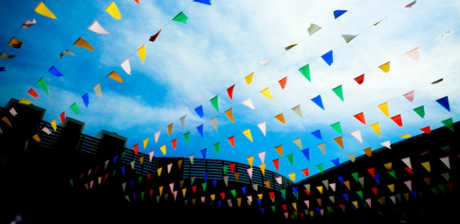
Display of Banners..

Slide 3
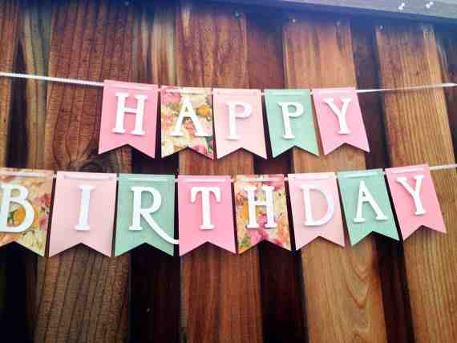
Celebrations..

Slide 4
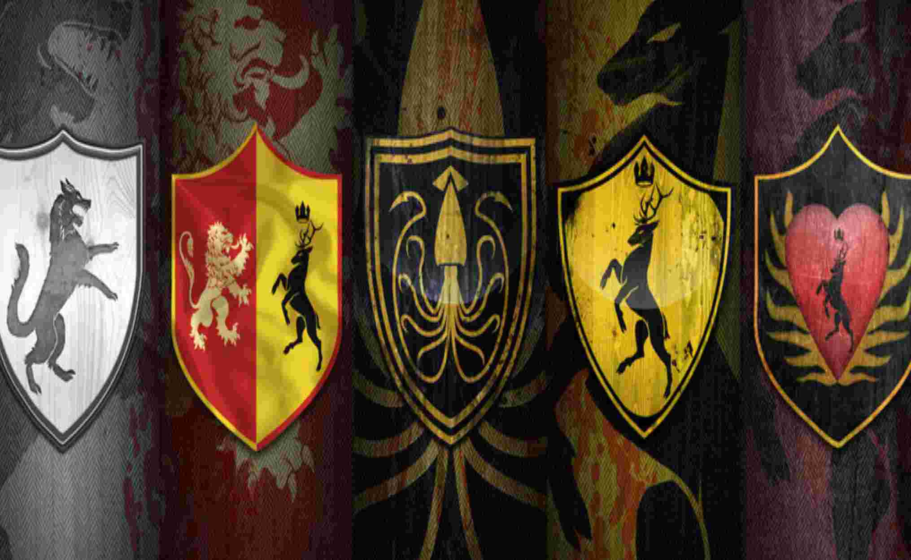
Shields..

Slide 5
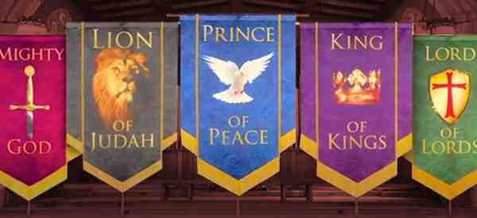
Worship banners..

Slide 6
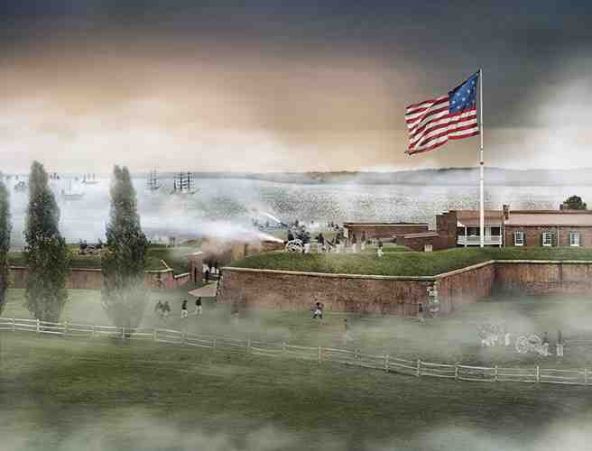
America’s banner ..

Slide 7
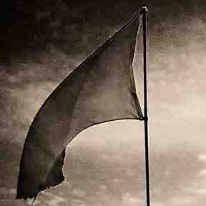
Jehovah Nissi The Lord is My Banner
Exodus 17:13-15 So Joshua defeated Amalek and his people with the edge of the sword. 14 Then the Lord said to Moses, "Write this for a memorial in the book and recount it in the hearing of Joshua, that I will utterly blot out the remembrance of Amalek from under heaven." 15 And Moses built an altar and called its name, The-Lord-Is-My-Banner.

Slide 8
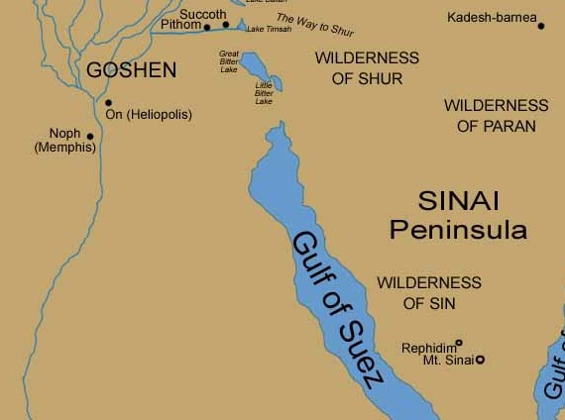

Slide 9
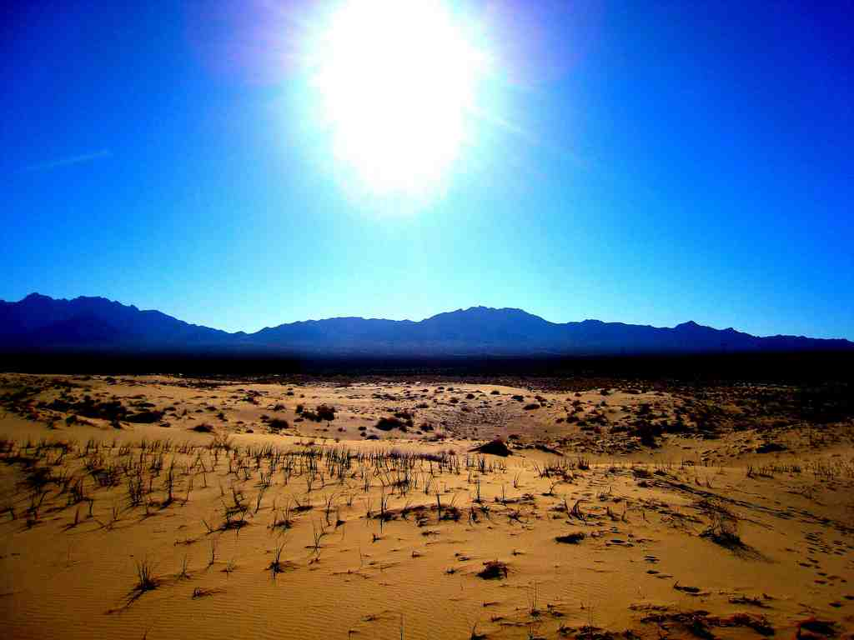
Exodus 17:1-7
1 Then all the congregation of the children of Israel set out on their journey from the Wilderness of Sin, according to the commandment of the Lord, and camped in Rephidim; but there was no water for the people to drink. 2 Therefore the people contended with Moses, and said, "Give us water, that we may drink."
So Moses said to them, "Why do you contend with me? Why do you tempt the Lord?" 3 And the people thirsted there for water, and the people complained against Moses, and said, "Why is it you have brought us up out of Egypt, to kill us and our children and our livestock with thirst?"

Slide 10
Exodus 17:1-7
4 So Moses cried out to the Lord, saying, "What shall I do with this people? They are almost ready to stone me!" 5 And the Lord said to Moses, "Go on before the people, and take with you some of the elders of Israel. Also take in your hand your rod with which you struck the river, and go. 6 Behold, I will stand before you there on the rock in Horeb; and you shall strike the rock, and water will come out of it, that the people may drink."
And Moses did so in the sight of the elders of Israel. 7 So he called the name of the place Massah and Meribah, because of the contention of the children of Israel, and because they tempted the Lord, saying, "Is the Lord among us or not?"

Slide 11
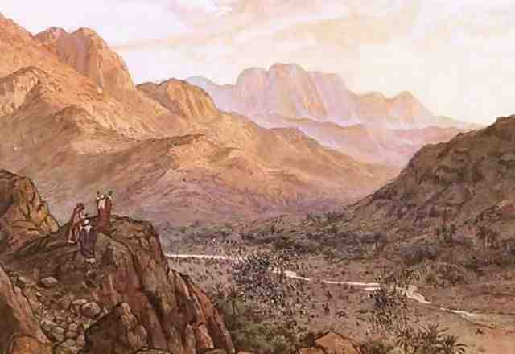
Exodus 17:8-16
8 Now Amalek came and fought with Israel in Rephidim. 9 And Moses said to Joshua, "Choose us some men and go out, fight with Amalek. Tomorrow I will stand on the top of the hill with the rod of God in my hand."
10 So Joshua did as Moses said to him, and fought with Amalek. And Moses, Aaron, and Hur went up to the top of the hill. 11 And so it was, when Moses held up his hand, that Israel prevailed; and when he let down his hand, Amalek prevailed.

Slide 12
Exodus 17:8-16
12 But Moses' hands became heavy; so they took a stone and put it under him, and he sat on it. And Aaron and Hur supported his hands, one on one side, and the other on the other side; and his hands were steady until the going down of the sun. 13 So Joshua defeated Amalek and his people with the edge of the sword.

Slide 13
Exodus 17:8-16
14 Then the Lord said to Moses, "Write this for a memorial in the book and recount it in the hearing of Joshua, that I will utterly blot out the remembrance of Amalek from under heaven." 15 And Moses built an altar and called its name, The-Lord-Is-My-Banner; 16 for he said, "Because the Lord has sworn: the Lord will have war with Amalek from generation to generation."

Slide 14
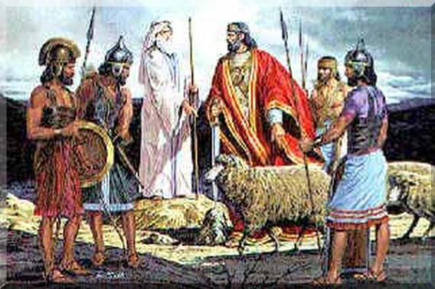
King Saul’s disobedience..

Slide 15
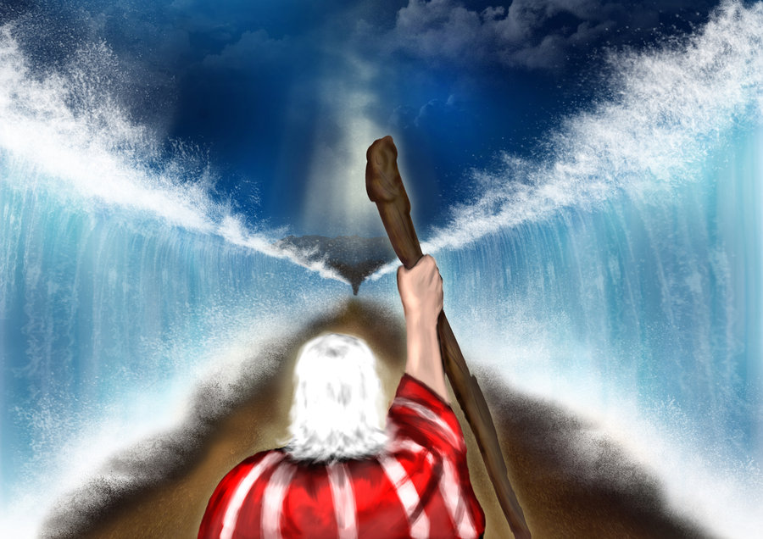
Moses’ banner ..

Slide 16
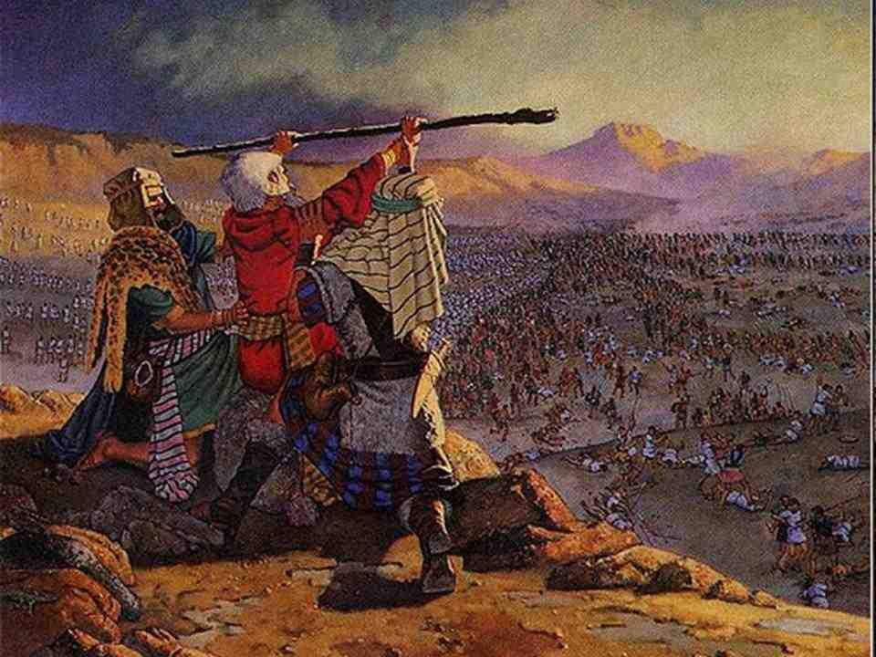
Israel’s key to victory..

Slide 17
A banner for God’s people..
Psalms 60:4-6 You have given a banner to those who fear You, That it may be displayed because of the truth.5 That Your beloved may be delivered, Save with Your right hand, and hear me.

Slide 18
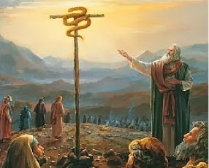
John 3:14-15 And as Moses lifted up the serpent in the wilderness, even so must the Son of Man be lifted up, 15 that whoever believes in Him should not perish but have eternal life. 16 For God so loved the world that He gave His only begotten Son, that whoever believes in Him should not perish but have everlasting life.

Slide 19
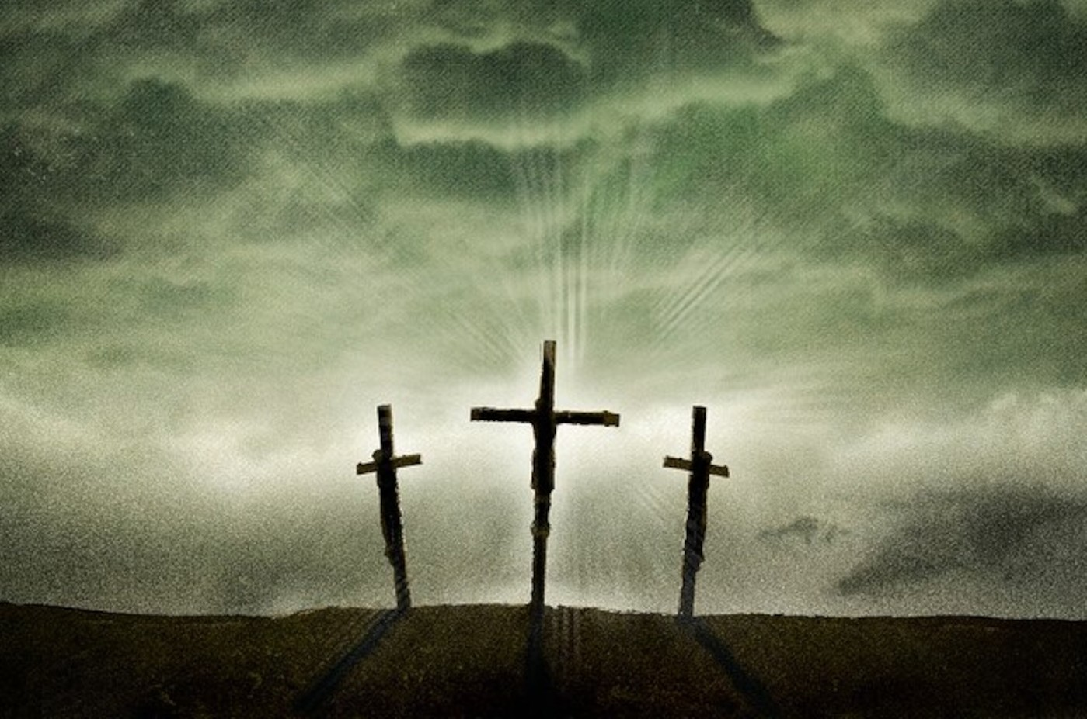
Who is your banner..

Slide 20
Jehovah Nissi The Lord is My Banner
Exodus 17:8-16

