Slide 1
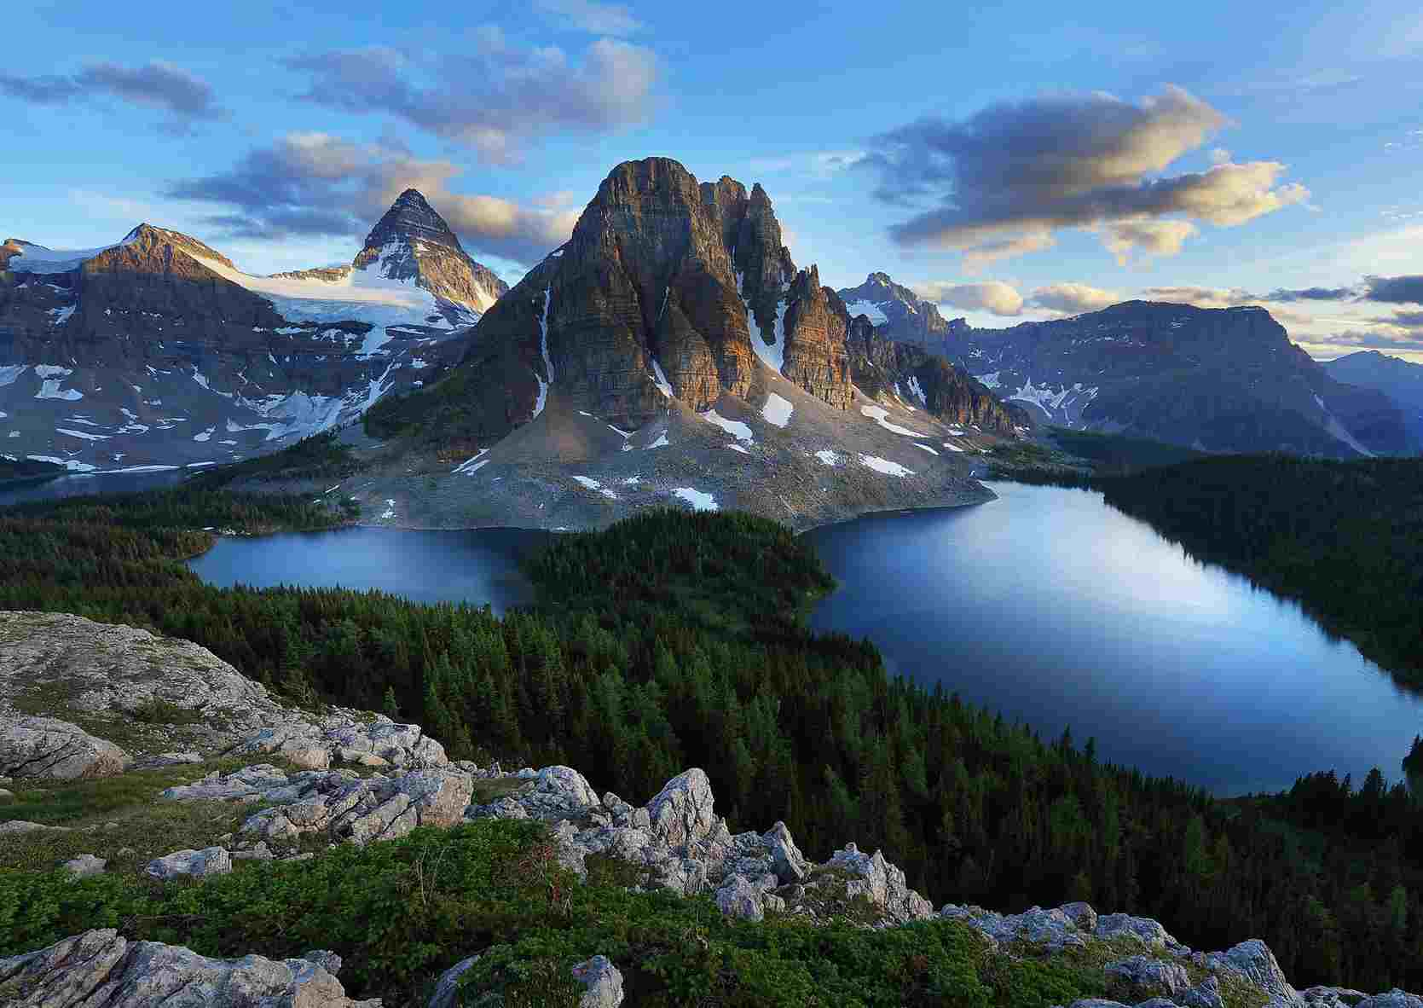
Jehovah Rapha The Lord Who Heals
Exodus 15:22-27

Slide 2
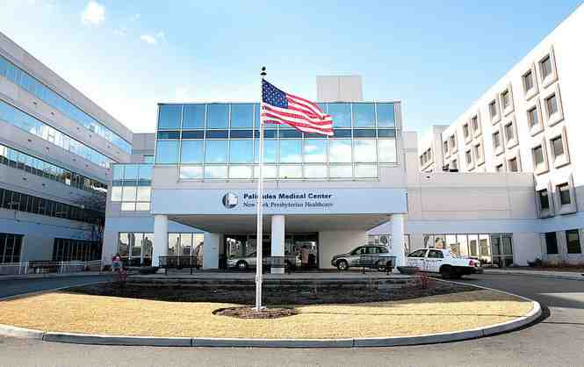
Evidence of pain and sickness

Slide 3
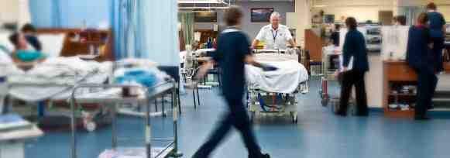
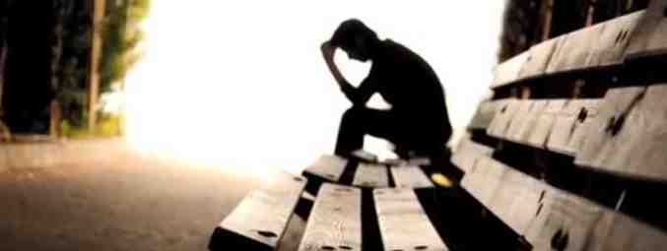
Physical healing
Emotional healing

Slide 5
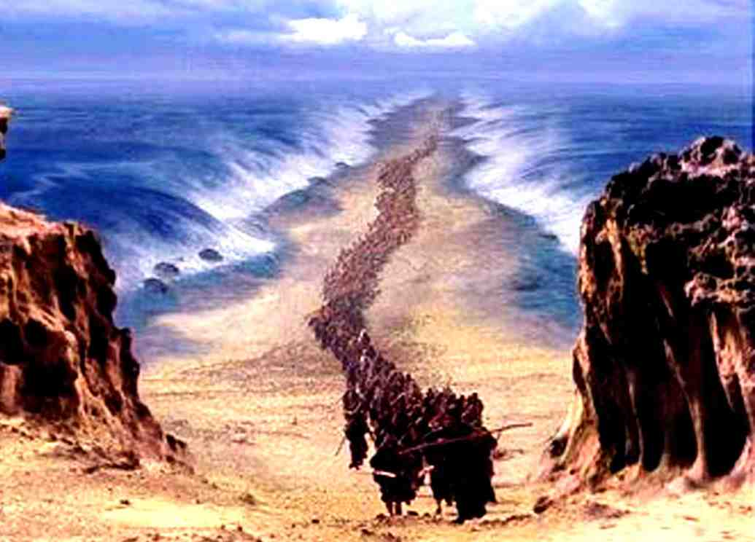
“Then Moses led Israel from the Red Sea”..
Exodus 15:22

Slide 6
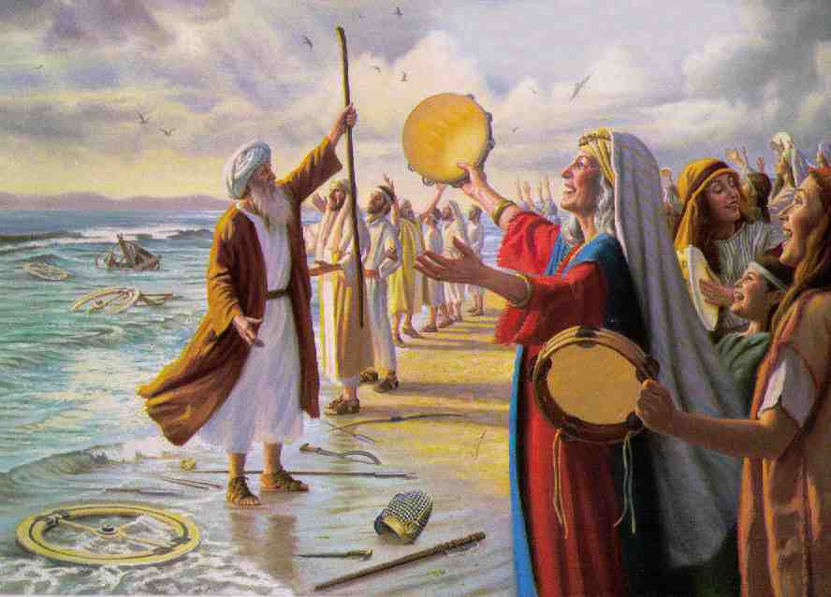
Exodus 15:1-3 Then Moses and the children of Israel sang this song to the Lord, and spoke, saying: "I will sing to the Lord, For He has triumphed gloriously! The horse and its rider He has thrown into the sea! 2 The Lord is my strength and song, And He has become my salvation; He is my God, and I willpraise Him; My father's God, and I will exalt Him. 3 The Lord is a man of war; The Lord is His name.

Slide 7
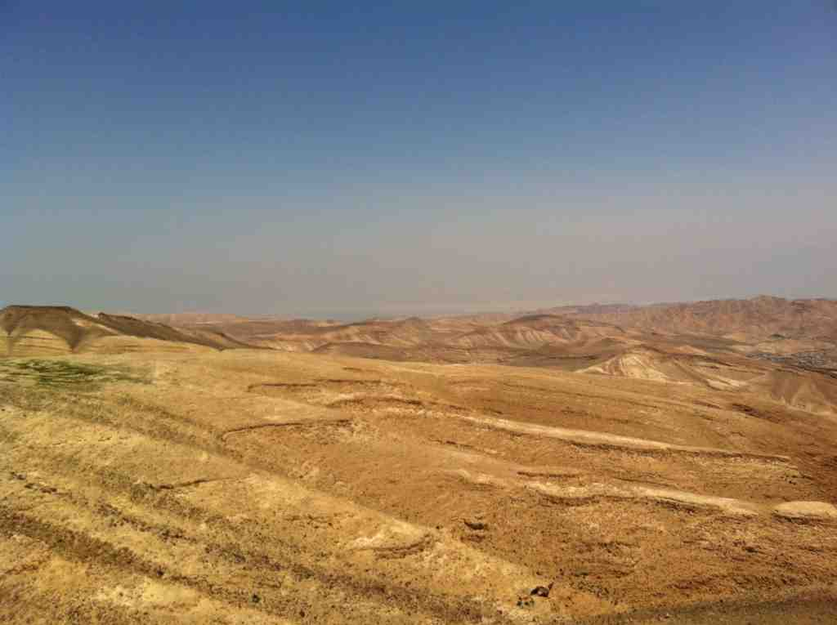
“.. Then they went out into the wilderness of Shur”..
Exodus 15:22
The only way to get from Egypt to Canaan was through the wilderness..

Slide 8
22 And they went three days in the wilderness and found no water. 23 Now when they came to Marah, they could not drink the waters of Marah, for they were bitter. Therefore the name of it was called Marah.

Slide 9
24 And the people complained against Moses, saying, "What shall we drink?" 25 So he cried out to the Lord, and the Lord showed him a tree. When he cast it into the waters, the waters were made sweet.

Slide 10
God’s purpose..
25 There He made a statute and an ordinance for them, and there He tested them..
We are tested to see what we’ve learned

Slide 11
God allows our faith to be tested to help us to become more mature and strong..

Slide 12
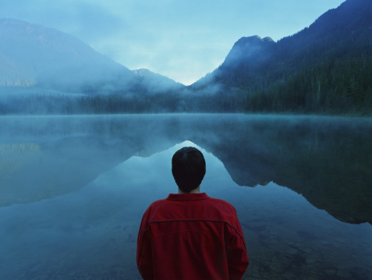
Your faith tested..
2 Corinthians 1:8-9 For we do not want you to be ignorant, brethren, of our trouble which came to us in Asia: that we were burdened beyond measure, above strength, so that we despaired even of life. 9 Yes, we had the sentence of death in ourselves, that we should not trust in ourselves but in God who raises the dead,

Slide 13
24 And the people complained against Moses, saying, "What shall we drink?" 25 So he cried out to the Lord, and the Lord showed him a tree. When he cast it into the waters, the waters were made sweet.

Slide 14
The Lord Who Heals..
There He made a statute and an ordinance for them, and there He tested them, 26 and said, "If you diligently heed the voice of the Lord your God and do what is right in His sight, give ear to His commandments and keep all His statutes, I will put none of the diseases on you which I have brought on the Egyptians. For I am the Lord who heals you."

Slide 15
The Lord Who Heals..
Psalms 103:2-3 Bless the Lord, O my soul, And forget not all His benefits: 3 Who forgives all your iniquities, Who heals all your diseases,
James 5:14-15 Is anyone among you sick? Let him call for the elders of the church, and let them pray over him, anointing him with oil in the name of the Lord. 15 And the prayer of faith will save the sick, and the Lord will raise him up. And if he has committed sins, he will be forgiven.

Slide 16
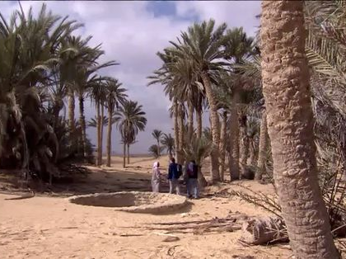
27 Then they came to Elim, where there were twelve wells of water and seventy palm trees; so they camped there by the waters.

Slide 17
Jehovah Rapha The Lord Who Heals
Exodus 15:22-27

