Slide 1
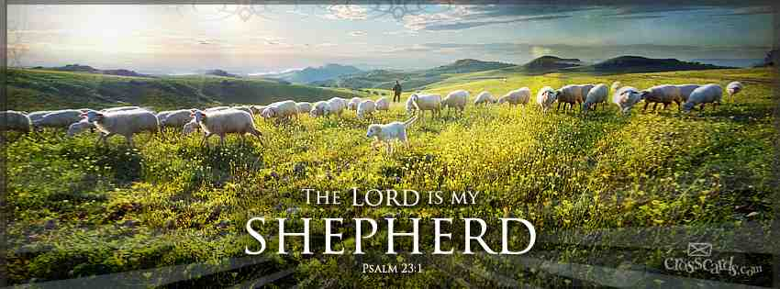
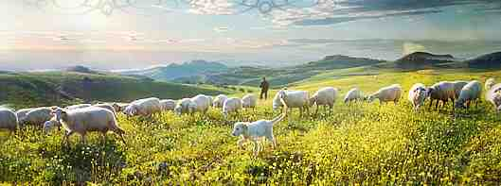
Jehovah Rohi The Lord is My Shepherd
Psalm 23:1-6

Slide 2
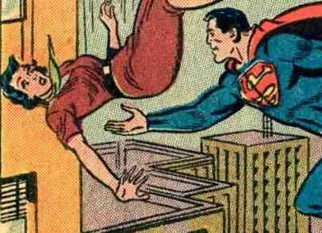
“Do you think I have enough power to save you from the fire but not enough to safely take you home?”

Slide 3
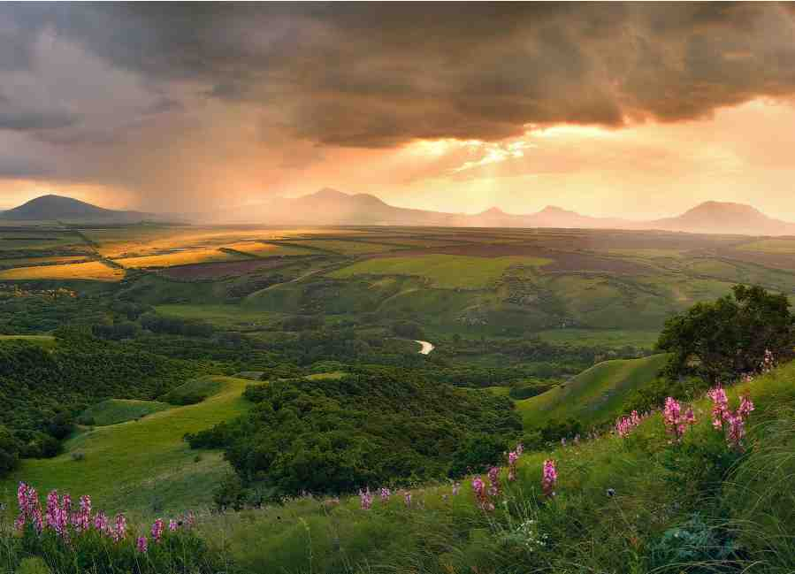
We trust the Lord to deliver us from hell, but do we have confidence He is with us here on earth?

Slide 4
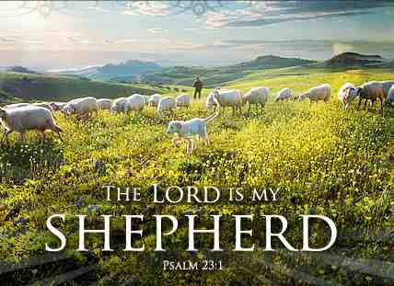
Jehovah Rohi
The LORD (Yahweh)
Self-Revealing Personal God
(Rohi) shepherd
“to tend, pasture, shepherd”
Psalm 23:1-6

Slide 5
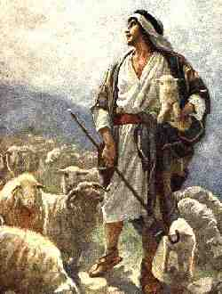
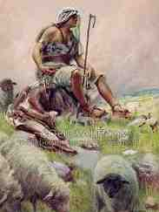
David remembered his own experience as a young shepherd

Slide 6
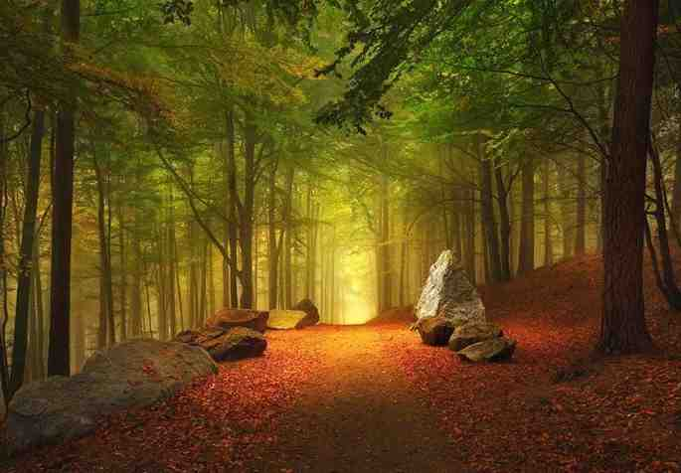
“The LORD is MY shepherd”
Who do you look to you to tend your life and take care of you?

Slide 7
Ways God takes care of us…
Psalm 23:1-6

Slide 8
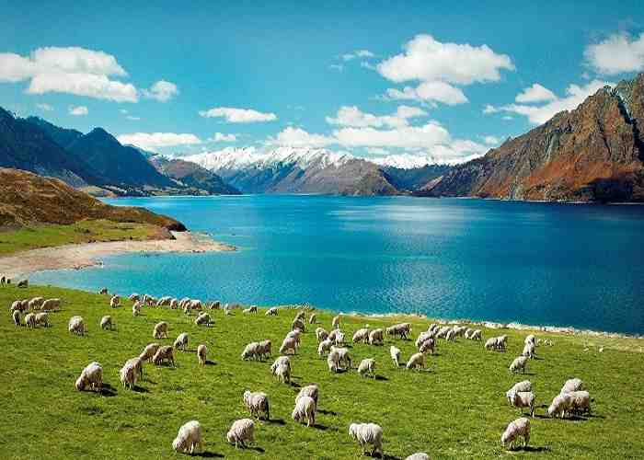
“I Shall Not Want”
A good shepherd tends to the needs of his sheep.. The Lord tends to each of our needs..

Slide 9
“I Shall Not Want”
Ezek 34:2-4 What God expects a shepherd to do:
Feed the flock, strengthen the weak, heal the sick, bind up the broken, bring back the strays, seek the lost
John 10:11 "I am the good shepherd. The good shepherd gives His life for the sheep.

Slide 10
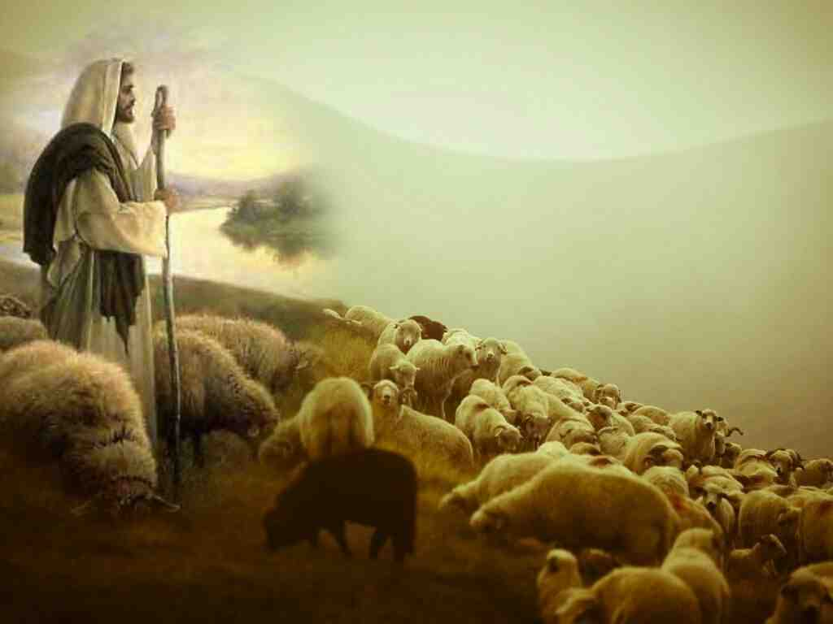
The best shepherd is willing to put his own life on the line for his sheep

Slide 11
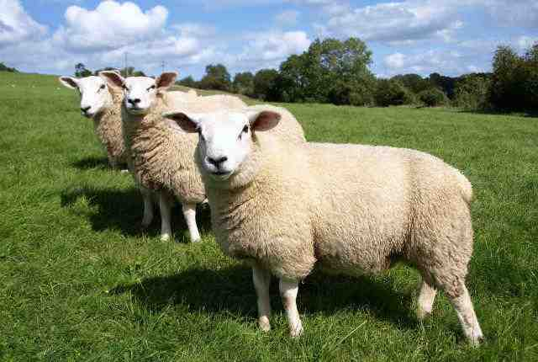
Characteristics of sheep..

Slide 12
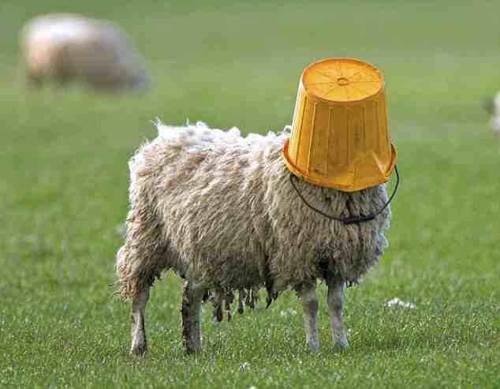
Characteristics of sheep..
The dumbest of all animals..

Slide 13
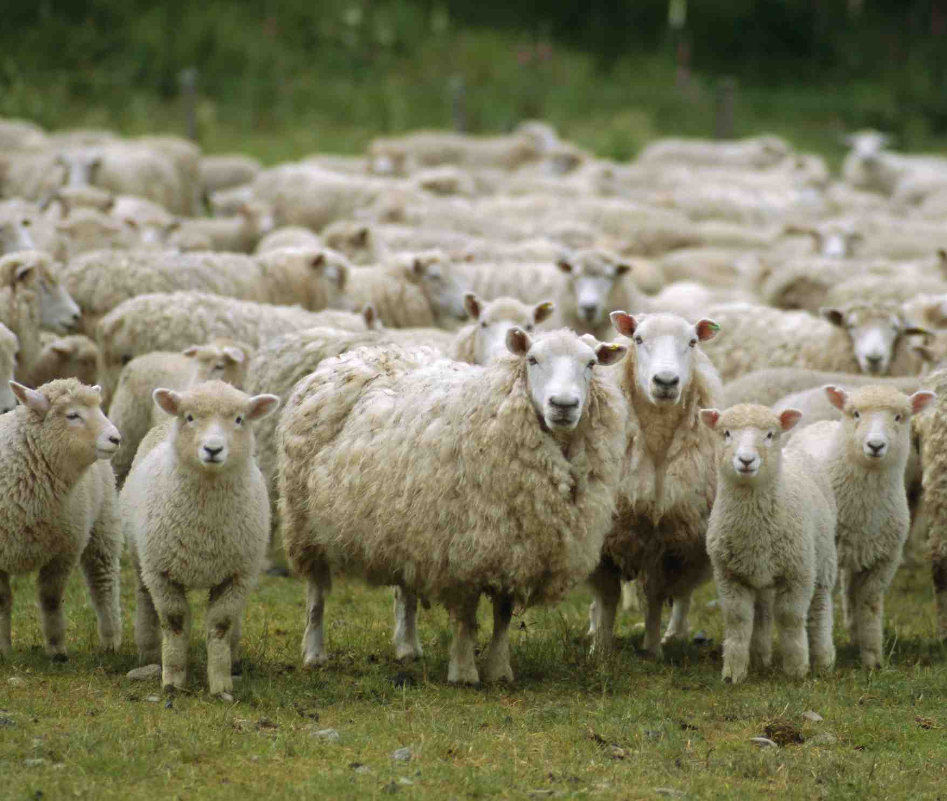
Characteristics of sheep..
Defenseless..

Slide 14
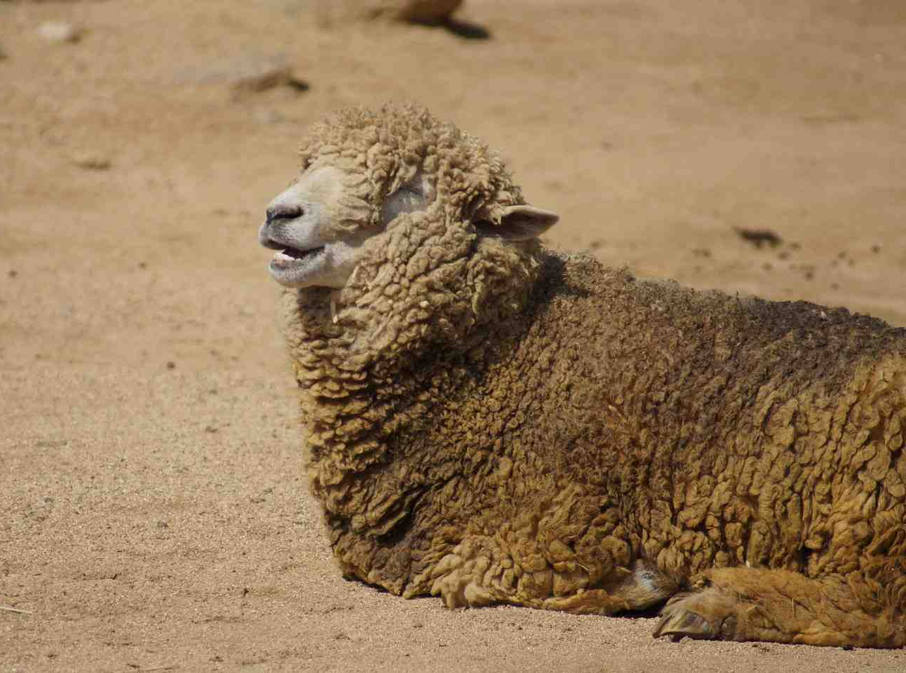
Characteristics of sheep..
Dirty..

Slide 15
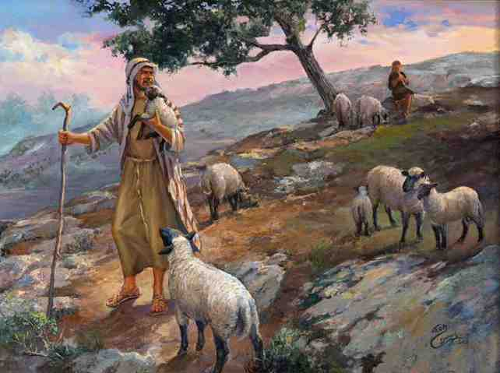
Characteristics of sheep..
Dependent..

Slide 16
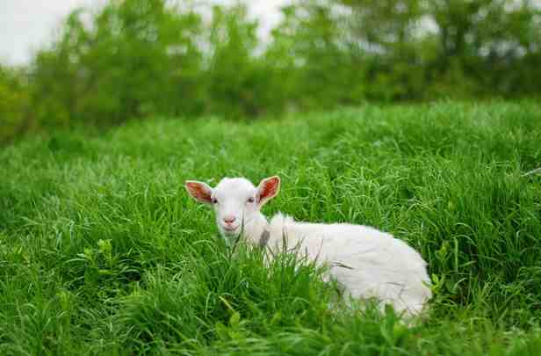
Green pastures, restored soul
Are you needing a restored soul?

Slide 17
Green pastures, restored soul
He makes you lie down in green pastures

Slide 18
Learn to rest in Him..
Quiet waters

Slide 19
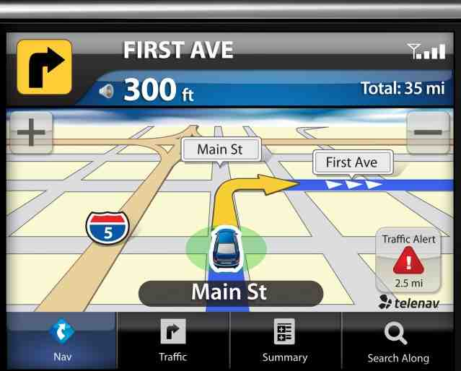
Paths of righteousness..
Our navigational system..

Slide 20
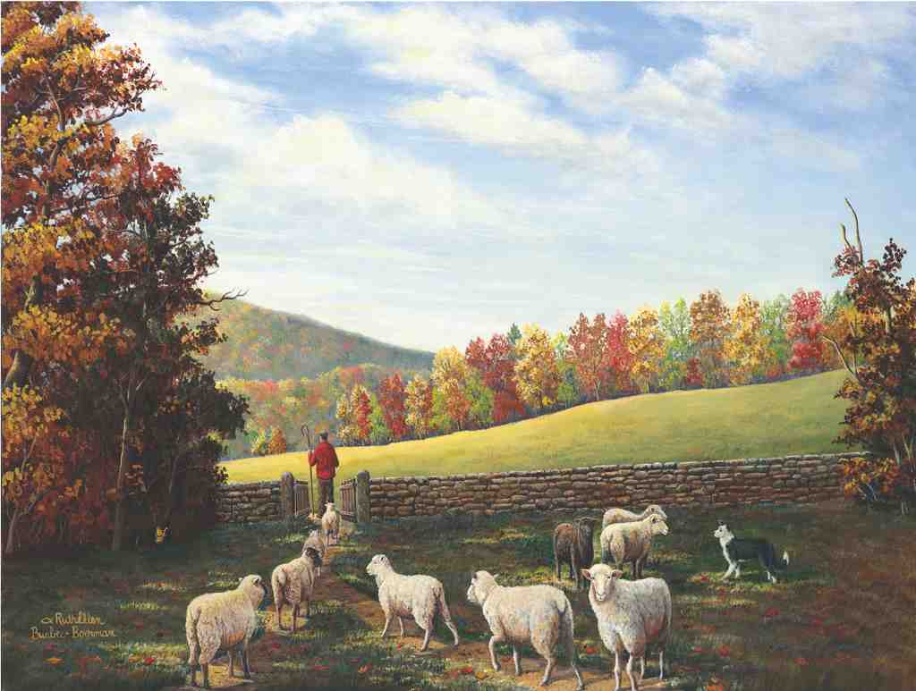
Paths of righteousness..
He Guides me for His name’s sake..

Slide 21
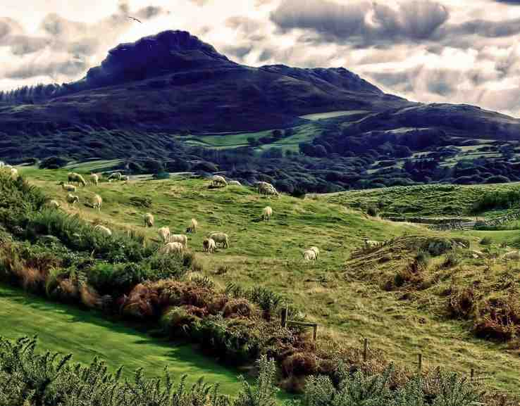
Valleys, shadows..
A low place.. a place of vulnerability

Slide 22
Valleys, shadows..
To reach the next mountain we must go through the valley..

Slide 23
A table and oil for my head..
The Lord Himself prepares the table

Slide 24
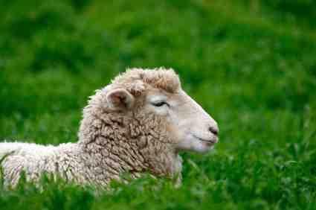
My cup overflows..
2 Cor 9:8 And God is able to make all grace abound toward you, that you, always having all sufficiency in all things, may have an abundance for every good work. .

Slide 25
Jehovah Rohi The Lord is My Shepherd
Psalm 23:1-6

