Slide 1
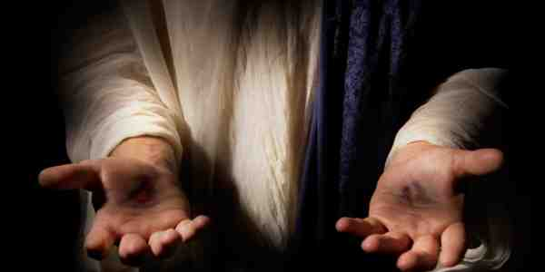
Immanuel God With Us
Matthew 1:18-23

Slide 2
Matthew 1:21-23
"She will bring forth a Son, and you shall call His name Jesus, for He will save His people from their sins." All this was done that it might be fulfilled which was spoken by the Lord through the prophet, saying: "Behold, the virgin shall be with child, and bear a Son, and they shall call His name Immanuel," which is translated, "God with us."

Slide 3
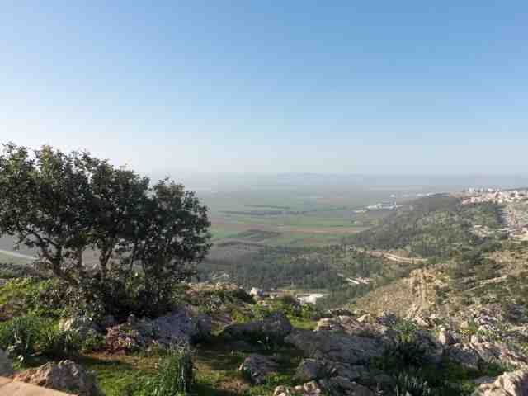
Deuteronomy 6:4-5
"Hear, O Israel: The Lord our God, the Lord is one! 5 You shall love the Lord your God with all your heart, with all your soul, and with all your strength.
God
the Father
God
the Son
God the
Holy Spirit

Slide 4
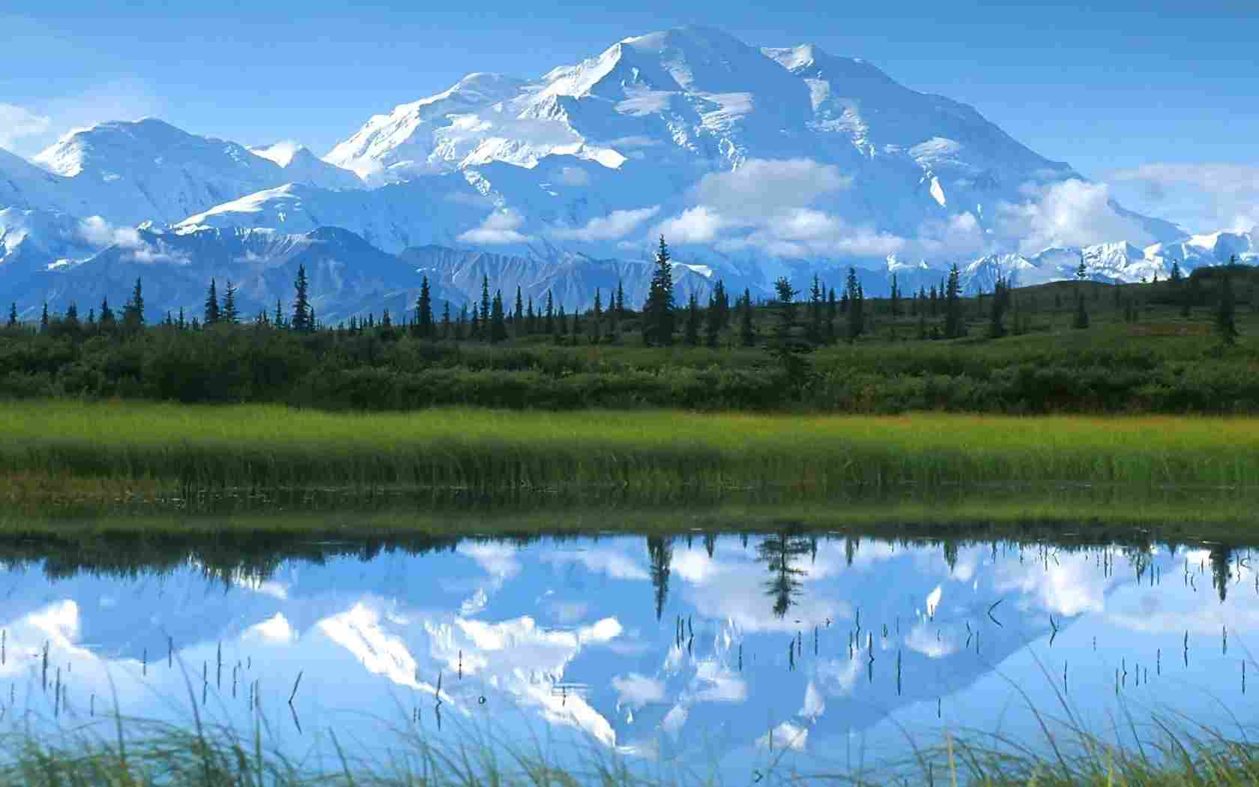
God’s Names..
The names were given by God (not developed by man..
His names demonstrate God’s desire that we can know and worship Him..
Each name reveals a portion of His goodness and glory

Slide 5
Foundational Names..
Elohim (Strong Creator)
Yahweh (Personal God)
Adonai (Owner and Master)

Slide 6
Compound Names..
El Shaddai (God Almighty)
Jehovah Jireh (My Provider)
Jehovah Rapha (The LORD our Healer)
Jehovah Nissi (The LORD our Banner)
Jehovah Rohi (The LORD is my Shepherd)
Jehovah Tsidkenu (The LORD our Righteousness)

Slide 7
Matthew 1:21-23
"She will bring forth a Son, and you shall call His name Jesus, for He will save His people from their sins." All this was done that it might be fulfilled which was spoken by the Lord through the prophet, saying: "Behold, the virgin shall be with child, and bear a Son, and they shall call His name Immanuel," which is translated, "God with us."

Slide 8
Isaiah 9:6
For unto us a Child is born, Unto us a Son is given; And the government will be upon His shoulder. And His name will be called Wonderful, Counselor, Mighty God, Everlasting Father, Prince of Peace.

Slide 9
Hebrews 10:5-7
5 Therefore, when He came into the world, He said:"Sacrifice and offering You did not desire,But a body You have prepared for Me. 6 In burnt offerings and sacrifices for sin You had no pleasure. 7 Then I said, 'Behold, I have come — In the volume of the book it is written of Me — To do Your will, O God.'"

Slide 10
Jesus the very likeness of God..
Colossians 1:15 “image of the invisible God”
Hebrews 1:3 “the radiance of God’s glory and the exact representation of His being”
John 1:1 “In the beginning was the Word…
John 1:3 “Through Him all things were made”
John 1:14 “The word became flesh and dwelt among us and we beheld His glory”
Colossians 1:19 God was pleased to have His fullness dwell in Him”
John 1:18 the only Son who is Himself God has made Him known

Slide 11
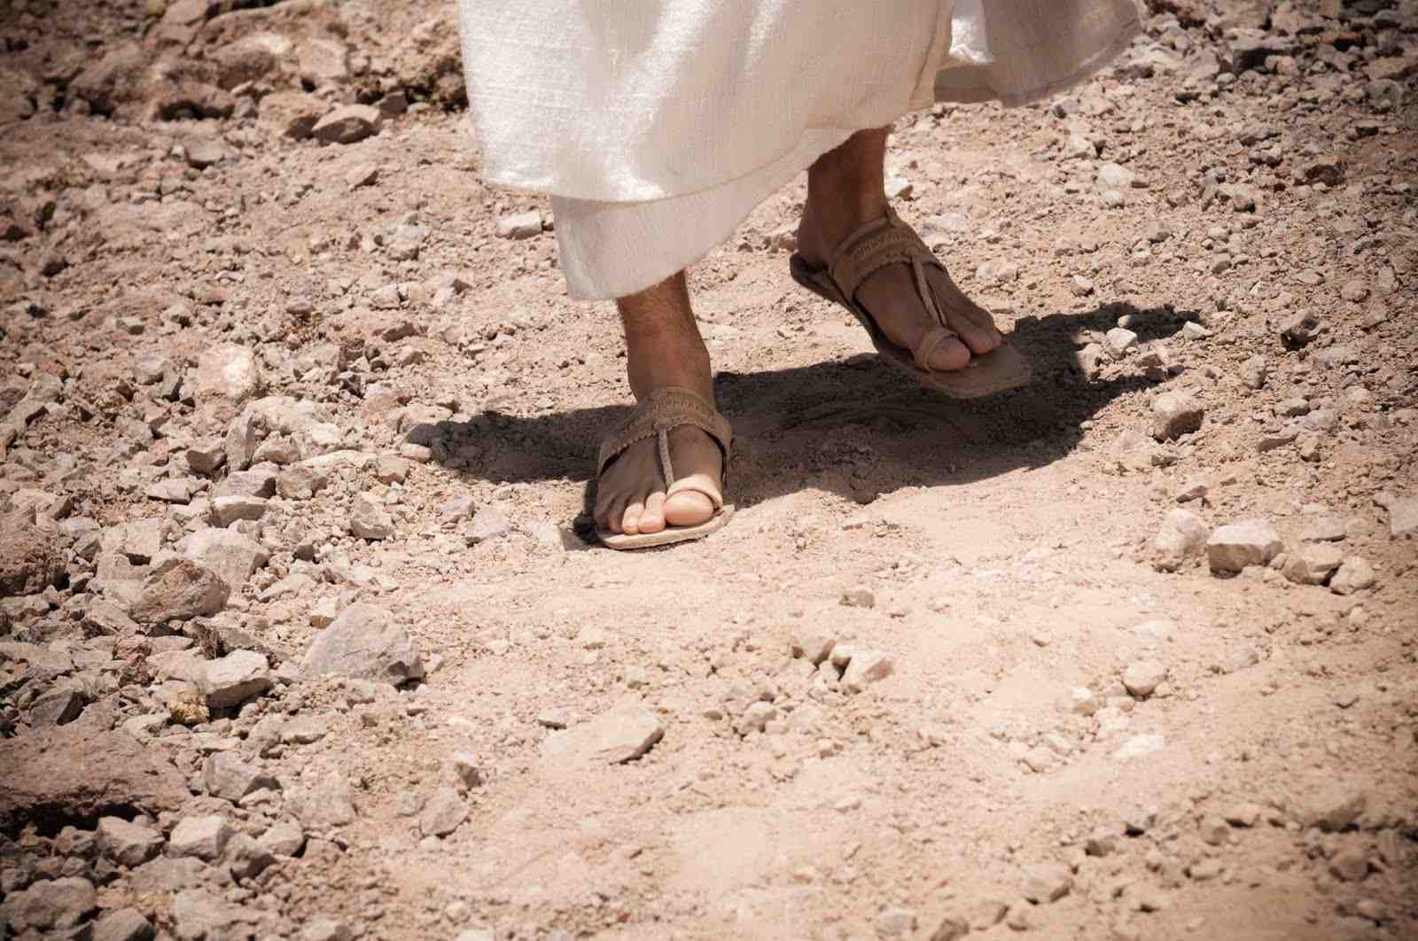
Jesus is God with us..
John 14:8-9 Philip said to Him, "Lord, show us the Father, and it is sufficient for us." 9 Jesus said to him, "Have I been with you so long, and yet you have not known Me, Philip? He who has seen Me has seen the Father; so how can you say, 'Show us the Father'?

Slide 12
The Wonder of His Name
Wonderful Counselor ..
Mighty God ..
Everlasting Father ..
Prince of Peace ..
Philippians 4:7 and the peace of God, which surpasses all understanding, will guard your hearts and minds through Christ Jesus.

Slide 13
The Fulfiller of God’s Names
Elohim (Strong Creator)
Yahweh (Relational God)
Adonai (Master and Ruler)
El Shaddai (Almighty God)
Jehovah Jireh (Our Provider)
Jehovah Rapha (the Lord who heals)
Jehovah Nissi (the Lord my Banner)
Jehovah Rohi (the Lord my Shepherd)
Jehovah Tsidkenu (Our Righteousness)

Slide 14
Philippians 2:5-8
5 Let this mind be in you which was also in Christ Jesus, 6 who, being in the form of God, did not consider it robbery to be equal with God, 7 but made Himself of no reputation, taking the form of a bondservant, and coming in the likeness of men. 8 And being found in appearance as a man, He humbled Himself and became obedient to the point of death, even the death of the cross.

Slide 15
Philippians 2:9-11
9 Therefore God also has highly exalted Him and given Him the name which is above every name, 10 that at the name of Jesus every knee should bow, of those in heaven, and of those on earth, and of those under the earth, 11 and that every tongue should confess that Jesus Christ is Lord, to the glory of God the Father.

Slide 16
Immanuel God With Us
Matthew 1:18-23

