Slide 1
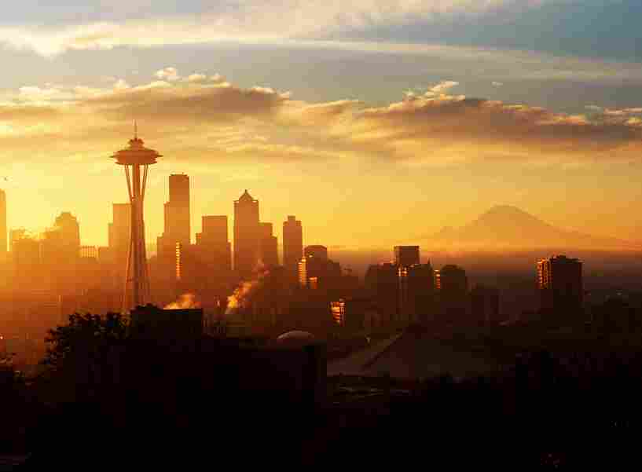
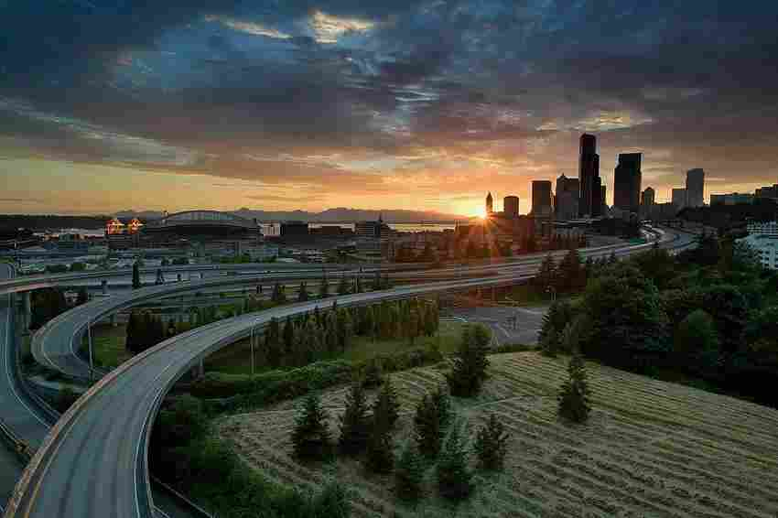
The Lord Our Righteousness Jehovah Tsidkenu
Jeremiah 23:1-6

Slide 2
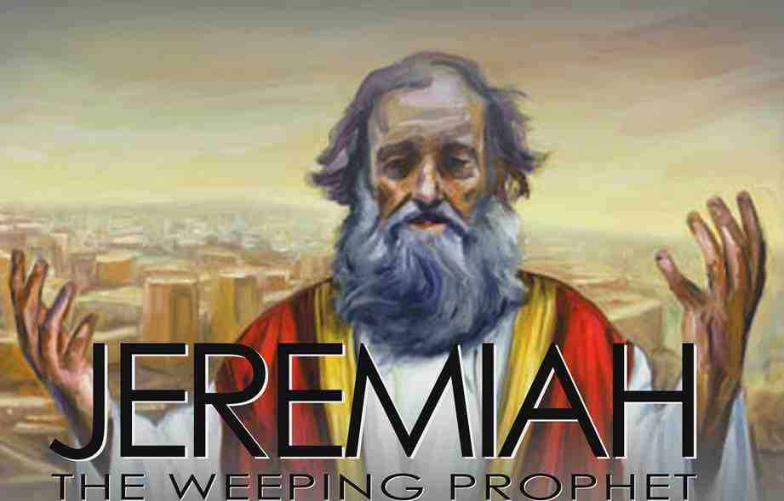
Jeremiah..
Judah’s leaders have not learned ..
Moral stability of nation determined by that of its leaders
The further you depart from God, the more you invite decline in your life..

Slide 3
Jeremiah 23:1 "Woe to the shepherds who destroy and scatter the sheep of My pasture!" says the Lord.
2 Therefore thus says the Lord God of Israel against the shepherds who feed My people: "You have scattered My flock, driven them away, and not attended to them. Behold, I will attend to you for the evil of your doings," says the Lord.

Slide 4
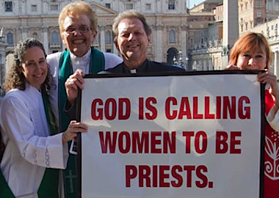

Slide 5
3 "But I will gather the remnant of My flock out of all countries where I have driven them, and bring them back to their folds; and they shall be fruitful and increase. 4 I will set up shepherds over them who will feed them; and they shall fear no more, nor be dismayed, nor shall they be lacking," says the Lord.

Slide 6
5 "Behold, the days are coming," says the Lord, "That I will raise to David a Branch of righteousness; A King shall reign and prosper, And execute judgment and righteousness in the earth. 6 In His days Judah will be saved, And Israel will dwell safely; Now this is His name by which He will be called: THE LORD OUR RIGHTEOUSNESS.

Slide 7
The LORD our Righteousness
Jehovah (LORD) the self revealing God
Tsidkenu (Righteousness) – “tsedek” (straight)
Why couldn’t Judah see the impact of their own disobedience?

Slide 8
Are we failing to see the moral decline in our nation?
Do we ignore the spiritual apathy in our own lives?

Slide 9
How do we decide right from wrong in our society?
Each person decides for himself.. (Jer 10:23)
Let the majority decide
God is our standard of rightness

Slide 10
Jeremiah 33:15-16 'In those days and at that time I will cause to grow up to David A Branch of righteousness; He shall execute judgment and righteousness in the earth. 16 In those days Judah will be saved, And Jerusalem will dwell safely. And this is the name by which she will be called: THE LORD OUR RIGHTEOUSNESS.'

Slide 11
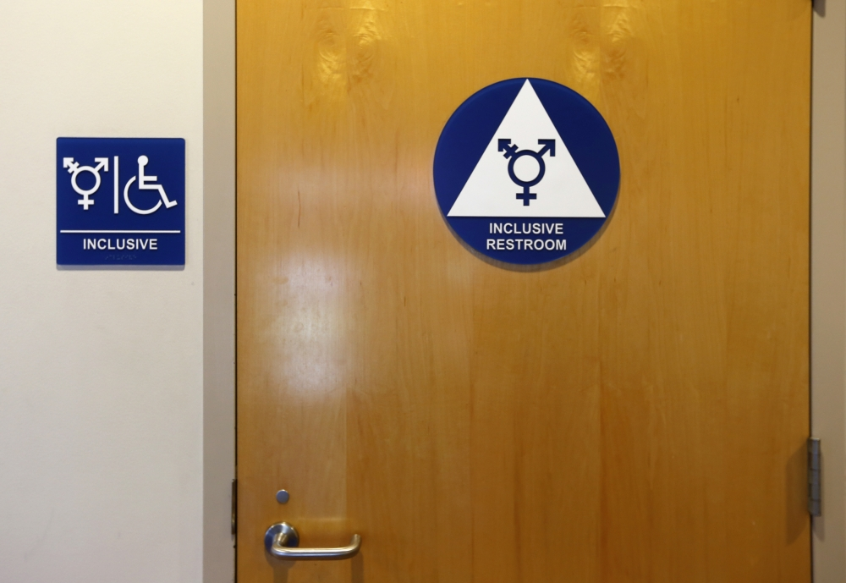

Slide 12
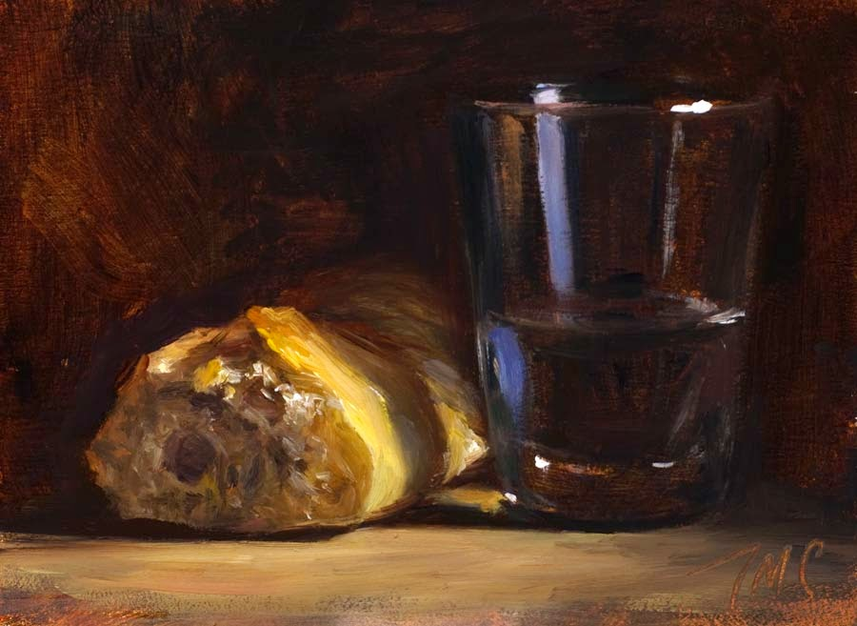
Spiritual appetite..
Matthew 5:6 Blessed are those who hunger and thirst for righteousness, For they shall be filled.

Slide 15
2 Corinthians 5:20-21 Now then, we are ambassadors for Christ, as though God were pleading through us: we implore you on Christ's behalf, be reconciled to God. 21 For He made Him who knew no sin to be sin for us, that we might become the righteousness of God in Him.

Slide 16
Galatians 3:26-27 For you are all sons of God through faith in Christ Jesus. 27 For as many of you as were baptized into Christ have put on Christ.
Romans 6:17-18 But God be thanked that though you were slaves of sin, yet you obeyed from the heart that form of doctrine to which you were delivered. 18 And having been set free from sin, you became slaves of righteousness.

Slide 17
Ephesians 4:24 and that you put on the new man which was created according to God, in true righteousness and holiness.
Romans 13:14 But put on the Lord Jesus Christ, and make no provision for the flesh, to fulfill its lusts.

Slide 18
The Lord Our Righteousness Jehovah Tsidkenu
Jeremiah 23:1-6

