Slide 1
The Church - Devoted to God -
Acts 2:42

Slide 2
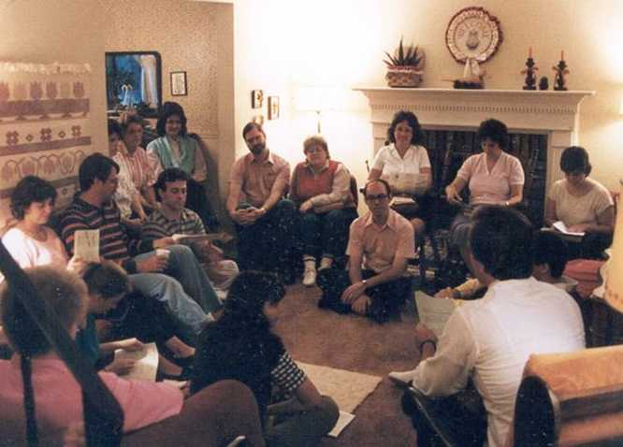
Many churches have begun in homes

Slide 3
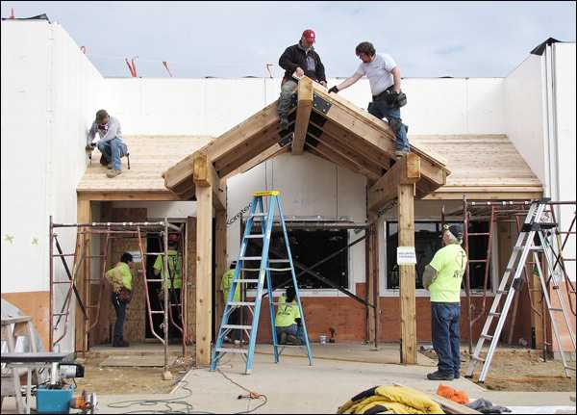
The church grew as members worked together

Slide 4
Growth ceiling..
Ephesians 4:15-16 may grow up in all things into Him who is the head — Christ — 16 from whom the whole body, joined and knit together by what every joint supplies, according to the effective working by which every part does its share, causes growth of the body for the edifying of itself in love.
Limit of combined strength of membership

Slide 5
Keys to growth in Acts..
Acts 2:42 And they continued steadfastly in the apostles' doctrine and fellowship, in the breaking of bread, and in prayers.
Learning
Loving
Communing
Praying

Slide 6
Apostles’ Doctrine.. Devoted to Learning
John 16:8-10 And when He has come, He will convict the world of sin, and of right-eousness, and of judgment: 9 of sin, because they do not believe in Me; 10 of righteousness, because I go to My Father and you see Me no more..
John 16:12-13 "I still have many things to say to you, but you cannot bear them now. 13 However, when He, the Spirit of truth, has come, He will guide you into all truth.."

Slide 7
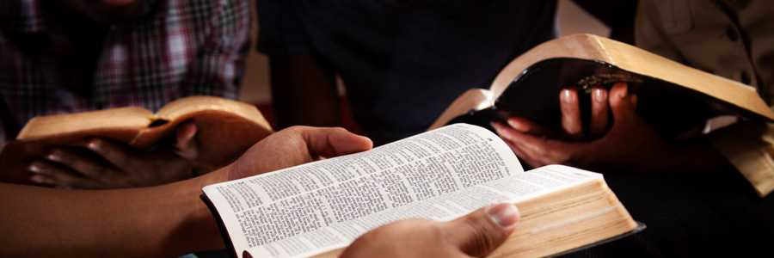
Desiring to Learn from God..
Acts 2:43 Then fear came upon every soul, and many wonders and signs were done through the apostles.
Acts 2:37 Now when they heard this, they were cut to the heart, and said to Peter and the rest of the apostles, "Men and brethren, what shall we do?"

Slide 8
Desiring to Learn from God..
Being present when God’s way taught..
Heeding what the apostles taught..
Spending time in God’s word..
Meditating and surrendering to it..

Slide 9
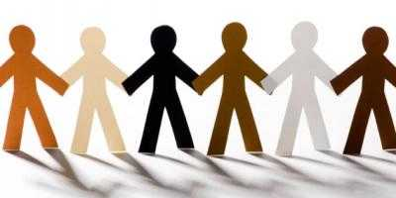
Fellowship.. Devoted to Loving
Acts 20:28 Therefore take heed to yourselves and to all the flock, among which the Holy Spirit has made you overseers, to shepherd the church of God which He purchased with His own blood.

Slide 10
Fellowship.. Devoted to Loving
Acts 2:44-47 Now all who believed were together, and had all things in common, 45 and sold their possessions and goods, and divided them among all, as anyone had need.
46 So continuing daily with one accord in the temple, and breaking bread from house to house, they ate their food with gladness and simplicity of heart, 47 praising God and having favor with all the people. And the Lord added to the church daily those who were being saved.
Community with those we have in common

Slide 11
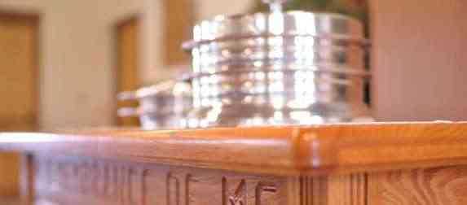
The Breaking of Bread.. Devoted to Communion
1 Corinthians 10:16 The cup of blessing which we bless, is it not the communion of the blood of Christ? The bread which we break, is it not the communion of the body of Christ?

Slide 12
The Breaking of Bread.. Devoted to Communion
Acts 20:7 Now on the first day of the week, when the disciples came together to break bread, Paul, ready to depart the next day, spoke to them and continued his message until midnight.
1 Corinthians 16:2 On the first day of the week let each one of you lay something aside, storing up as he may prosper, that there be no collections when I come.
We need a regular encounter with the death of Jesus to remind us we aren’t saved by ourselves..

Slide 13
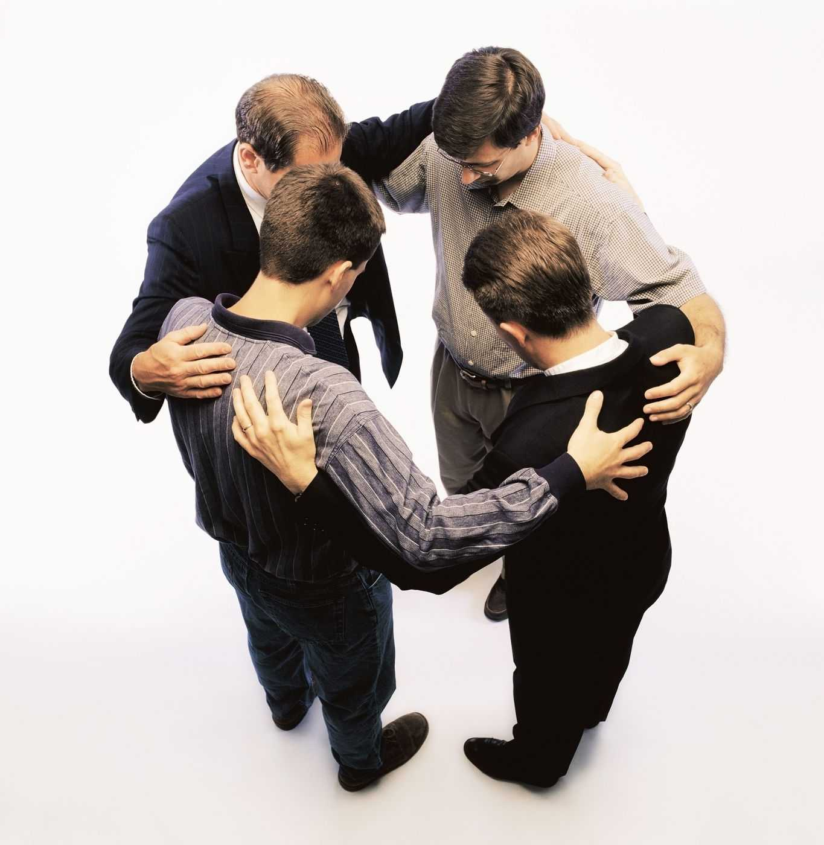
Prayer.. Devoted to God’s Power
Acts 1:14 These all continued with one accord in prayer and supplication, with the women and Mary the mother of Jesus, and with His brothers.
Acts 3:1 Now Peter and John went up together to the temple at the hour of prayer, the ninth hour.

Slide 14
Prayer.. Devoted to God’s Power
Acts 4:29-31 Now, Lord, look on their threats, and grant to Your servants that with all boldness they may speak Your word, 30 by stretching out Your hand to heal, and that signs and wonders may be done through the name of Your holy Servant Jesus." 31 And when they had prayed, the place where they were assembled together was shaken; and they were all filled with the Holy Spirit, and they spoke the word of God with boldness.

Slide 15
Keys to growth in Acts..
Acts 2:42 And they continued steadfastly in the apostles' doctrine and fellowship, in the breaking of bread, and in prayers.
Learning
Loving
Communing
Praying

Slide 16
The Church - Devoted to God -
Acts 2:42

