Slide 1
The Church - One Heart and One Soul -
Acts 2:42

Slide 2
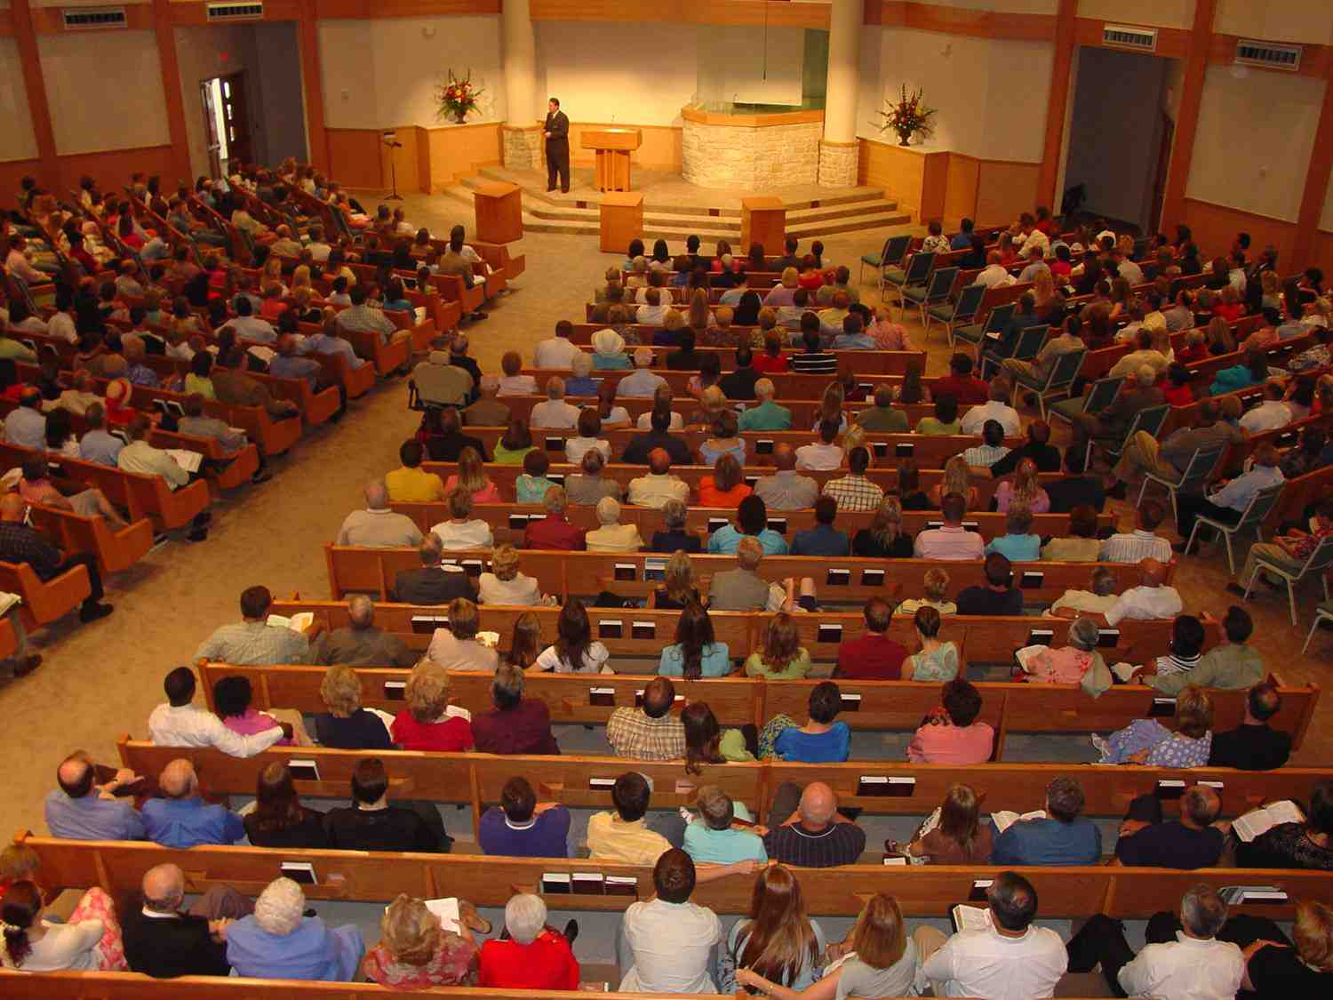
What are the keys to a strong active church?

Slide 3
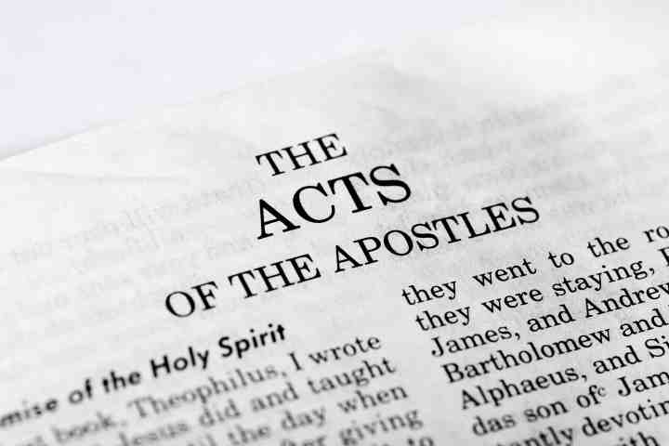
God’s manual for the strong living church..

Slide 4
Key #1 Devoted to God..
Acts 2:42 And they continued steadfastly in the apostles' doctrine and fellowship, in the breaking of bread, and in prayers.
Learning
Loving
Communing
Praying

Slide 5
Key #2 Being United..
Acts 4:32 Now the multitude of those who believed were of one heart and one soul; neither did anyone say that any of the things he possessed was his own, but they had all things in common.

Slide 6
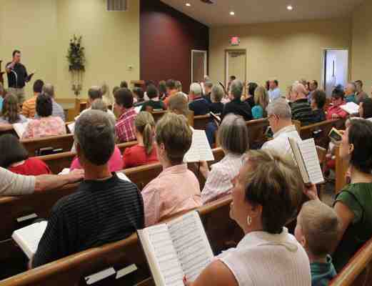
Godly unity makes a church strong

Slide 7
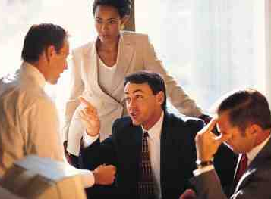
Unity goes beyond outward agreement

Slide 8
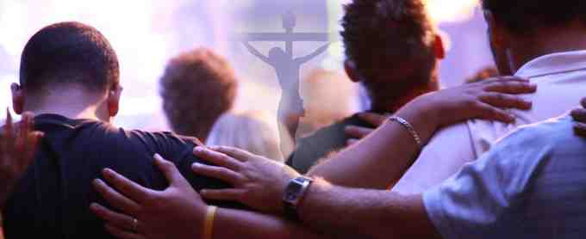
Part of something bigger than themselves..
One heart and soul…
The center of life and being
The seat of thoughts and emotions
Ephesians 5:23-25 For the husband is head of the wife, as also Christ is head of the church; and He is the Savior of the body... just as Christ also loved the church and gave Himself for her..

Slide 9
Romans 12:4-5 For as we have many members in one body, but all the members do not have the same function, 5 so we, being many, are one body in Christ, and individually members of one another.

Slide 10
Benefit of the body placed above benefit of individual..
Acts 4:32 Now the multitude of those who believed were of one heart and one soul; neither did anyone say that any of the things he possessed was his own, but they had all things in common.
Acts 5:4 While it remained, was it not your own? And after it was sold, was it not in your own control?
They had individual ownership, not communism

Slide 11
Benefit of the body placed above benefit of individual..
Philippians 2:3-8 Let nothing be done through selfish ambition or conceit, but in lowliness of mind let each esteem others better than himself. 4 Let each of you look out not only for his own interests, but also for the interests of others.
5 Let this mind be in you which was also in Christ Jesus, 6 who, being in the form of God, did not consider it robbery to be equal with God, 7 but made Himself of no reputation, taking the form of a bondservant, and coming in the likeness of men.

Slide 12
Subordinating our own goals to the goals of the body..
We each have our own lives to lead..
Providing for our families..
1 Timothy 5:8 But if anyone does not provide for his own, and especially for those of his household, he has denied the faith and is worse than an unbeliever.
We still have our own jobs, homes, goals..
These goals are subordinated to Christ and His body
Individual pursuits now take on new purpose

Slide 13
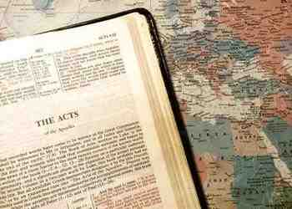
Unity in Christ overshadowed diversity of backgrounds..
Acts 2:5-11 And there were dwelling in Jerusalem Jews, devout men, from every nation under heaven. 6 And when this sound occurred, the multitude came together, and were confused, because everyone heard them speak in his own language..
Acts 6:1-2 Now in those days, when the number of the disciples was multiplying, there arose a complaint against the Hebrews by the Hellenists, because their widows were neglected in the daily distribution.

Slide 14
Unity in Christ overshadowed diversity of backgrounds..
Colossians 3:9-11 you have put off the old man with his deeds, 10 and have put on the new man who is renewed in knowledge according to the image of Him who created him, 11 where there is neither Greek nor Jew, circumcised nor uncircumcised, barbarian, Scythian, slave nor free, but Christ is all and in all.

Slide 15
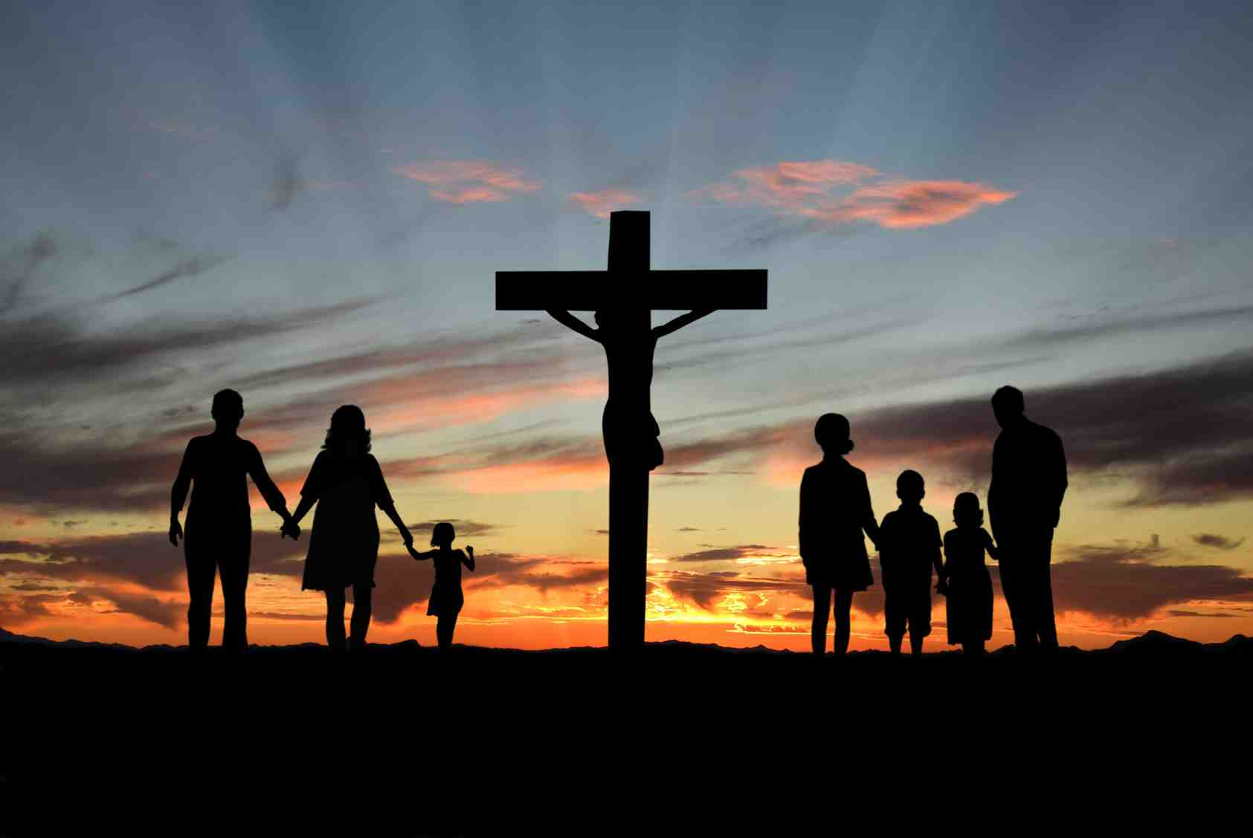
Unity increases our testimony of the risen Jesus..
Acts 4:33 And with great power the apostles gave witness to the resurrection of the Lord Jesus. And great grace was upon them all.
John 17:20-21 "I do not pray for these alone, but also for those who will believe in Me through their word; 21 that they all may be one, as You, Father, are in Me, and I in You; that they also may be one in Us, that the world may believe that You sent Me.

Slide 16
We are part of something bigger than ourselves..
We must place the body above our own lives

Slide 17
The Church - One Heart and One Soul -
Acts 2:42

