Slide 1
The Church - Compelled to Proclaim Jesus -
Acts 4:20

Slide 2
Growing .. or Dead ?

Slide 3
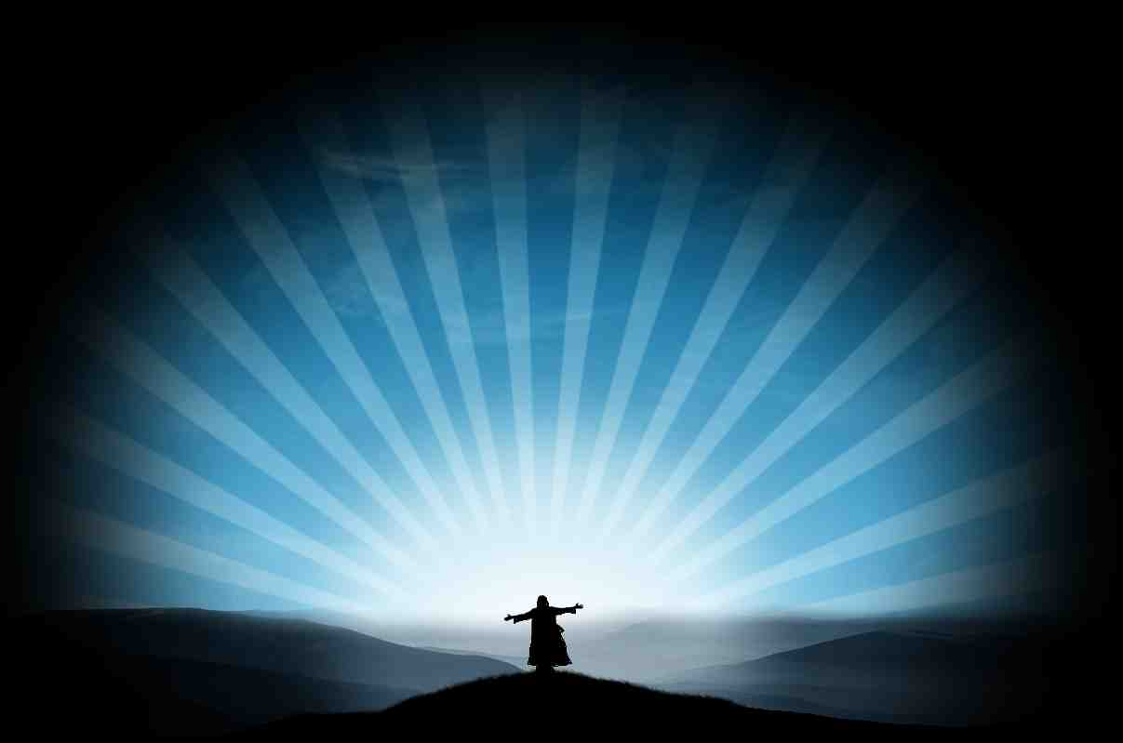
We want to pursue victory

Slide 4
Key #1 Devoted to God..
Acts 2:42 And they continued steadfastly in the apostles' doctrine and fellowship, in the breaking of bread, and in prayers.
Learning
Loving
Communing
Praying

Slide 5
Key #2 Being United..
Acts 4:32 Now the multitude of those who believed were of one heart and one soul; neither did anyone say that any of the things he possessed was his own, but they had all things in common.

Slide 6
Proclaiming Jesus
Acts 4:18-20 they commanded them not to speak at all nor teach in the name of Jesus. 19 But Peter and John answered and said to them, "Whether it is right in the sight of God to listen to you more than to God, you judge. 20 For we cannot but speak the things which we have seen and heard."

Slide 7
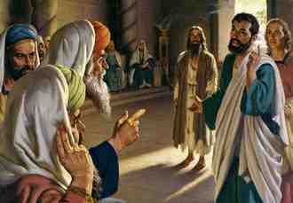
They could not stop proclaiming Christ ..

Slide 8
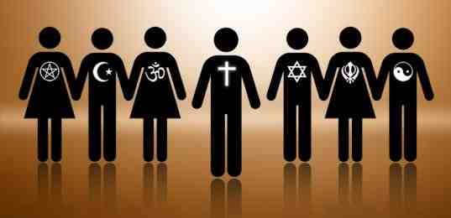
Charging us not to speak..
Political Correctness.. Tolerance

Slide 9
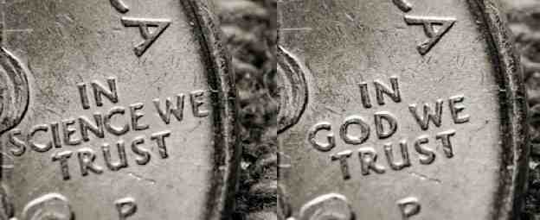
Charging us not to speak..
The atheist elite ..

Slide 10
Charging us not to speak..
The post-modernists..

Slide 11
Charging us not to speak..
The secularist..

Slide 12
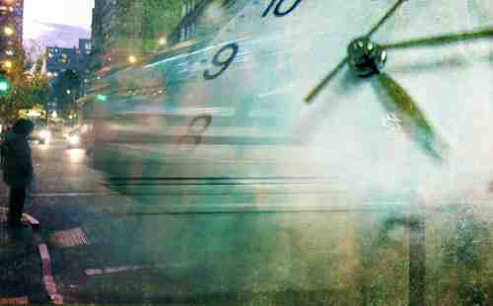
Charging us not to speak..
Our busy schedules ..

Slide 13
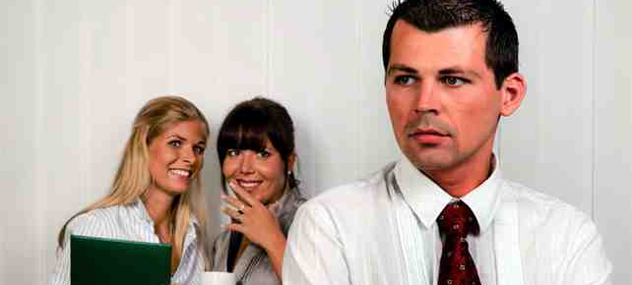
Charging us not to speak..
Fear of rejection ..

Slide 14
Why couldn’t they stop?
It was their mission..
Acts 1:8 But you shall receive power when the Holy Spirit has come upon you; and you shall be witnesses to Me in Jerusalem, and in all Judea and Samaria, and to the end of the earth."
Acts 8:4 Therefore those who were scattered went everywhere preaching the word.

Slide 15
Why couldn’t they stop?
Their faith ..
John 6:68 But Simon Peter answered Him, "Lord, to whom shall we go? You have the words of eternal life.
Good News.. Romans 1:16-17
Greatest Commands .. Luke 10:27
Peter’s own Failure .. John 18:15-27

Slide 16
What can you do?
Invite others to our services..
Offer to pray with them..
Share how God has helped you..
Ask them if they ever read the Bible..
Ask waitress if you can pray for them..
Ask if they have spiritual beliefs..
Greet our visitors and welcome them..
Set up a Bible study..

Slide 17
The Church - Compelled to Proclaim Jesus -
Acts 4:20

