Slide 1
The Church - Handling Problems Wisely -
Acts 6:1-7

Slide 2
Key #1 Devoted to God..
Acts 2:42 And they continued steadfastly in the apostles' doctrine and fellowship, in the breaking of bread, and in prayers.
Learning
Loving
Communing
Praying

Slide 3
#2 Being United..
Acts 4:32 Now the multitude of those who believed were of one heart and one soul; neither did anyone say that any of the things he possessed was his own, but they had all things in common.

Slide 4
#3 Proclaiming Jesus
Acts 4:18-20 they commanded them not to speak at all nor teach in the name of Jesus. 19 But Peter and John answered and said to them, "Whether it is right in the sight of God to listen to you more than to God, you judge. 20 For we cannot but speak the things which we have seen and heard."

Slide 5
The Problem
Acts 6:1-7 Now in those days, when the number of the disciples was multiplying, there arose a complaint against the Hebrews by the Hellenists, because their widows were neglected in the daily distribution.
Complaint (gongysmos) murmuring

Slide 6
The Solution
2 Then the twelve summoned the multitude of the disciples and said, "It is not desirable that we should leave the word of God and serve tables. 3 Therefore, brethren, seek out from among you seven men of good reputation, full of the Holy Spirit and wisdom, whom we may appoint over this business; 4 but we will give ourselves continually to prayer and to the ministry of the word."

Slide 7
Wisdom of apostles..
They did not ignore the problem (James 1:27)
They listened and acted with wisdom
Gathered “all” the people
Seven men with qualifications
The apostles would continue their work of prayer and the word

Slide 8
The Outcome..
5 And the saying pleased the whole multitude. And they chose Stephen, a man full of faith and the Holy Spirit, and Philip, Prochorus, Nicanor, Timon, Parmenas, and Nicolas, a proselyte from Antioch, 6 whom they set before the apostles; and when they had prayed, they laid hands on them.

Slide 9
The Outcome..
7 Then the word of God spread, and the number of the disciples multiplied greatly in Jerusalem, and a great many of the priests were obedient to the faith.

Slide 10
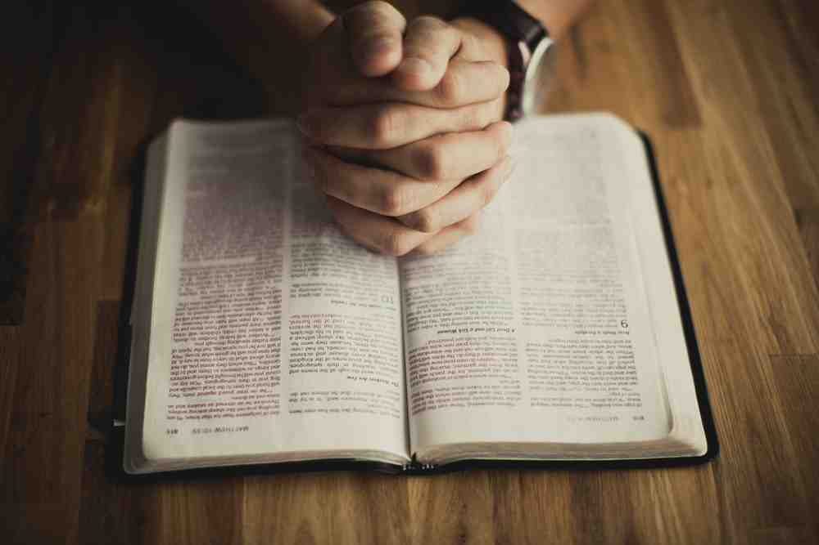
What we learn..
Dealing with issues wisely..
Leaders focus on prayer and the word..
Not overlooking anyone..
Involving the group in the solution..

Slide 11
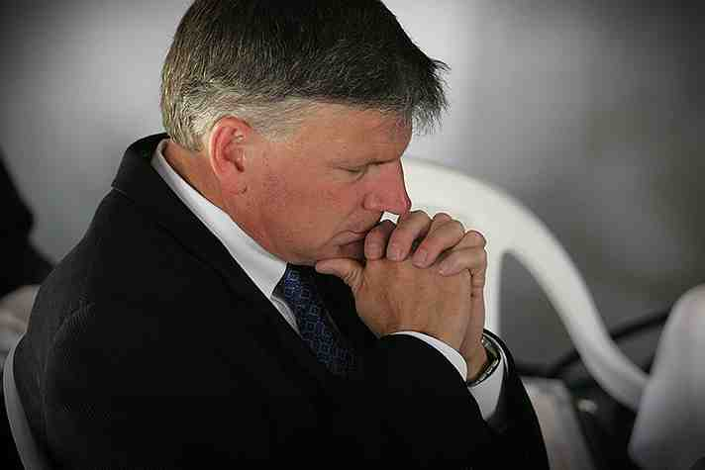
Leaders and prayer..
Godly leaders realize their role in prayer..

Slide 12
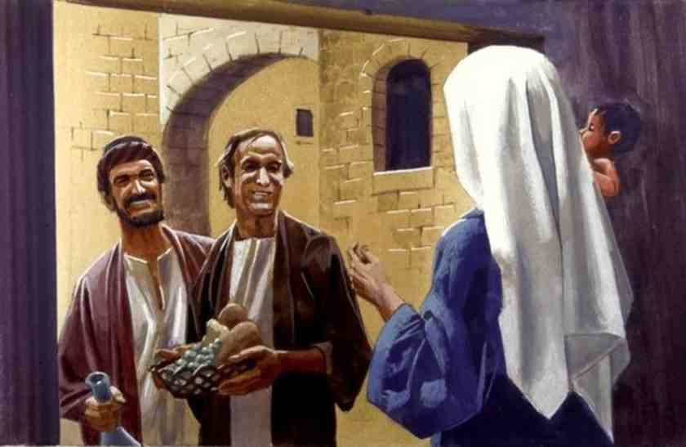
Three qualifications..
Seven men of good report
Full of the Holy Spirit
Filled with wisdom

Slide 13
The Church - Handling Problems Wisely -
Acts 6:1-7

