Slide 1
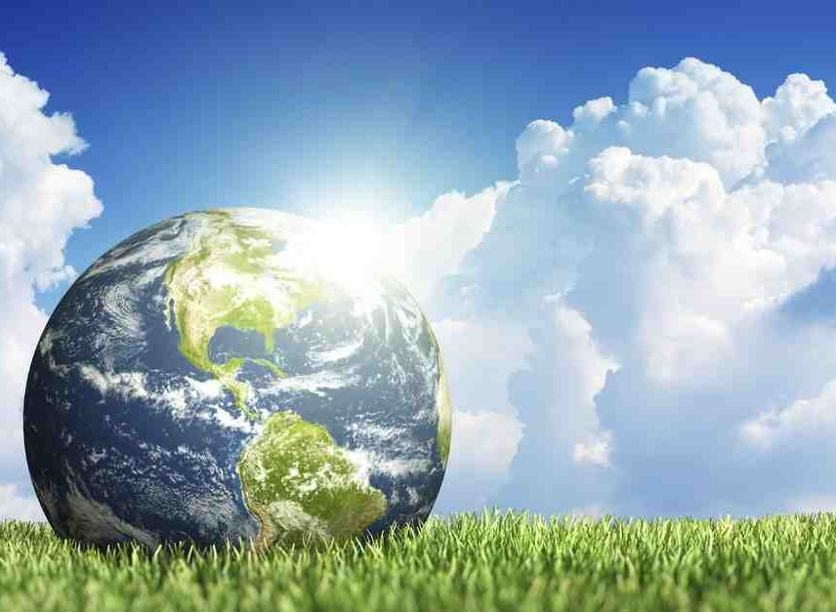
What Does the Bible Say About Environmentalism?
Romans 1:20-25

Slide 2
Our greatest threat...
Islamic terrorism..
Communism..
Global warming?

Slide 3
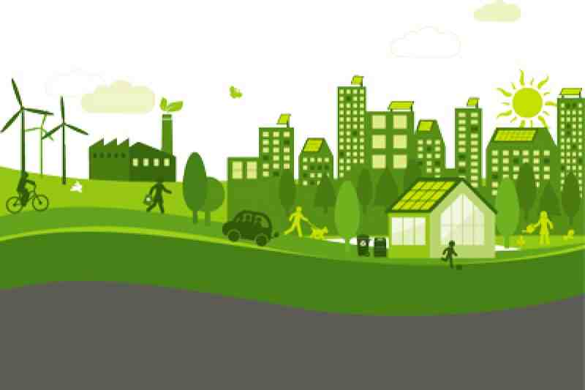
Green movement..
Recycling
Planting trees
Green energy
Organic crops
Protect “Mother Nature”
What is the underlying philosophy?

Slide 4
Is this becoming a religion?

Slide 5
Romans 1:20…
20 For since the creation of the world His invisible attributes are clearly seen, being understood by the things that are made, even His eternal power and Godhead, so that they are without excuse, 21 because, although they knew God, they did not glorify Him as God, nor were thankful, but became futile in their thoughts, and their foolish hearts were darkened.

Slide 6
Romans 1:20…
22 Professing to be wise, they became fools, 23 and changed the glory of the incorruptible God into an image made like corruptible man — and birds and four-footed animals and creeping things.
24 Therefore God also gave them up to uncleanness, in the lusts of their hearts, to dishonor their bodies among themselves, 25 who exchanged the truth of God for the lie, and worshiped and served the creature rather than the Creator, who is blessed forever. Amen.

Slide 7
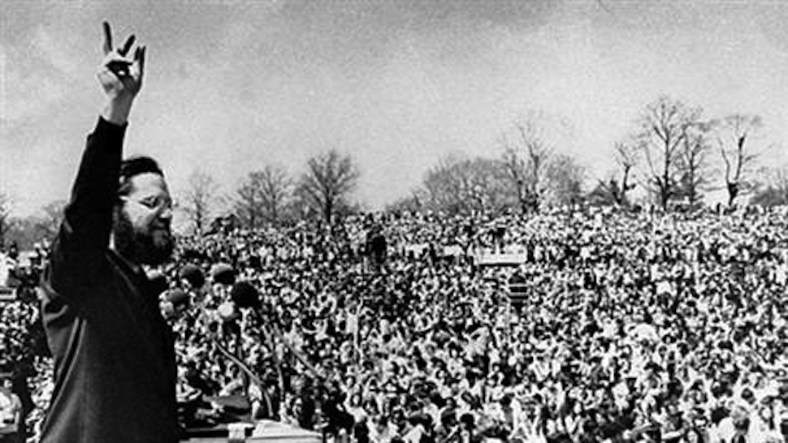
First “Earth Day” 1970

Slide 8
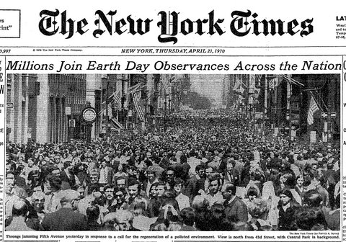

Slide 9
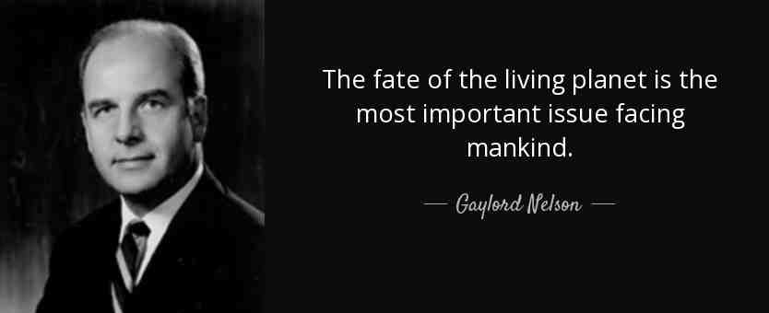
“Within 25 years 70% of animal population will be extinct..

Slide 10
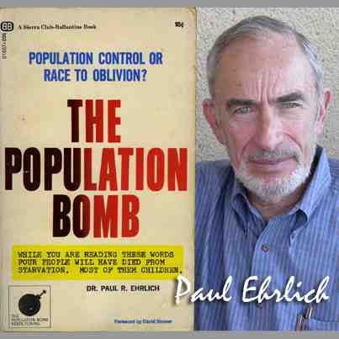
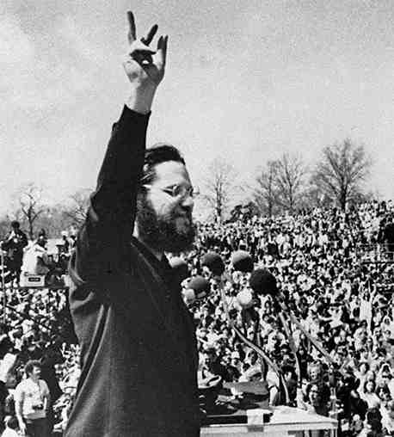
“100 to 200 million people will die in 10 years due to overpopulation”

Slide 11
United Nations..
First International Earth Day – 1971
International Earth Summit – 1972
(Global problem requiring Global solution)
World Earth Summit – 1992
Agenda 21
Sustainability
Imposing worldwide standards

Slide 12
Six Things the Bible Says..
The Earth Belongs to God
Psalms 24:1-2 The earth is the Lord's, and all its fullness, The world and those who dwell therein. 2 For He has founded it upon the seas, And established it upon the waters.
Gen 1:1 In the beginning God created the heavens and the earth.
We are to honor God’s creation..

Slide 13
Six Things the Bible Says..
God gave man dominion over earth
Genesis 1:28 Then God blessed them, and God said to them, "Be fruitful and multiply; fill the earth and subdue it; have dominion over the fish of the sea, over the birds of the air, and over every living thing that moves on the earth."
Genesis 2:15 Then the Lord God took the man and put him in the garden of Eden to tend and keep it.
Psalms 115:16 The heaven, even the heavens, are the Lord's; But the earth He has given to the children of men.
We are stewards, caretakers of earth

Slide 14
Six Things the Bible Says..
The earth reflects the beauty of God..
Psalms 19:1-2 The heavens declare the glory of God; And the firmament shows His handiwork. 2 Day unto day utters speech, And night unto night reveals knowledge.
The earth is filled with His glory..
We are to enjoy the earth,
but don’t worship it..

Slide 15
Six Things the Bible Says..
Man is placed above the creation and is uniquely responsible to God..
Psalms 8:3-4 When I consider Your heavens, the work of Your fingers, The moon and the stars, which You have ordained, 4 What is man that You are mindful of him, And the son of man that You visit him?
All living things have value, but all living things do not have equal value

Slide 16
Six Things the Bible Says..
God commands protecting the land, animals, vegetation for common good
Lev 25 .. Leaving the land fallow 7th year
Deut 20 .. Do not destroy the trees with fruit
Consumption and production balanced with conservation..

Slide 17
Six Things the Bible Says..
Christ’s redemption includes creation
Romans 8:19-21 For the earnest expectation of the creation eagerly waits for the revealing of the sons of God. 20 For the creation was subjected to futility, not willingly, but because of Him who subjected it in hope; 21 because the creation itself also will be delivered from the bondage of corruption into the glorious liberty of the children of God.
We must treat the earth with the same priority God does..

Slide 18
What Does the Bible Say About Environmentalism?
Romans 1:20-25

