Slide 1
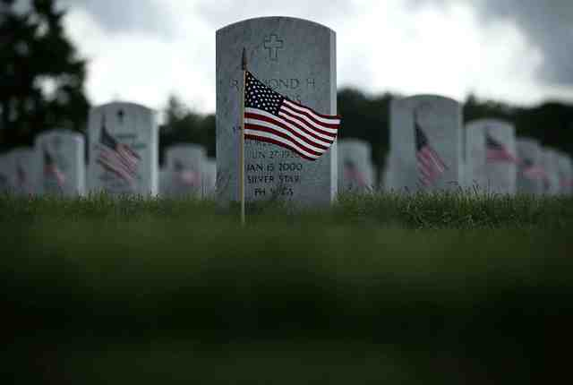
Defending Truth and Freedom
John 8:31-36

Slide 2
John 8:31-32 "If you abide in My word, you are My disciples indeed. 32 And you shall know the truth, and the truth shall make you free."

Slide 3
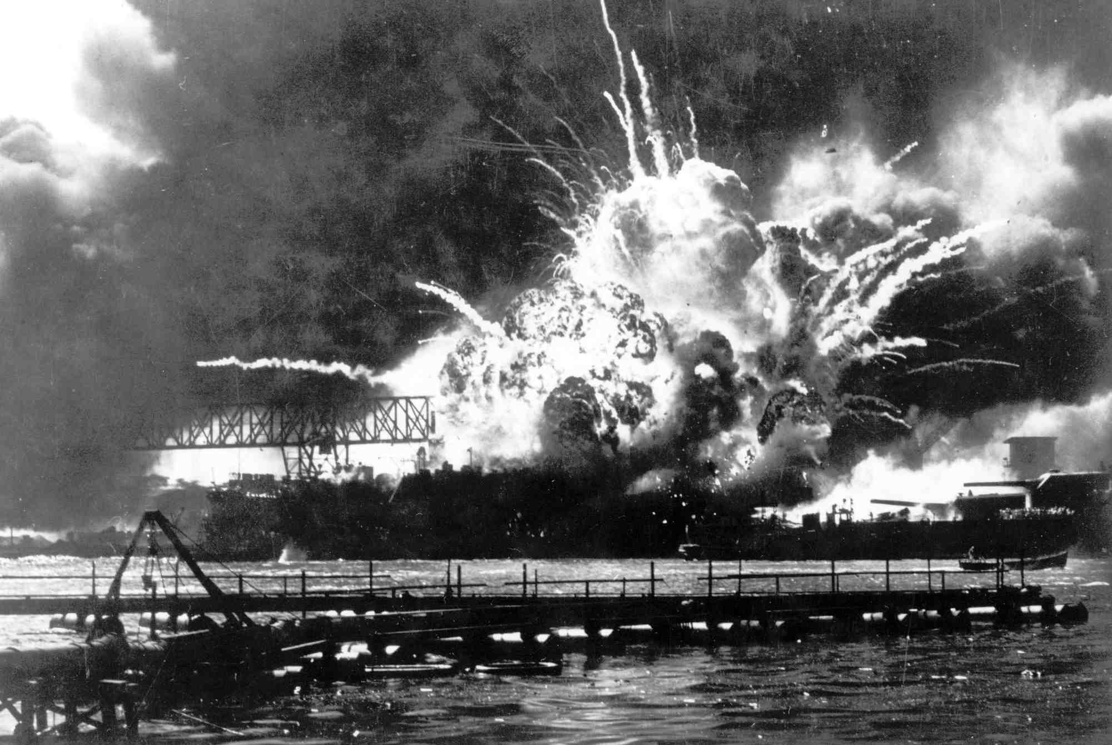

Slide 4
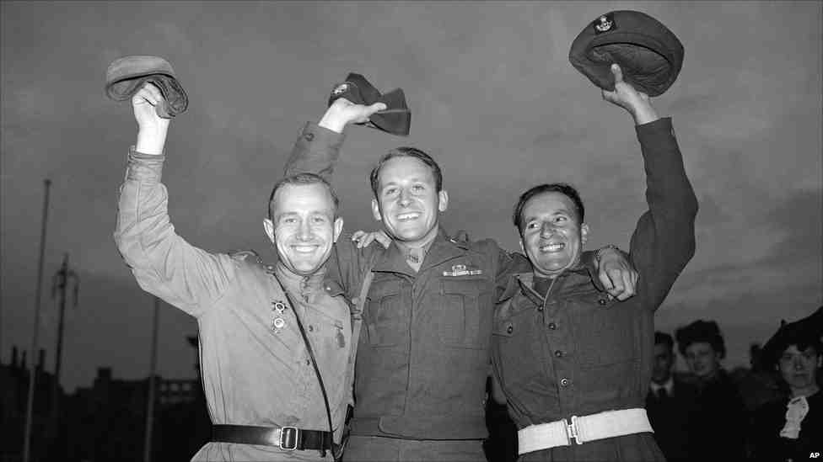

Slide 5
Remember

Slide 6
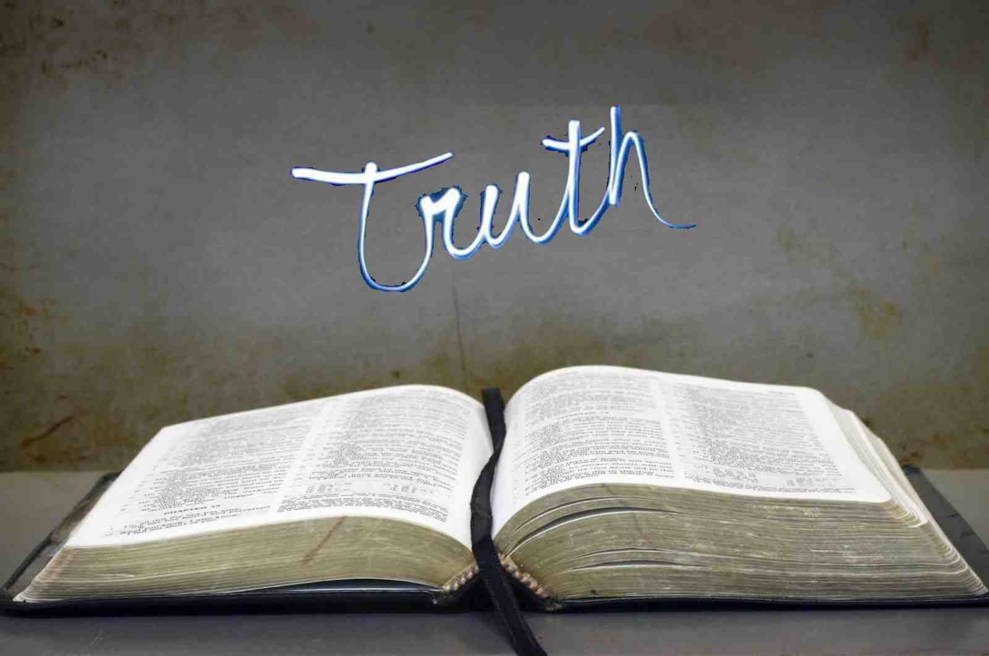
The truth of God’s word..
John 8:31-32 "If you abide in My word, you are My disciples indeed. 32 And you shall know the truth, and the truth shall make you free."
John 17:17 Sanctify them by Your truth. Your word is truth.

Slide 7
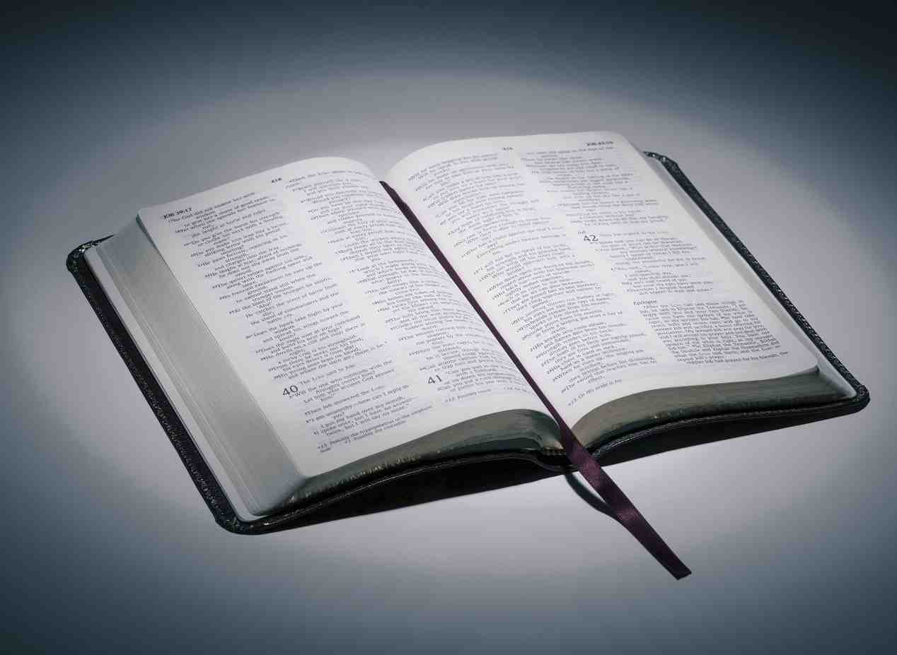
Is it harmful to defend the truth?
Philippians 1:17-18 knowing that I am appointed for the defense of the gospel.
1 John 4:1 Beloved, do not believe every spirit, but test the spirits, whether they are of God; because many false prophets have gone out into the world.

Slide 8
Commended for defending the truth
Revelation 2:2-3 "I know your works, your labor, your patience, and that you cannot bear those who are evil. And you have tested those who say they are apostles and are not, and have found them liars; 3 and you have persevered and have patience, and have labored for My name's sake and have not become weary.

Slide 9
Truth will unite us..
John 17:19-21 And for their sakes I sanctify Myself, that they also may be sanctified by the truth. 20 "I do not pray for these alone, but also for those who will believe in Me through their word; 21 that they all may be one, as You, Father, are in Me, and I in You; that they also may be one in Us, that the world may believe that You sent Me.

Slide 10
Platform of unity..
Ephesians 4:3-6 endeavoring to keep the unity of the Spirit in the bond of peace. 4 There is one body and one Spirit, just as you were called in one hope of your calling; 5 one Lord, one faith, one baptism; 6 one God and Father of all, who is above all, and through all, and in you all.

Slide 11
Principles of unity..
One body (the church).. defend it
Matt 16:18; Acts 20:28; Eph 1:22-23
One Spirit.. preach what He revealed
John 14:26; 16:13; Eph 2:20-22; 4:11-13
One hope … live for it
Lam 3:26; Titus 3:7; Col 1:5
One faith .. Don’t change it
Jude 3; Rom 1:17

Slide 12
Principles of unity..
One baptism .. Preach it
Matt 3:13-17; Matt 28:19; Mark 16:15-16
One God .. Submit to Him as children
1 John 3:1; 1 Pet 1:14-15

Slide 13
Defending truth or promoting a lie..
“All have sinned” .. Rom 3:10,23
1 John 1:8,10 If we say that we have no sin, we deceive ourselves, and the truth is not in us...10 If we say that we have not sinned, we make Him a liar, and His word is not in us.
Knowing God/Keeping His commandments
1 John 2:3-4 Now by this we know that we know Him, if we keep His commandments. 4 He who says, "I know Him," and does not keep His commandments, is a liar, and the truth is not in him.

Slide 14
Defending truth or promoting a lie..
Jesus Christ is the Son of God
1 John 2:21-22 I have not written to you because you do not know the truth, but because you know it, and that no lie is of the truth. Who is a liar but he who denies that Jesus is the Christ? He is antichrist who denies the Father and the Son.
John 8:44 You are of your father the devil, and the desires of your father you want to do. He was a murderer from the beginning, and does not stand in the truth, because there is no truth in him. When he speaks a lie, he speaks from his own resources, for he is a liar and the father of it.

Slide 15
Defending truth in love..
Ephesians 4:14-15 but speaking the truth in love, may grow up in all things into Him who is the head — Christ —
1 Peter 3:15 But sanctify the Lord God in your hearts, and always be ready to give a defense to everyone who asks you a reason for the hope that is in you, with meekness and fear;
2 Timothy 2:24-25 And a servant of the Lord must not quarrel but be gentle to all, able to teach, patient, 25 in humility correcting those who are in opposition, if God perhaps will grant them repentance, so that they may know the truth,

Slide 16
John 8:31-32 "If you abide in My word, you are My disciples indeed. 32 And you shall know the truth, and the truth shall make you free."
Jude 3 I found it necessary to write to you exhorting you to contend earnestly for the faith which was once for all delivered to the saints.

Slide 17
Defending Truth and Freedom
John 8:31-36

