Slide 1
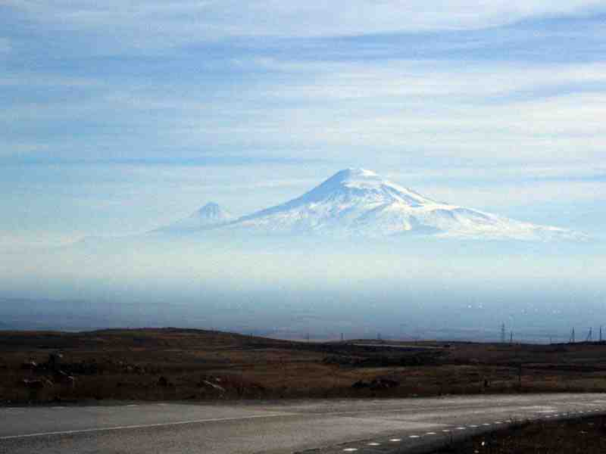
NOAH
FINDING
Genesis 6:1-12

Slide 2
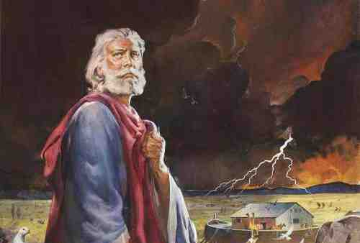
LISTENING TO THE LORD..
Gen 6:13-16..
Make yourself an ark … Specific instructions..
v22 Noah did all God commanded..
Ch 7:1-5..
Come into the ark.. Animals..
v5 Noah did all God commanded..

Slide 3
LISTENING TO THE LORD..
1 Peter 3:19-21 He went and preached to the spirits in prison, 20 who formerly were disobedient, when once the Divine longsuffering waited in the days of Noah, while the ark was being prepared, in which a few, that is, eight souls, were saved through water.

Slide 4
LISTENING TO THE LORD..
21 There is also an antitype which now saves us — baptism (not the removal of the filth of the flesh, but the answer of a good conscience toward God), through the resurrection of Jesus Christ..

Slide 5
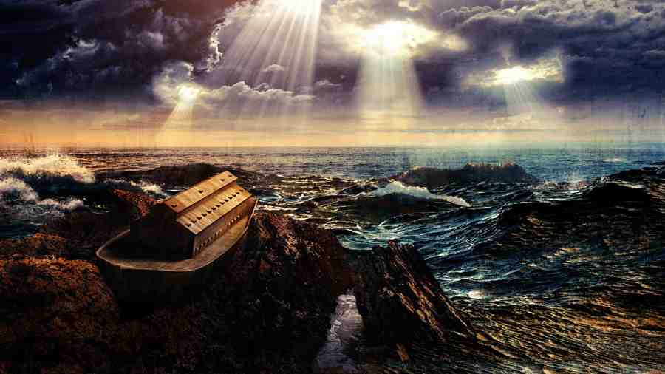
WAITING ON THE LORD..
7:11 600th year, 2nd month, 17th day
7:12 rain 40 days, nights
7:24 prevailed 150 days
8:4 ark rested 7th month, 17th day
8:5 10th month, 1st day mountain tops
8:13 601st year, 1st month, 1st day
8:14 2nd month, 27th day earth dry
8:15 God said “Go out of the ark”

Slide 6
WAITING ON THE LORD..
2 Peter 2:4-9 For if God did not spare the angels who sinned, but cast them down to hell and delivered them into chains of darkness, to be reserved for judgment; 5 and did not spare the ancient world, but saved Noah, one of eight people, a preacher of righteousness, bringing in the flood on the world of the ungodly..

Slide 7
WAITING ON THE LORD..
9 then the Lord knows how to deliver the godly out of temptations and to reserve the unjust under punishment for the day of judgment..

Slide 8
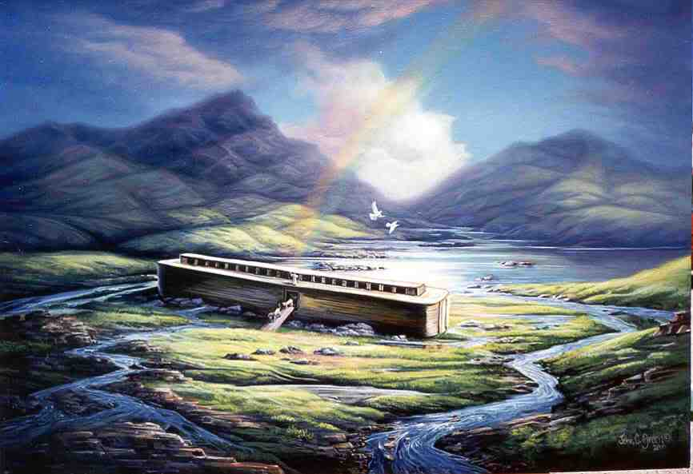
BLESSED BY THE LORD..
Gen 9:1 God blessed Noah..
Given a fresh start.. Repopulate..
New covenant..
Those who did not heed .. Matt 24:37ff

Slide 9
BLESSED BY THE LORD..
Hebrews 11:7 By faith Noah, being divinely warned of things not yet seen, moved with godly fear, prepared an ark for the saving of his household, by which he condemned the world and became heir of the righteousness which is according to faith.

Slide 10
NOAH
FINDING
Genesis 6:1-12

