Slide 1
Spiritual Living
Philippians 1:21-24

Slide 2
Philippians 1:21-24 For to me, to live is Christ, and to die is gain. 22 But if I live on in the flesh, this will mean fruit from my labor; yet what I shall choose I cannot tell. 23 For I am hard-pressed between the two, having a desire to depart and be with Christ, which is far better. 24 Nevertheless to remain in the flesh is more needful for you.

Slide 3
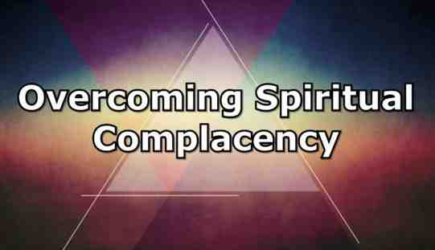
Judges 2:10-12 When all that generation had been gathered to their fathers, another generation arose after them who did not know the Lord nor the work which He had done for Israel.

Slide 4
Hebrews 2:1-3 Therefore we must give the more earnest heed to the things we have heard, lest we drift away... 3 how shall we escape if we neglect so great a salvation..

Slide 5
Keys to Spiritual Living..
To Live as if Jesus were in your place..
Gal 2:20 I have been crucified with Christ; it is no longer I who live, but Christ lives in me..
Gal 5:16 I say then: Walk in the Spirit, and you shall not fulfill the lust of the flesh.
Gal 5:18 But if you are led by the Spirit, you are not under the law.
Romans 8:13 For if you live according to the flesh you will die; but if by the Spirit you put to death the deeds of the body, you will live.

Slide 6
Keys to Spiritual Living..
To Live as if Jesus were in your place..
Gal 5:19-21 Now the works of the flesh are evident, which are: adultery, fornication, uncleanness, lewdness, 20 idolatry, sorcery, hatred, contentions, jealousies, outbursts of wrath, selfish ambitions, dissensions, heresies, 21 envy, murders, drunkenness, revelries, and the like; of which I tell you beforehand, just as I also told you in time past, that those who practice such things will not inherit the kingdom of God.
Gal 5:22-23 But the fruit of the Spirit is love, joy, peace, longsuffering, kindness, goodness, faithfulness, 23 gentleness, self-control. Against such there is no law.

Slide 7
Keys to Spiritual Living..
To Live as if Jesus were in your place..
Colossians 1:27-28 To them God willed to make known what are the riches of the glory of this mystery among the Gentiles: which is Christ in you, the hope of glory. 28 Him we preach, warning every man and teaching every man in all wisdom, that we may present every man perfect in Christ Jesus.
Col 3:1-2 If then you were raised with Christ, seek those things which are above, where Christ is, sitting at the right hand of God. 2 Set your mind on things above, not on things on the earth.
Col 3:10 and have put on the new man who is renewed in knowledge according to the image of Him who created him… (see vs. 12-17)

Slide 8
Keys to Spiritual Living
Living with a sense of God’s presence..
John 4:34 "My food is to do the will of Him who sent Me, and to finish His work...
John 5:19-20 "Most assuredly, I say to you, the Son can do nothing of Himself, but what He sees the Father do; for whatever He does, the Son also does in like manner. 20 For the Father loves the Son, and shows Him all things that He Himself does; and He will show Him greater works than these, that you may marvel...
John 5:30 I can of Myself do nothing. As I hear, I judge; and My judgment is righteous, because I do not seek My own will but the will of the Father who sent Me.
John 6:38 For I have come down from heaven, not to do My own will, but the will of Him who sent Me.

Slide 9
Keys to Spiritual Living
Living with a sense of God’s presence..
John 17:1-4 Jesus spoke these words, lifted up His eyes to heaven, and said: "Father, the hour has come. Glorify Your Son, that Your Son also may glorify You, 2 as You have given Him authority over all flesh, that He should give eternal life to as many as You have given Him. 3 And this is eternal life, that they may know You, the only true God, and Jesus Christ whom You have sent. 4 I have glorified You on the earth. I have finished the work which You have given Me to do.
Paul had this confidence – 2 Tim 4:6-8

Slide 10
Philippians 1:21-24 For to me, to live is Christ, and to die is gain. 22 But if I live on in the flesh, this will mean fruit from my labor; yet what I shall choose I cannot tell. 23 For I am hard-pressed between the two, having a desire to depart and be with Christ, which is far better. 24 Nevertheless to remain in the flesh is more needful for you.

Slide 12
Spiritual Living
Philippians 1:21-24

