Slide 1
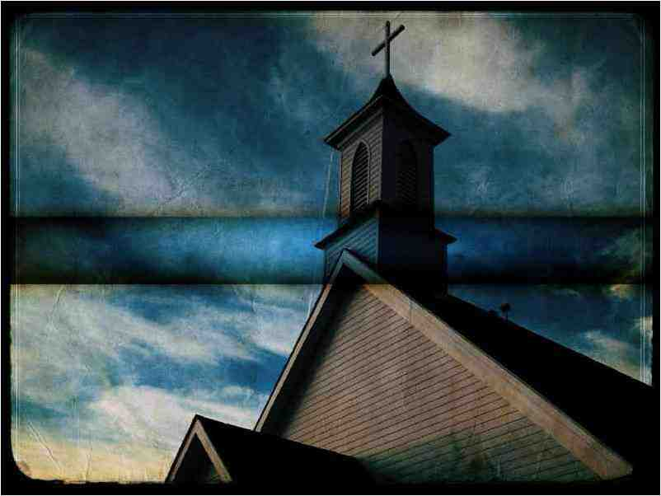
What is the Church of Christ?
Matthew 16:13-19

Slide 2
2 John 9
Whoever goes onward and does not abide in the doctrine of Christ does not have God.
2 Timothy 3:16-17
All scripture given by inspiration of God…
profitable for doctrine..instruction..

Slide 3
What is the Church of Christ?..
It is God’s called out people..
Matthew 16:15-18 And I also say to you that you are Peter, and on this rock I will build My church, and the gates of Hades shall not prevail against it. (Ecclesia – called out)
1 Peter 2:9 you are a chosen generation, a royal priesthood, a holy nation, His own special people, that you may proclaim the praises of Him who called you out of darkness into His marvelous light..

Slide 4
What is the Church of Christ?..
It is God’s called out people..
Romans 16:16 Greet one another with a holy kiss. The churches of Christ greet you.
1 Corinthians 1:2 To the church of God which is at Corinth, to those who are sanctified in Christ Jesus, called to be saints, with all who in every place call on the name of Jesus Christ our Lord, both theirs and ours:
Galatians 1:22-23 And I was unknown by face to the churches of Judea which were in Christ.

Slide 5
What is the Church of Christ?..
It is the Kingdom..
Matthew 16:18-19 on this rock I will build My church,.. 19 And I will give you the keys of the kingdom of heaven, and whatever you bind on earth will be bound in heaven, and whatever you loose on earth will be loosed in heaven."
John 18:37 Pilate therefore said to Him, "Are You a king then?"Jesus answered, "You say rightly that I am a king. For this cause I was born, and for this cause I have come into the world, that I should bear witness to the truth. Everyone who is of the truth hears My voice."

Slide 6
What is the Church of Christ?..
It is the saved..
Acts 2:47 praising God and having favor with all the people. And the Lord added to the church daily those who were being saved.

Slide 7
What is the Church of Christ?..
It is the pillar and ground of the truth..
1 Timothy 3:14-15 These things I write to you, though I hope to come to you shortly; 15 but if I am delayed, I write so that you may know how you ought to conduct yourself in the house of God, which is the church of the living God, the pillar and ground of the truth.
2 Timothy 2:19 Nevertheless the solid foundation of God stands, having this seal: "The Lord knows those who are His," and, "Let everyone who names the name of Christ depart from iniquity."

Slide 8
What is the Church of Christ?..
It is body of Christ..
Romans 12:4-5 For as we have many members in one body, but all the members do not have the same function, 5 so we, being many, are one body in Christ, and individually members of one another.
Colossians 1:18 And He is the head of the body, the church, who is the beginning, the firstborn from the dead, that in all things He may have the preeminence.
Ephesians 1:22-23 And He put all things under His feet, and gave Him to be head over all things to the church, 23 which is His body, the fullness of Him who fills all in all.

Slide 9
What is the Church of Christ?..
It is the building of God..
1 Peter 2:5 you also, as living stones, are being built up a spiritual house, a holy priesthood, to offer up spiritual sacrifices acceptable to God through Jesus Christ
Ephesians 2:19-22 you are no longer strangers and foreigners, but fellow citizens with the saints and members of the household of God, 20 having been built on the foundation of the apostles and prophets, Jesus Christ Himself being the chief cornerstone, 21 in whom the whole building, being fitted together, grows into a holy temple in the Lord, 22 in whom you also are being built together for a dwelling place of God in the Spirit.

Slide 10
What is the Church of Christ?..
It is the bride of Christ..
Ephesians 5:22-23 Wives, submit to your own husbands, as to the Lord. 23 For the husband is head of the wife, as also Christ is head of the church; and He is the Savior of the body.
2 Corinthians 11:2-3 For I am jealous for you with godly jealousy. For I have betrothed you to one husband, that I may present you as a chaste virgin to Christ. 3 But I fear, lest somehow, as the serpent deceived Eve by his craftiness, so your minds may be corrupted from the simplicity that is in Christ.

Slide 11
What is the Church of Christ?..
It is the bride of Christ..
Revelation 19:7 Let us be glad and rejoice and give Him glory, for the marriage of the Lamb has come, and His wife has made herself ready."
Revelation 21:9 Then one of the seven angels who had the seven bowls filled with the seven last plagues came to me and talked with me, saying, "Come, I will show you the bride, the Lamb's wife."

Slide 12
What is the church made up of?
It is composed of Christians..
Acts 2:47And the Lord added to the church daily those who were being saved.
Acts 11:26 And when he had found him, he brought him to Antioch. So it was that for a whole year they assembled with the church and taught a great many people. And the disciples were first called Christians in Antioch.
1 Peter 4:16 Yet if anyone suffers as a Christian, let him not be ashamed, but let him glorify God in this matter.

Slide 13
What is the church made up of?
In character, they are called saints..
1 Corinthians 1:2 To the church of God which is at Corinth, to those who are sanctified in Christ Jesus, called to be saints, with all who in every place call on the name of Jesus Christ our Lord, both theirs and ours:
Colossians 1:1-2 Paul, an apostle of Jesus Christ by the will of God, and Timothy our brother, 2 To the saints and faithful brethren in Christ who are in Colosse:
Philippians 1:1-2 Paul and Timothy, bondservants of Jesus Christ, To all the saints in Christ Jesus who are in Philippi, with the bishops and deacons:

Slide 14
What is the church made up of?
In their work, they are servants..
2 Timothy 2:24 And a servant of the Lord must not quarrel but be gentle to all, able to teach, patient,
Romans 6:16-18 Do you not know that to whom you present yourselves servants to obey, you are that one's servants whom you obey, whether of sin leading to death, or of obedience leading to righteousness? 17 But God be thanked that though you were servants of sin, yet you obeyed from the heart that form of doctrine to which you were delivered. 18 And having been set free from sin, you became servants of righteousness.

Slide 15
What is the church made up of?
In this world, they are sojourners..
1 Peter 2:11 Beloved, I beg you as sojourners and pilgrims, abstain from fleshly lusts which war against the soul,
Philippians 3:20-21 For our citizenship is in heaven, from which we also eagerly wait for the Savior, the Lord Jesus Christ, 21 who will transform our lowly body that it may be conformed to His glorious body, according to the working by which He is able even to subdue all things to Himself.

Slide 16
What is the church made up of?
In God’s family, they are brothers..
1 Corinthians 11:2 Now I praise you, brethren, that you remember me in all things and keep the traditions just as I delivered them to you.
3 John 9-10 I wrote to the church, but Diotrephes, who loves to have the preeminence among them, does not receive us. 10 Therefore, if I come, I will call to mind his deeds which he does, prating against us with malicious words. And not content with that, he himself does not receive the brethren, and forbids those who wish to, putting them out of the church.

Slide 17
What is the church made up of?
In life’s struggles they are soldiers..
2 Timothy 2:4 No one engaged in warfare entangles himself with the affairs of this life, that he may please him who enlisted him as a soldier.
2 Corinthians 10:3-5 For though we walk in the flesh, we do not war according to the flesh. 4 For the weapons of our warfare are not carnal but mighty in God for pulling down strongholds, 5 casting down arguments and every high thing that exalts itself against the knowledge of God, bringing every thought into captivity to the obedience of Christ.

Slide 18
What is the church made up of?
To their Master, they are disciples..
John 8:31-32 Then Jesus said to those Jews who believed Him, "If you abide in My word, you are My disciples indeed. 32 And you shall know the truth, and the truth shall make you free."
Acts 11:26 And the disciples were first called Christians in Antioch.

Slide 19
2 John 9
Whoever goes onward and does not abide in the doctrine of Christ does not have God.
2 Timothy 3:16-17
All scripture given by inspiration of God…
profitable for doctrine..instruction..

Slide 20
What is the Church of Christ?
Matthew 16:13-19

Slide 21
What is the Church of Christ?
Matthew 16:13-19

