Slide 1
Newness of Life Putting God First
Luke 14:15-24

Slide 2
New life in Christ..
Romans 6:4 Therefore we were buried with Him through baptism into death, that just as Christ was raised from the dead by the glory of the Father, even so we also should walk in newness of life.

Slide 3
Matthew 4:4
2 Tim 3:16 All Scripture is given by inspiration of God
(“God-breathed”)

Slide 4
Deuteronomy 6:5-6 You shall love the Lord your God with all your heart.. 6 "And these words which I command you today shall be in your heart. 7 You shall teach them diligently to your children, and shall talk of them when you sit in your house, when you walk by the way, when you lie down, and when you rise up.

Slide 5
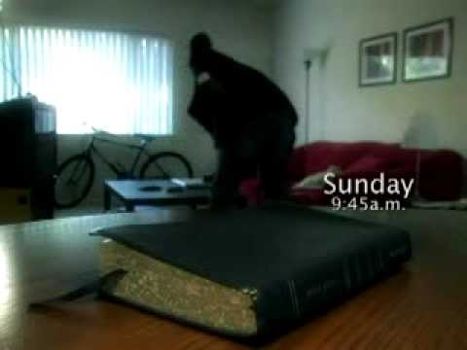
Tale of the Neglected Bible

Slide 6
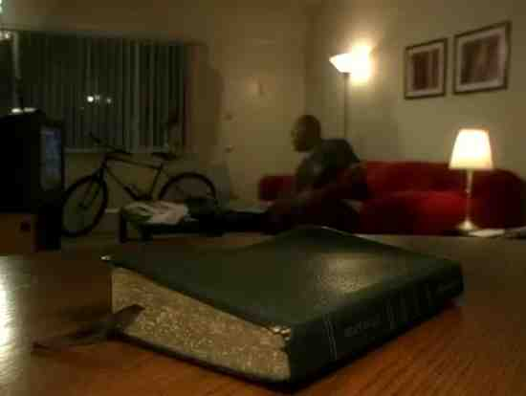

Slide 10
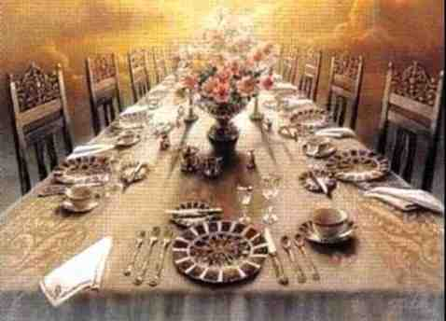
The Great Supper
Luke 14:15-24 "A certain man gave a great supper and invited many, 17 and sent his servant at supper time to say to those who were invited, 'Come, for all things are now ready.'

Slide 11
The Great Supper
18 But they all with one accord began to make excuses. The first said to him, 'I have bought a piece of ground, and I must go and see it. I ask you to have me excused.' 19 And another said, 'I have bought five yoke of oxen, and I am going to test them. I ask you to have me excused.' 20 Still another said, 'I have married a wife, and therefore I cannot come.'

Slide 12
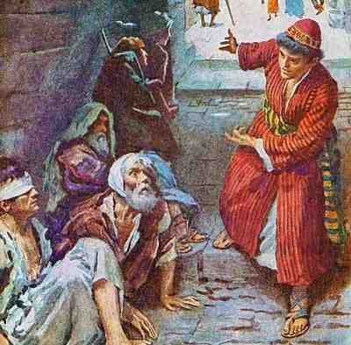
Inviting others
21 So that servant came and reported these things to his master. Then the master of the house, being angry, said to his servant, 'Go out quickly into the streets and lanes of the city, and bring in here the poor and the maimed and the lame and the blind.'

Slide 13
Excuses are counted as rejection
22 And the servant said, 'Master, it is done as you commanded, and still there is room.' 23 Then the master said to the servant, 'Go out into the highways and hedges, and compel them to come in, that my house may be filled. 24 For I say to you that none of those men who were invited shall taste my supper.'"

Slide 14
Filled with those who come gladly

Slide 15
Luke 14:25-34 "If anyone comes to Me and does not hate his father and mother, wife and children, brothers and sisters, yes, and his own life also, he cannot be My disciple. 27 And whoever does not bear his cross and come after Me cannot be My disciple.

Slide 16
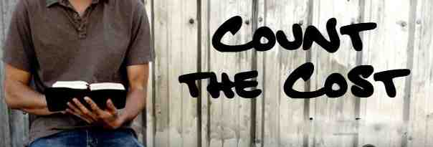
28 For which of you, intending to build a tower, does not sit down first and count the cost, whether he has enough to finish it — 29 lest, after he has laid the foundation, and is not able to finish, all who see it begin to mock him, 30 saying, 'This man began to build and was not able to finish…
33 So likewise, whoever of you does not forsake all that he has cannot be My disciple.

Slide 18
God’s love
Romans 5:6-10 For when we were still without strength, in due time Christ died for the ungodly. 7 For scarcely for a righteous man will one die; yet perhaps for a good man someone would even dare to die. 8 But God demonstrates His own love toward us, in that while we were still sinners, Christ died for us. 9 Much more then, having now been justified by His blood, we shall be saved from wrath through Him. 10 For if when we were enemies we were reconciled to God through the death of His Son, much more, having been reconciled, we shall be saved by His life.

Slide 19
Sacrificial love
1 John 3:15-18 Whoever hates his brother is a murderer, and you know that no murderer has eternal life abiding in him. 16 By this we know love, because He laid down His life for us. And we also ought to lay down our lives for the brethren. 17 But whoever has this world's goods, and sees his brother in need, and shuts up his heart from him, how does the love of God abide in him? 18 My little children, let us not love in word or in tongue, but in deed and in truth.

Slide 20
Expressing our love for God
1 John 4:19-21 We love Him because He first loved us. 20 If someone says, "I love God," and hates his brother, he is a liar; for he who does not love his brother whom he has seen, how can he love God whom he has not seen? 21 And this commandment we have from Him: that he who loves God must love his brother also.

Slide 21
Ephesians 4:11-16

Slide 22
Ephesians 4:15-16 but, speaking the truth in love, may grow up in all things into Him who is the head — Christ — 16 from whom the whole body, joined and knit together by what every joint supplies, according to the effective working by which every part does its share, causes growth of the body for the edifying of itself in love.

Slide 23
Hebrews 10:19-31

Slide 27
Newness of Life Putting God First
Luke 14:15-24

