Slide 1
Raising a Godly Family ( And How Satan Seeks to Destroy It )
Ephesians 5:18-21

Slide 2
Satan’s attacks on family..
Devalue divorce..
Out of wedlock births..
Abortion..
Infidelity..
Homosexuality..
Women’s rights..
Children’s rights..
Redefine the family

Slide 3
Can the family be saved?
The purpose of God..
Blessings..
Raising of children
Place of intimacy
Memories
Foundation for life
Place of love, stabilization..

Slide 4
Place where kids can build confidence

Slide 5
God’s way of raising a family..
Ephesians 5:18-21
18 And do not be drunk with wine, in which is dissipation; but be filled with the Spirit,
19 speaking to one another in psalms and hymns and spiritual songs, singing and making melody in your heart to the Lord,
20 giving thanks always for all things to God the Father in the name of our Lord Jesus Christ,
21 submitting to one another in the fear of God.

Slide 6
God’s way of raising a family..
Eph 5:18 – Be filled with the Spirit
Contrast “do not be drunk”
Historical context: worship of pagan gods
Causes excess --- you be filled with the Spirit
Compare parallel reference..
Col 3:16 “Let the word of Christ dwell in you richly”
When word dominates life and I respond obediently
Be filled .. continuous

Slide 7
God’s way of raising a family..
Eph 5:19 – Be filled with praise
Speaking in psalms, hymns, spiritual songs
Dealing with worship, but also with life in general
Dealing with positive relationships
Spirit filled life leads me to praise God
Person committed to serving God is a happy, praise filled person who loves to worship
Genuinely pleasant to be around

Slide 8
God’s way of raising a family..
Eph 5:20 – filled with thankfulness
Spirit filled life leads to thankfulness
Giving thanks to God in any circumstance
No matter what circumstances
We have been saved, redeemed, home in heaven
Promised constant care of God who will guide us

Slide 9
God’s way of raising a family..
Eph 5:21 – life of submission
Submitting to one another .. reverence for Christ
To rank under (military term)
Place ourselves under each other
1 Cor 16:16; Heb 13:17; 1 Pet 2:13; 5:5; James 4:7
How humble are we?
To make relationships with others what we ought to
Jesus our perfect example – John 13; Phil 2:3-4

Slide 10
Satan attacks these principles..
Self centered pride
Society proclaims individualism, rights
These lead to isolation, independence, loneliness
More interested in self fulfillment than giving
James 3:16-18
Jealousy and selfish ambition .. disorder, evil
Wisdom from above pure, peaceable, gentle

Slide 11
Satan attacks these principles..
Human philosophies
2 Cor 10:3-5 human wisdom against God
Our weapons mighty to destroy strongholds
Taking every thought captive to obedience of Christ
Human wisdom raised against God today
Humanism, sexual freedom, divorce, me-first
Enters our homes through media, schools, music
People self centered, without joy, godless

Slide 12
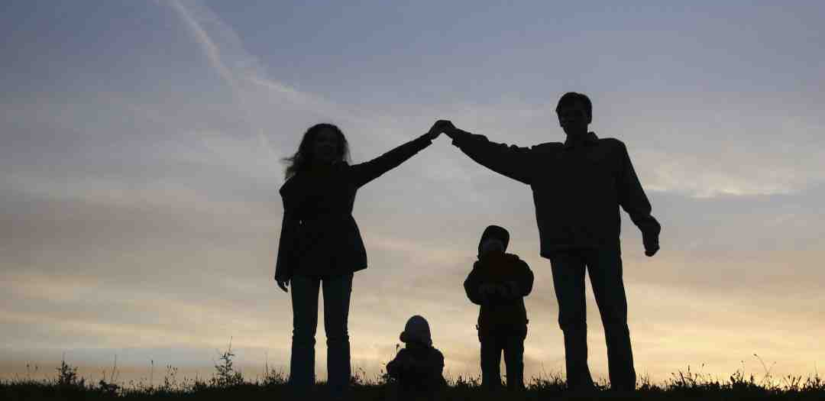
Will we follow Jesus?
Will we lead a life of submission?
Eph 5:21 Mutual submission
God’s pattern – 1 Cor 11:3
Jesus himself is submissive
We must follow – Romans 12:9-10; Jn 13:34

Slide 13
Raising a Godly Family ( And How Satan Seeks to Destroy It )
Ephesians 5:18-21

