Slide 1
Newness of Life Understanding God’s Authority
Romans 6:1-5

Slide 2
New life in Christ..
Romans 6:1-5
3 Or do you not know that as many of us as were baptized into Christ Jesus were baptized into His death? 4 Therefore we were buried with Him through baptism into death, that just as Christ was raised from the dead by the glory of the Father, even so we also should walk in newness of life.
5 For if we have been united together in the likeness of His death, certainly we also shall be in the likeness of His resurrection..

Slide 3
I am a disciple..
John 8:31-32 Then Jesus said to those Jews who believed Him, "If you abide in My word, you are My disciples indeed. 32 And you shall know the truth, and the truth shall make you free."

Slide 4
1 Peter 2:2-3 as newborn babes, desire the pure milk of the word, that you may grow thereby, 3 if indeed you have tasted that the Lord is gracious.
2 Timothy 2:15 Be diligent to present yourself approved to God, a worker who does not need to be ashamed, rightly dividing the word of truth.

Slide 5
My Attitude toward the Bible..
Psalms 119:18 Open my eyes, that I may see wondrous things from Your law.
Psa 119:97 Oh, how I love Your law! It is my meditation all the day.
Psa 119:105 Your word is a lamp to my feet and a light to my path.

Slide 6
Key ingredient to my faith..
Romans 10:17 So then faith comes by hearing, and hearing by the word of God.
Acts 17:11 These were more fair-minded than those in Thessalonica, in that they received the word with all readiness, and searched the Scriptures daily to find out whether these things were so.

Slide 7
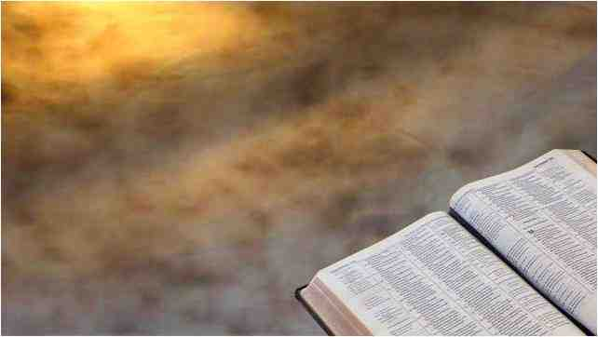
What goals or commitments can you make toward personal Bible study?
Pray to God to help you with this?..
Set aside periods of time?..
Turn the television off?..

Slide 8
Accuracy of the words..
Matthew 24:35 Heaven and earth will pass away, but My words will by no means pass away.
John 16:12-13 "I still have many things to say to you, but you cannot bear them now. 13 However, when He, the Spirit of truth, has come, He will guide you into all truth; for He will not speak on His own authority, but whatever He hears He will speak; and He will tell you things to come.

Slide 9
Following God by feelings?
Prov 14:12 There is a way that seems right to a man, But its end is the way of death.
Jeremiah 10:23 O Lord, I know the way of man is not in himself; It is not in man who walks to direct his own steps.
2 Corinthians 5:7 For we walk by faith, not by sight.

Slide 10
Pray for understanding..
Psalms 119:18 Open my eyes, that I may see Wondrous things from Your law.
Ephesians 3:3-4 how that by revelation He made known to me the mystery (as I have briefly written already, 4 by which, when you read, you may understand my knowledge in the mystery of Christ)..

Slide 11
Understanding God’s authority..
Deuteronomy 4:1-2 "Now, O Israel, listen to the statutes and the judgments which I teach you to observe, that you may live, and go in and possess the land which the Lord God of your fathers is giving you. 2 You shall not add to the word which I command you, nor take from it, that you may keep the commandments of the Lord your God which I command you.
Revelation 22:18-19 For I testify to everyone who hears the words of the prophecy of this book: If anyone adds to these things, God will add to him the plagues that are written in this book; 19 and if anyone takes away from the words of the book of this prophecy, God shall take away his part from the Book of Life, from the holy city, and from the things which are written in this book.

Slide 12
Understanding God’s authority..
2 John 9-11 Whoever transgresses and does not abide in the doctrine of Christ does not have God. He who abides in the doctrine of Christ has both the Father and the Son. 10 If anyone comes to you and does not bring this doctrine, do not receive him into your house nor greet him; 11 for he who greets him shares in his evil deeds.

Slide 13
Discerning true and false teaching
Matthew 7:15-20 "Beware of false prophets, who come to you in sheep's clothing, but inwardly they are ravenous wolves. 16 You will know them by their fruits. Do men gather grapes from thornbushes or figs from thistles?
17 Even so, every good tree bears good fruit, but a bad tree bears bad fruit. 18 A good tree cannot bear bad fruit, nor can a bad tree bear good fruit. 19 Every tree that does not bear good fruit is cut down and thrown into the fire. 20 Therefore by their fruits you will know them.
Philippians 1:9-11 And this I pray, that your love may abound still more and more in knowledge and all discernment, 10 that you may approve the things that are excellent, that you may be sincere and without offense till the day of Christ, 11 being filled with the fruits of righteousness which are by Jesus Christ, to the glory and praise of God.

Slide 14
God’s word in our hearts
Deuteronomy 6:4-9 "Hear, O Israel: The Lord our God, the Lord is one! 5 You shall love the Lord your God with all your heart, with all your soul, and with all your strength.
6 "And these words which I command you today shall be in your heart. 7 You shall teach them diligently to your children, and shall talk of them when you sit in your house, when you walk by the way, when you lie down, and when you rise up. 8 You shall bind them as a sign on your hand, and they shall be as frontlets between your eyes. 9 You shall write them on the doorposts of your house and on your gates.
Hebrews 8:10 For this is the covenant that I will make with the house of Israel after those days, says the Lord: I will put My laws in their mind and write them on their hearts; and I will be their God, and they shall be My people.

Slide 15
Thanking God for revealing His word to us..
Matthew 11:25-30 At that time Jesus answered and said, "I thank You, Father, Lord of heaven and earth, that You have hidden these things from the wise and prudent and have revealed them to babes. 26 Even so, Father, for so it seemed good in Your sight. 27 All things have been delivered to Me by My Father, and no one knows the Son except the Father. Nor does anyone know the Father except the Son, and the one to whom the Son wills to reveal Him. 28 Come to Me, all you who labor and are heavy laden, and I will give you rest. 29 Take My yoke upon you and learn from Me, for I am gentle and lowly in heart, and you will find rest for your souls. 30 For My yoke is easy and My burden is light."

Slide 16
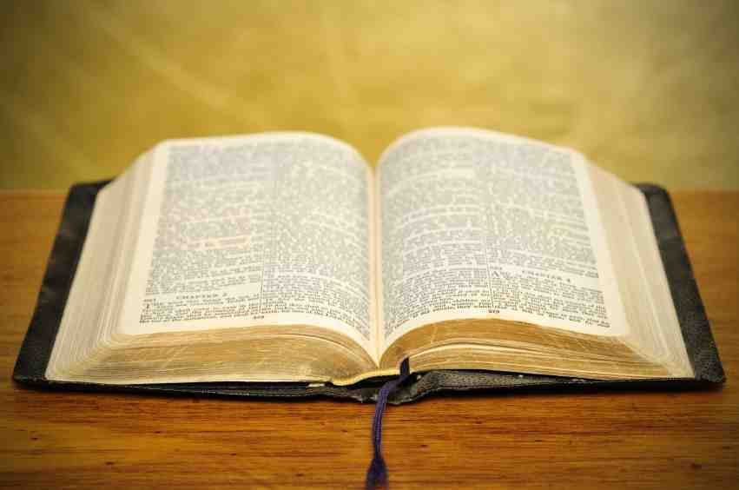
His Word is Complete
2 Timothy 3:16-17 All Scripture is given by inspiration of God, and is profitable for doctrine, for reproof, for correction, for instruction in righteousness, 17 that the man of God may be complete, thoroughly equipped for every good work.
2 Peter 1:1-3 Simon Peter, a bondservant and apostle of Jesus Christ, To those who have obtained like precious faith with us by the righteousness of our God and Savior Jesus Christ: 2 Grace and peace be multiplied to you in the knowledge of God and of Jesus our Lord, 3 as His divine power has given to us all things that pertain to life and godliness, through the knowledge of Him who called us by glory and virtue,

Slide 17
Newness of Life Understanding God’s Authority
Romans 6:1-5

