Slide 1
Christ’s Wake-up Call
Revelation 2:1-7

Slide 2
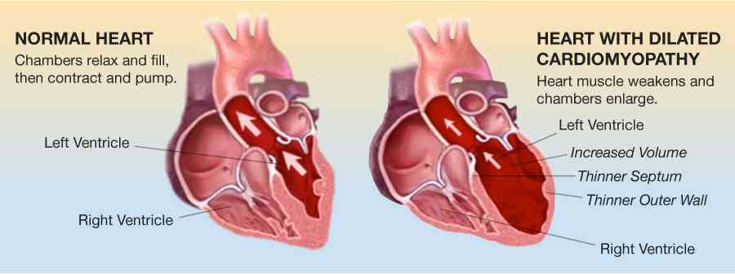
A church in crisis..
Spiritual heart disease in church ..
untreated the church would eventually die
“LOVE DEFICIENCY”

Slide 4
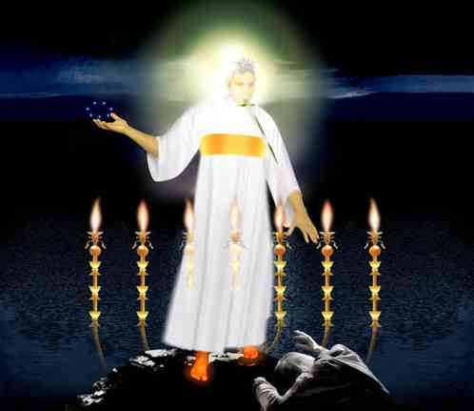
Description of Christ
His Power
His Presence
Rev 2:1 "To the angel of the church of Ephesus write, 'These things says He who holds the seven stars in His right hand, who walks in the midst of the seven golden lampstands..”

Slide 5
The Problem of Lost Love
Rev 2:2-3, 6 "I know your works, your labor, your patience, and that you cannot bear those who are evil. And you have tested those who say they are apostles and are not, and have found them liars; 3 and you have persevered and have patience, and have labored for My name's sake and have not become weary… 6 this you have, that you hate the deeds of the Nicolaitans, which I also hate.

Slide 6
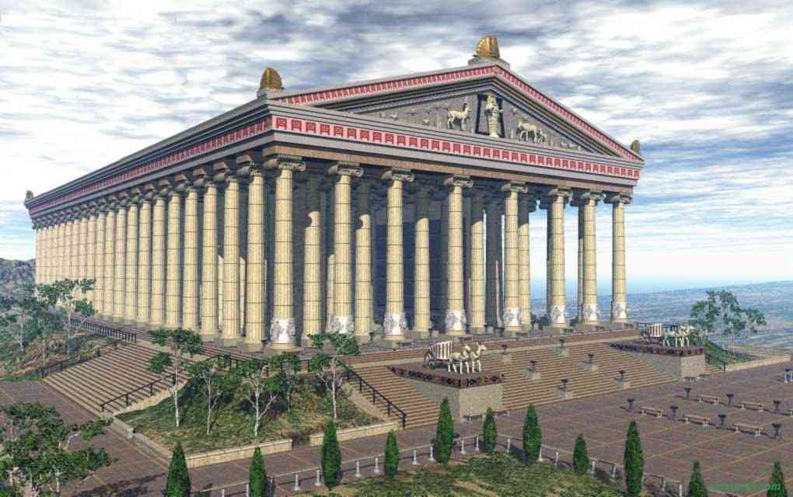
“a hotbed for every kind of cult and superstition”

Slide 7
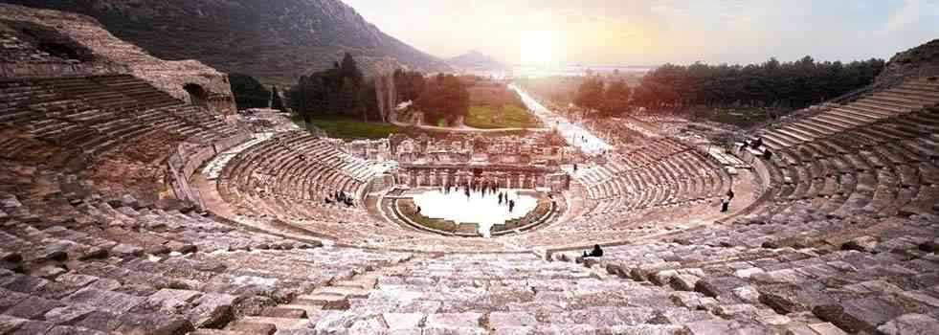
Living in Ephesus
Emperor worship/imperial cult
Prosperous trade center/immoral port

Slide 8
Commendable qualities..
They worked hard
Endured trials and opposition
No tolerance for loose lifestyles
Testing false teachers/apostles
Persevered and not grown weary

Slide 9
Still something was wrong..
4 Nevertheless I have this against you, that you have left your first love.
5 Remember therefore from where you have fallen; repent and do the first works, or else I will come to you quickly and remove your lampstand from its place — unless you repent.

Slide 10
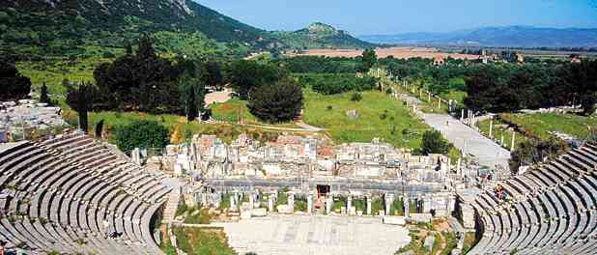
Their love at the first..
Acts 19:9-10 reasoning daily in the school of Tyrannus… for two years.. all Asia heard the word of the Lord Jesus..
Acts 20:18-20 "from the first day that I came.. taught you publicly and from house to house..
Ephesians 1:15-16 after I heard of your faith in the Lord Jesus and your love for all the saints, 16 do not cease to give thanks for you..

Slide 11
Why a life or death issue?
1st Comm: Love God totally (Deut 6:5)
2nd Comm: Love neighbor as self (Lev 19:18)
Jesus must come first (Lk 9:23; Matt 10:37)
Jesus gave a new standard (John 13:34-35)
Christ loved church, gave Himself (Eph 5:25)

Slide 12
When a church lacks love..
Motivation is missing..
2 Cor 5:14-15 For the love of Christ controls us, because we have concluded this: that one has died for all, therefore all have died; and he died for all, that those who live might no longer live for themselves but for him..
Eph 3:17-19 that you.. may have strength to comprehend with all the saints what is the breadth and length and height and depth, and to know the love of Christ that surpasses knowledge..

Slide 13
All else w/o love is nothing..
1 Cor 13:1-3 speak with tongues of men and of angels, have not love.. sounding brass or a clanging cymbal.
2 though I have the gift of prophecy..understand all mysteries and all knowledge.. have all faith..I could remove mountains, but have not love, I am nothing.
3 though I bestow all my goods to feed the poor.. give my body to be burned, but have not love, profits me nothing.
5 - 1 =
0
000000000000000000..

Slide 14
Christ’s remedy vs 5..
REMEMBER from where you have FALLEN..
See the reality of our condition
REPENT
Godly sorrow over its failure
DO THE FIRST WORKS
Do the deeds of love it once did

Slide 15
How to Cultivate Love..
Study love..
John 15:9-10 "As the Father loved Me, I also have loved you; abide in My love. 10 If you keep My commandments, you will abide in My love, just as I have kept My Father's commandments and abide in His love.
1 Cor 14:1 Pursue love..
Heb 10:24 And let us consider one another in order to stir up love and good works..

Slide 16
How to Cultivate Love..
Pray for love..
Eph 3:18-19 that you may be able to comprehend with all the saints what is the width and length and depth and height — 19 to know the love of Christ which passes knowledge; that you may be filled with all the fullness of God.
1 Thess 3:12 And may the Lord make you increase and abound in love to one another and to all, just as we do to you..
Philippians 1:9 And this I pray, that your love may abound still more and more in knowledge and all discernment..

Slide 17
How to Cultivate Love..
Learn to express love..
Put it into words…
Matthew 3:17 "This is My beloved Son, in whom I am well pleased."
John 15:9 "As the Father loved Me, I also have loved you..

Slide 18
How to Cultivate Love..
Express heartfelt love..
Philemon 7 For we have great joy and consolation in your love, because the hearts of the saints have been refreshed by you, brother.
Philippians 1:7-8 just as it is right for me to think this of you all, because I have you in my heart, inasmuch as both in my chains and in the defense and confirmation of the gospel, you all are partakers with me of grace. 8 For God is my witness, how greatly I long for you all with the affection of Jesus Christ.

Slide 19
How to Cultivate Love..
Show physical signs of affection..
1 Peter 5:14 Greet one another with a kiss of love.
1 Pet 1:22 love one another fervently with a pure heart.
1 Pet 4:8 And above all things have fervent love for one another.
Acts 20:37 Then they all wept freely, and fell on Paul's neck and kissed him.

Slide 20
Christ’s Wake-up Call
Revelation 2:1-7

Slide 21
Christ’s Wake-up Call
Revelation 2:1-7

