Slide 1
Sound Doctrine
Titus 2:1

Slide 2
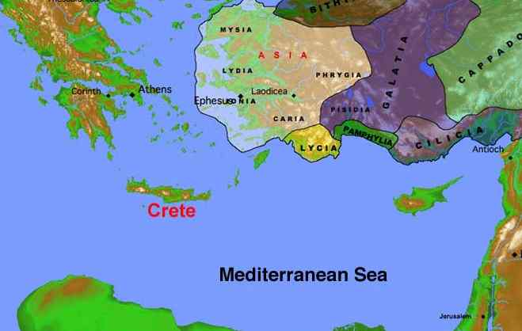
Titus
Titus assigned to help churches on Crete develop spiritual leadership and maturity

Slide 3
Sound doctrine..
hugiano – “to be of sound health”
Tit 1:9 holding fast the faithful word as he has been taught, that he may be able, by sound doctrine, both to exhort and convict those who contradict.
Tit 1:13 Therefore rebuke them sharply, that they may be sound in the faith..
Healthy
doctrine
Healthy
living

Slide 4
Sound doctrine..
Tit 1:10-11 But as for you, speak the things which are proper for sound doctrine: that the older men be sober, reverent, temperate, sound in faith, in love, in patience;
Tit 2:7-8 in all things showing yourself to be a pattern of good works; in doctrine showing integrity, reverence, incorruptibility, 8 sound speech that cannot be condemned, that one who is an opponent may be ashamed, having nothing evil to say of you.

Slide 5
Unsound doctrine..
Tit 1:10 For there are many insubordinate, both idle talkers and deceivers, especially those of the circumcision, 11 whose mouths must be stopped, who subvert whole households, teaching things which they ought not, for the sake of dishonest gain.
Tit 3:9-10 But avoid foolish disputes, genealogies, contentions, and strivings about the law; for they are unprofitable and useless. 10 Reject a divisive man after the first and second admonition..

Slide 6
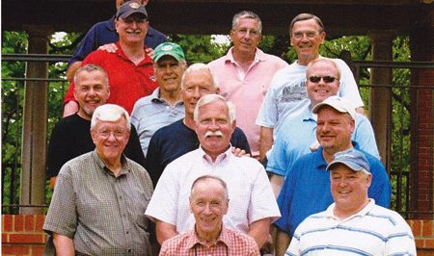
Older men (vs 2)
that the older men be sober, reverent, temperate, sound in faith, in love, in patience..

Slide 7
Older/younger women (3-5)
Titus 2:3-5 the older women likewise, that they be reverent in behavior, not slanderers, not given to much wine, teachers of good things — 4 that they admonish the young women to love their husbands, to love their children, 5 to be discreet, chaste, homemakers, good, obedient to their own husbands, that the word of God may not be blasphemed.

Slide 8
Titus/younger men (6-8)
Titus 2:6-8 Likewise, exhort the young men to be sober-minded, 7 in all things showing yourself to be a pattern of good works; in doctrine showing integrity, reverence, incorruptibility, 8 sound speech that cannot be condemned, that one who is an opponent may be ashamed, having nothing evil to say of you.

Slide 9
In workplace (9-10)
Titus 2:9-10 Exhort bondservants to be obedient to their own masters, to be well pleasing in all things, not answering back, 10 not pilfering, but showing all good fidelity, that they may adorn the doctrine of God our Savior in all things.

Slide 10
Holy living is proper..
Tit 1:16 They profess to know God, but in works they deny Him, being abominable, disobedient, and disqualified for every good work.
Tit 2:1 But as for you, speak the things which are proper for sound doctrine:
Tit 2:15 Speak these things, exhort, and rebuke with all authority. Let no one despise you.

Slide 11
Holy living..
Romans 12:1-2 I beseech you therefore, brethren, by the mercies of God, that you present your bodies a living sacrifice, holy, acceptable to God, which is your reasonable service.
1 Peter 1:15-16 but as He who called you is holy, you also be holy in all your conduct, 16 because it is written, "Be holy, for I am holy."

Slide 12
Our lives affect others..
Titus 2:5 to be discreet, chaste, homemakers, good, obedient to their own husbands, that the word of God may not be blasphemed.
Titus 2:8 sound speech that cannot be condemned, that one who is an opponent may be ashamed, having nothing evil to say of you.

Slide 13
Our lives affect others..
Titus 2:10 showing all good fidelity, that they may adorn the doctrine of God our Savior in all things.

Slide 14
Sound Doctrine
Titus 2:1

