Slide 1
Becoming More Like Jesus
Mark 7:31-37

Slide 2
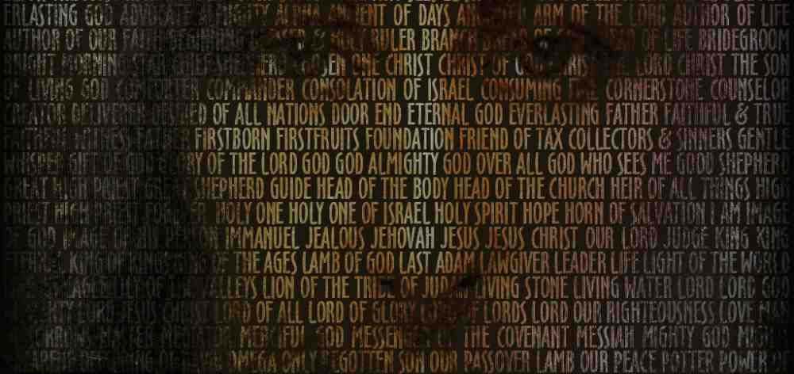
Who do YOU say that I Am?
Matt 16:13-15
Who do men say that I Am?

Slide 4
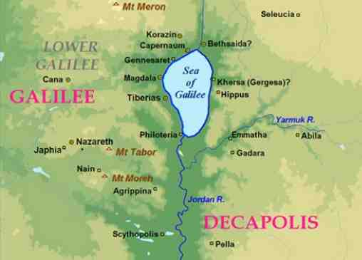
How did Jesus influence so many people’s lives?

Slide 5
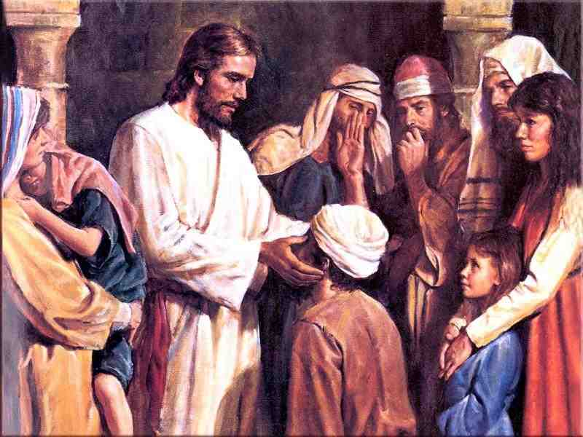
Acts 10:38 “He went about doing good and healing all who were oppressed by the devil.. for God was with Him…”

Slide 6
His life brought beauty into this world..
Is it possible for your life to bring beauty into the lives of people around you?

Slide 7
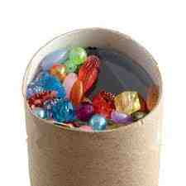
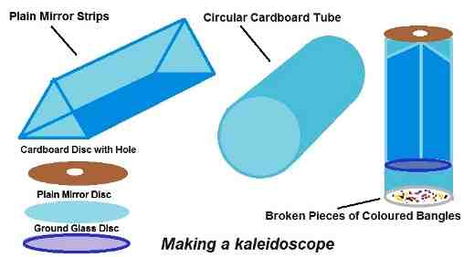
Kaleidoscope .. beauty from pieces of glass

Slide 8
The lifestyle of Jesus..
Promise yourself you will take some of the characteristics of Jesus and make them characteristics of your life..

Slide 9
Jesus was mindful of others..
Acts 10:38 He went about doing good..
He was mindful of His parents (Luke 2)
He was mindful of His Father in heaven
He was mindful of those around Him
As mindful of good men as He was sinful men
As mindful of the rich as He was of the poor
He was mindful of the sick, hurting, forgotten and He was moved with compassion

Slide 10
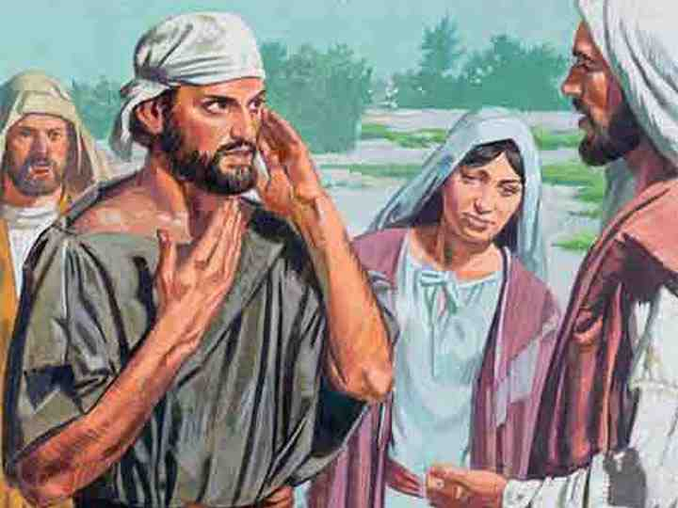
Mark 7:31-37 Again, departing from the region of Tyre and Sidon, He came through the midst of the region of Decapolis to the Sea of Galilee. 32 Then they brought to Him one who was deaf and had an impediment in his speech, and they begged Him to put His hand on him.

Slide 11
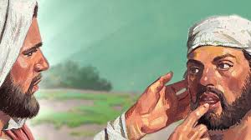
33 And He took him aside from the multitude, and put His fingers in his ears, and He spat and touched his tongue. 34 Then, looking up to heaven, He sighed, and said to him, "Ephphatha," that is, "Be opened."

Slide 12
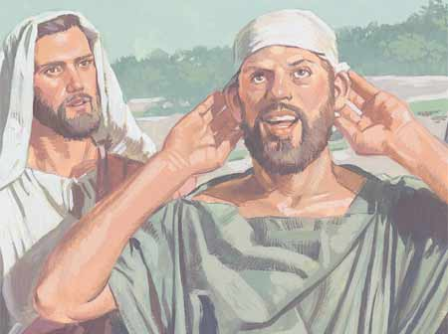
35 Immediately his ears were opened, and the impedi-ment of his tongue was loosed, and he spoke plainly. 36 Then He commanded them that they should tell no one; but the more He commanded them, the more widely they proclaimed it. 37 And they were astonished beyond measure, saying, "He has done all things well. He makes both the deaf to hear and the mute to speak."

Slide 13
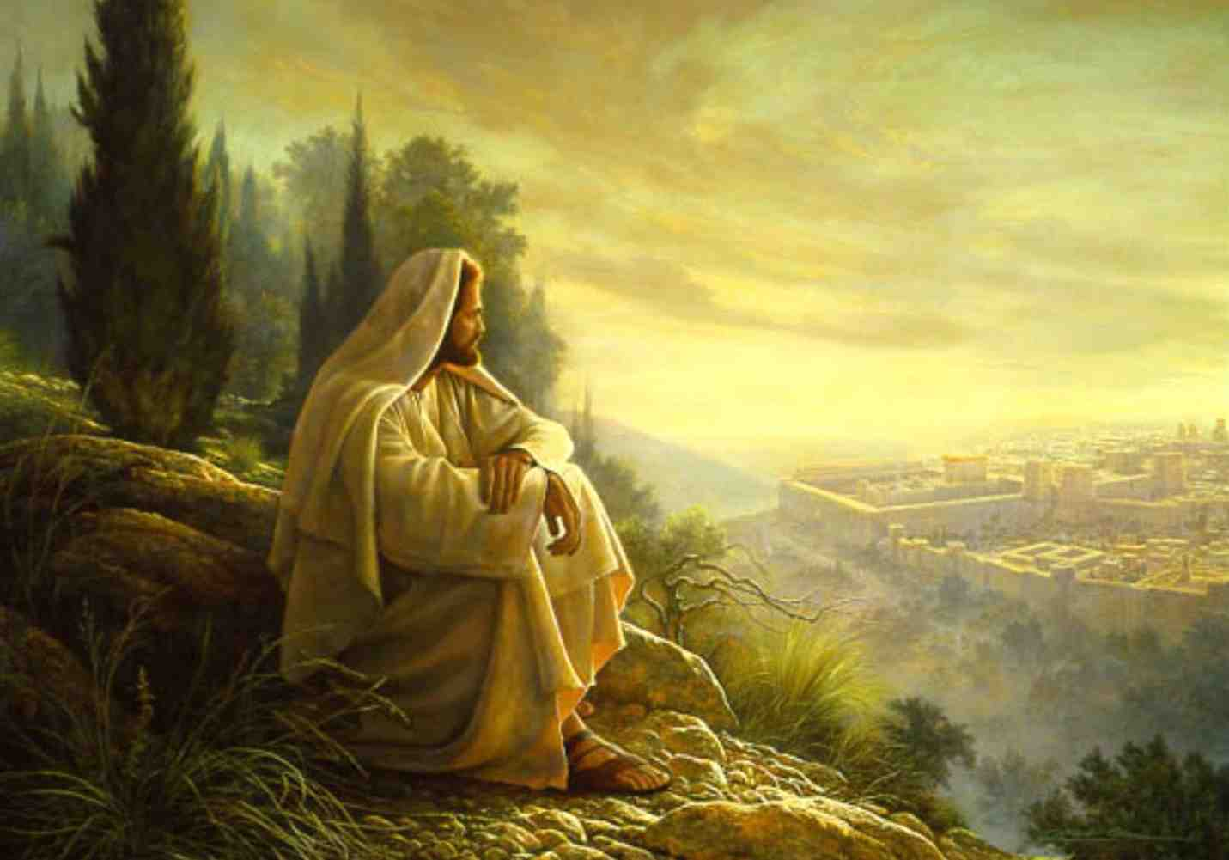
His Focus was the will of God..
How He felt about pleasing His Father
John 6:38 For I have come down from heaven, not to do My own will, but the will of Him who sent Me.
How His Father felt about His Son
Matthew 17:5 "This is My beloved Son, in whom I am well pleased. Hear Him!"

Slide 14
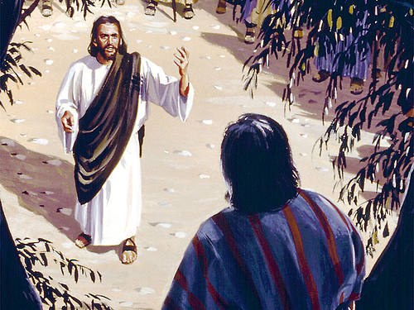
Luke 19:1-10 And when Jesus came to the place, He looked up and saw him, and said to him, "Zacchaeus, make haste and come down, for today I must stay at your house."10 for the Son of Man has come to seek and to save that which was lost."

Slide 15
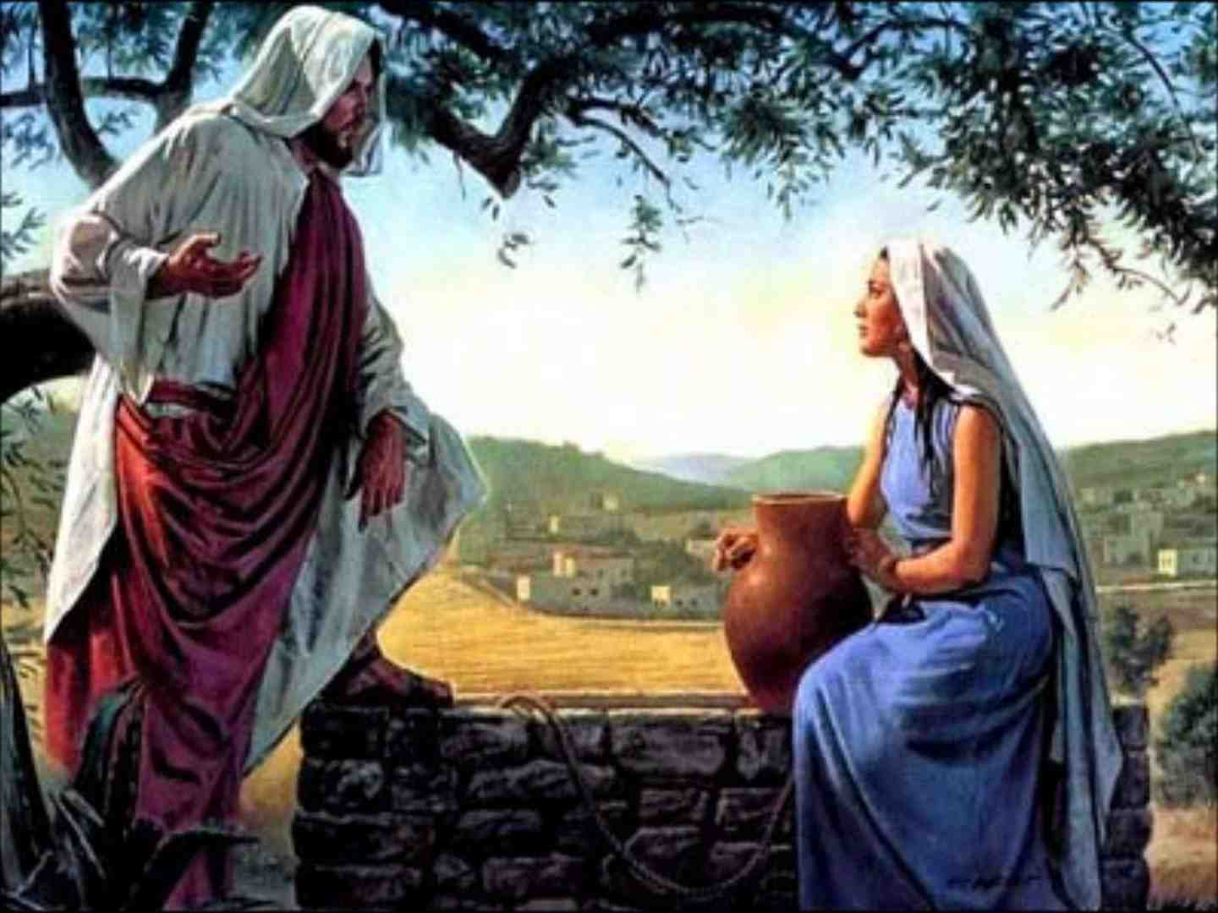
John 4:34-35 Jesus said to them, "My food is to do the will of Him who sent Me, and to finish His work. 35 Do you not say, 'There are still four months and then comes the harvest'? Behold, I say to you, lift up your eyes and look at the fields, for they are already white for harvest!

Slide 17
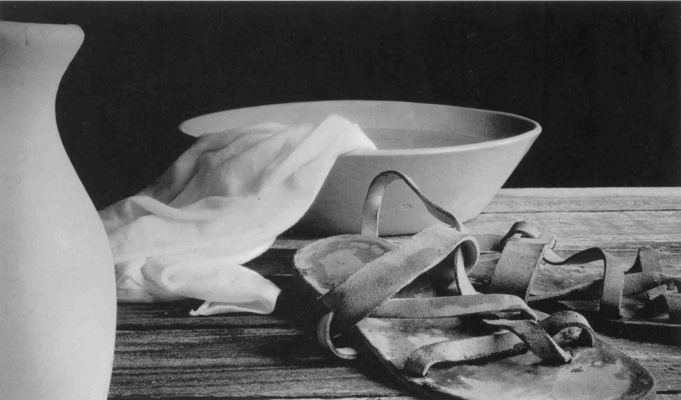
Jesus was a Servant..
Mark 10:43-45 whoever desires to become great among you shall be your servant. 44 And whoever of you desires to be first shall be slave of all. 45 For even the Son of Man did not come to be served, but to serve, and to give His life a ransom for many."

Slide 18
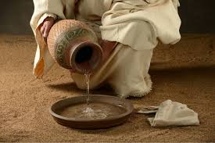
John 13:3-5 Jesus..rose from supper and laid aside His garments, took a towel and girded Himself. 5 After that, He poured water into a basin and began to wash the disciples' feet, and to wipe them with the towel with which He was girded.

Slide 19
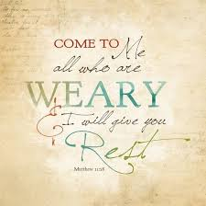
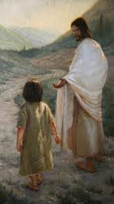
John 13:3-5 Jesus..rose from supper and laid aside His garments, took a towel and girded Himself. 5 After that, He poured water into a basin and began to wash the disciples' feet, and to wipe them with the towel with which He was girded.

Slide 20
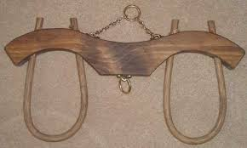
Matthew 11:29-30 Take My yoke upon you and learn from Me, for I am gentle and lowly in heart, and you will find rest for your souls. 30 For My yoke is easy and My burden is light."

Slide 22
The will of His Father
The beauty of Jesus
Mindful of others
A humble servant

Slide 23
Becoming More Like Jesus
Mark 7:31-37

