Slide 1
Let Jesus Be Seen in Me
Romans 8:1-10

Slide 2
When Jesus is in us..
Romans 8:1 There is therefore now no condemnation to those who are in Christ Jesus, who do not walk according to the flesh, but according to the Spirit.
Rom 8:10 And if Christ is in you, the body is dead because of sin, but the Spirit is life because of righteousness.

Slide 3
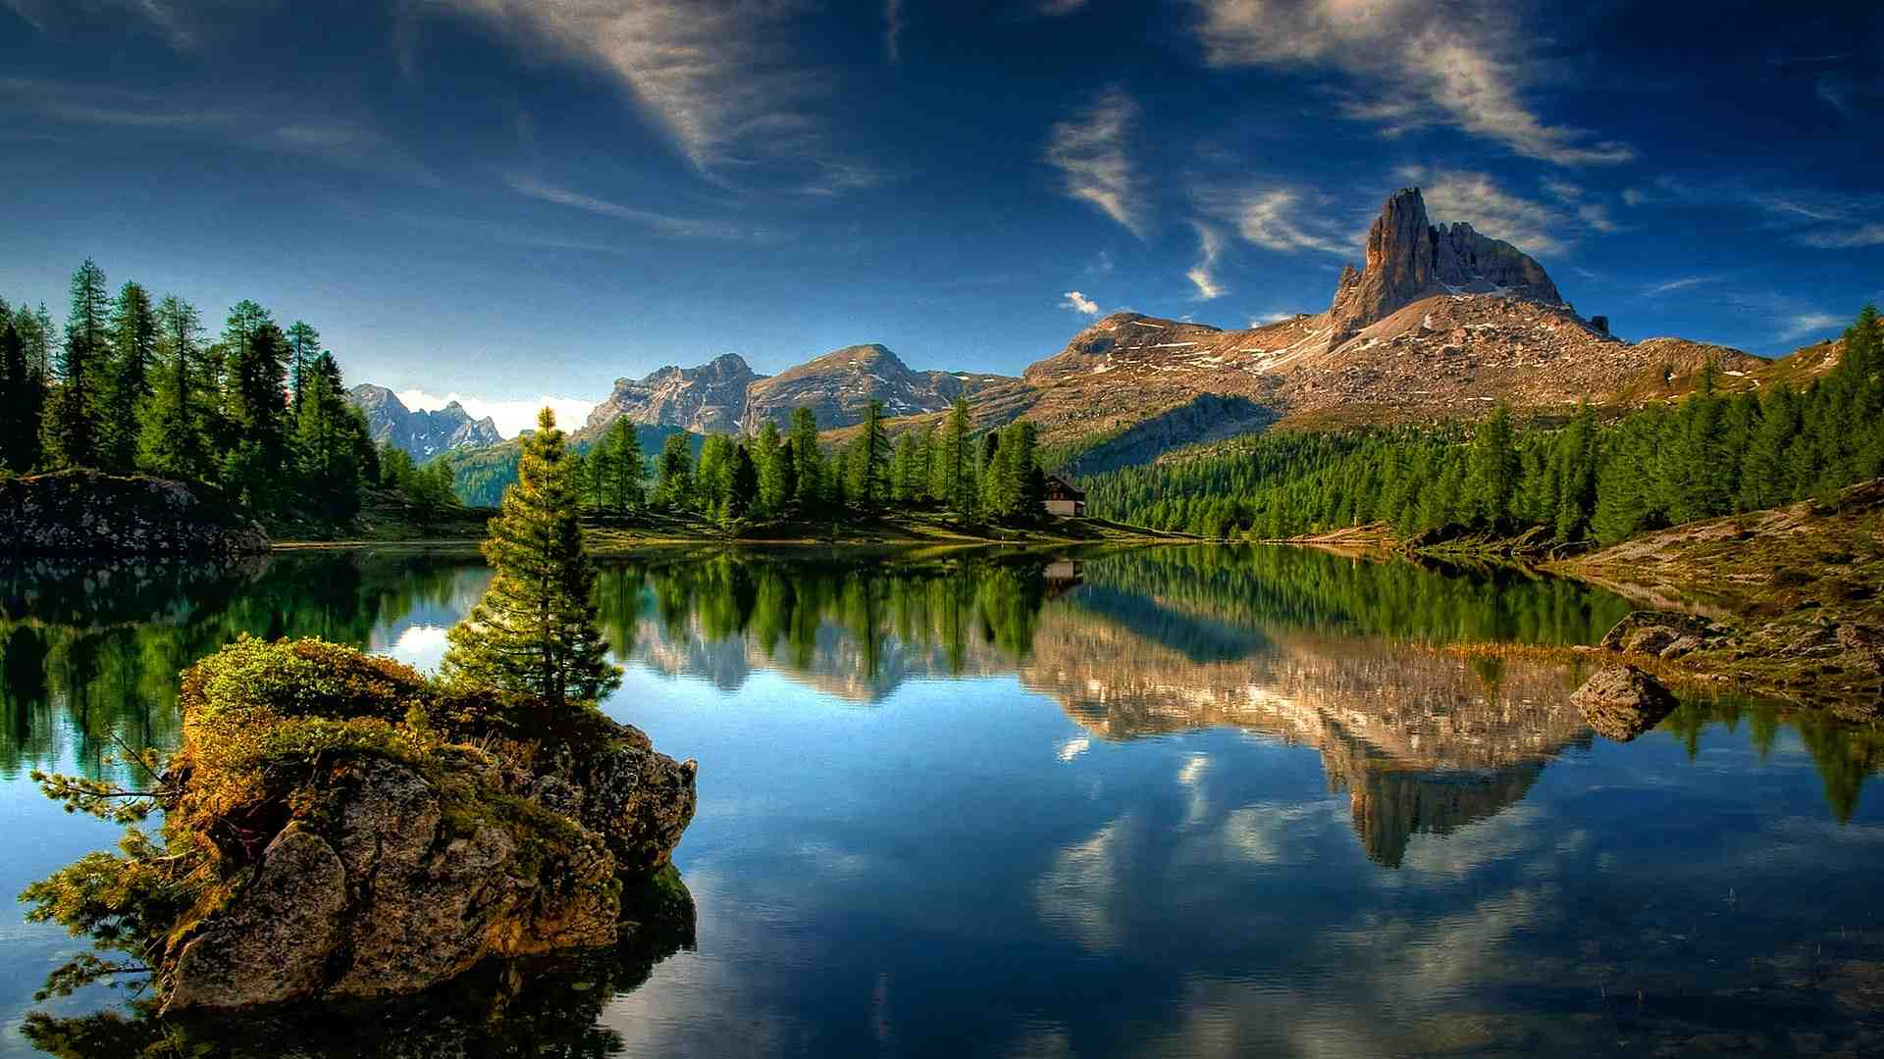
Let the beauty of Jesus be seen in me, All His wonderful passion and purity. May His Spirit divine all my being refine Let the beauty of Jesus be seen in me.

Slide 4
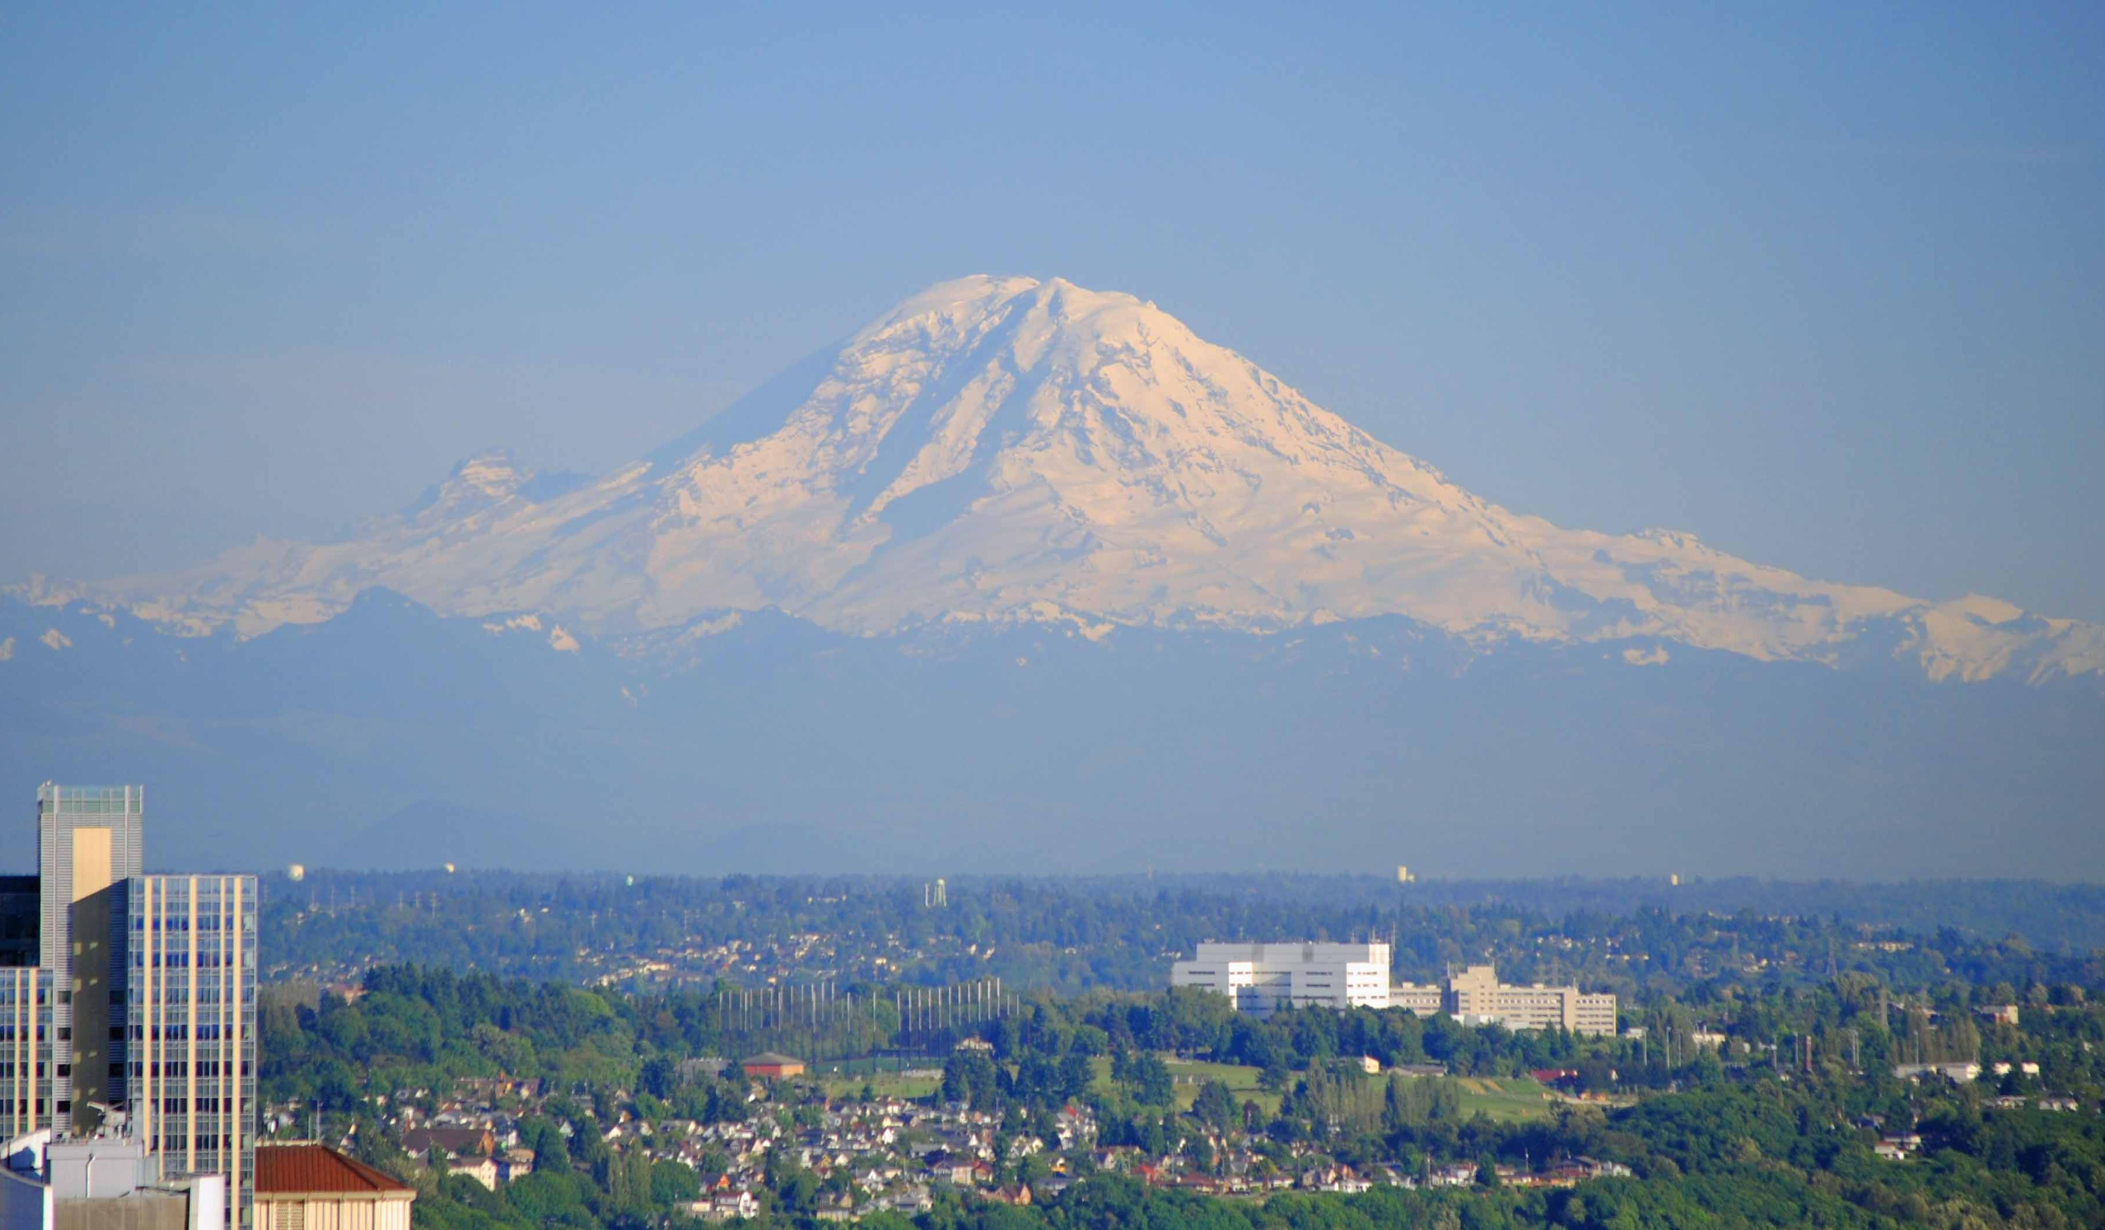
Beauty attracts our attention..

Slide 5
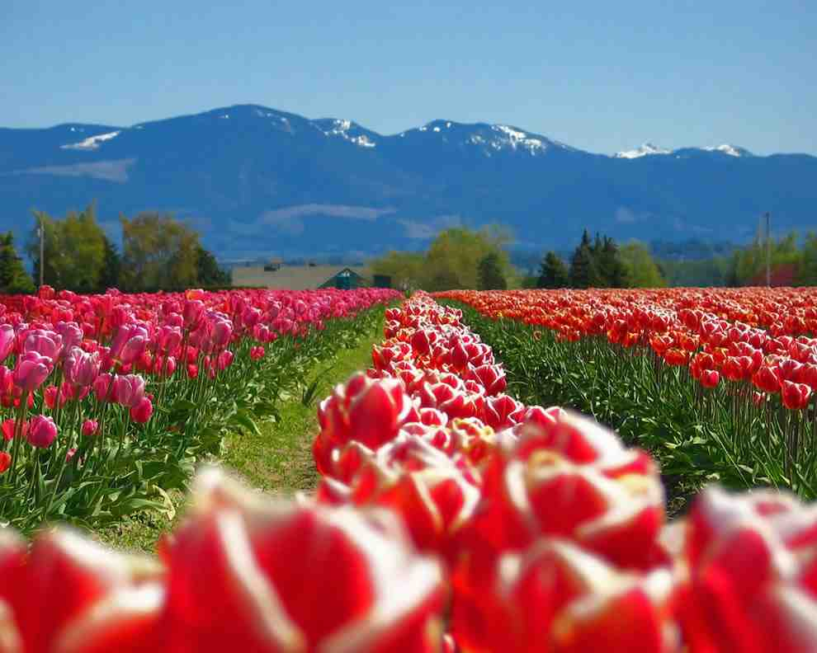
We see beauty every day..

Slide 6
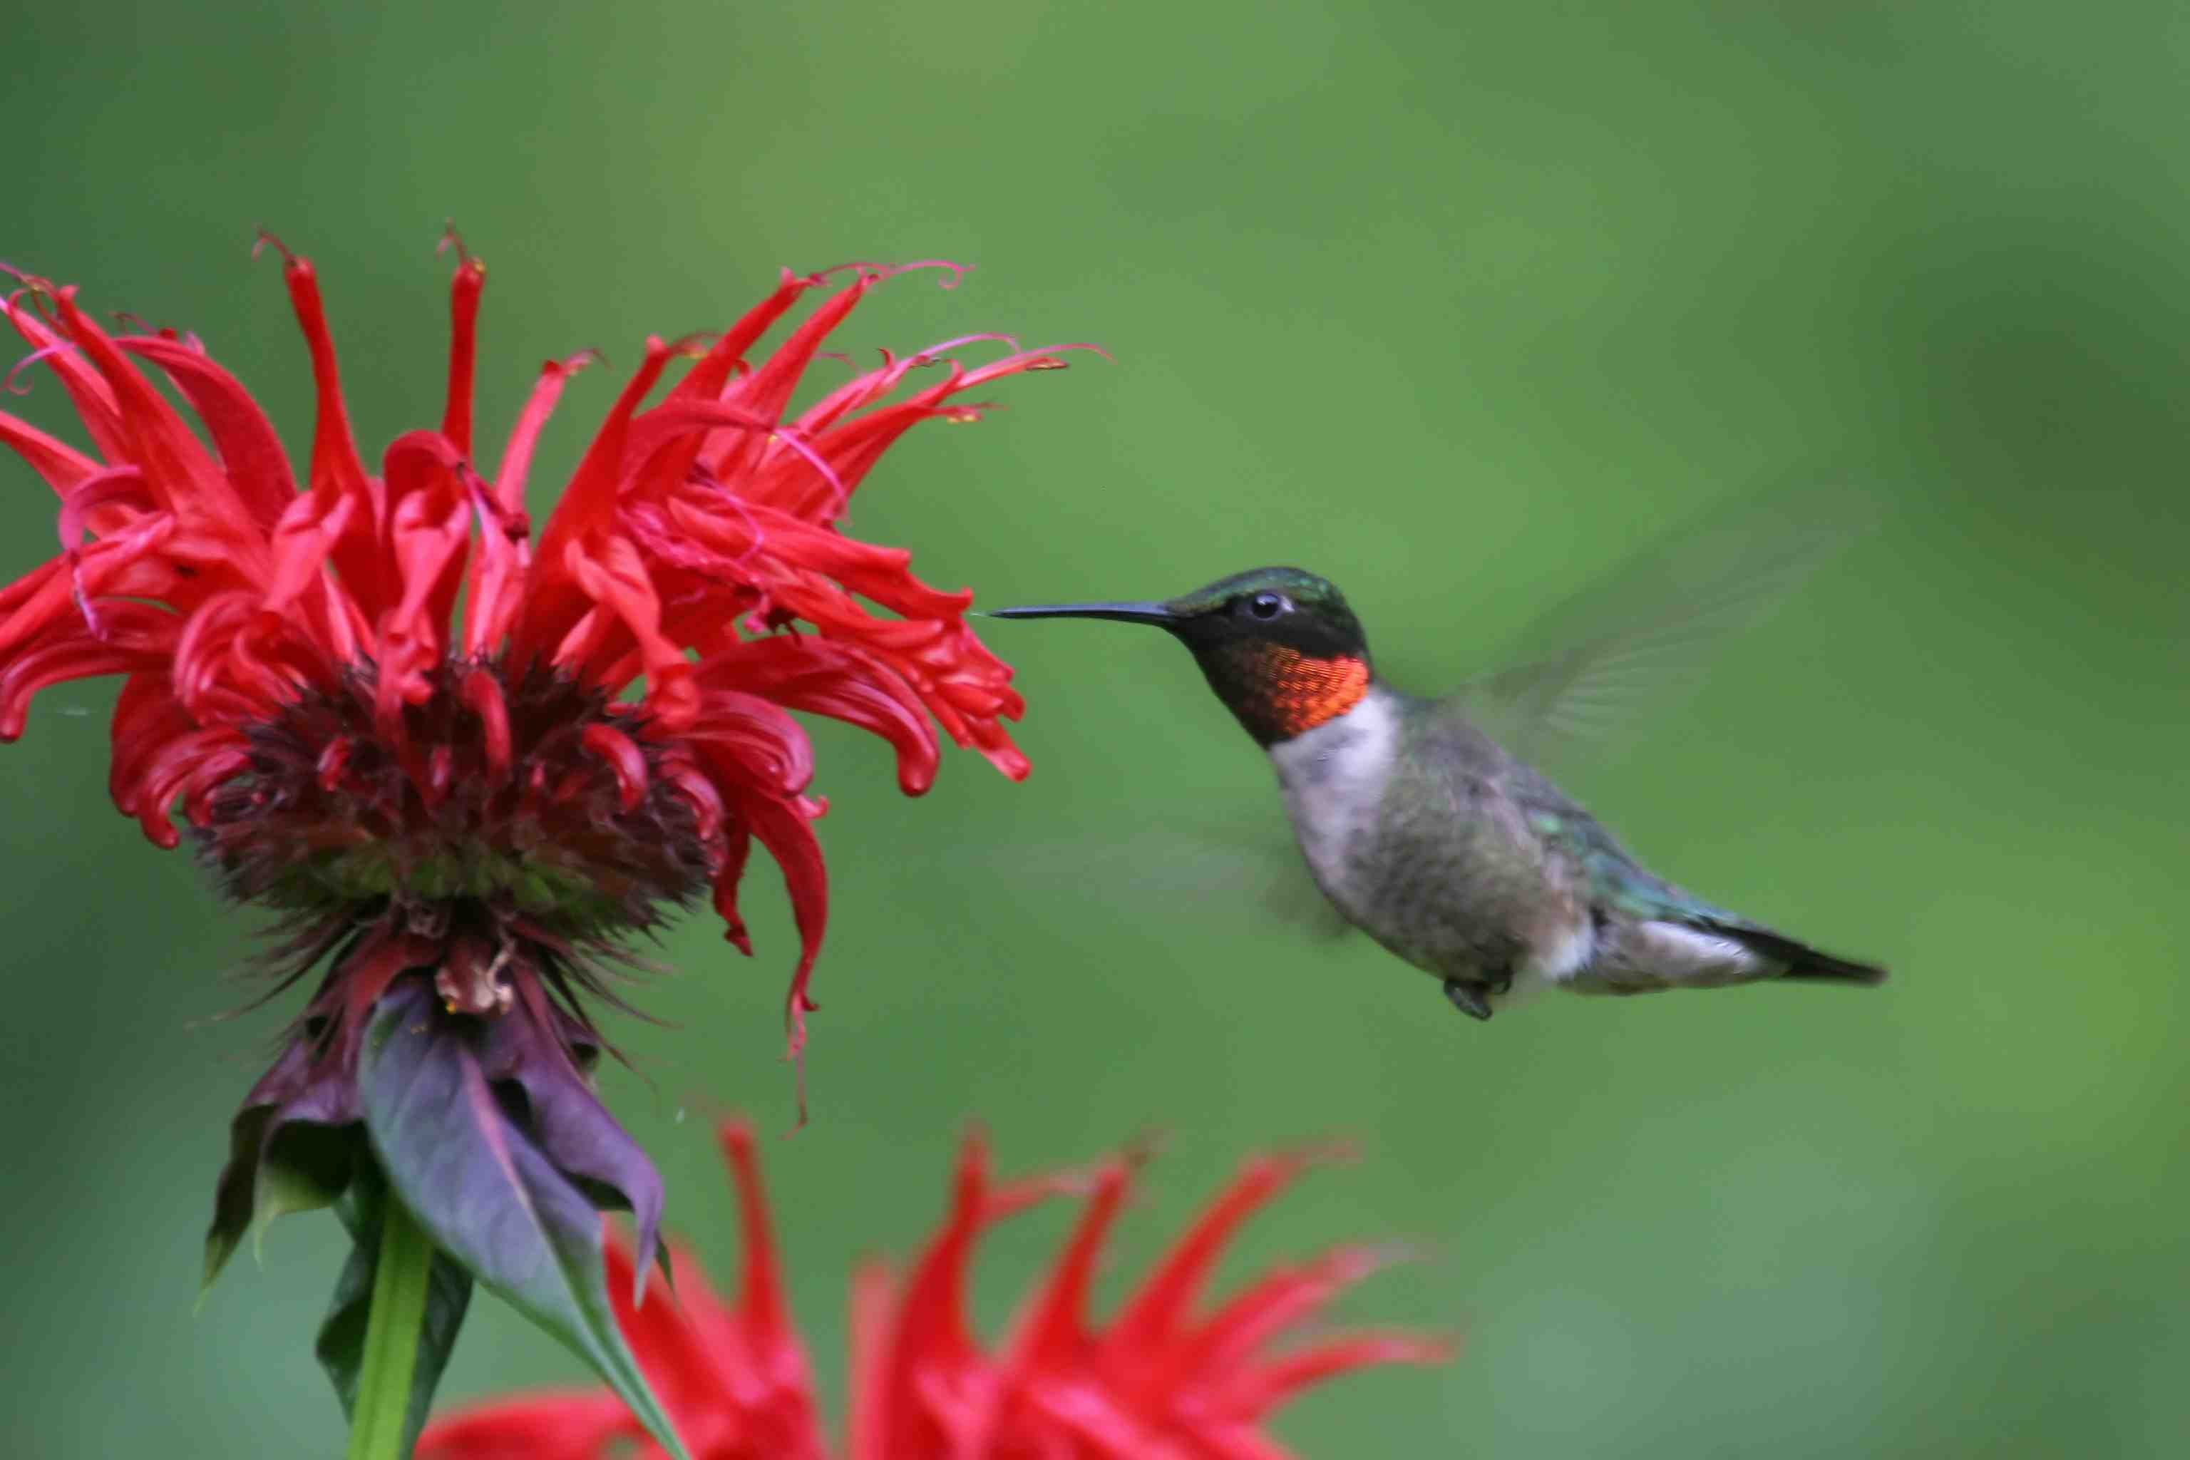
Birds ..

Slide 7
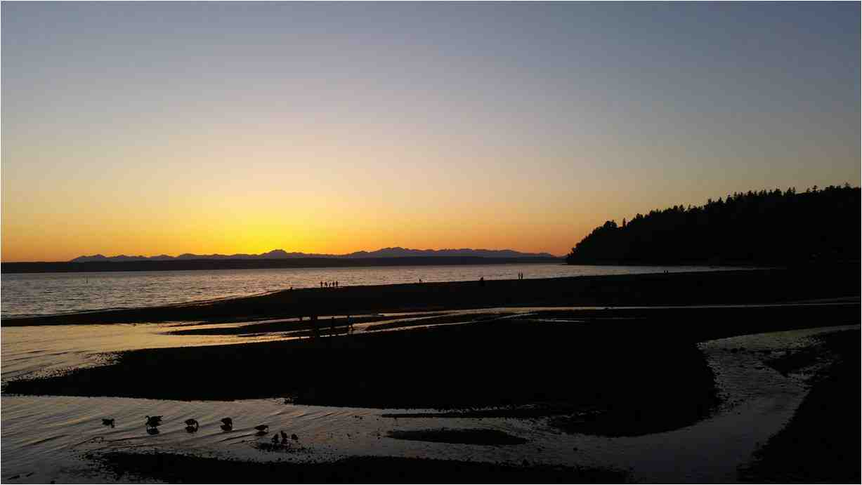
Sunsets ..

Slide 8
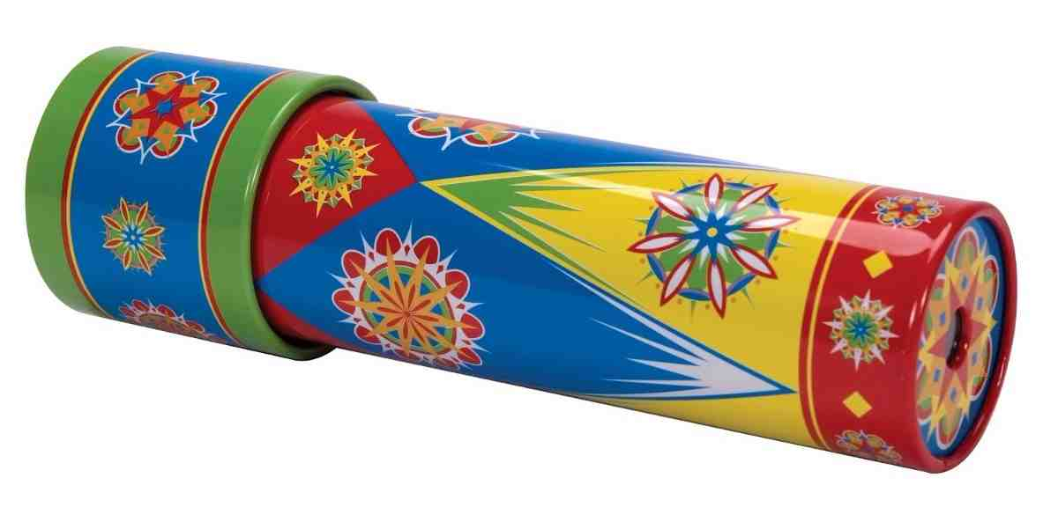
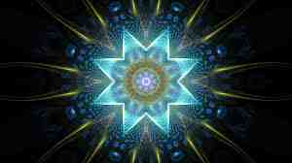
Kaleidoscope .. beauty from pieces of glass

Slide 9
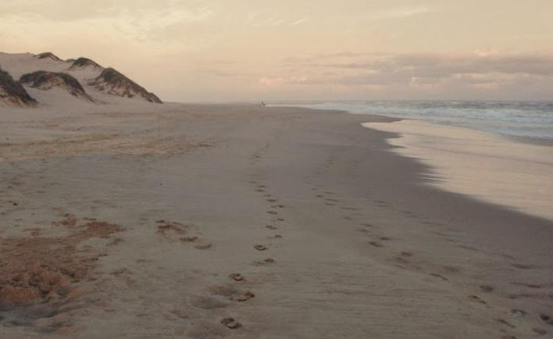
Your life.. beauty from your following Jesus

Slide 10
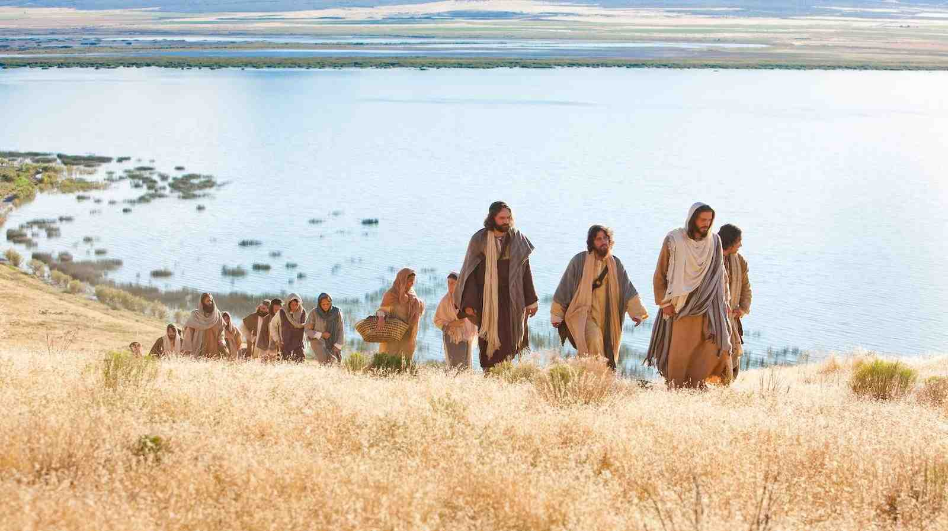
Let the beauty of Jesus be seen in me, All His wonderful passion and purity. May His Spirit divine all my being refine Let the beauty of Jesus be seen in me.

Slide 11
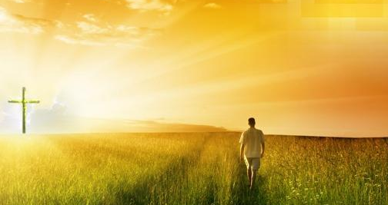
Galatians 2:20 I have been crucified with Christ; it is no longer I who live, but Christ lives in me; and the life which I now live in the flesh I live by faith in the Son of God, who loved me and gave Himself for me.

Slide 12
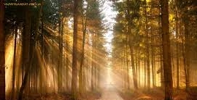
Passion and purity..
Philippians 2:15 that you may become blameless and harmless, children of God without fault in the midst of a crooked and perverse generation, among whom you shine as lights in the world.
James 1:27 Pure and undefiled religion before God and the Father is this: to visit orphans and widows in their trouble, and to keep oneself unspotted from the world.

Slide 13
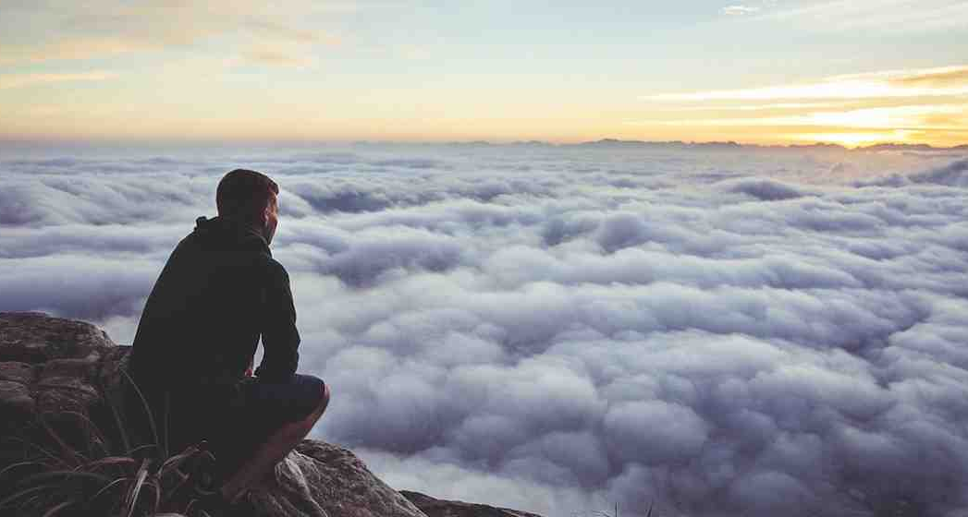
When your burden is heavy and hard to bear When your neighbors refuse all your load to share When you're feeling so blue,
Don't know just what to do Let the beauty of Jesus be seen in you.

Slide 14
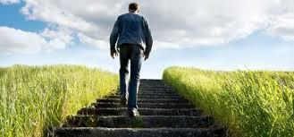
When burdens are heavy..
Psalms 55:22 Cast your burden on the Lord, And He shall sustain you; He shall never permit the righteous to be moved.
Galatians 6:2-5 Bear one another's burdens, and so fulfill the law of Christ.

Slide 15
Hebrews 4:14-16 For we do not have a High Priest who cannot sympathize with our weaknesses, but was in all points tempted as we are, yet without sin. 16 Let us therefore come boldly to the throne of grace, that we may obtain mercy and find grace to help in time of need.

Slide 16
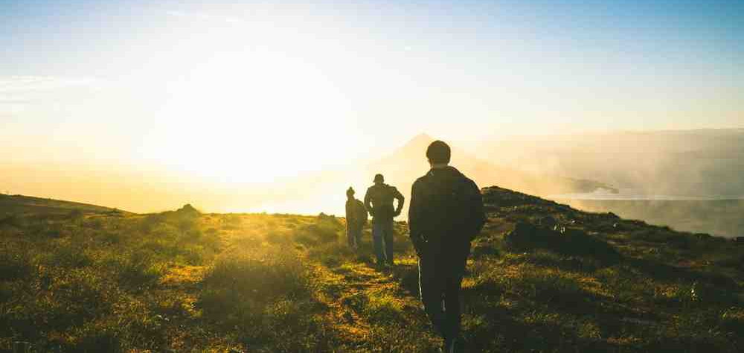
When somebody has been so unkind to you, Some word spoken that pierces you
through and through.
Think how He was beguiled,
spat upon and reviled, Let the beauty of Jesus be seen in you.

Slide 17
Remember His example
1 Pet 2:21-24 For to this you were called, because Christ also suffered for us, leaving us an example, that you should follow His steps: "Who committed no sin, Nor was deceit found in His mouth"; who, when He was reviled, did not revile in return; when He suffered, He did not threaten, but committed Himself to Him who judges righteously; who Himself bore our sins in His own body on the tree, that we, having died to sins, might live for righteousness — by whose stripes you were healed.

Slide 18
From the dawn of the morning till close of day, In example in deeds and in all you say, Lay your gifts at His feet, ever strive to keep sweet Let the beauty of Jesus be seen in you.

Slide 19
Let Jesus Be Seen in You
Luke 9:23"If anyone desires to come after Me, let him deny himself, and take up his cross daily, and follow Me.
Colossians 3:17 And whatever you do in word or deed, do all in the name of the Lord Jesus, giving thanks to God the Father through Him.

Slide 20
Let Jesus Be Seen in Me
Romans 8:1-10

