Slide 1
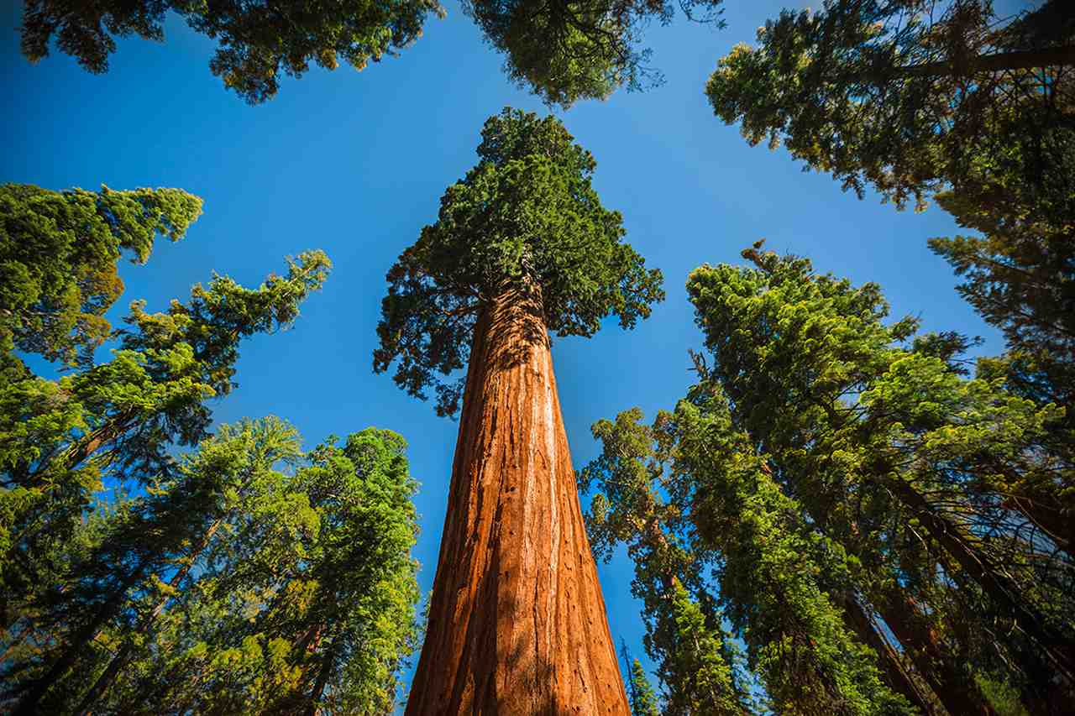
Strength for Every Day
Ephesians 1:15-20

Slide 2
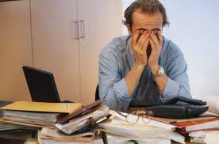
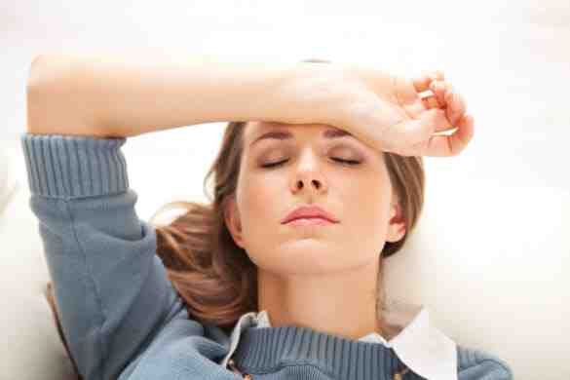
Feeling tired..
When our strength runs out, it affects us emotionally and spiritually ..

Slide 3
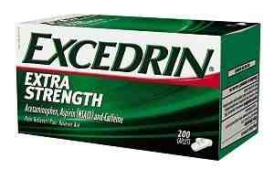
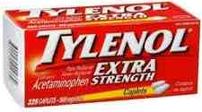
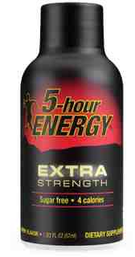
Where can we find the extra strength we need?

Slide 4
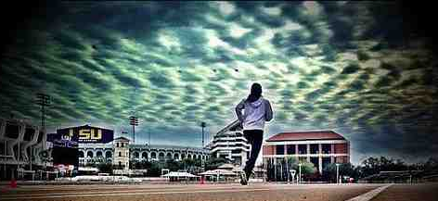
Proverbs 24:10 If you faint in the day of adversity, Your strength is small.

Slide 5
In difficult times, we need stronger families, stronger people..
“I can do all things through Christ
who strengthens me”

Slide 6
God’s call to be strong..
Eph 6:10 Be strong in the Lord, and His mighty power."

Slide 7
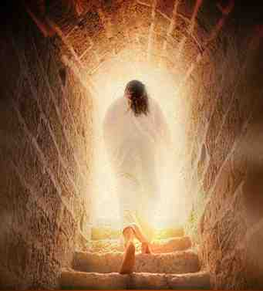
Ephesians 1:18-20 that you may know .. the exceeding greatness of His power toward us who believe, according to the working of His mighty power..

Slide 8
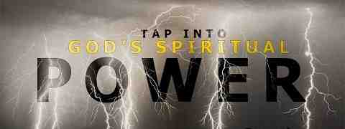
Isaiah 41:10 Fear not, for I am with you; Do not be dismayed, for I am your God. I will strengthen you, and help you, I will uphold you with My righteous right hand.'
2 Peter 1:3 His divine power has given to us all things that pertain to life and godliness..

Slide 9
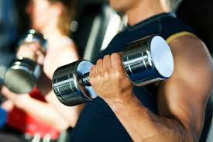
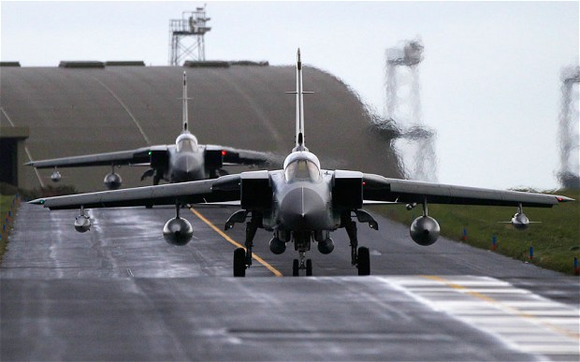
Our world is enamored with strength

Slide 10
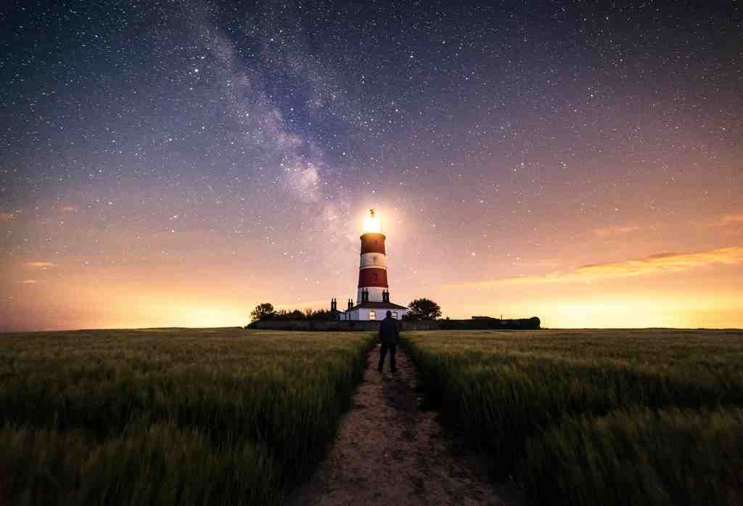
Psalm 84:5-7 Blessed is the man whose strength is in you, whose heart is set on pilgrimage .. they go from strength to strength.. until each one appears before God in Zion..

Slide 11
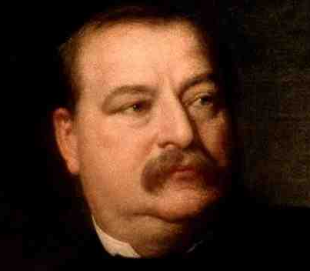
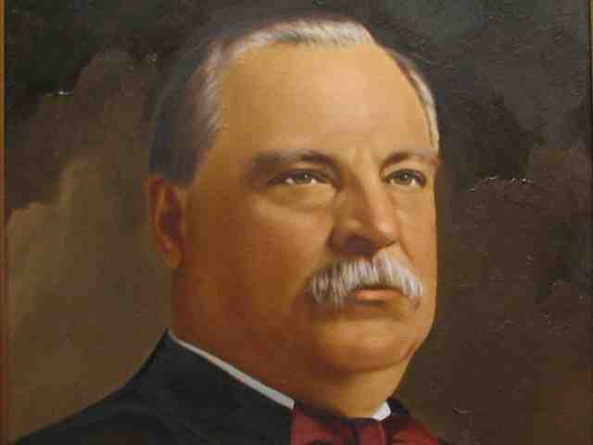
Grover Cleveland..
22nd President
24th President
“As your days, so shall your strength be.”
Deuteronomy 33:25

Slide 12
The tribe of Asher..
Genesis 30:12-13 Leah's maid Zilpah bore Jacob a second son. 13 Then Leah said, "I am happy, for the daughters will call me blessed." So she called his name Asher.

Slide 13
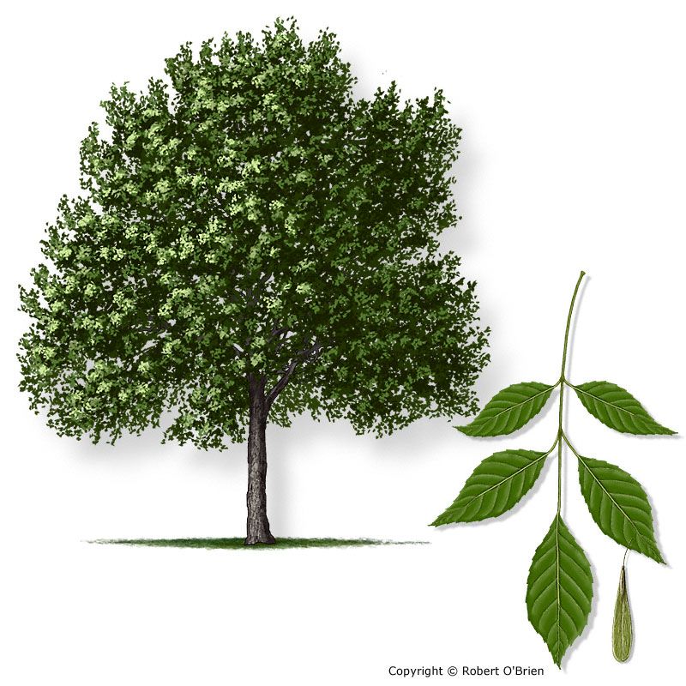
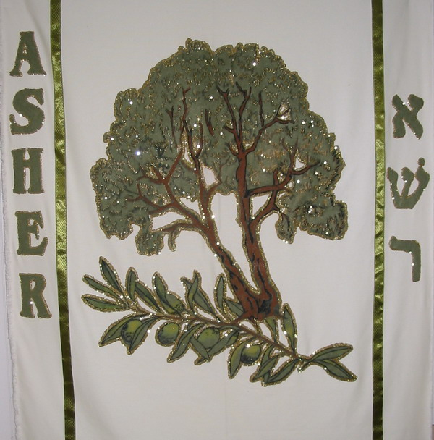
The tribe of Asher..
Genesis 49:20 "Bread from Asher shall be rich, and he shall yield royal dainties.

Slide 14
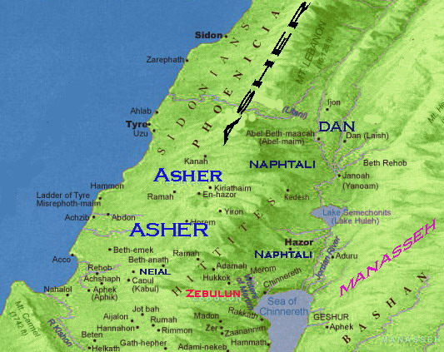
The tribe of Asher..
Deut 33:24-27"Asher is most blessed of sons; Let him be favored by his brothers,And let him dip his foot in oil. 25 Your sandals shall be iron and bronze; As your days, so shall your strength be. "There is no one like the God of Jeshurun, Who rides the heavens to help you, And in His excellency on the clouds. 27 The eternal God is your refuge, And underneath are the everlasting arms..

Slide 15
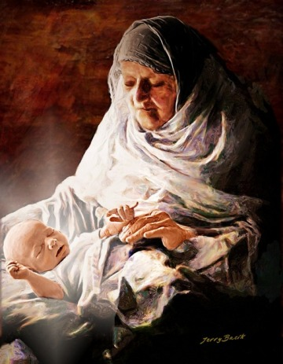
The tribe of Asher..
Luke 2:36-38 Now there was one, Anna, a prophetess, the daughter of Phanuel, of the tribe of Asher. She was of a great age, and had lived with a husband seven years from her virginity; 37 and this woman was a widow of about eighty-four years, who did not depart from the temple, but served God with fastings and prayers night and day. 38 And coming in that instant she gave thanks to the Lord, and spoke of Him to all those who looked for redemption in Jerusalem.

Slide 16
Lessons of Asher..
We belong to a happy tribe..
We belong to Christ, He is our protection..
We have a baby to introduce to the world..
God promises strength equal to our days..
Underneath are the everlasting arms..

Slide 17
Strength for Every Day
Ephesians 1:15-20

